Slide 1
PHASE I · PROGRESS UPDATE
Digitalization of the KSRTC Station-Master Operation
Video Observation · Python Analysis · ML Classification · Digital Waybill & Real-Time Monitoring
Team Members
Adithyan S (TVE23EC0xx)
Student 2 (TVE23EC0xx) · Student 3 (TVE23EC0xx)
Project Guide
Dr. ——————
Department of Electronics and Communication Engineering
College of Engineering Trivandrum · September 2026
Workplace Performance Measurement · Digitalization of Station-Master Operation · Phase-I
Dept. of ECE

Slide 2
Progress at a Glance
WPM-KSRTC | 02/14
Milestone / Sub-task | Status
4K video recording of the operation | Done
Frame conversion (video → 1 Hz frames) | Done
Literature review (journal paper: WPM method, analysis & ML) | Done
AI automatic waybill entry - number-plate detection website | Done
Phase-I analysis pipeline using Python | Planned (Oct)
Phase-II ML model training | After Phase-I
WPM real-time monitoring website | Building now
Workplace Performance Measurement · Digitalization of Station-Master Operation · Phase-I
Dept. of ECE

Slide 3
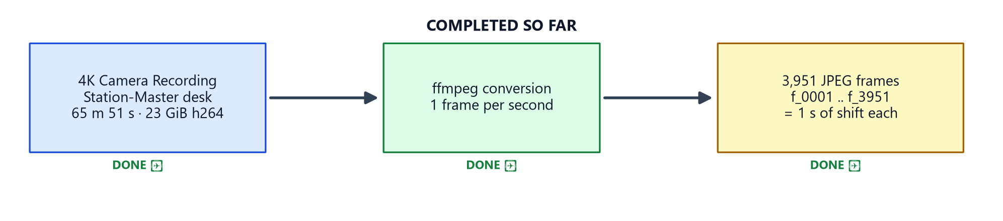
Work Completed — Video & Frames
WPM-KSRTC | 03/14
▪ Recorded the operation: a 4K bedside camera captured the station-master waybill-entry desk — 3840×2160 @29.92 fps · 118,174 frames · 65 m 51 s · 23.04 GiB h264
▪ Converted to frames: ffmpeg samples 1 frame/second → 3,951 JPEG frames (f_0001 … f_3951), each covering 1 second of the shift
▪ Purpose: frames are the input for the Python analysis and, later, the ML classification studied in the literature
Workplace Performance Measurement · Digitalization of Station-Master Operation · Phase-I
Dept. of ECE

Slide 4
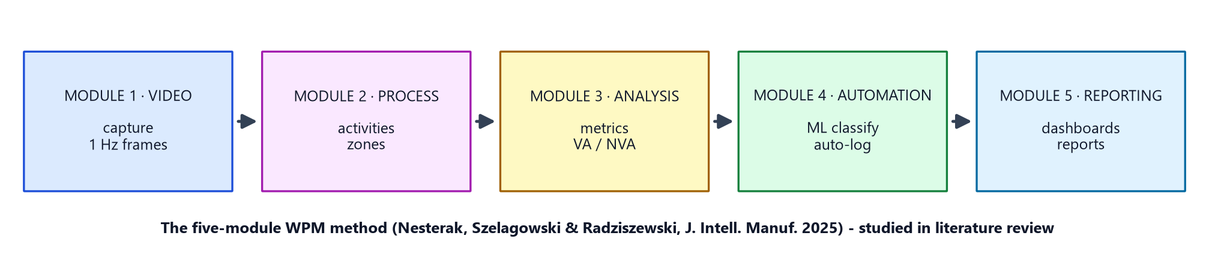
Work Completed — Literature Review
WPM-KSRTC | 04/14
▪ Studied the journal paper: Nesterak, Szelagowski & Radziszewski — “Workplace performance measurement: digitalization of work observation and analysis”, J. Intell. Manuf. (2025)
▪ WPM method understood: five modules — video → process → analysis → automation → reporting
▪ Analysis approach researched: motion metrics, desk-zone mapping, activity classification and VA / NVA (value-added) discovery
▪ ML model researched: classifier over per-frame features (grayscale, colour histogram, edge/sharpness), labels derived from observed activities
The five-module WPM method is the blueprint
Phase-I will realise modules 1–3; Phase-II adds modules 4–5 (ML automation + reporting).
Workplace Performance Measurement · Digitalization of Station-Master Operation · Phase-I
Dept. of ECE

Slide 5
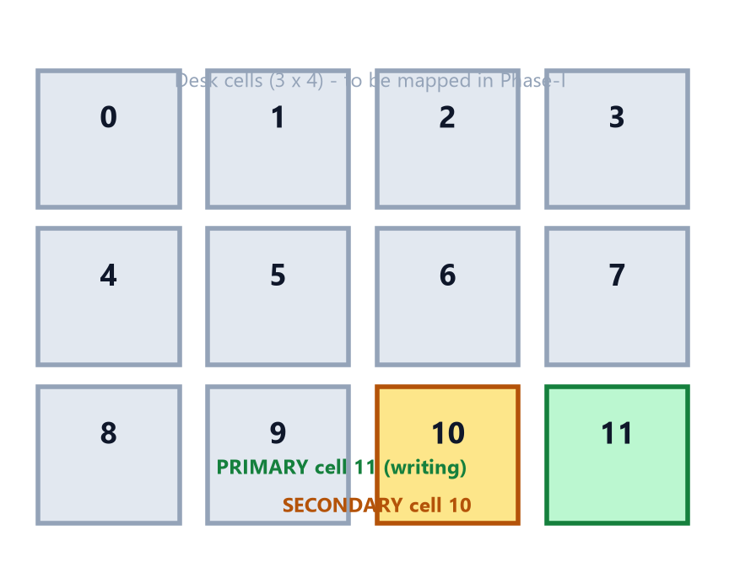
Upcoming — Phase-I Analysis Using Python
WPM-KSRTC | 05/14
Planned for October
▪ Input: the 3,951 converted frames (1 Hz timeline)
▪ Compute per second: grayscale motion energy, motion in desk cells, hue-histogram change
▪ Map workspace: 3×4 desk grid; primary/secondary zones (writing area) found from motion persistence
▪ Classify activities: WRITE, CREW, CHECK, PAGE, WAIT per the journal method
▪ Build event log: run-length encode consecutive labels → events tagged VA / NVA (LEAN)
▪ Output: activity distribution, VA/NVA split, event log CSV/JSON
Cells derived from motion persistence, not manual assignment
Workplace Performance Measurement · Digitalization of Station-Master Operation · Phase-I
Dept. of ECE

Slide 6
Upcoming — Phase-II ML Model Training
WPM-KSRTC | 06/14
After Phase-I
▪ When: starts only after Phase-I provides the labelled event log from the October analysis
▪ Model (from literature): RandomForest-style classifier over per-frame features — grayscale 48×48, HSV histogram, edge energy, sharpness
▪ Labels: activity per second taken from the Phase-I event log → supervised training set
▪ Split & training: stratified train/test, class weights for imbalance (PAGE/CHECK are rare), compressed model artefact
▪ Automation (module 4): predict on all 3,951 frames → auto duty-log to MongoDB — no manual re-entry
▪ Reporting (module 5): dashboards, VA/NVA KPIs, PDF duty report
Workplace Performance Measurement · Digitalization of Station-Master Operation · Phase-I
Dept. of ECE

Slide 7
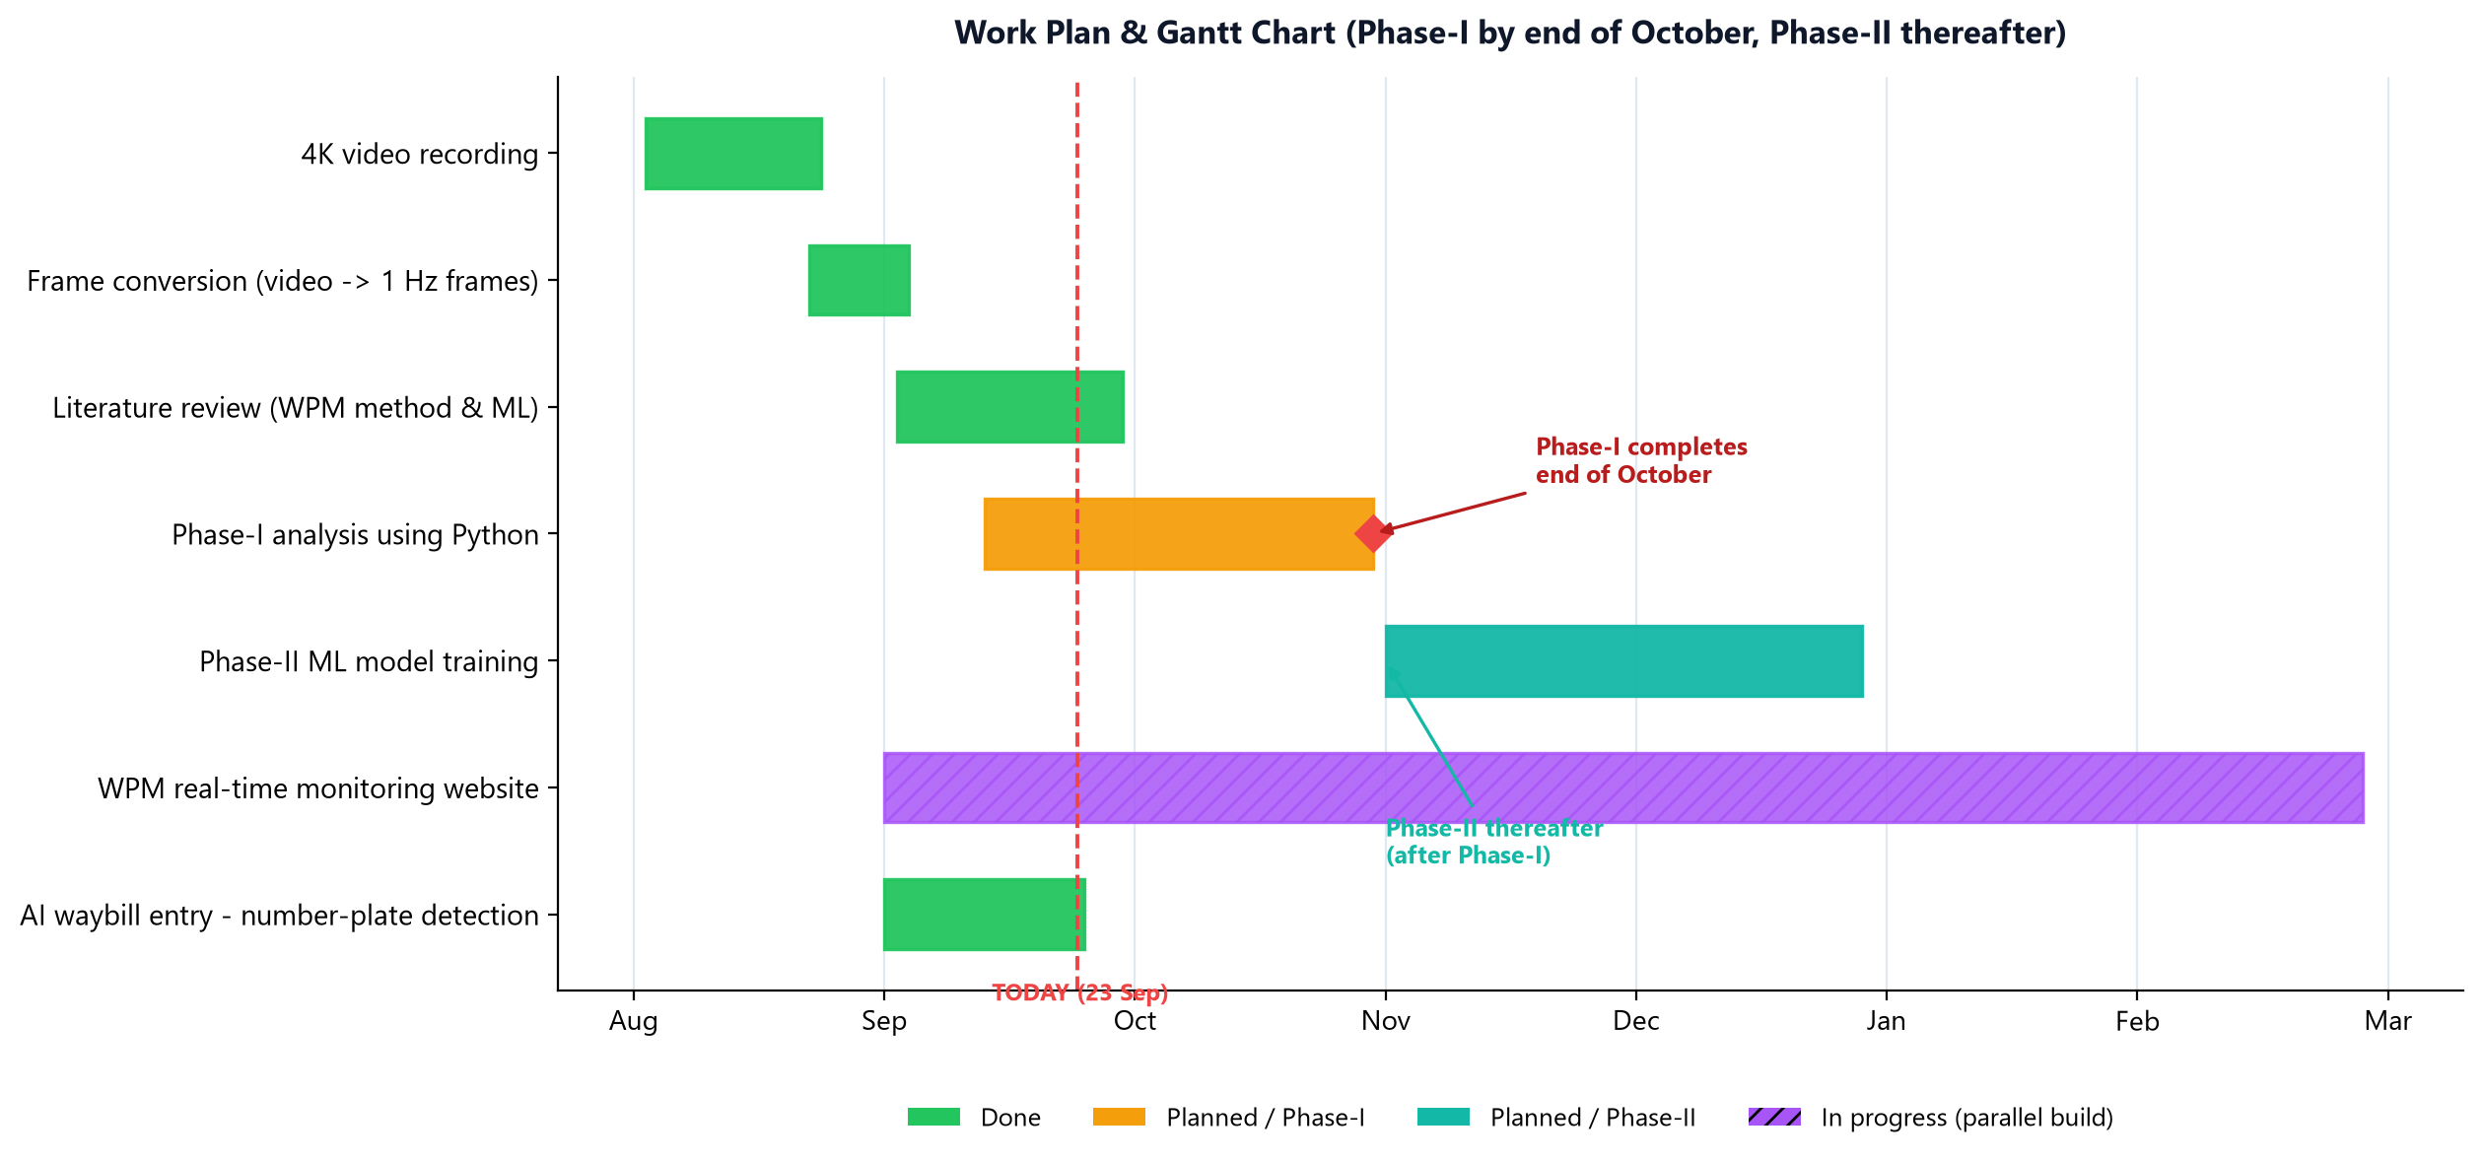
Work Plan & Gantt Chart
WPM-KSRTC | 07/14
Key: Phase-I analysis completes by 31 Oct · Phase-II begins thereafter · both website builds run in parallel now
Workplace Performance Measurement · Digitalization of Station-Master Operation · Phase-I
Dept. of ECE

Slide 8
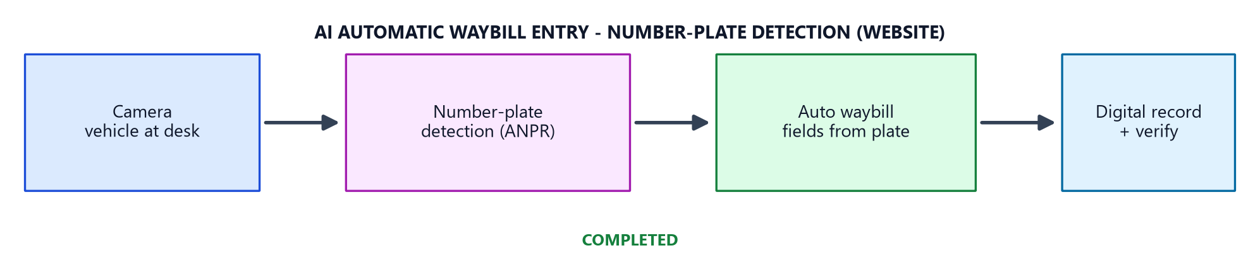
Completed — AI Automatic Waybill Entry
WPM-KSRTC | 08/14
Number-plate detection based website · delivered
▪ Delivered: automatic waybill entry from the vehicle number plate — replaces manual typing at the desk
▪ How it works: camera reads the plate (ANPR) → auto-fills waybill fields → digital record for verification
▪ Status: website and detection pipeline complete and working — live alongside the WPM build
Workplace Performance Measurement · Digitalization of Station-Master Operation · Phase-I
Dept. of ECE

Slide 9
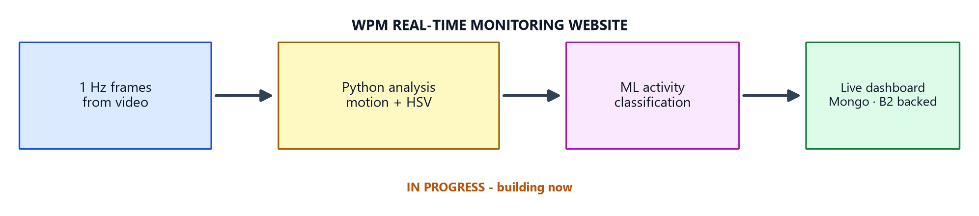
In Progress — WPM Real-Time Monitoring Website
WPM-KSRTC | 09/14
Website in progress
▪ Goal: live monitoring dashboards of station-master activity — VA/NVA, activity mix, event log
▪ How: 1 Hz frames → Python analysis → ML classification → live dashboard (MongoDB + Backblaze B2 assets)
▪ Status: under construction — framework, configuration and asset serving are in place; analysis/ML hooks attach after Phase-I
Workplace Performance Measurement · Digitalization of Station-Master Operation · Phase-I
Dept. of ECE

Slide 10
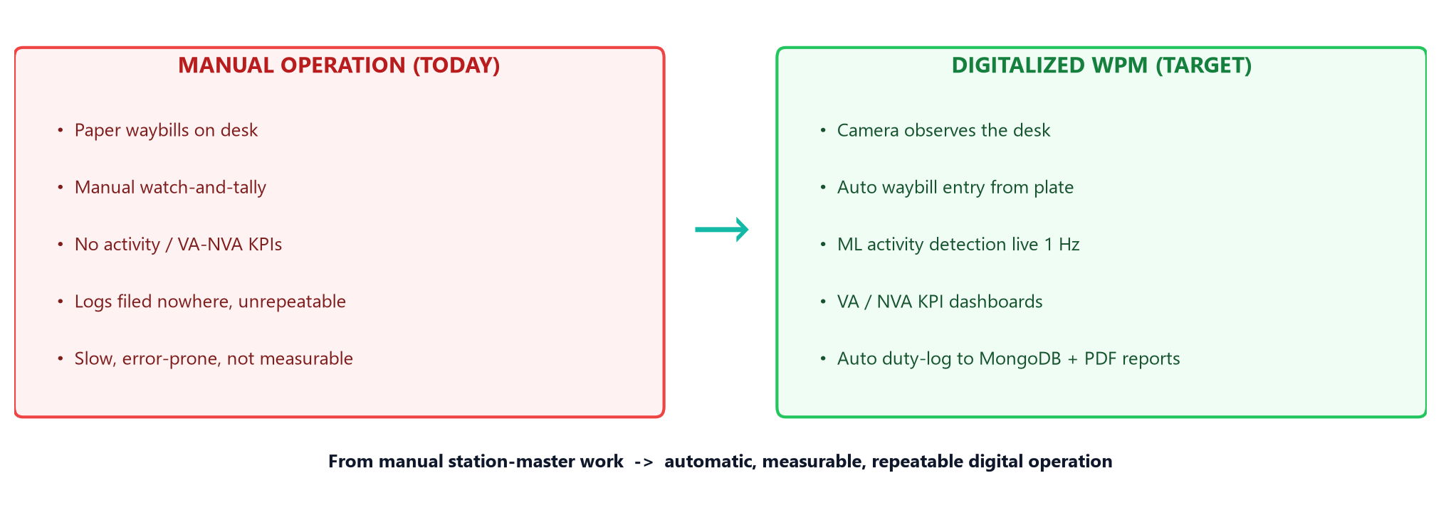
Digital Transformation of the Station-Master Operation
WPM-KSRTC | 10/14
▪ Problem: manual, slow, error-prone, unmeasurable — no digital evidence of the process or its performance
▪ Solution: observe automatically, classify activities, auto-fill waybills, and publish live KPIs — all bottleneck areas addressed
Workplace Performance Measurement · Digitalization of Station-Master Operation · Phase-I
Dept. of ECE

Slide 11
Next Steps (to end of October)
WPM-KSRTC | 11/14
Planned Task | Deliverable | Window
Build Phase-I Python analysis (motion + zones + events) | Event log + VA/NVA report | Oct
Map desk grid & verify activity thresholds | Validated activity classes | Oct
Complete & document Phase-I | Phase-I report + demo | End Oct
Begin Phase-II ML training on the labelled frames | Trained model | Nov onwards
Finish WPM real-time monitoring website | Live dashboard | In progress
Workplace Performance Measurement · Digitalization of Station-Master Operation · Phase-I
Dept. of ECE

Slide 12
Phase-I Timeline Overview
WPM-KSRTC | 12/14
Task | Aug | Sep | Oct | Nov | Dec
4K video recording & frames | ✓
Literature review (analysis & ML) |  | ✓
Waybill plate-entry website (completed) |  | ✓
Phase-I Python analysis |  |  | ✓
Phase-II ML model training |  |  |  | ✓
WPM real-time monitoring website (build) |  |  | ✓ | ✓ | ✓
Phase-I closes end of October; Phase-II (ML automation) proceeds from November.
Workplace Performance Measurement · Digitalization of Station-Master Operation · Phase-I
Dept. of ECE

Slide 13
Thank You!
Questions & Feedback
Digitalization of the KSRTC Station-Master Operation · Phase-I Progress Update
Dept. of Electronics and Communication Engineering · College of Engineering Trivandrum
Workplace Performance Measurement · Digitalization of Station-Master Operation · Phase-I
Dept. of ECE

