Slide 1


DXC REAL TIME PROJECTs
PRESENTATION BY – ADITYA (DXCAB1203)

Slide 2
Contents
Introduction
Azure Cosmos DB
Azure Blob storage
Azure Synapse analytics
Azure Data factory
Azure data bricks
Integrations with PowerBI, GITHUB, Logical Apps
Udemy Projects

Slide 3
Introduction
DATABASE- A collection of data that is logically coherent.
SQl
DDL(Data definition Language)
DML(Data manipulation language)
DCL(data control language)
MONGO DB
MONGO compass
Performing operations Data using command line arguments and by GUI
Pyspark
To support python with spark Apache spark community released a tool pyspark
Features of pyspark
Demonstration on pyspark in colab as well as in Databricks

Slide 4
Azure cosmos DB
NoSQL database
Single-digit millisecond response times
instant scalability
guarantee speed at any scale
Azure Cosmos DB
Mostly using in Microsoft Own E-commerce platforms that run Windows store and Xbox Live
Used for storing catalogue data
Order processing pipelines

Slide 5
Azure blob storage
Storing unstructured object data
Azure Blob Storage helps you create data lakes for your analytics needs
provides storage to build powerful cloud-native and mobile apps.
Optimize costs with tiered storage for your long-term data
flexibly scale up for high-performance computing
machine learning workloads.
Industry Usage :
Walmart, CVS health corporation, And many us based banking and health sectors using Blob storage in the organisation

Slide 6

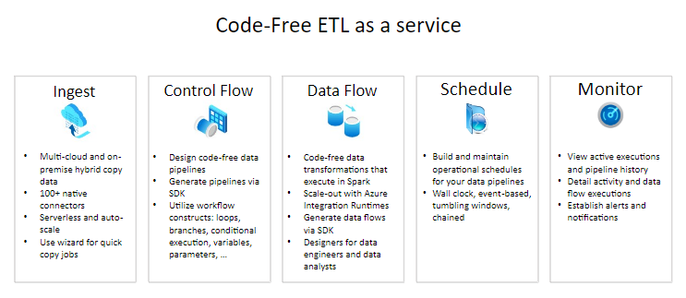
Azure Data factory
Companies using Azure Data factory
Ecolab
Walmart
GSK Pharma …

Slide 7
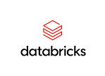
Azure databricks
Azure Databricks is a data analytics platform optimized for the Microsoft Azure cloud services platform.
Azure Databricks offers three environments for developing data intensive applications:
Databricks SQL
Databricks Data Science & Engineering
Databricks Machine Learning.
Companies using Databricks
ABN-Amro
H&M
T-Mobile
HSBC

Slide 8
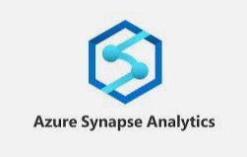
Azure synapse analytics
Azure Synapse Analytics is a limitless analytics service that brings together data integration, enterprise data warehousing and big data analytics.
It gives you the freedom to query data on your terms, using either serverless or dedicated options—at scale.
Ability to integrate with various data platforms and services.
Descriptive/Diagnostic Analytics: Use T-SQL queries against the Synapse database to perform data exploration and discovery.
Azure synapse analytics Serving organizations
Bank of America Corporation
Merck & Co
United States based Life Sciences organization

Slide 9
Integrations
Azure blob storage + Azure sql database
Azure synapse analytics + Azure blob storage
Databricks + powerBI
Databricks + Data factory
Synapse + PowerBI

Slide 10

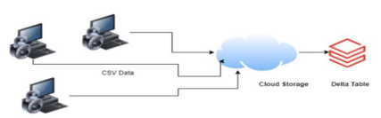
Udemy Project’s
project-1 Connected vehicles
project-2 Ap Morgan data platform

Slide 11
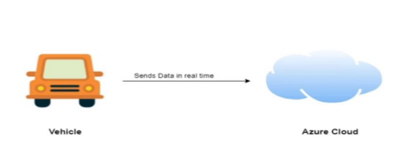
Project-1 connected vehicles
Our client general motors is roll out new features based on IOT to improve their service.

Slide 12
Our task
Move data
Validate data
Store
data

Slide 13
Project outline
AWS
COPY DATA IN AZURE
VALIDATE JSON
STORE IN SQL

Slide 14
Resources provided
Azure data factory
Azure functions
Azure sql server
Azure blob storage account

Slide 15
Getting started with the project
creating azure data factory
Creating Azure data factory pipeline
Creating blob trigger logic
Creating azure sql server and data base
Adding another pipeline to move data from staging to sql data base

Slide 16
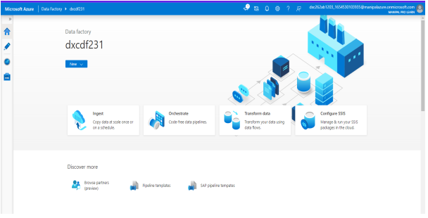
Creating azure data factory

Slide 17
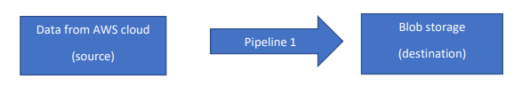
Creating azure data factory pipeline

Slide 18
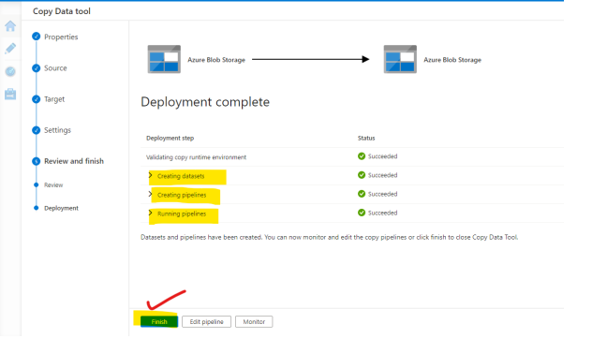
Creating azure data factory pipeline

Slide 19
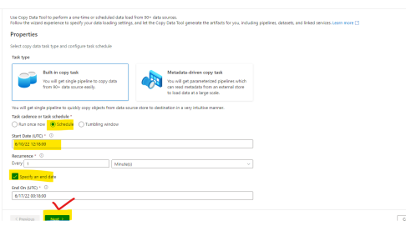
Creating blob trigger logic

Slide 20
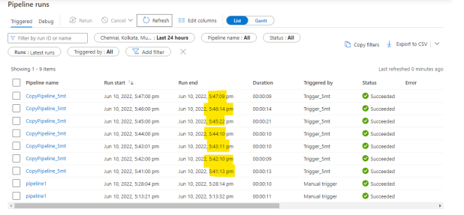
Creating blob trigger logic

Slide 21
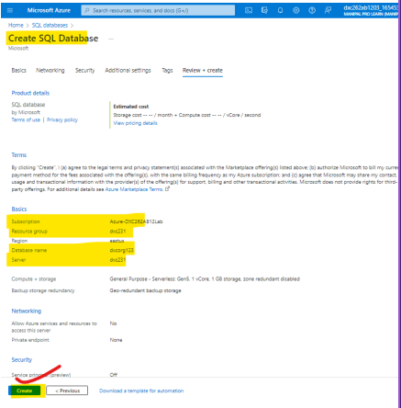
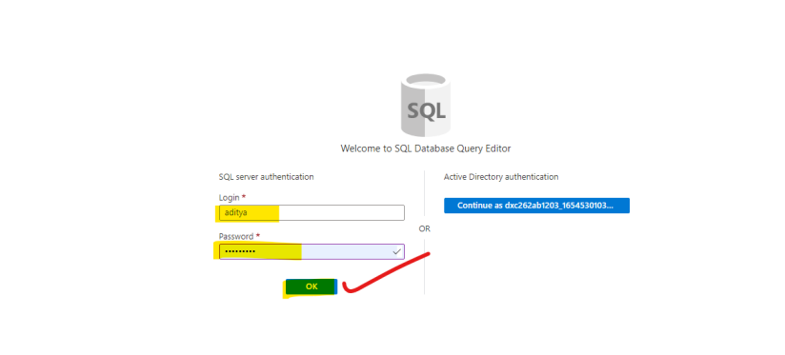
Creating sql server and data base

Slide 22
Adding another pipe line
Sql DB
Staging
Pipe line 2

Slide 23
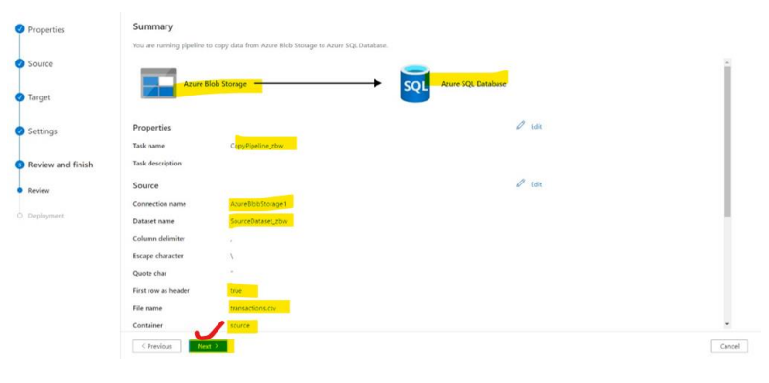
Adding another pipeline

Slide 24
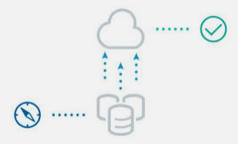
result
The data is successfully rolled out into the cloud

Slide 25
Project-2 ap Morgan data platform

Slide 26
Our task
Collection of data
Validate data
Store
data

Slide 27
Resources provided
Azure data factory
Azure functions
Azure sql server
Azure blob storage account

Slide 28
Getting started with the project
Create data bricks
Creating the cluster in data bricks
Adding note book in data bricks & implement business logic
Creating data factory
Creating azure data bricks linked service in azure data factory

Slide 29
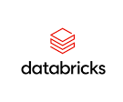
data bricks
Databricks provides a unified, open platform for all your data.
It empowers data scientists, data engineers
We can perform data analytics with a simple collaborative environment to run interactive and scheduled data analysis workloads.

Slide 30
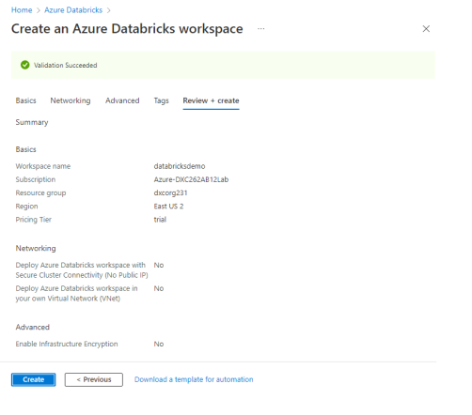
Creating data bricks

Slide 31
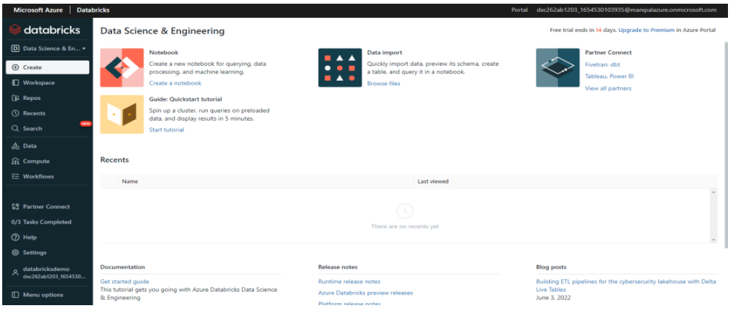
Creating data bricks

Slide 32
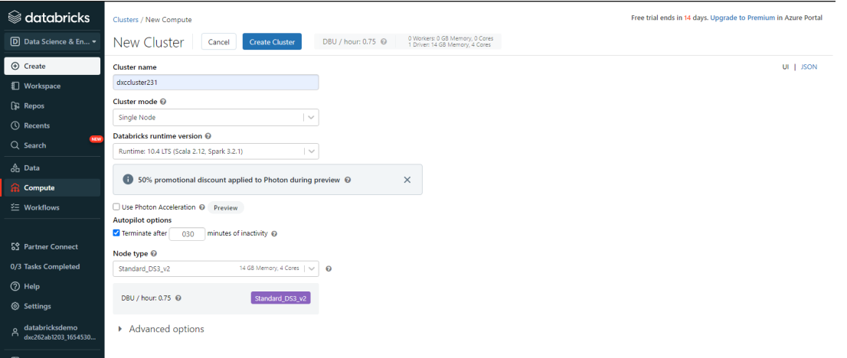
Creating a cluster in data bricks

Slide 33
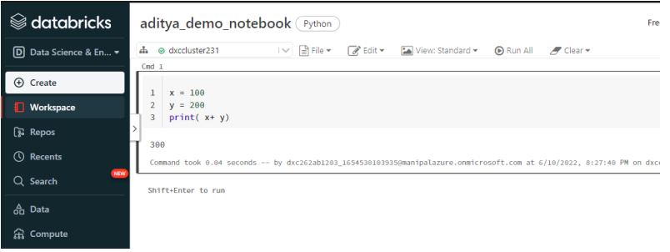
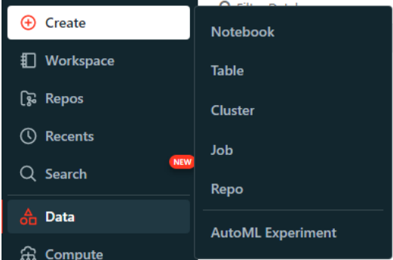
Adding note book in data bricks

Slide 34
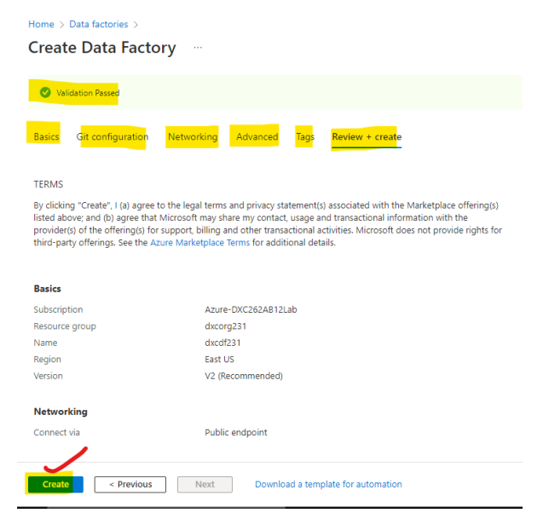
Creating data factory

Slide 35

Creating azure data bricks linked service in azure data factory

Slide 36
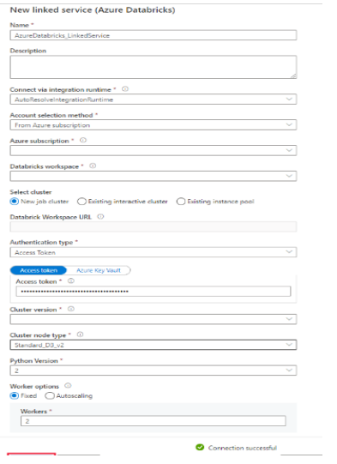
Creating azure data bricks linked service in azure data factory

Slide 37
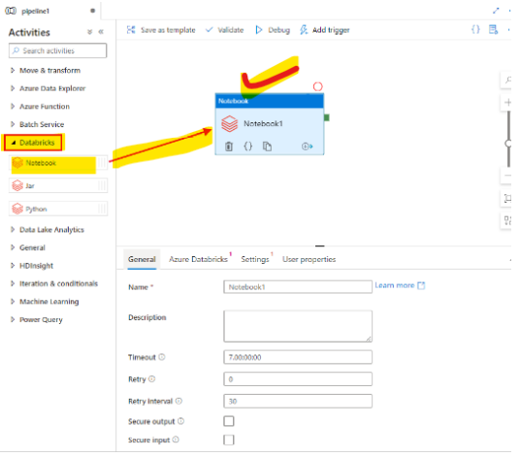
Creating azure data bricks linked service in azure data factory

Slide 38
result
The data from different applications are stored in azure storage and then into the data bricks channelled through data factory and now we can access the data, we can perform analysis on data.

Slide 39
references
https://docs.microsoft.com/en-us/azure/azure-sql/database/index
https://github.com/solliancenet/microsoft-data-engineering-ilt-deploy
https://docs.microsoft.com/en-us/azure/cosmos-db/introduction
https://docs.microsoft.com/en-us/azure/synapse-analytics/
https://docs.microsoft.com/en-us/azure/data-factory/
https://docs.microsoft.com/en-us/azure/data-bricks/
https://docs.microsoft.com/en-us/azure/logic-apps/

Slide 40
thankyou

