Slide 1
Identification of dog’s breed using Bidirectional lstm CNN Model
BY
Kedaar Kamath-4NM18CS076
Hawaralu Vignesh-4NM18CS064
Priyanka Nagesh-4NM18CS122
M Adithya Nayak-4NM18CS082

Slide 2
INDEX
Abstract
Introduction
Literature Review
Literature Survey
Problem Definition
Problem Description
Methodology
Project current status

Slide 3
Abstract
Dogs are domesticated mammals, not natural wild animals.
Today, somedogs are used as pets, others are used to help humans do their work. It’s a significant task for the owners to care and maintain their pet dog.
For that, they need to know the breed of the dog to train and cure disease.
Aim is identifying the breed of a dog in a given image which includes convolution neural networks.
The Network is trained and evaluated on the Dog
breed data set to identify the breed

Slide 4
Introduction
This is the process is to find a dog breed via an android application by snapping it’s picture.
It may not always be possible to approach the owner and enquire about the breed of the dog.
Convolutional neural network works like human vision.
CNN takes every input as an image.
CNN are proven to be effective in analyzing the visual imagery.
Our main aim is to build an android application using which a user can identify the breed of a dog.

Slide 5
Data Pre-processing stages:
Greyscale images to 28x28 pixels
Image database
Reshaping the images to 28x28 pixels
Converting images to greyscale
Consolidated data
Merge CSV files
CSV files with image pixel data
Converting 2D matrix into vector

Slide 6
Literature Review-1(Dog breed identification) by Whitney LaRow,Vijay
This project uses computer vision and machine learning techniques to predict dog breeds from images.
First, identification dog facial keypoints for each image using a convolutional neural network.
These keypoints are then used to extract features via SIFT descriptors and color histograms. Then it is compared to a variety of classification algorithms, which use these features to predict the breed of the dog .
The best classifier is an SVM with a linear kernel and it predicts the correct dog breed on its first guess 52% of the time; 90% of the time the correct dog breed is in the top 10 predictions.
The primary focus of the paper is to find the facial key points of the dog.

Slide 7
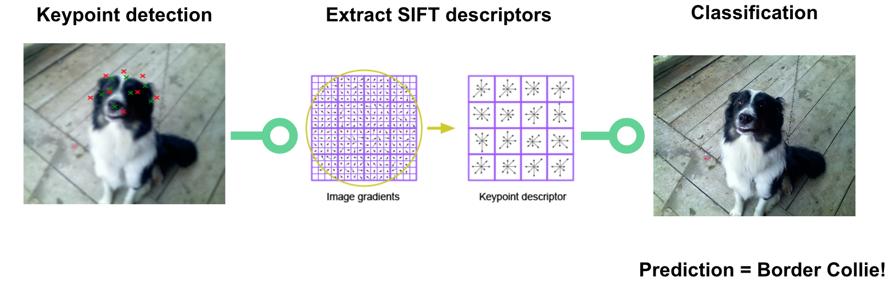
A sliding window SVM detector using SIFT greyscale descriptors is used over each eye and nose.
After the eyes and nose have been detected, greyscale SIFT descriptors around the keypoints are used as features by an SVM classifier.
Dataset includes 8,350 images of 133 different dog breeds.
This paper used Pythons cv2 library from OpenCV to calculate these SIFT descriptors.
Accuracy with SVM is found to be best with 52%.

Slide 8
Literature Review-2(Identifying Dog breed using CNN Architecture) by Kanika,Bhavya
This is a multiclass classification problem with 160 classes representing different breeds of dogs. Input is given as an image and the goal is to classify it to its appropriate class.
The problem is tackled as an Image Classification problem using Deep Convolutional Neural Network. Further on, trans-fer learning technique is used to improve the accuracy
The set of data utilized in this study which is Stanford Dogs set of data, which contains 120 unique dog breeds and 10222 and 10357 images for training and testing respectively.

Slide 9
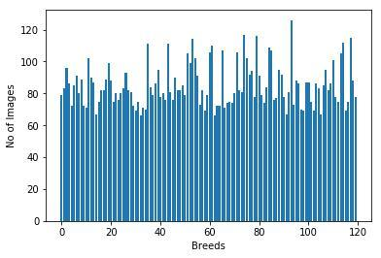

Transfer learning is an approach in DL where pre-trained models are used for building the model.
The images were augmented by flipping, zooming, shifting and rescaling by 255.
As an improvement and future work, data masking can be done on the train set. Noise from background of the images can be canceled by masking images.

Slide 10
Literature Review-3(Dog Breed Identification using DenseNet) by WentingShi,MuyunLiu
This project is based on PR which is to identify the dog’s breed.
Dataset contains 10,000+ images of 120 breeds of dogs, it uses 4 methods to do the identification.
Each method has a different training model. The four models are ResNet18, VGG16, DenseNet161, and AlexNet.
Based on the models, they also made some improvements on the optimization methods to increase the identification accuracy.
This paper proposes DenseNet model is best with accuracy of 85.14%

Slide 11
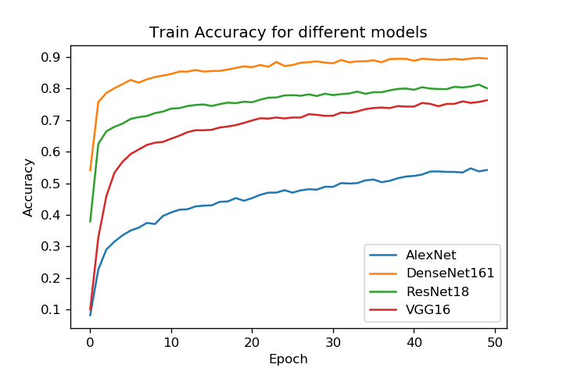
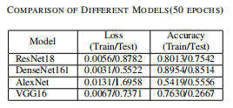
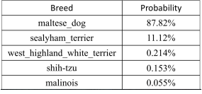

Slide 12
Literature Review-4(Dog Breed Identification using CNN and WebScraping)by Arun,Praveen
The current paper presents the methodology of fine-tuning CNN which is implemented in Stanford dog breed dataset.
There are several fine-tuned transfer learning which are widely used. In this application, Inception-ResNet-V2 [3]are implemented over the dataset.
Web Scraping or Web Data Extraction is a technique
employed to extract large amount of data from websites.
It automates the process, so that instead of manually copying the data from websites, the web scraping will perform the same task within a fraction of the time.

Slide 13
The Stanford dog breed dataset contains images of 130 breeds and there are 20,580 images in the dataset.
In this present paper, Inception-ResNet-v2 has been utilized in order to fetch the better performance. This network is 164 layers deep and classify images into 1000 objects.
The data model has to be saved for the further usage.
In this current paper, the flow of the application has split majorly into 2 segments. Firstly, image processing using neural network.
Secondly, data rendering using web scraping.

Slide 14
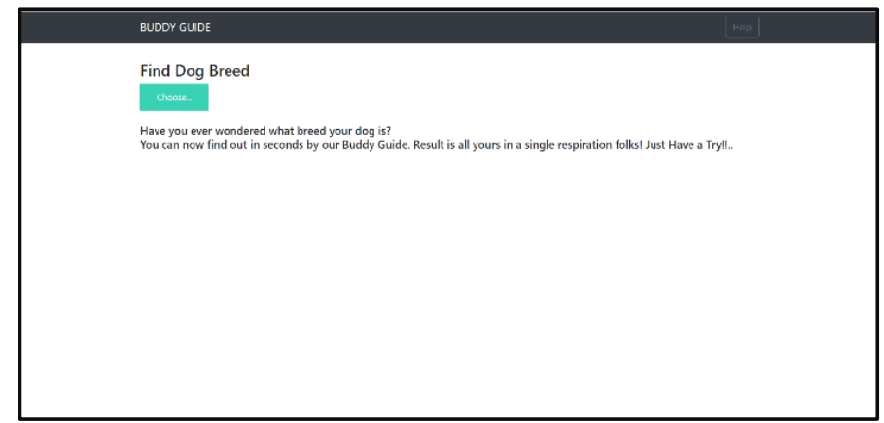
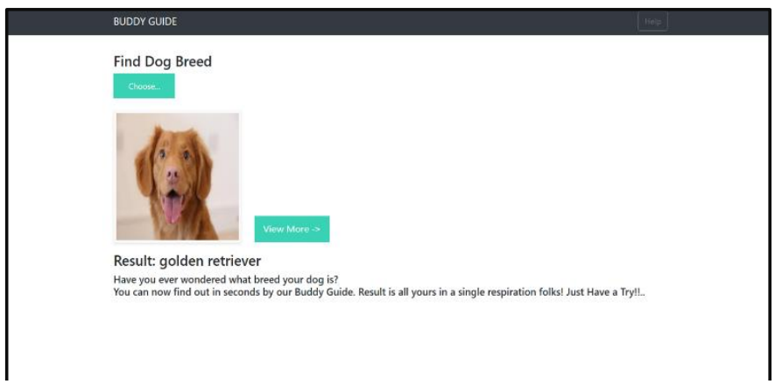
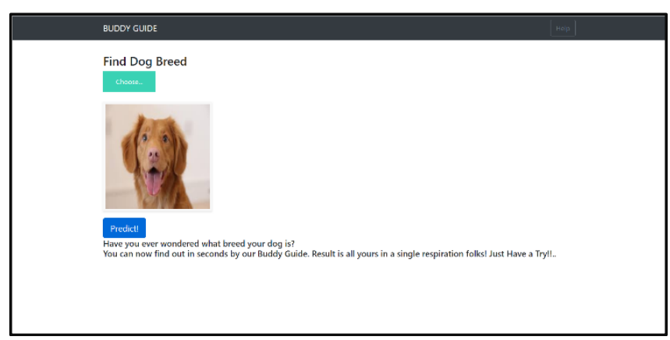

Slide 15
Literature Review-5(Convolutional Neural Network with Bi-directional Long Short-Term Memory Approach for Image Captioning)by Suramya Patel
This paper introduces a novel neural systems design that Convert Image into Sentences utilizing a half and half bidirectional LSTM with CNN Approach.
Convolutional neural networks (CNN) have turned out to be mainstream in picture handling for include extraction.
This paper proves bi-directional LSTM Perform better than another neural network.
Bi-directional demonstrate by nourishing sentence to LSTM from forward and in reverse arrange so utilize of both the past and future setting data of a sentence in foreseeing word.
To beginwith its Taking Input from CNN Extricated Features.

Slide 16
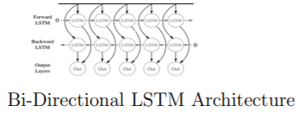
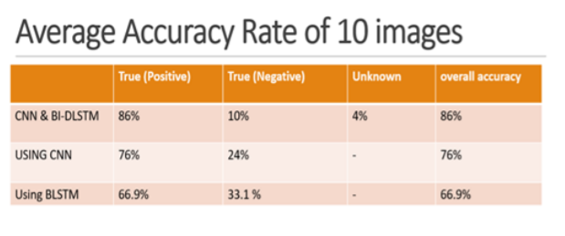
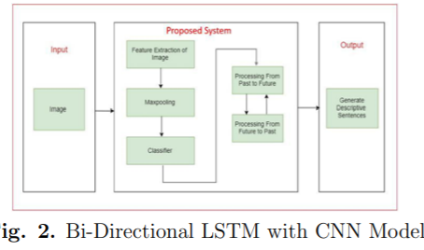

Slide 17
Literature Survey
By going through the above research papers , we conclude that CNN is best for image classification related tasks due to its excessive accuracy.
We define a CNN based approach for spotting dogs in perchance complex images and due to this fact reflect inconsideration on the identification of the one of kinds of dog breed.
Bidirectional long-short term memory(bi-lstm) is the process of making any neural network o have the sequence information in both directions backwards (future to past) or forward(past to future).

Slide 18
Problem Definition
We are provided with a training set and a test set of images of dogs.
Each image has a filename that is its unique id.
The dataset comprises 120 breeds of dogs.
The goal is to create a classifier capable of determining a dog's breed from a photo.

Slide 19
Problem Description
In this Task, we were provided a strictly canine subset of ImageNet in order to practice fine-grained image categorization.
How well we can tell our Norfolk Terriers from our Norwich Terriers?
With 120 breeds of dogs and a limited number training images per class, we might find the problem more, err, ruff than we anticipated.

Slide 20
Methodology
SYSTEM ARCHITECTURE:
The android application has four major activities:
Gets a picture
Top 3 predictions
Upload
Application
Take photo
Description of all 120 Breeds
View
Instruction
Instructions of the app

Slide 21
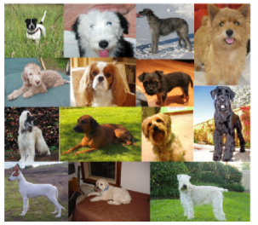
DATASET USED:
To train the model, we have used Kaggle dog’s dataset.
This dataset has 120 different dog breed images.
Whole dataset is divided into:
Train data
Validation data
Test data
FEATURE EXTRACTION FROM IMAGES:
Feature of images are extracted using pre-trained model.

Slide 22
DOG BREED IDENTIFICATION ON ANDROID:
Keras model is converted to tensorflow protobuff file.
Steps are:
Run Keras model on the server.
Convert the model to a tensor protobuff file.
Save the latest checkpoint.
Freeze the graph.
Finally optimize the saved model.

Slide 23
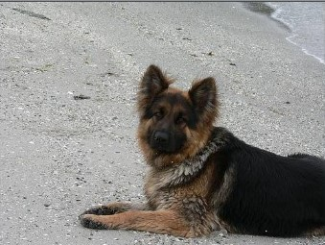
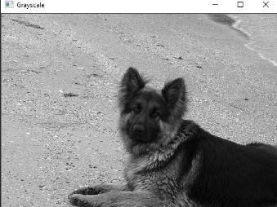
Project current status
RGB image of dog
Grey scale image

Slide 24
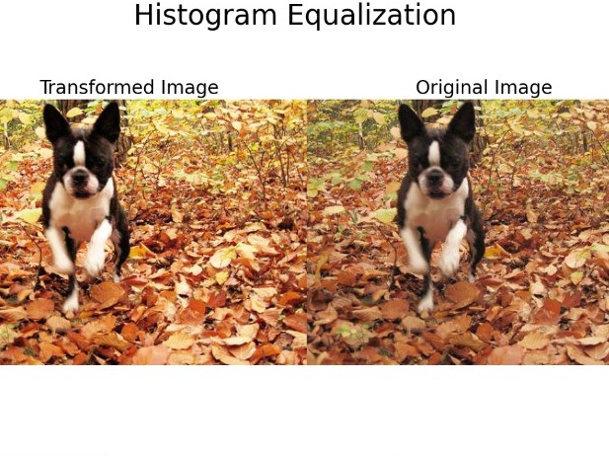
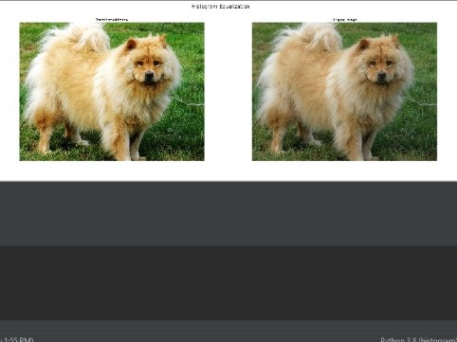
Histogram equalization

Slide 25


