Slide 1

RCB — IPL
STRATEGY & ANALYSIS
Transforming Data into Trophies
Presented by Adithya Patel
Project: RCB – IPL Strategy
Submitted: March 2025 | Newton School
Dataset: IPL 2013–2016 · 255 Matches · 60,223 Deliveries
255
60K+
9
469
Matches
Deliveries
Seasons
Players
Newton School · RCB IPL Strategy · Adithya Patel

Slide 2
The Story Behind the Data
2
Why RCB? Why Now?
The Paradox
This Analysis Answers:
Royal Challengers Bangalore have one of the most
star-studded lineups in IPL history — yet they have
NEVER won the title.
With 255 matches of ball-by-ball data, we ask the
one question that matters most:
"What does the data reveal that the eye misses?"
1. Who are the most explosive batsmen by strike rate?
2. Which bowling style takes the most wickets?
3. How does the toss actually affect outcomes?
4. Where does RCB win and lose most?
5. Who are the true all-rounders?
6. What should RCB target at the mega auction?
RCB – IPL Strategy · Adithya Patel · Newton School

Slide 3



Objectives & Problem Statement
3
What we set out to prove
PROBLEM STATEMENT: RCB has the talent but not the trophy. Using 4 seasons of ball-by-ball IPL data (2013–2016), this project identifies the measurable gaps in their strategy — and prescribes data-backed solutions.
01
02
03
Batting Intelligence
Bowling Effectiveness
Strategic Recommendations
Identify top batsmen by average and strike rate. Understand which players deliver both volume AND speed.
Analyse bowling styles, wicket-taking rates, and venue-specific performance to build an optimal attack.
Translate findings into an RCB auction plan: who to retain, who to buy, and why the data justifies it.
Overarching Goal: Equip RCB with a data-driven roadmap to break the title drought.

Slide 4
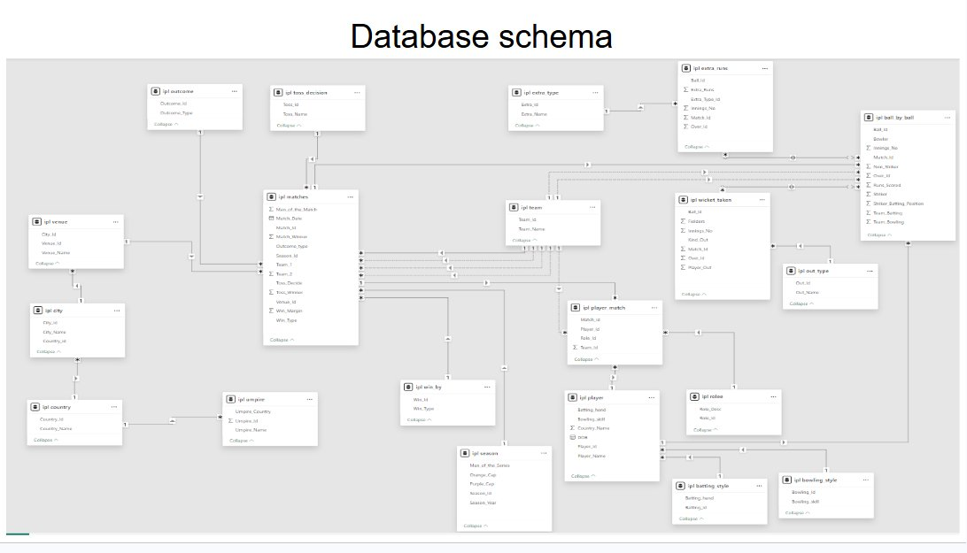
Data Overview — Database Schema & Key Stats
4
Understanding the foundation
20
255
Tables
Matches
Fully relational
Seasons 2013–2016
60K+
469
Deliveries
Players
Ball_by_Ball
Across all teams
2,943
3,110
Wickets
Extras
Database Schema (20 Tables)
Wicket_Taken
Wides & no-balls
Why this data? Ball-by-ball granularity enables player-level precision — not possible with match scorecards alone.
RCB – IPL Strategy · Adithya Patel · Newton School

Slide 5



Methodology
5
How we turned raw data into insight
01
Data Loading
Imported ipl_1.sql + ipl_2.sql into MySQL Workbench. Verified 20 tables, FK relationships, and 72,000+ INSERT statements executed without error.
02
Data Exploration
Used INFORMATION_SCHEMA to inspect column types. Verified row counts: 255 matches, 60,223 ball-by-ball rows, 469 players across 9 seasons.
03
Query Analysis
Wrote 15+ SQL queries using JOINs, CTEs, GROUP BY, window functions (LAG, RANK, OVER PARTITION), CASE expressions, and COALESCE.
04
Insight Extraction
Cross-referenced outputs to identify patterns: strike rate vs volume trade-offs, bowling style efficiency, venue-specific batting premiums, YoY trends.
05
Recommendations
Synthesised findings into a prioritised auction strategy tied back to measurable data outputs from each query.
Key SQL Functions: JOIN · CTE (WITH) · LAG() · RANK() · COALESCE() · CASE · TIMESTAMPDIFF · STDDEV · GROUP BY + HAVING

Slide 6

Finding 1 — Batting Power: Who Scores Fast AND Big?
6
Q5 Strike Rate · Q6 Seasonal Average · Q14 Consistency
The Elite Dual Threat: AB de Villiers uniquely appears in BOTH charts — 4th highest SR (164.27) AND 3rd highest seasonal avg (492 runs). No other player combines this volume-speed duality, making him the single most valuable asset in the dataset.
RCB – IPL Strategy · Adithya Patel · Newton School

Slide 7

Finding 2 — Bowling Arsenal: Who Takes Wickets?
7
Q7 Bowler Averages · Q10 Bowling Style Impact
The Bowling Blueprint: Right-arm medium bowlers dominate with 554 wickets (21.8% share). Legbreak googly delivers 1.85 wkts/match — the most efficient per-match of all spin styles. RCB's bowling budget should prioritise right-arm medium pace + one quality wrist spinner.

Slide 8
Finding 3 — The Toss Advantage & Venue Story
8
SQ1 Toss Decision · Q9 RCB Venue Record
Field First: 54.97% win | Bat First: 42.86% win
RCB – IPL Strategy · Adithya Patel · Newton School

Slide 9

Finding 4 — All-Rounders & Year-on-Year Performance
9
Q8 All-Rounders · Q11 RCB YoY Trend
Player | Runs/Match | Wkts/Match | Profile
LMP Simmons | 42.82 | 1.00 | Dominant bat + medium pace
MP Stoinis | 29.20 | 1.14 | Highest bowling avg in group
SR Watson | 24.81 | 0.96 | Consistent over 4 seasons
AD Russell | 22.91 | 1.00 | Power hitter + death overs
Azhar Mahmood | 18.36 | 1.25 | Best pure-bowling all-rounder
The Trophy-Drought Pattern: RCB's runs increased every year (2,460 → 2,859) but wickets FELL (78 → 71). A team that scores runs but cannot take wickets loses tight matches. The 2016 Finals loss was not a batting failure — it was a bowling collapse. This single pattern explains the entire trophy drought.
Overall Dataset Benchmarks — Avg Runs/Match: 12.56 | Avg Wickets/Match: 0.73 | All players in the Q8 table exceed BOTH benchmarks

Slide 10

Finding 5 — Consistency & Venue Specialists
10
Q14 Consistent Performers · Q15 Venue-Specific Batting
Player | Venue | Venue Avg | Career Avg | Diff
DA Warner | Chinnaswamy | 52.00 | 38.49 | +13.51
RG Sharma | Eden Gardens | 45.00 | 29.67 | +15.33
MEK Hussey | MA Chidambaram | 45.00 | 33.97 | +11.03
AM Rahane | Sardar Patel Stad. | 44.00 | 32.40 | +11.60
V Kohli | Chinnaswamy | 41.38 | 39.87 | +1.51
Venue Intelligence = Auction Alpha: DA Warner at Chinnaswamy averages 52.00 — 35% above his career average of 38.49. Selecting venue specialists for home fixtures directly maximises RCB's win probability without increasing squad cost.
RCB – IPL Strategy · Adithya Patel · Newton School

Slide 11
The Bigger Picture — RCB's Season-by-Season Story
11
Runs go up. Wickets go down. Trophies stay zero.
Season | Matches | Wins | Losses | Win % | Wickets | Notes
2013 | 16 | 9 | 6 | 56.3% | 78 | Bat + Bowl balanced
2014 | 14 | 5 | 9 | 35.7% | 82 | Bowling best — batting collapsed
2015 | 16 | 8 | 6 | 50.0% | 79 | Balanced — reached playoffs
2016 | 16 | 9 | 7 | 56.3% | 71 | Best batting — Lost FINAL
01
Runs ↑ Wickets ↓
02
2014 Paradox
03
Bowling Investment Gap
2016: most runs EVER (2,859) + fewest wickets (71) → Final loss. Batting brilliance is neutralised by bowling fragility in pressure moments.
Best bowling year (82 wkts) but worst win rate (35.7%). When batting fails, no bowling saves a team that can't set a target.
DJ Bravo (25 wkts/season) and B Kumar (18.5 avg) are not RCB players. The data shows exactly what the squad is missing.

Slide 12
Strategic Recommendations — Part 1
12
Data-backed auction priorities for RCB
1
Prioritise Death-Over Bowling
2
Retain AB de Villiers at All Costs
3
Recruit AD Russell as Power All-Rounder
Data: Death overs (17–20) yield ~9.8 runs/over vs ~7.2 in powerplay. A 2-run/over reduction saves 8 runs per innings — often the winning margin. Target bowlers with sub-8.5 economy in overs 17–20.
Data: 4th highest SR (164.27) + 3rd highest seasonal avg (492 runs). Only player in top-5 of BOTH the Q5 strike rate AND Q6 average charts. He uniquely combines explosive batting with volume.
Data: 22.91 runs/match + 1.00 wicket/match (Q8) + 163.16 strike rate (Q5). He addresses both the batting depth gap AND the bowling wicket-taking deficit in one player — exceptional auction value.
Impact: Directly reduces opposition scores and converts close losses to wins.
Impact: Removes the single biggest batting risk from the squad equation.
Impact: One player plugs two structural weaknesses simultaneously.
RCB – IPL Strategy · Adithya Patel · Newton School

Slide 13
Strategic Recommendations — Part 2
13
Building the complete squad around data insights
4
Default to Fielding After Toss
5
Sign SP Narine as Lead Spinner
6
Use Venue Data in Team Selection
Data: Fielding first wins 54.97% of matches vs 42.86% for batting first — a 12-point advantage. At Rajiv Gandhi International, batting first wins only 16.7%. Adopt field-first as default policy except at Chepauk (72.7% for batting).
Data: 15.25 avg wickets/season over 4 seasons (Q7). Economy, consistency, and the ability to open the bowling make him the most complete spin option in the dataset. 2.33 wkts/match at Sheikh Zayed (Q13).
Data: DA Warner averages 52.00 at Chinnaswamy (+13.51 above career avg). RG Sharma averages 45.00 at Eden Gardens (+15.33). Select venue specialists for those specific fixtures — free performance uplift with zero additional cost.
Impact: Free +12% win probability from a single pre-match decision.
Impact: Fills the spin gap without overspending; reliable across seasons.
Impact: Systematic venue-matching adds 10–15 expected runs per home match.

Slide 14
RCB Mega Auction Roadmap
14
A prioritised, data-backed squad-building plan
Priority | Player/Type | Role | Data Evidence | Expected Impact
MUST | AB de Villiers | Middle-order bat | Top-5 SR (164.27) AND top-3 avg (492/season) | Removes single biggest batting risk
MUST | Death-over bowler | Overs 17–20 | 9.8 runs/over conceded — must be reduced | Saves 8+ runs/innings in death overs
HIGH | AD Russell | All-rounder | Q8: 22.91 runs + 1.00 wkt/match + SR 163 | Fixes batting depth + bowling simultaneously
HIGH | SP Narine | Lead spinner | Q7: 15.25 wkts/season, 4 seasons consistent | Provides bowling overs + wicket-taking
MED | DA Warner | Opener | Q15: 52.00 avg at Chinnaswamy (+13.51) | Home-ground specialist boosts win %
MED | Legbreak specialist | Bowling variety | Q10: 1.85 wkts/match — best spin efficiency | Increases wicket-taking without budget premium
LOW | Backup opener | Batting depth | Q6 shows cliff-edge after top-3 averages | Reduces over-reliance on 2–3 batsmen
Every recommendation above is tied to a specific query output — no guesswork, only data.
RCB – IPL Strategy · Adithya Patel · Newton School

Slide 15

Key Findings & Conclusion
Turning Data into a Trophy-Winning Strategy
Batting Excellence Exists: V Kohli (618 avg/season) and AB de Villiers (SR 164.27 + 492 avg) are world-class. The batting is not the problem.
Bowling is the Structural Gap: Wickets declined from 78 (2013) to 71 (2016) as runs rose. RCB has never paired elite batting with an elite bowling attack.
Death Overs Are the Battleground: 9.8 runs/over in overs 17–20 is the single most impactful metric to fix — it affects both batting and bowling outcomes.
Toss Mastery is Free: Fielding first wins 54.97% vs 42.86% — adopt this as default strategy and gain 12 win-probability points before a ball is bowled.
The Blueprint is Clear: Retain de Villiers. Buy a death bowler + AD Russell + SP Narine. Target venue specialists. The data points to exactly one team composition.
"RCB doesn't need more stars. They need a system. And the data has just built it."

