Slide 1
A presentation on aggression detection
BY:
CHIRAG SASTRY
SURABHI NAGENDRA
ADITHYA RAMESH
AISHWARYA KIRAN

Slide 2
Problem Definition: Aggression can be defined as a state of mind in which an individual is subjected to uncontrollable anger or antipathy resulting in a hostile behavior causing harm to them and/or the people around them by the means of a physical or verbal attack, triggered by anxiety, depression, unrest, un-friendly environment sometimes un-controllable emotions whose occurrence may be sudden and due to apparent reasons
AGGRESSION DETECTION

Slide 4
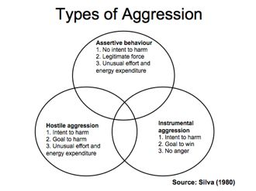
TYPES OF AGGRESSION

Slide 5
AGGRESSION BROADLY CLASSIFIED AS: Instrumental Aggression: They are noticed in people who are determined to extremes on their goals, but can lead, sometimes to harm’s way. Hostile Aggression: They are intended to harm other people, cases have been noticed in which people have attacked their own family members. Assertive Aggression: They are the most commonly noticed, in most of cases not harmful. The above classification suggests, the first two types of aggression should be given priority in detection and solution.
TYPES OF AGGRESSION

Slide 6
One of the most prime causes of Alzheimer’s disease - anxiety, apathy, leading to deterioration of blood cells, intervening with daily activities, initially causing temporary memory loss and finally causing permanent change in the brain cell orientation, but a most important parameters to be considered are the age and the stress level of the person
AGGRESSION LEADING TO ALZHEIMER’S

