Slide 1


Recruit Restaurant Visitor Forecasting
MSBA 6420 (001)
Predictive Analytics Project
Team 10 – Gautam Ramesh, Adithya Ramesh, Sidharth Sundararaman, Priya Priya, Deepak Vohra

Slide 2
Problem Statement
Fundamental Question : How many customers to expect each day ?
Potential Benefits : Efficient inventory management, staffing, store design and customer satisfaction.
Task : Forecast restaurant visits for the last week of April 2017 to the end of May 2017

Slide 3
Visits: Total of 829 restaurants with visit information at a day level.
Reservation : Total of 314 restaurants with reservation information at an hour level
Store Information: 14 genres of restaurants across 108 different locations
Weather*: Avg Temperature, Precipitation, Snowfall
(External Source)
Holidays: Japanese Holiday Calendar information
Brief Summary of Data:

Slide 4
Feature Selection Consolidation

Slide 5
Number of restaurants captured increases in July 2016, while the average visits per day is constant
Lag information for around 500 restaurants will be not available. A timeseries information may not be straightforward

Slide 6
Average visits vary with Day of week and Holidays, with peaks on Weekends
Since we observe the above variation, we calculate the average visits of a restaurant at a day of week level as an indicator for restaurant demand and use it as a feature

Slide 7
Average visits vary with the Genre of restaurant with Asian as most prominent
Since visits are varying with Genre means it’s an indicator for restaurant demand and can be used as a feature

Slide 8
Reservations are good indicators of visits
The above graph represents an equivalent time period in 2016 compared to 2017 predication period

Slide 9
Feature Engineering : Creating potential features as indicators of restaurant size

Slide 10
Mean Visitors
The mean no. of visitors on a given day of the week for each restaurant with priority given to holiday over the day of week.
No. of Neighbors
For each restaurant total no. of neighboring restaurants based on weather station
Median Visitors
The median no. of visitors on a given day of the week for each restaurant with priority given to holiday over the day of week.

Slide 11
Final features
Mean Visitors
No. of neighbors
Traffic of Location
Average Temperature
No. of Reservations
Genre
Day of the week
Holiday / Non-Holiday
Month
City Flag

Slide 12
Model Building: XG Boost Regressor

Slide 13

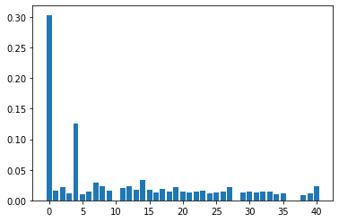
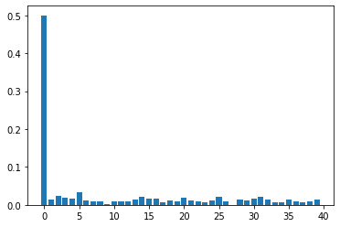
Two XG Boost Models were built to accommodate for reservation information
Model 1
Model 2
For 300 restaurants with reservation info
For the remaining restaurants
PEDICTIONS * WEIGHT
RMSLE = 0.5343
Mean Visitors
Mean Visitors
Feature Importance
Reservations

Slide 14
Improving the Model Performance RMSLE= 0.5280 (Improved from 0.5343) By: Hyper Parameter Tuning, Seasonality weight and Cross validation
Seasonality Weight = (Avg. Visits in Jan – Apr 2017 / Avg. Visits in Jan – Apr 2016) * Predictions
Learning Rate = 0.1
Max Depth = 7
Gamma = 0.3

Slide 15
Model Comparison: Running alternate models

Slide 16
Model Comparison (Based on log loss)
XG Boost (Optimized)* : 0.5280
Decision Tree : 0.5483
Support Vector Machine : 0.5472
Linear Regressor : 0.5489
* Final Model

Slide 17
Conclusion

Slide 18
Prediction is matching at most places, however it’s underperforming for Golden Week (29Apr-5thMay)
Golden Week
Peaks are lagged by a day. This is explainable. 21 May 2016 was a Saturday. Similar effect will be seen on 20 May 2017 and this is captured by the model

Slide 19
Potential Enhancements
Use LSTM model
Rolling mean on 3 month window as a feature
Including other weather information such as precipitation and snow

Slide 20
Thank You

