Slide 1


Heart Attack Prediction Using Multi-Layer Perceptron Model
Adithya Ravi
(Department of Computer and Information Science)

Slide 2
Problem Definition
Early detection and treatment of a heart attack are critical and can save a person's life. A heart attack differs from cardiac arrest, which occurs when the heart stops functioning altogether. Both are medical emergencies, and a heart attack without care can progress to cardiac arrest.In my project, I'd like to solve this problem by forecasting if a person is more likely to suffer a heart attack depending on their present health state.
Challenges:
The detection of a heart attack is usually hard and time-consuming. This might provide a quick assessment before consulting a doctor.
Notes:
Editorial Guidelines on Bullets:
1. Vertical lists are best introduced by a grammatically complete sentence followed by a colon. No periods
are required at the end of entries unless at least one entry is a complete sentence, in which case a period
is necessary at the end of each entry.
Example: A university can be judged by three measures:
· The quality of its students
· The quality of it faculty
· The quality of its infrastructure
2. If a list completes the sentence that introduces it, items begin with lowercase letters, commas or semicolons
(if individual items contain commas) are used to separate each item, and the last item ends with a period.
Note that the introductory clause does not end with a colon.
Example: A university can be judged by
· the quality of its students,
· the quality of its faculty,
· the quality of its infrastructure.
3. Avoid mixing sentence and nonsentence items in a bulleted list.

Slide 3
Data Description: heart.csv dataset
Heart.csv - the dataset is from kaggle (https://www.kaggle.com/datasets/rashikrahmanpritom/heart-attack-analysis-prediction-dataset)
Data specs:
a) Total of 303 columns
b) 13 features
Notes:
Editorial Guidelines on Bullets:
1. Vertical lists are best introduced by a grammatically complete sentence followed by a colon. No periods
are required at the end of entries unless at least one entry is a complete sentence, in which case a period
is necessary at the end of each entry.
Example: A university can be judged by three measures:
· The quality of its students
· The quality of it faculty
· The quality of its infrastructure
2. If a list completes the sentence that introduces it, items begin with lowercase letters, commas or semicolons
(if individual items contain commas) are used to separate each item, and the last item ends with a period.
Note that the introductory clause does not end with a colon.
Example: A university can be judged by
· the quality of its students,
· the quality of its faculty,
· the quality of its infrastructure.
3. Avoid mixing sentence and nonsentence items in a bulleted list.

Slide 4
Machine Learning Algorithms used
I choose to employ the Multi-Layer Perceptron model since it may have more number of hidden layers, is capable of working with non-linear datasets, and performs well with huge datasets. It also gives faster prediction for classification problems after training, which will be extremely useful in the project's future development.
6 hidden layers in total

Slide 5
Network Training
Training Details
Number of paramaters: 13
Optimizer: Adam optimizer
Batch-size: 32
Epochs:
SciKit Learn Model: 1700
TensorFlow Model: 1000
Evaluation Metrics
Confusion Matrix and thereby deriving the accuracy, precision, recall and the F1 score
Dataset Splits
Training: 212
Testing: 91

Slide 6
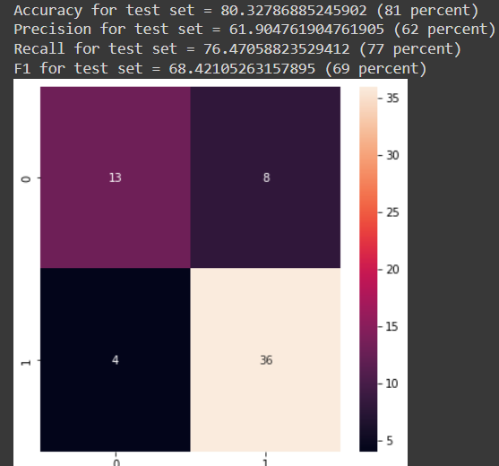
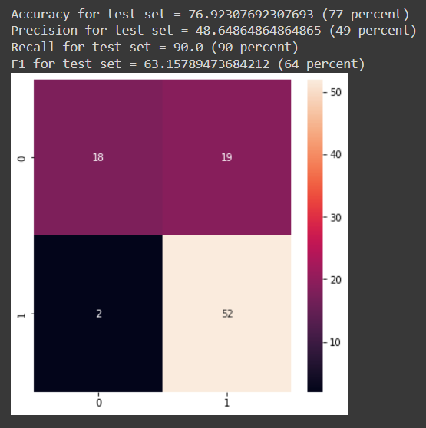
Perfomance Evaluation
MLPClassifier from sklearn.neural_network
Case 1: iterations: 1200, act_fn: relu, train_test_split: 0.8-0.2
Case 2: iterations: 1000, act_fn: relu, train_test_split: 0.7-0.3

Slide 7
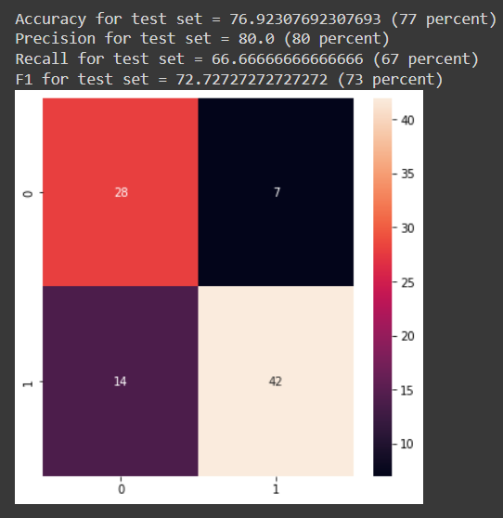
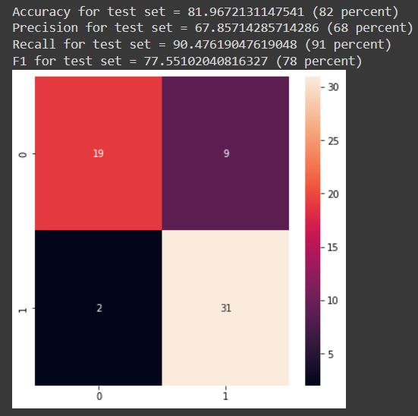
Perfomance Evaluation
MLPClassifier from sklearn.neural_network
Case 3: iterations: 2000, act_fn: tanh, train_test_split: 0.6-0.4
Case 4: iterations: 1800, act_fn: relu, train_test_split: 0.8-0.2 (most optimum)

Slide 8
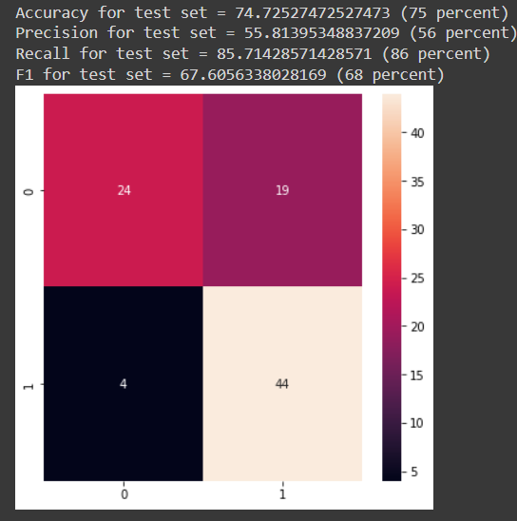
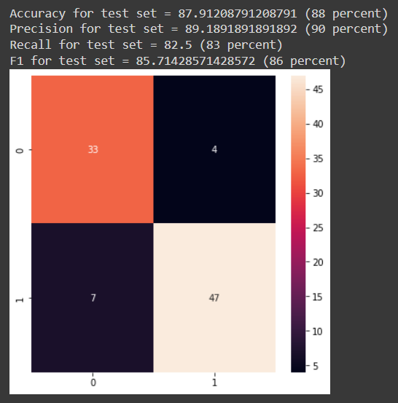
Perfomance Evaluation
Neural network developed using TensorFlow
Case 1: hidden layers: 7, act_fn: 4 relu, 3 tanh, epochs: 1000, train_test_split: 0.7-0.3
Case 2: hidden layers: 6, act_fn: 6 relu, epochs: 1000, train_test_split: 0.7-0.3 (most optimum)

