Slide 1
Location of an unmanned marine vehicle

Slide 2
Brief Introduction
We define an approach to determine the location of an unmanned marine vehicle and later perform various operations with the vehicle location.
Key components used for implementation:
Arduino
Ultrasonic sensor – Transmitter and Receiver
Software's used:
LabVIEW
Matlab
Python

Slide 3
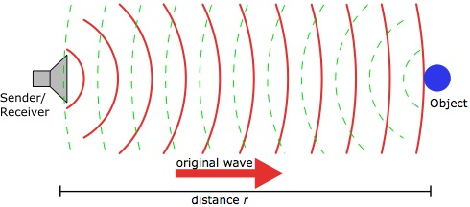
Distance calculation
We get the time it takes for a signal to travel from the transmitter to the receiver.
This is done by taking the mean time of the signals received and calculating the distance from each receiver.
Distance of calculated using the following formula
Distance = Speed * Time ,
where speed is a constant.

Slide 4

Need for Machine Learning
The time taken for the signal to be received by the receiver is not
accurate due to various environmental factors.
Thus, in order to achieve a greater accuracy various
machine learning algorithms were implemented.
We trained our model with a few algorithms and found the predicted value to vary in a desired manner for a given distance value and there by providing a more accurate distance values.

Slide 5
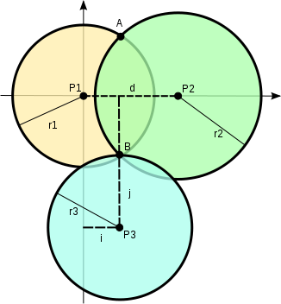
Location estimation
Approach used: TRILATERATION
In this method, 3 most accurate distance values are considered as attribures to a function that returns the location coordinates.
Explanation

Slide 6
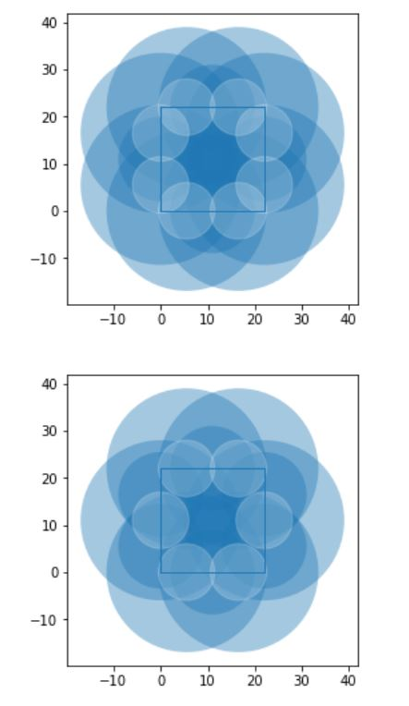
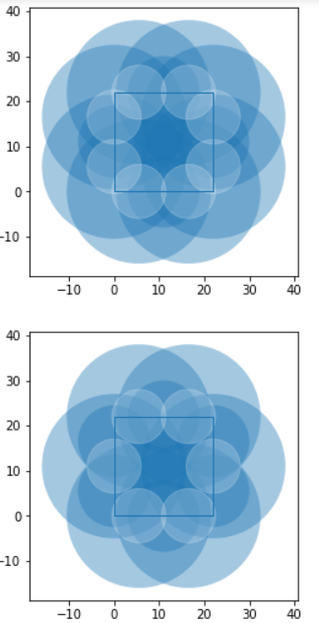
Various sensor configuration approaches
(i)
(ii)

Slide 7
Conclusions and Future work
A comprehensive study has been made for determining an ideal approach to the method to determine the vehicle location.
It has been implemented to a great accuracy and is under testing.
In the near future, we plan to add an automatic navigation, object avoidance etc.

