Slide 2
Introduction to GitHub
Adithya Sai Saladi
Notes:
Link to published module on Learn: https://docs.microsoft.com/en-us/learn/modules/learn-pr/language/react-get-started/

Slide 3
Prerequisites
A GitHub account

Slide 4
Learning objectives
Open a repo using GitHub
Create a branch
Commit changes to the branch
Create a pull request
Merge the pull request
Delete the branch

Slide 5
Agenda
Version Control
What is GitHub & Git?
Work in GitHub
Quiz
Summary

Slide 6
Version Control

Slide 7
Version Control
Version control is the management of changes to documents, computer programs, large web sites, and other collections of information.
Having the ability to commit, compare, merge, and restore past revisions of objects to the repository allows for richer cooperation and collaboration within and between teams
Version control enables teams to deal with conflicts that result from having multiple people working on the same file or project at the same time, and provides a safe way to make changes and roll them back if necessary

Slide 8
Version Control
When choosing the appropriate version control system (VCS) for your environment, look for one that encourages the sort of collaboration in your organization that you want to see
Opening and forking repositories;
Contributing back to repositories;
Contributions to your own repositories;
Defining processes for contributing; and
Sharing commit rights

Slide 9
Benefits
Change history
Concurrent working (Collaboration)
Traceability
Backup & Restoration

Slide 10
What is GitHub & Git?

Slide 11
Introduction
GitHub is a development platform that enables you to host and review code, manage projects, and build software alongside 50 million developers.
Git is a distributed version control system that allows users to track changes made to files and collaborate with others on a project. It is particularly popular among software developers, but can also be used for other types of projects.
Notes:
GitHub is a development platform that enables you to host and review code, manage projects, and build software alongside 50 million developers.
Why is everyone building on GitHub? Because it provides the important DevOps features companies and organizations of all sizes need for their public and private projects. Whether it's planning features, fixing bugs, or collaborating on changes, GitHub is the place where the world's software developers gather to make things. And then make them better.
In this module, you learn to use key GitHub features, including issues, notifications, branches, commits, and pull requests.

Slide 12




What is git
Popular Source Control system
Distributed system
Free (Open Source tool)
Notes:
GitHub is a development platform that enables you to host and review code, manage projects, and build software alongside 50 million developers.
Why is everyone building on GitHub? Because it provides the important DevOps features companies and organizations of all sizes need for their public and private projects. Whether it's planning features, fixing bugs, or collaborating on changes, GitHub is the place where the world's software developers gather to make things. And then make them better.
In this module, you learn to use key GitHub features, including issues, notifications, branches, commits, and pull requests.

Slide 13





Why Use Git
Fast
Disconnected
Powerful yet easy
Branching
Pull Requests
Notes:
GitHub is a development platform that enables you to host and review code, manage projects, and build software alongside 50 million developers.
Why is everyone building on GitHub? Because it provides the important DevOps features companies and organizations of all sizes need for their public and private projects. Whether it's planning features, fixing bugs, or collaborating on changes, GitHub is the place where the world's software developers gather to make things. And then make them better.
In this module, you learn to use key GitHub features, including issues, notifications, branches, commits, and pull requests.

Slide 14
The GitHub flow
In addition to providing a platform for collaborative software development, GitHub also offers a workflow designed to optimize use of its various features.
Notes:
In addition to providing a platform for collaborative software development, GitHub also offers a workflow designed to optimize use of its various features. While this unit offers a cursory overview of important platform components, it's recommended that you first review Understanding the GitHub flow.

Slide 15





What is Git Hub
Hosting service on Git
More than just source control for your code
Issue management, Working with Teams, etc.,
Free & Paid options
Notes:
In addition to providing a platform for collaborative software development, GitHub also offers a workflow designed to optimize use of its various features. While this unit offers a cursory overview of important platform components, it's recommended that you first review Understanding the GitHub flow.

Slide 16
Git and GitHub
As you work with Git and GitHub, you may wonder about the difference between the two.
Issues
Discussions
Pull requests
Notifications
Labels
Actions
Forks
Projects
Installed and used on your local machine
Handles version control
Supports branching
Notes:
As you work with Git and GitHub, you may wonder about the difference between the two.
Git is a distributed version control system (DVCS) that allows multiple developers or other contributors to work on a project. It provides a way to work with one or more local branches and push them to a remote repository. Git is responsible for everything GitHub-related that happens locally on your computer. Key features provided by Git include:
Installed and used on your local machine
Handles version control
Supports branching
To learn more about Git, see Using common Git commands.
GitHub is a cloud platform that uses Git as its core technology. It simplifies the process of collaborating on projects and provides a website, command-line tools, and overall flow that allows developers and users to work together. GitHub acts as the "remote repository" mentioned previously in the Git section.
Key features provided by GitHub include:
Issues
Discussions
Pull requests
Notifications
Labels
Actions
Forks
Projects
To learn more about GitHub, see Getting started with GitHub.

Slide 17


Git
Working with Git
Console
We will use this
GUI
GitHub Desktop Source tree

Slide 18


Git & GitHub
Getting your system ready
Install appropriate Git bash form official site
Command line (Git bash)
Server account (GitHub account)
Windows
Mac
Linux
Support for all platform

Slide 19



Git Foundation
The 3 stages of git
Modified
Staged
Committed

Slide 20

Git Foundation
The 3 areas of git
Working directory
Staging area
.git repo
Remote repo GitHub

Slide 21





GitHub
GitHubs Main features
Code management
Pull requests
Issues
CICD
Global search

Slide 22
Key Concepts of Git
Repository: A repository is a collection of files that are being tracked by Git.
Commit: A commit is a snapshot of a repository at a particular point in time. When changes are made to a repository, they are grouped together into a commit.
Branch: A branch is a separate version of a repository that allows users to work on changes without affecting the main branch.
Merge: When changes made on one branch need to be incorporated into another branch, they can be merged.
Notes:
Branches are the preferred way to create changes in the GitHub flow. They provide isolation so that multiple people may simultaneously work on the same code in a controlled way. This model enables stability among critical branches, such as main, while allowing complete freedom for developers to commit any changes they need to meet their goals. Once the code from a branch is ready to become part of the main branch, it may be merged via pull request.
To learn more about GitHub branches, see About branches.

Slide 23
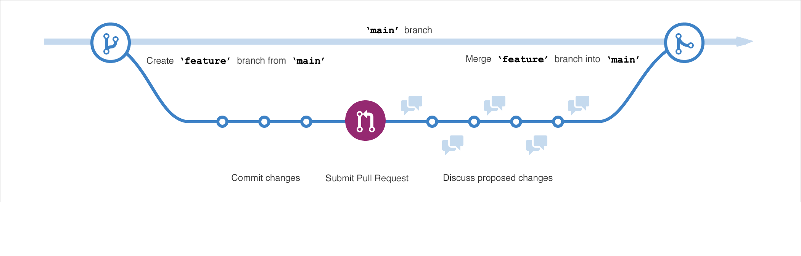
Branches
Branches are the preferred way to create changes in the GitHub flow.
Notes:
Branches are the preferred way to create changes in the GitHub flow. They provide isolation so that multiple people may simultaneously work on the same code in a controlled way. This model enables stability among critical branches, such as main, while allowing complete freedom for developers to commit any changes they need to meet their goals. Once the code from a branch is ready to become part of the main branch, it may be merged via pull request.
To learn more about GitHub branches, see About branches.

Slide 24
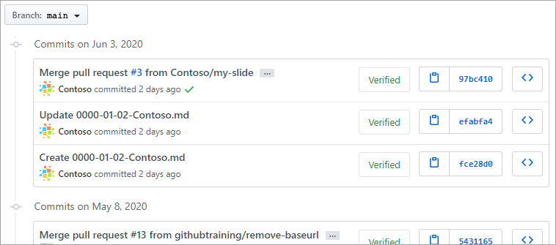
Commits
A commit is a change to one or more files on a branch.
Notes:
A commit is a change to one or more files on a branch. Every time a commit is created, it is assigned a unique ID and tracked, along with the time and contributor. This provides a clear audit trail for anyone reviewing the history of a file or linked item, such as an issue or pull request.
To learn more about GitHub commits, see Committing and reviewing changes to your project.

Slide 25
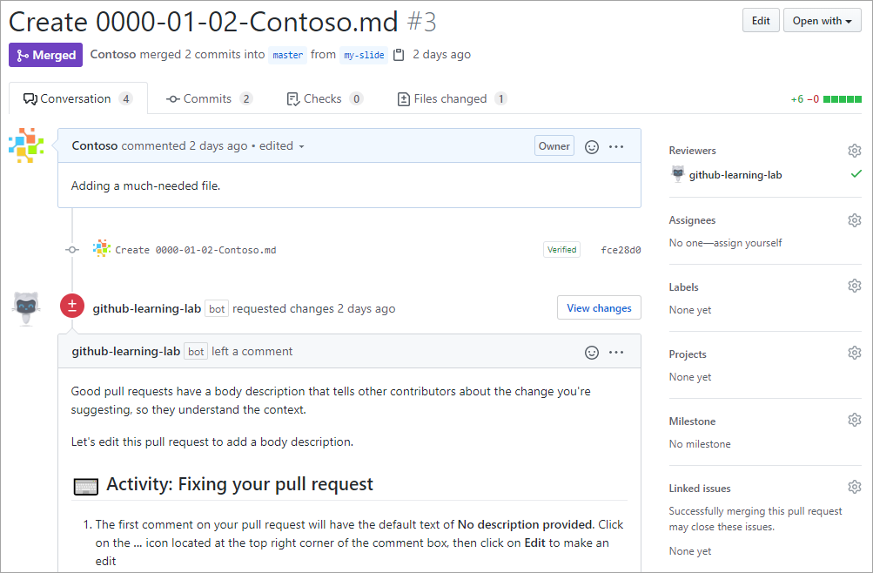
Pull Requests
A pull request is the mechanism used to signal that the commits from one branch are ready to be merged into another branch.
Notes:
A pull request is the mechanism used to signal that the commits from one branch are ready to be merged into another branch. The developer submitting the pull request will often request one or more reviewers to verify the code and approve the merge. These reviewers have the opportunity to comment on changes, add their own, or use the pull request itself for further discussion. Once the changes have been approved (if approval is required), the pull request's source branch (the compare branch) may be merged in to the base branch.
To learn more about GitHub pull requests, see About pull requests.

Slide 26
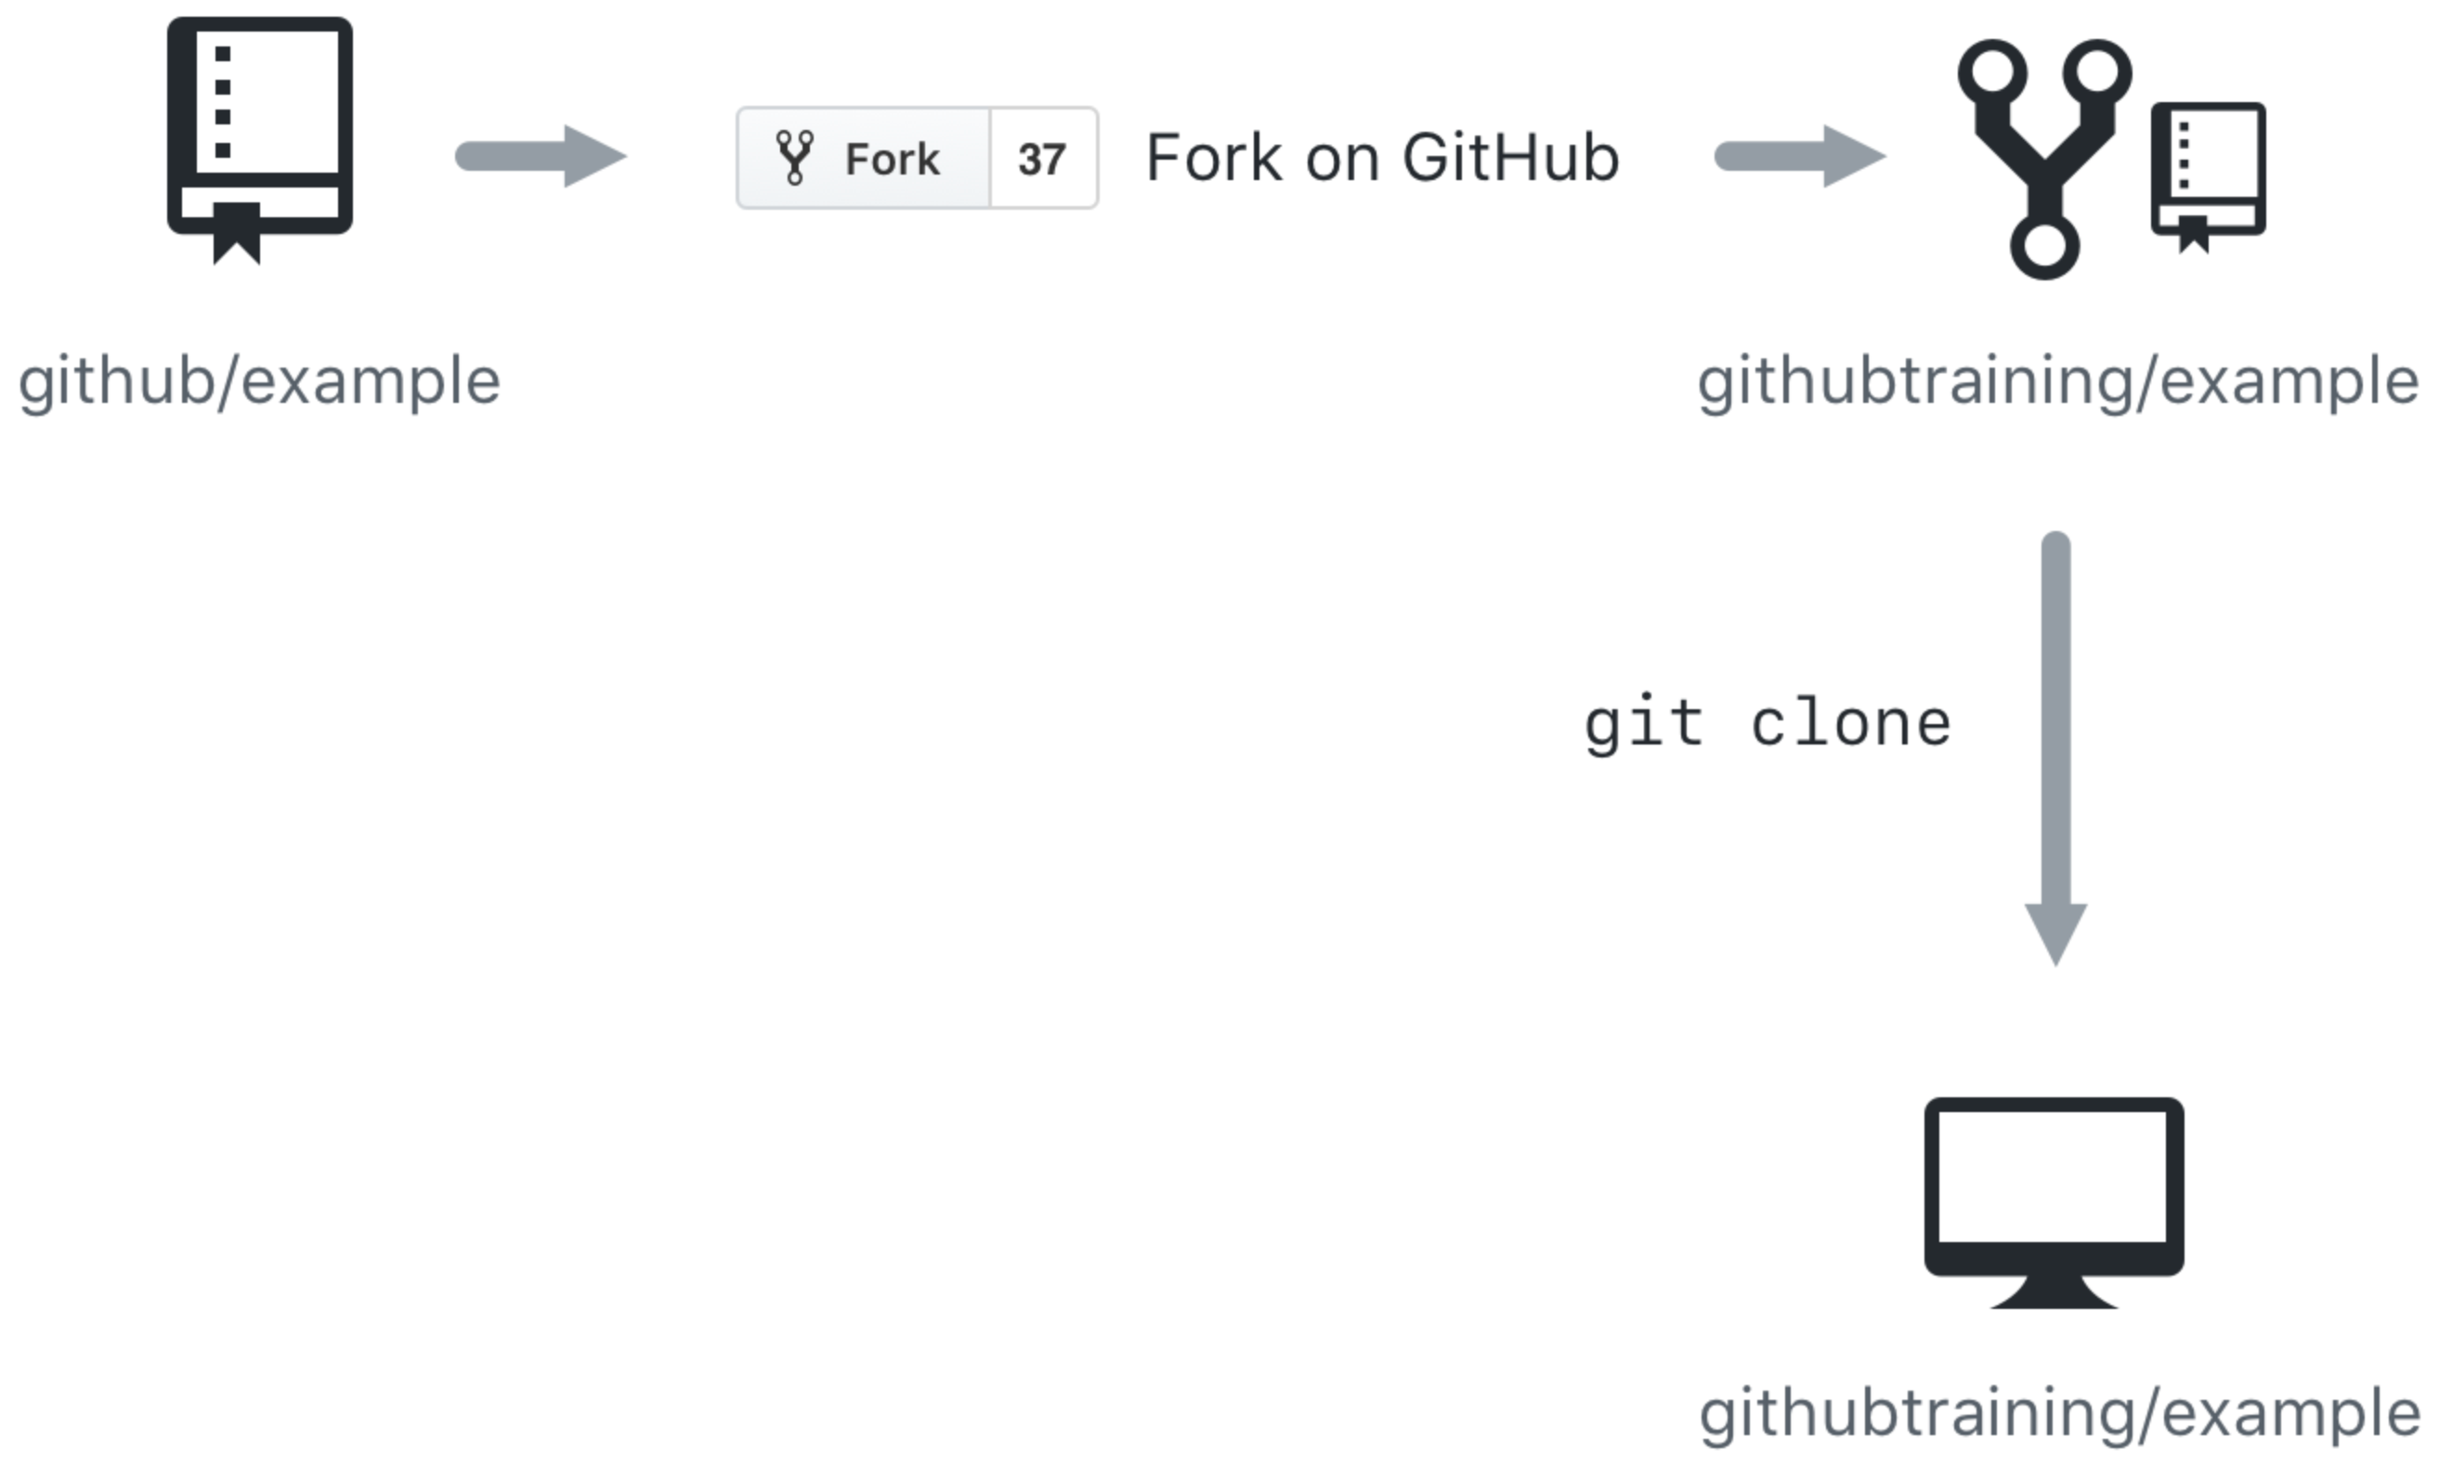
Cloning and forking
GitHub provides multiple ways to copy a repository so that you can work on it.
Cloning a Repository - Cloning a repository will make a copy of the repository and its history on your local machine. If you have write access to the repository you can push changes from your local machine to the remote repository (called the origin) as they're completed. To clone a repository you can use the git clone [url] command or the GitHub CLI's gh repo clone [url] command.
Forking a Repository - Forking a repository makes a copy of the repository in your GitHub account. The parent repository is referred to as the upstream while your forked copy is referred to as the origin. Once you've forked a repository into your GitHub account you can clone it to your local machine. Forking allows you to freely make changes to a project without affecting the original upstream repository. To contribute changes back to the upstream repository you create a pull request from your forked repository. You can also run git commands to ensure that your local copy stays synced with the upstream repository.
Notes:
GitHub provides multiple ways to copy a repository so that you can work on it.
Cloning a Repository - Cloning a repository will make a copy of the repository and its history on your local machine. If you have write access to the repository you can push changes from your local machine to the remote repository (called the origin) as they're completed. To clone a repository you can use the git clone [url] command or the GitHub CLI's gh repo clone [url] command.
Forking a Repository - Forking a repository makes a copy of the repository in your GitHub account. The parent repository is referred to as the upstream while your forked copy is referred to as the origin. Once you've forked a repository into your GitHub account you can clone it to your local machine. Forking allows you to freely make changes to a project without affecting the original upstream repository. To contribute changes back to the upstream repository you create a pull request from your forked repository. You can also run git commands to ensure that your local copy stays synced with the upstream repository.
When would you clone a repository versus fork a repository? If you're working with a repository and have write access you can clone it to your local machine. From there you can make modifications and push your changes directly to the origin repository.
If you need to work with a repository created by another owner such as github/example and don't have write access, you can fork the repository into your GitHub account, and then clone the fork to your local machine. To see this visually, let's assume that your GitHub account is called githubtraining for this example. Using the GitHub website you can fork githubtraining or any other examples into your account. From there you can clone the forked version of the repository to your local machine. These steps are shown in the following image.
Changes can be made to your local copy of githubtraining/example and then pushed back to your remote origin repository (githubtraining/example). The changes can then be submitted to the github/example upstream repository using a pull request as shown next.
To learn more, see Fork a repo.

Slide 27
Git Hub Commands
To check git version | git version
To configure GIT for the first time | git config --global user.name "Your Name“ git config --global user.email "your.email@your-place.com"
To initialize the git repo | git init
To clone a repo | git clone url
To add files to staging | git add . (. will add all the changed/added files in staging)
To commit | git commit -m "commit message"
to check commit history | git log git show --> this also shows the git diff output, basically the git log with more details. git hist
Backout changes | after adding to staging area- git reset HEAD <file> after getting the file upstaged and now getting the changes reverted- git checkout – <file>
To delete/rename files using git | git mv file1 file2 git rm file1
To ignore files to be tracked by git | create a .gitignore file and add the filenames to it
To create a new branch | git checkout -b <branch_name>
To checkout to a branch | git checkout <branch_name>
To check which branch you are in | git branch
To force checkout to a branch | git checkout <branch_name> --force
To resolve merging issues | git mergetool
git pull from a commit id from a build | git fetch

Slide 28
Git Hooks
Git Hooks are scripts that run automatically when certain events occur in a Git repository.
They can be used to automate tasks such as enforcing coding standards, running tests, and sending notifications.
Rebasing
Rebasing is the process of moving a branch to a new base commit.
It is commonly used to incorporate changes from one branch into another while maintaining a clean and linear commit history.

Slide 29
Cherry - picking
Cherry-picking is the process of selecting specific commits from one branch and applying them to another branch.
It is useful when you want to apply a specific change from one branch to another without merging the entire branch.
Remote Repositories
Remote repositories are Git repositories that are hosted on a server or another machine.
Working with remote repositories involves pushing changes to and pulling changes from the remote repository.
It also involves managing remote branches and setting up tracking branches

Slide 30
Workshop walk-through
Create a repo,Upload a sample HTML File, create a branch, make a change, push it, delete branch
<!DOCTYPE html> <html> <head> <title>Page Title</title> </head> <body> <h1>This is a Heading</h1> <p>This is a paragraph.</p> </body> </html>

Slide 31
Collaborative Software Development
Use a branching strategy
Commit Often
Write Descriptive commit description
Pull Frequently
Use pull requests
Use code reviews
Use issue tracking

Slide 32
Deploy Pages

Slide 33
Deploy Pages
Make sure the branch you want to use as your publishing source already exists in your repository.
On GitHub, navigate to your site's repository.
Under your repository name, click Settings. If you cannot see the "Settings" tab, select the dropdown menu, then click Settings.
In the "Code and automation" section of the sidebar, click Pages.
Under "Build and deployment", under "Source", select Deploy from a branch.

Slide 34
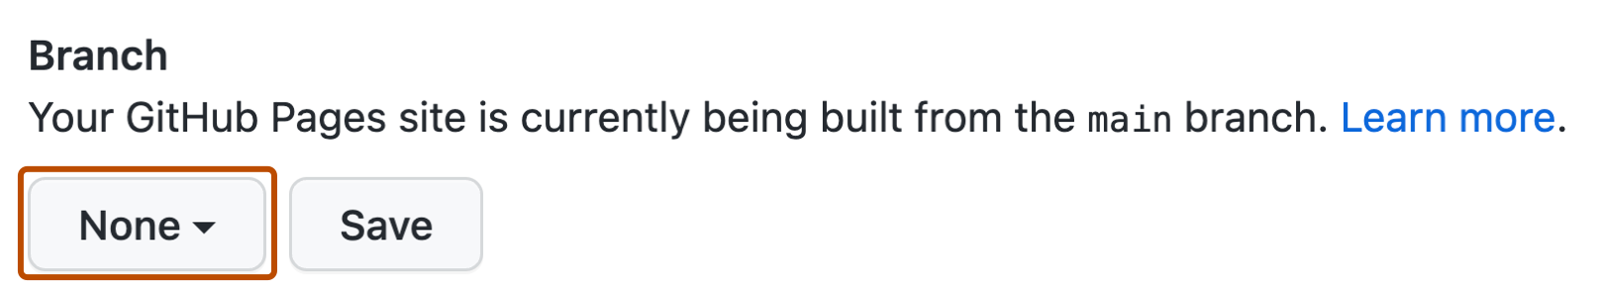
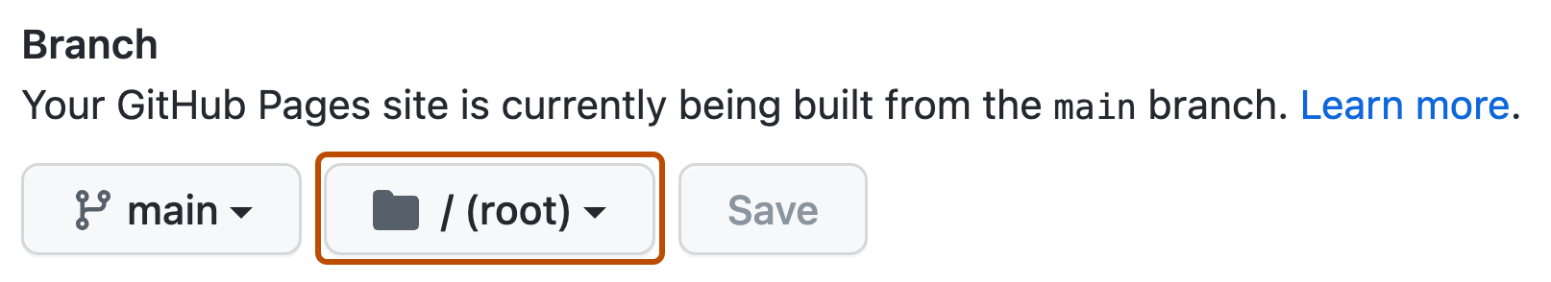
Deploy Pages
Under "Build and deployment", use the branch dropdown menu and select a publishing source.
Optionally, use the folder dropdown menu to select a folder for your publishing source.
Click “Save”
URL will be published in the Pages which can be used to access the website (May take 5 mins)

Slide 35
Quiz

Slide 36
Question 1
What is the best way to report a bug to a GitHub project?
Send an email to a project owner.
I don't bother reporting software bugs because there's no transparency and they never get fixed anyway.
Search for the bug in the project's existing issues and create a new one if it hasn't been reported yet.
Notes:
Explanation: A project's issues are visible to anyone who has access to the project, so you may find a resolution is already planned or available. Otherwise, you can create and track the issue yourself.

Slide 37
Question 1
What is the best way to report a bug to a GitHub project?
Send an email to a project owner.
I don't bother reporting software bugs because there's no transparency and they never get fixed anyway.
Search for the bug in the project's existing issues and create a new one if it hasn't been reported yet.
Notes:
Explanation: A project's issues are visible to anyone who has access to the project, so you may find a resolution is already planned or available. Otherwise, you can create and track the issue yourself.

Slide 38
Question 2
Suppose you have created a bug fix on a new branch and want it to become part of the next production build generated from the `main` branch. What should you do next?
Copy your branch changes and commit them directly to the `main` branch.
Create a pull request to merge your new branch into the `main` branch.
On second thought, maybe I won't share this fix. I'll just put it in my own private version of the source code.
Notes:
Explanation: Pull requests are the correct way to communicate that commits are ready for review and ultimate inclusion on the `main` branch.

Slide 39
Question 2
Suppose you have created a bug fix on a new branch and want it to become part of the next production build generated from the `main` branch. What should you do next?
Copy your branch changes and commit them directly to the `main` branch.
Create a pull request to merge your new branch into the `main` branch.
On second thought, maybe I won't share this fix. I'll just put it in my own private version of the source code.
Notes:
Explanation: Pull requests are the correct way to communicate that commits are ready for review and ultimate inclusion on the `main` branch.

Slide 40
Question 3
Suppose you'd like to work with a project on GitHub but you don't have write access to the project. What can you do to contribute?
Fork the project's repository to your GitHub account, clone the forked repository to your local machine, push changes to your repository, and submit a pull request to the target (upstream) repository.
Clone the project to your local machine and push updates directly to the project repository.
Use git commands to make a copy of the project so that you can work locally. Submit an issue to get your changes into the target repository.
Notes:
Explanation: GitHub provides forking functionality designed to allow you to work with projects where you aren't an owner or don't have write access. Forking makes a remote copy of the project in your repository that you can then clone locally. To submit updates to the target repository (upstream repository) you can submit a pull request.

Slide 41
Question 3
Suppose you'd like to work with a project on GitHub but you don't have write access to the project. What can you do to contribute?
Fork the project's repository to your GitHub account, clone the forked repository to your local machine, push changes to your repository, and submit a pull request to the target (upstream) repository.
Clone the project to your local machine and push updates directly to the project repository.
Use git commands to make a copy of the project so that you can work locally. Submit an issue to get your changes into the target repository.
Notes:
Explanation: GitHub provides forking functionality designed to allow you to work with projects where you aren't an owner or don't have write access. Forking makes a remote copy of the project in your repository that you can then clone locally. To submit updates to the target repository (upstream repository) you can submit a pull request.

Slide 42
Summary

Slide 43
Summary
In this module, you learned about the key features of GitHub and how to use it with GitHub.dev, including commits, branches, and pull requests.
Notes:
In this module, you learned about the key features of GitHub, including issues, commits, and pull requests. You also used GitHub Pages to publish a public site based on the contents of your project.
You learned about:
Communicating with the project community in issues
Managing notifications for project events
Creating branches to manage work in parallel
Making commits to update project source
Introducing changes with pull requests
Deploying a web page to GitHub Pages
Differences between Git and GitHub and the roles they play in the software development lifecycle
How a repository fork differs from a clone
Repository labels and where to apply them in issues and pull requests
Now that you're familiar with the basics of GitHub, learn to Upload your project by using GitHub best practices.

Slide 44
Learn more
Here are some links to more information on the topics we discussed in this module.
Setting up and managing organizations and teams
Committing changes to your project
Collaborating with issues and pull requests
About the role of labels
GitHub Actions
Fork a repo
Working with GitHub Pages
Please tell us how you liked this workshop by filling out this survey:
https://aka.ms/workshopomatic-feedback
Notes:
Here are some links to more information on the topics we discussed in this module.
Setting up and managing organizations and teams
Committing changes to your project
Collaborating with issues and pull requests
About the role of labels
GitHub Actions
Fork a repo
Working with GitHub Pages

