Slide 1
Project-1
Mid-Term Evaluation
Team Members: Aditya Gupta - 2021702002 Srayan Sankar Chatterjee - 2021702008 Arpit Sahni - 2021702009 Mohammad Waqas Wani - 2021702018

Slide 2
Steps taken to complete the project:
Part-1: In Part 1 of the project, we made the 24 (6 sizes & 4 types of topologies) matrices in the form of text files for NMOS_ON, NMOS_OFF, PMOS_ON & PMOS_OFF case.
Creation of NETLIST for AND GATE, XOR GATE & FULL 2x2 MULTIPLIER circuit Extraction of Node voltages as per our requirements for different widths.
Part-2: In Part 2 of the project, by referring to Sir’s VHDL files for AND GATE, FULL ADDER & SINGLE NMOS LEAKAGE model, we constructed our own Python file which does the following tasks:
Extraction of data from text (.txt) files created in Part-1 to LIST data type in Python
Node voltages for AND & XOR GATE for all 6 different Widths (1µm, 2µm, 3µm, 4µm, 6µm, 8µm) are hardcoded into a list in Python. These values we got by running NGSpice files for all the combinations
Contains the function for calculation of Leakage current for AND, XOR GATES
Contains the logic function of the MULTIPLIER, which calculates the intermediate LOGIC LEVELs of the MULTIPLIER circuit.
Calculation of TOTAL LEAKAGE CURRENT of the MULTILPIER circuit, by addition of all the Leakage currents of individual GATES.

Slide 3
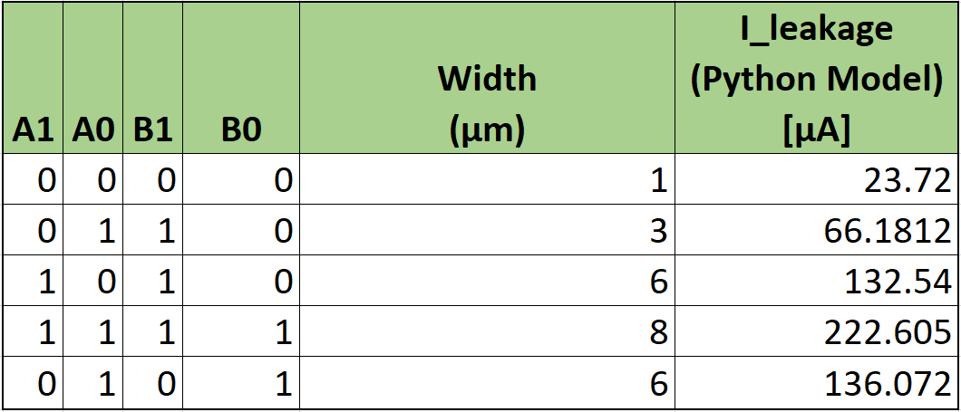
Leakage current values for some Random Input for different Mosfet Widths

Slide 4
Mid-Term Evaluation Progress presented on 8th March

Slide 5
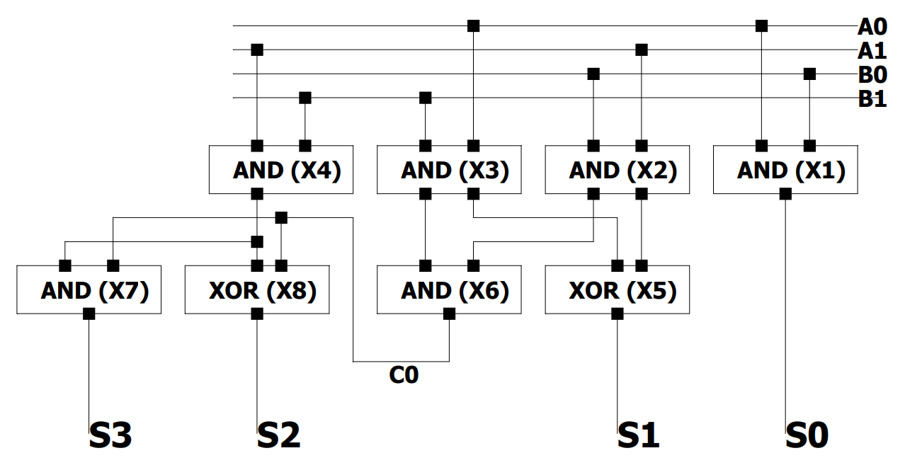
2x2 Multiplier
HALF-ADDER-2
HALF-ADDER-1

Slide 6
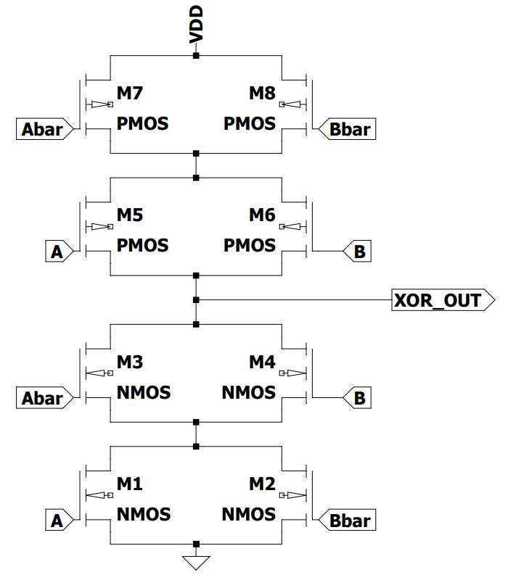
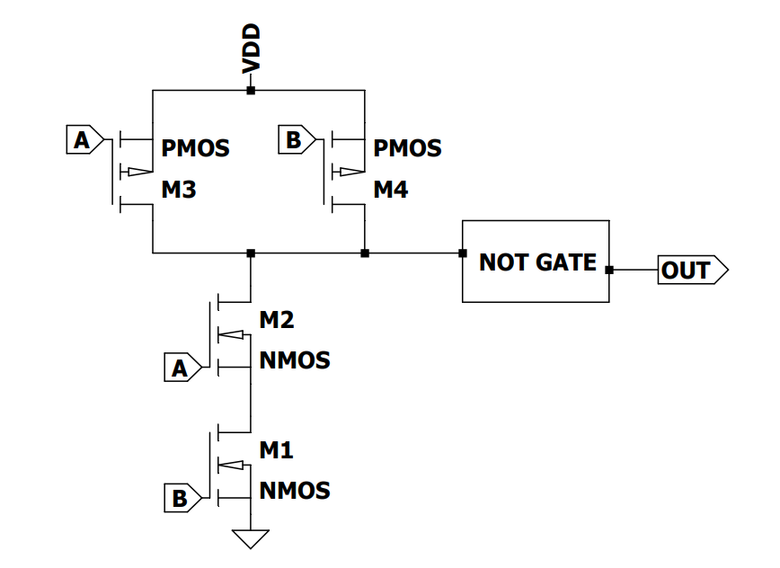
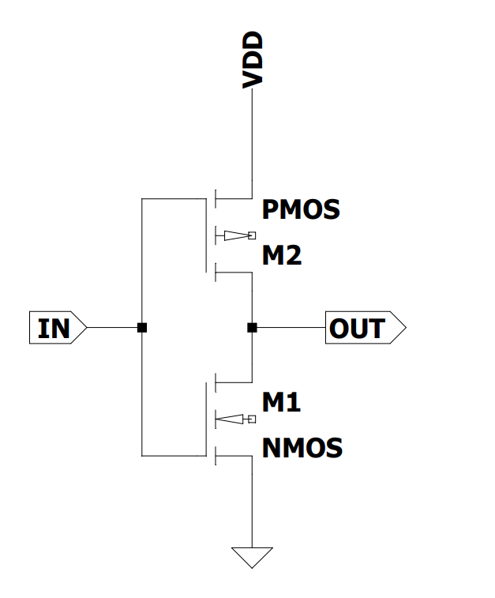
SUB-CIRCUITS (SCHEMATICS)
XOR GATE
AND GATE
NOT GATE

Slide 7
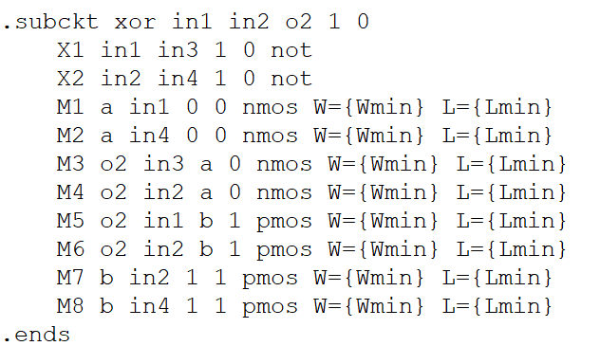
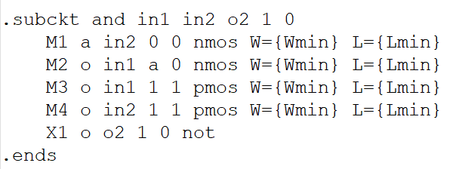
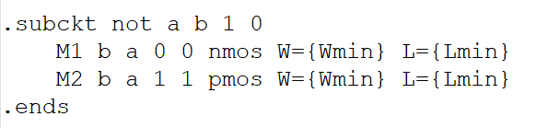
SUB-CIRCUITS (NETLIST)
XOR GATE
AND GATE
NOT GATE

