Slide 1
MISHMASH - ONLINE HACKATHON
Deep Tech / Machine Learning - Problem Statement 3 - Data Science POC Use Case
TEAM NAME : ALMA2020
Sai Suriya
Adithya UR
Venkatagiri Ramesh

Slide 2
PROBLEM STATEMENT
One of Unilever’s brands is going through some major changes in Business Execution plans and will like to know:
What are the major drivers for sales(EQ)?
Knowing the drivers, how can they predict future sales for the next 6 periods?
Dataset
Training_data.xlsx
Test_data.xlsx

Slide 3
TASK AND SOLUTION
The data regarding sales, are represented by factors involving sales and the value of sales.
The features are the factors involving sales and these factors are the most part of determining the mathematical relationship between features and sales values.
The machine learning algorithms are used to determine the best fitting mathematical relationship between features and the dependent value.
Sales Features
[Period, ……, RPI_Subcategory]
Sales Values
[Column Name : EQ]
Independent Variables
Dependent Variable
Mathematical Fit

Slide 4
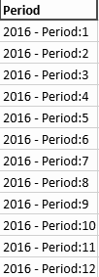
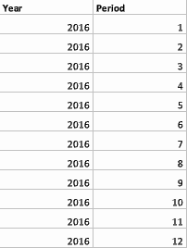
FEATURE ENHANCEMENT
The period column was converted from string type column to a categorical column of year and period as as an optimization of available features.
Original Feature
Enhanced Feature

Slide 5
MACHINE LEARNING
The data is trained initially trained in Microsoft Azure - Automated ML tool for comparison of the high performance models.
The best performing model is adapted to native python for metrics visualization and analysis.
Azure Automated ML Tool
Fit all possible models
Evaluate models for the highest performance metrics
Export the best model
Data
Local deployment of ML model
Metrics Analysis and Data Visualization

Slide 6
DEVELOPMENT TOOLS
The following are the tools used for development of project,
Microsoft Azure - Machine Learning Tools
Python
Scikit-learn - Machine Learning Tools
Flask
Jinja 2 (Template Language)

Slide 7
MACHINE LEARNING - METRICS
Best Performing Algorithm | Voting Ensemble | Normalized mean absolute error | 0.016218
Validation Accuracy | 0.9873 | Normalized median absolute error | 0.0062827
Variance | 0.99067 | Normalized root mean squared error | 0.023920
Mean absolute error | 6.7325 | Normalized root mean squared log error | 0.021287
Mean absolute percentage error | 2.1372 | Root mean squared error | 9.9296
Mean absolute error | 2.6080 | Training size | 39

Slide 8
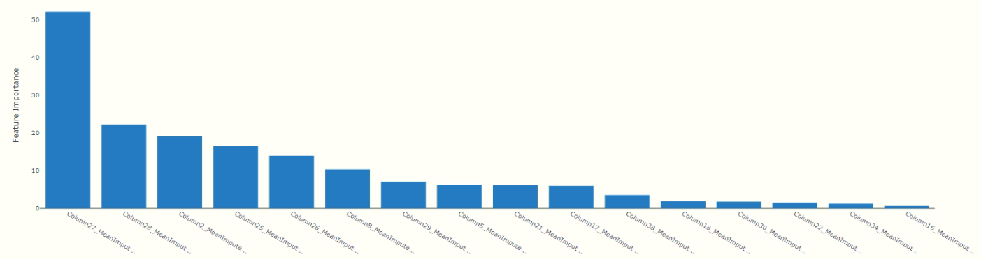
MAJOR FACTORS OF SALES
The following are the list of major driving factors of sales (ordered according to importance of factors),
1. pct_ACV | 5. Est_ACV_Selling | 9. Avg_EQ_Price | 13. RPI_Category
2. Avg_n0_of_Items | 6. Print_Impressions.Ads40 | 10. Fuel_Price | 14. Any_Promo_pct_ACV
3. Period | 7. pct_PromoMarketDollars_Category | 11. EQ_Subcategory | 15. Competitor2_RPI
4. EQ_Base_Price | 8. Social_Search_Working_cost | 12. Inflation | 16. Median_Rainfall

Slide 9
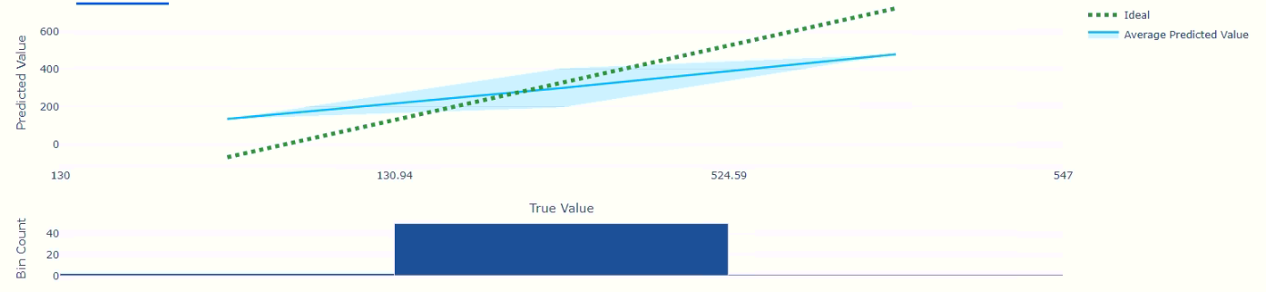
METRICS VISUALIZATION

Slide 10
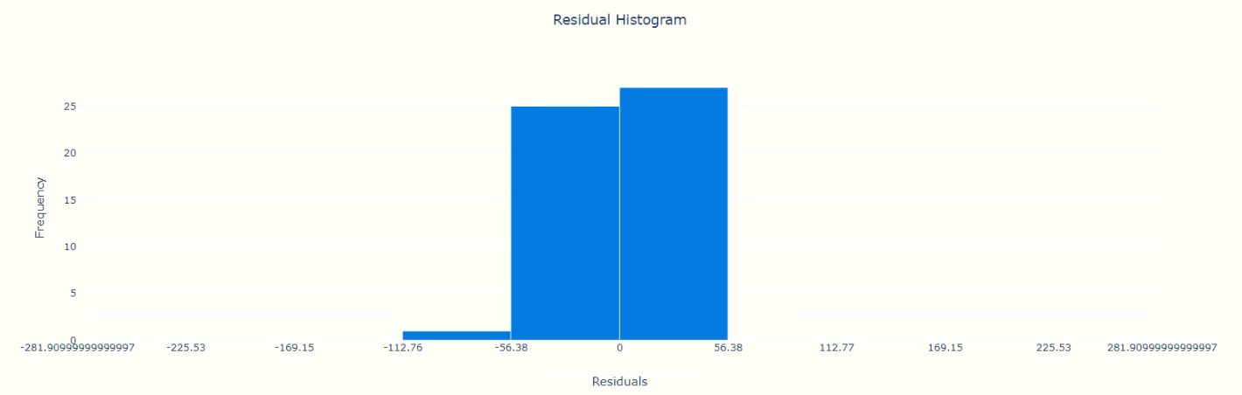
METRICS VISUALIZATION

Slide 11
MODEL DEPLOYMENT
Input Data
Input Data
FRONTEND
Javascript
FLASK
BACKEND
Python
Output Data
Output Data
Cloud Storage Infrastructure
Machine Learning Model
[Voting Ensemble]

Slide 12

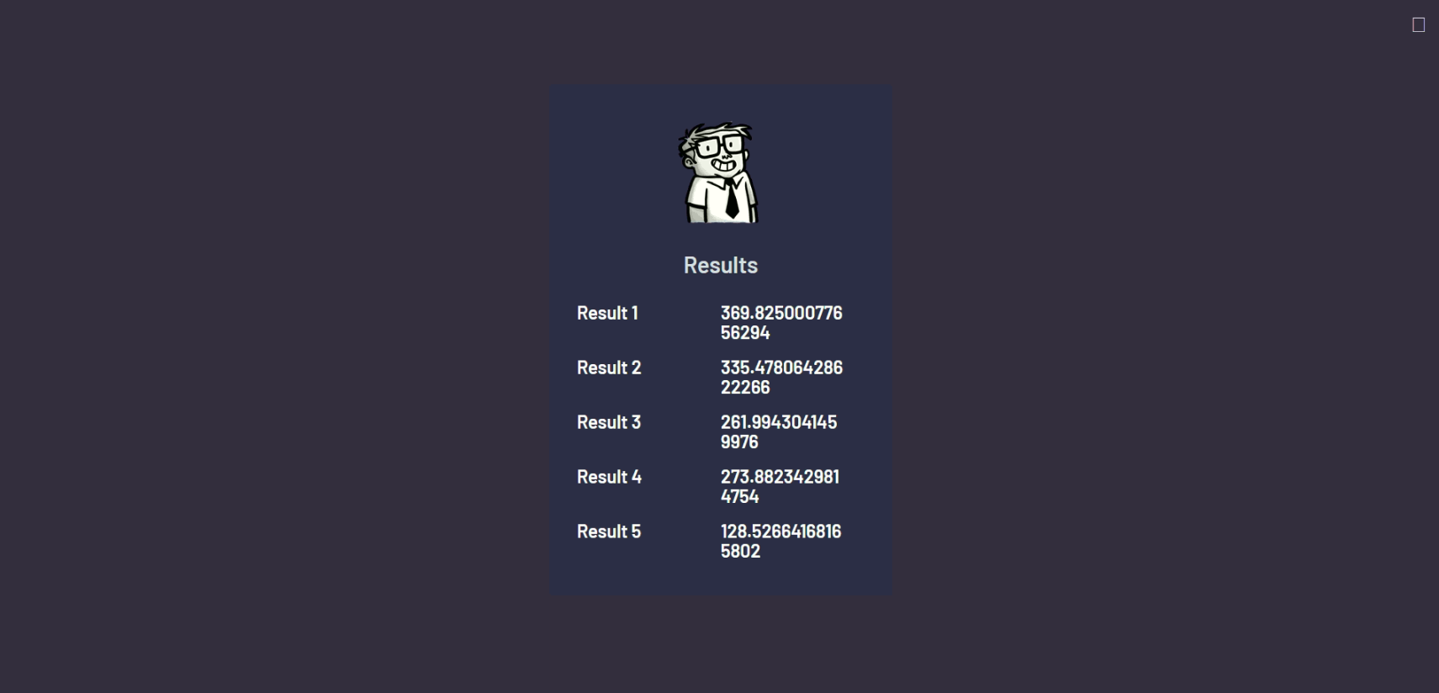
MODEL DEPLOYMENT
Tool Input
Tool Output

Slide 13
Thank You
For Your Attention !
The tool implements a Machine-Learning model of voting ensemble with accuracy of 98.7% and MAPE of 2.1372.

