Slide 1
⚡ Quantum AI-based Electricity
Demand Forecasting System
Hybrid Variational Quantum Circuit (VQC) vs Linear Regression
Adithya Varman Nandhivarman
Course: 23CSE304 • Quantum Computing Capstone Project

Slide 2
Problem Statement
Accurate short-term electricity demand forecasting is critical for grid stability and cost optimization.
Classical models (e.g., Linear Regression) are fast but may miss complex nonlinear patterns.
Can hybrid quantum-classical machine learning models improve forecasting accuracy?
This project investigates a Variational Quantum Circuit (VQC) for hourly electricity demand prediction.
Dataset: AEP hourly electricity consumption from PJM Interconnection (Kaggle).

Slide 3
Objectives
Build a hybrid quantum-classical regression model using PennyLane's Variational Quantum Circuit.
Compare VQC performance against a classical Linear Regression baseline.
Evaluate using MAE, RMSE, and R² on real-world hourly electricity demand data.
Deploy an interactive Streamlit web app for live predictions and result visualization.
Provide honest analysis: report whether quantum advantage is observed at this scale.

Slide 4
Proposed Algorithm: Hybrid VQC Regressor
Step 1: Create 4 lag features from hourly demand (t-4, t-3, t-2, t-1) → predict t.
Step 2: Scale features to [0,1] and target to [-1,1] (MinMaxScaler, fit on train only).
Step 3: Encode inputs via AngleEmbedding (RX gates, angle = π × x) on 4 qubits.
Step 4: Apply StronglyEntanglingLayers (2 layers, 24 params: Rot + CNOT entanglement).
Step 5: Measure ⟨Z₀⟩ as output, optimize MSE loss with Adam (lr=0.05, 80 epochs).

Slide 5
Proposed Algorithm: Pseudocode
1. Load AEP_hourly.csv, sort by Datetime, take first 1500 rows
2. Create lag matrix X[i] = [demand[i-4], ..., demand[i-1]], y[i] = demand[i]
3. Split 80/20 chronologically → X_train, X_test, y_train, y_test
4. Fit MinMaxScaler on train; transform both train and test
5. Initialize VQC weights θ ~ Uniform(0, 2π), shape = (2, 4, 3)
6. FOR epoch = 1 to 80:
loss = MSE( VQC(X_train, θ), y_train )
θ ← Adam_update(θ, ∇loss) # backprop on simulator
7. Evaluate VQC and Linear Regression on test set in original MW units

Slide 6
Algorithm Complexity
Time Complexity (Simulator): O(E × n × L × N × 2ⁿ)
E=80 epochs, n=4 qubits, L=2 layers, N=1196 samples, 2ⁿ=16 statevector
Space Complexity: O(2ⁿ + N×n + n×L) = O(16 + 1196×4 + 4×2)
On real quantum hardware, gradients use the parameter-shift rule (2 circuit evaluations per parameter per gradient).
This project uses backpropagation on the PennyLane default.qubit simulator for speed.

Slide 7
Implementation
Language: Python 3.14 | Quantum Framework: PennyLane 0.45
Libraries: NumPy, Pandas, scikit-learn, Matplotlib, Streamlit, Joblib
Simulator: default.qubit (statevector, diff_method='backprop')
Web App: Streamlit with 3 tabs (Predict, Results, Circuit)
@qml.qnode(dev, interface='autograd', diff_method='backprop')
def vqc(x, weights):
qml.AngleEmbedding(π*x, wires=range(4), rotation='X')
qml.StronglyEntanglingLayers(weights, wires=range(4))
return qml.expval(qml.PauliZ(0))

Slide 8
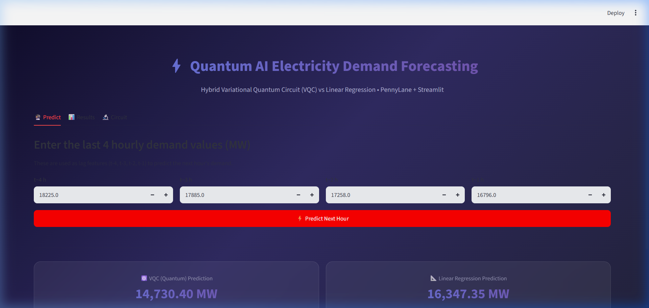
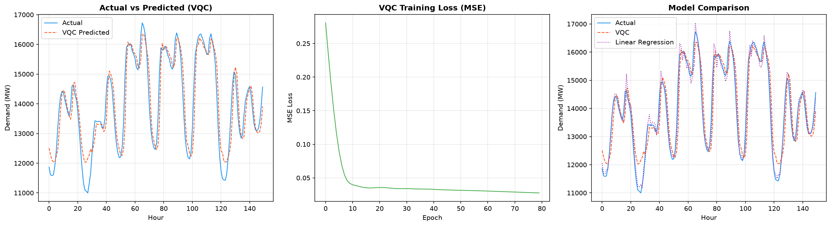
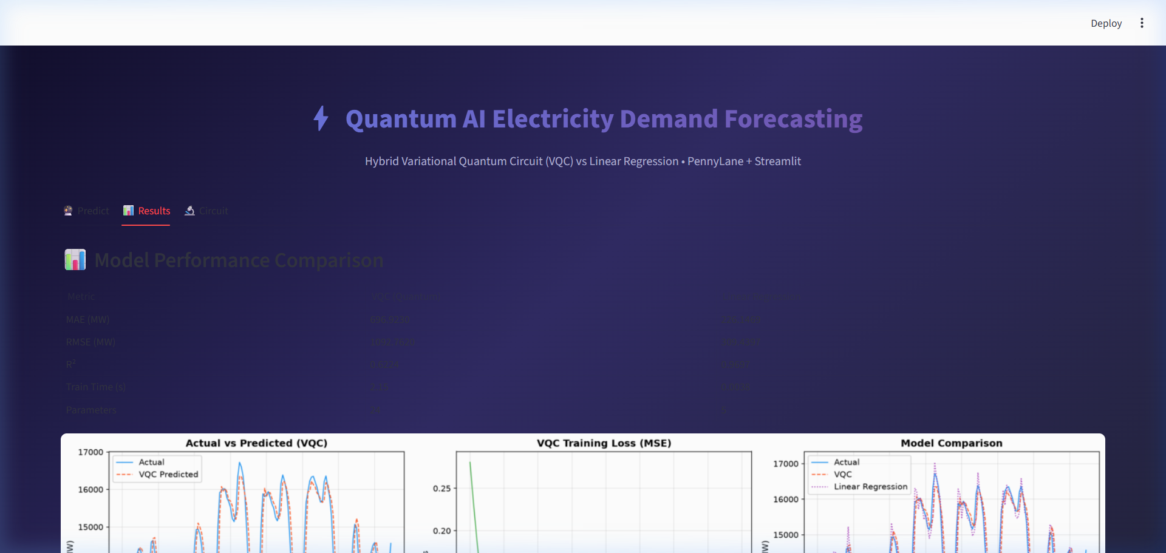
Results and Analysis
Metric VQC (Quantum) Linear Regression
──────────────────────────────────────────────────────
MAE (MW) 696.9230 226.1469
RMSE (MW) 1092.7620 309.4397
R² 0.6224 0.9697
Train time (s) 2.15 0.0038
Parameters 24 5

Slide 9
Conclusion
Linear Regression achieves R² = 0.9697, significantly outperforming VQC (R² = 0.6224).
This is expected: with only 4 qubits, 24 parameters, and mostly linear data, the VQC cannot capture the full pattern.
The VQC's expressivity is limited by the small Hilbert space (2⁴ = 16 dimensions) on a classical simulator.
No quantum advantage is claimed. On real hardware, noise and decoherence would further degrade performance.
Value: This project demonstrates a working hybrid quantum-classical ML pipeline, ready for scaling when hardware matures.

Slide 10
Thank You
Adithya Varman Nandhivarman • 23CSE304
Quantum AI-based Electricity Demand Forecasting
References:
• PennyLane Documentation — https://docs.pennylane.ai
• AEP Hourly Dataset — Kaggle (PJM Interconnection)

