Slide 1
CZ2006 Software Engineering
Prem Adithya Suresh
Tollar Vojtech
Chua Peng Hong
Lin Chien Yeh
Wu Ting Yu

Slide 2
HAWKERE (Hawker + Here)

Slide 3
Target Audience

Slide 4
Features
View hawker centres nearby sorted by distance
Search for hawker centres by name or address
View details of every hawker centre
Upload ratings/reviews for hawker centres
Upload photos for hawker centres
Share hawker centre details with other users

Slide 5
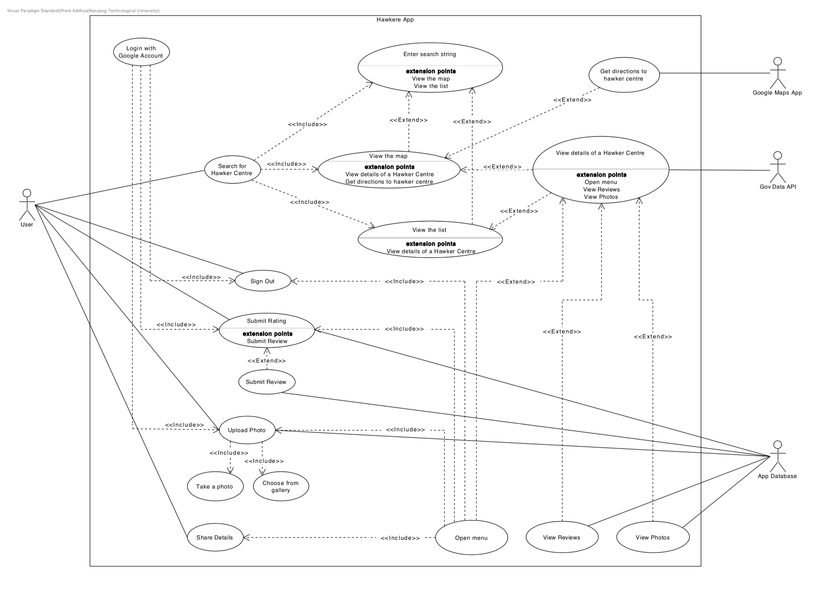

Slide 7
Design

Slide 8
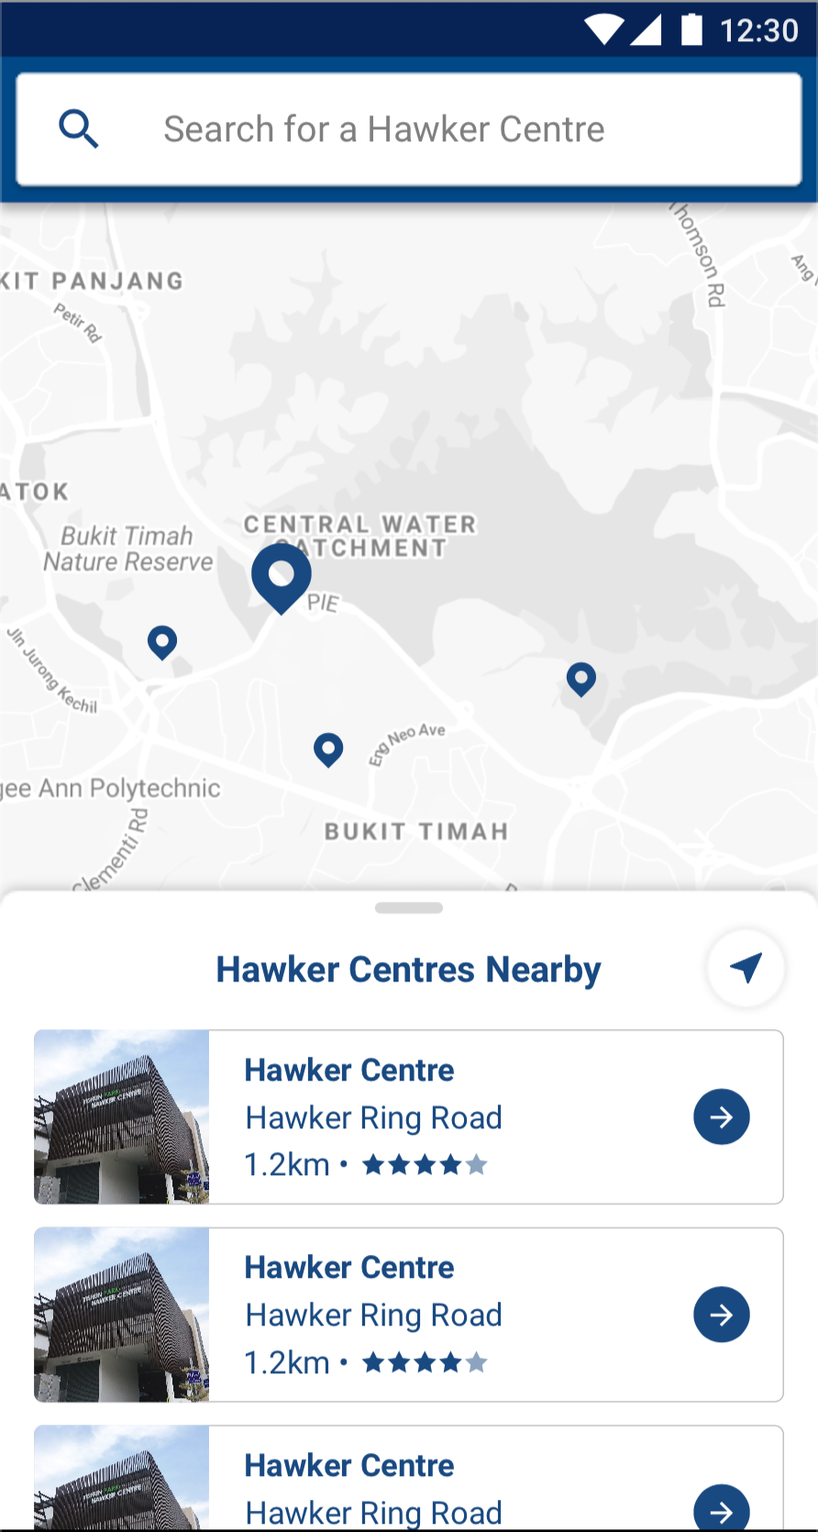

Slide 9
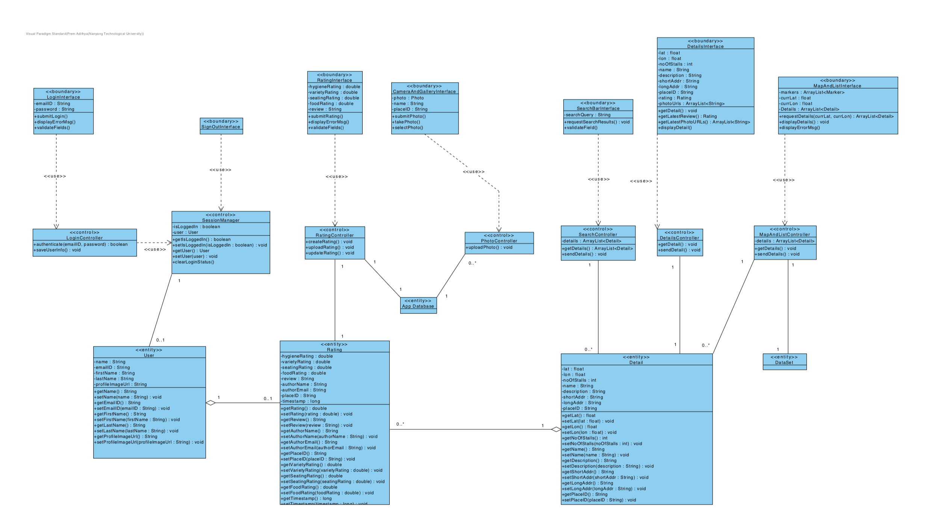

Slide 10
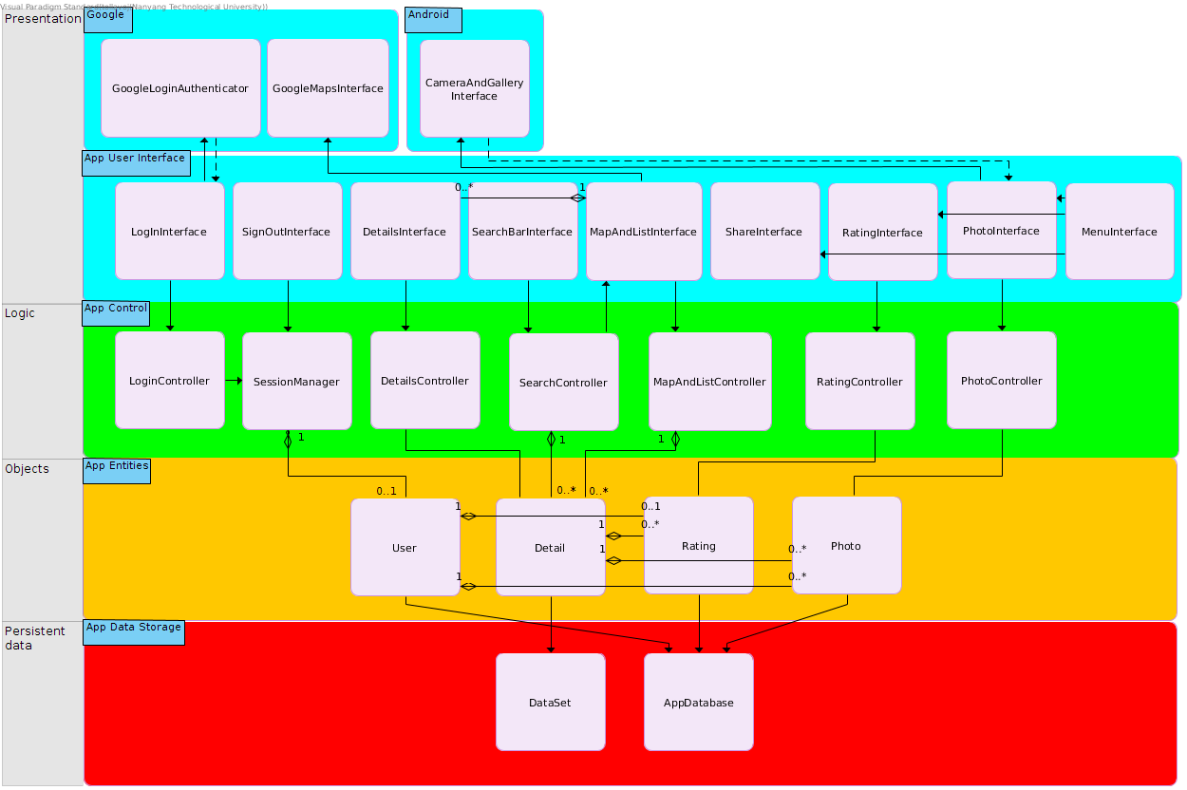

Slide 11
System Design Principles
4-Layered architecture
Loose coupling
Easy upgradeability
Modular

Slide 12
UI/UX Design Principles
Scrollable Bottom Sheets design similar to the implementation by Google Maps
Material Design throughout the app
Shneiderman’s Golden Rules

Slide 13
Testing

Slide 14
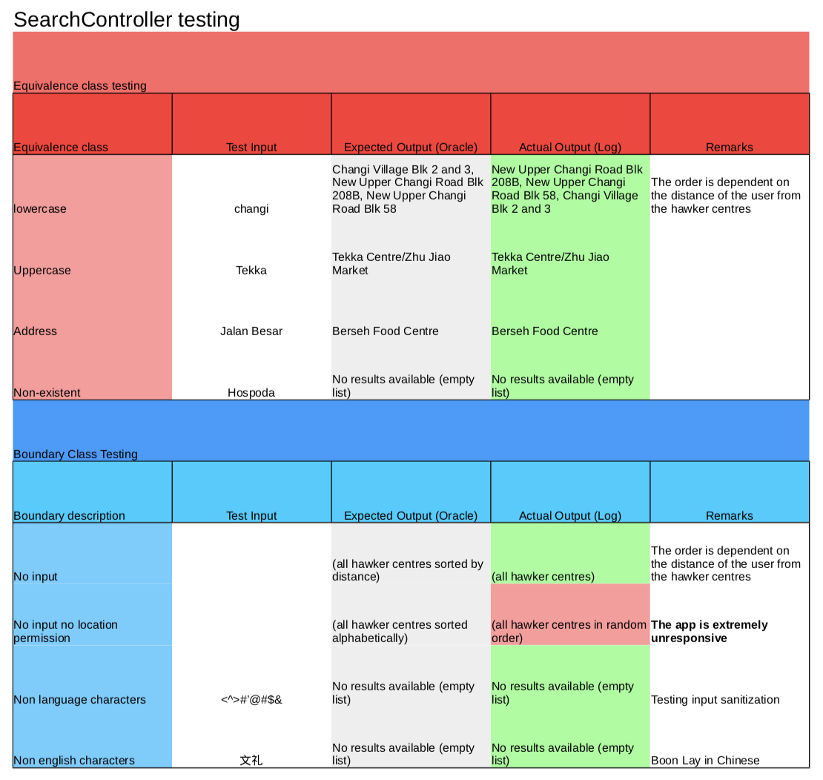
Blackbox Testing

Slide 15
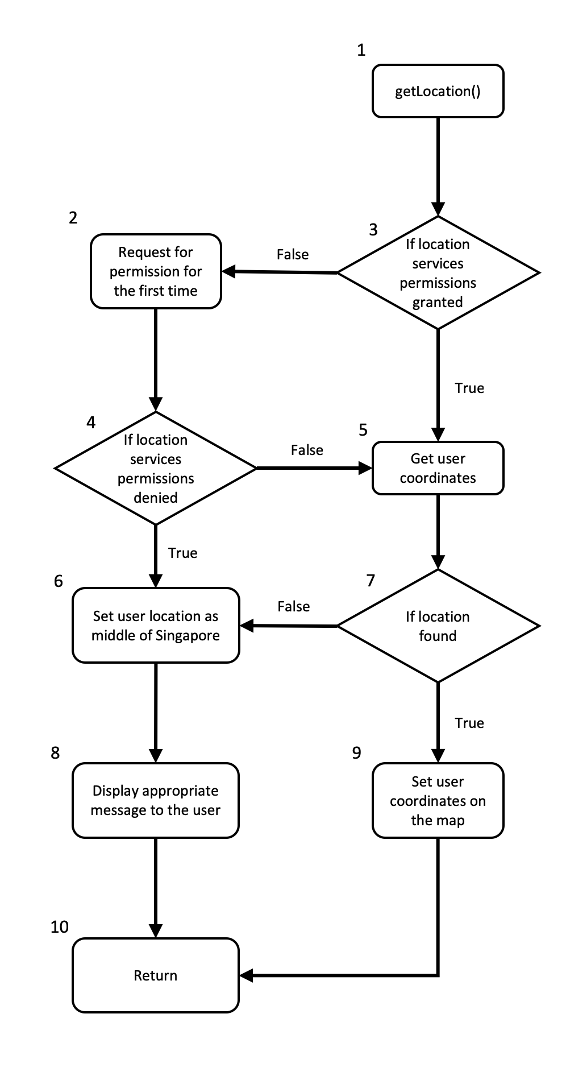
Whitebox Testing

Slide 16
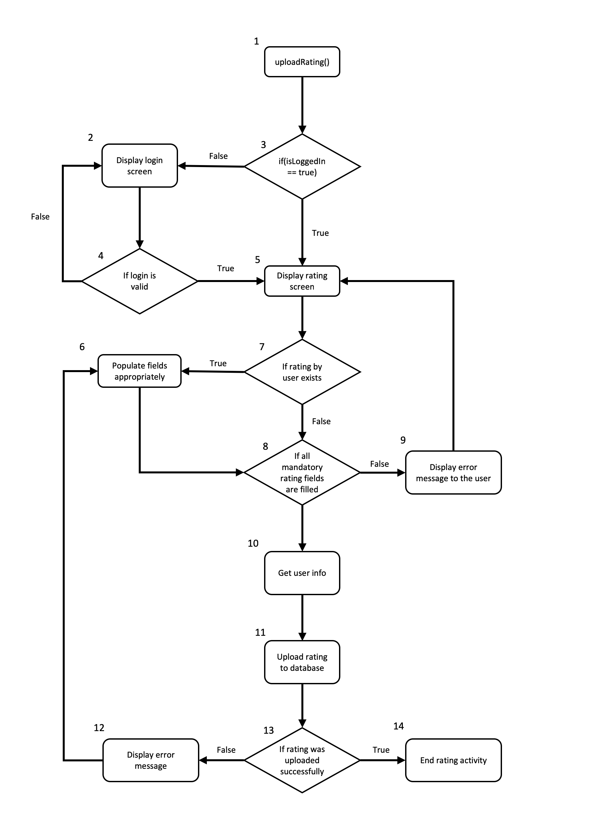
Whitebox Testing

Slide 17
Future Recommendations
Add support for restaurants
Add native support for operating hours
Add crowd density detection
Add stall information for hawker centres
Devise machine learning algorithms to provide users with customised suggestions after support for restaurants is added

Slide 18

Thank You

