Slide 1


NIVARA (നിവാര / निवारा)
Autonomous Civic Intelligence & Closed‑Loop Municipal Accountability Network
Transforming everyday smartphones into passive, autonomous civic watchdogs that collect tamper‑resistant photographic proof and contextual telemetry. Core philosophy: "Your City. Your Proof. Your Voice."
Team Nivara
Track
AppSprint 2026 · CivicTech Track · Production Release v1.0.65
Developed by Adithyan H
Core Tech
Flutter 3.x · Supabase PostgreSQL 15 + PostGIS
· NVIDIA NIM Llama‑3.2 Vision AI · Ola Maps Vector Engine
Bridging the broken trust loop between citizens and municipal authorities through passive sensor telemetry and tamper‑proof photographic proof.

Slide 2

Neighborhood Pulse — Live Metrics
Real‑time counts of hazards, repairs-in-progress and active crews. Sub‑2s spatial refresh via Geolocator.getServiceStatusStream() plus app lifecycle hooks — automatic reload on resume with no pull‑to‑refresh.
Feature highlight: "Zero Buffering Deadlocks · Sub‑2s Spatial Response · Hyperlocal Citizen Collaboration"
Ola Maps Dark Vector Engine
High‑performance vector tiles, spatial clustering, custom category pins. Proximity discovery for hospitals, police, fire, public toilets, clean water, and transit. One‑tap SOS beacon with turn‑by‑turn routing to nearest help.
Community Board & Verified Polls
Crypto‑bound voting to prevent duplicate votes and a hyperlocal micro‑task board for clean‑ups and volunteer drives.
GPS State Detection
Instant Reload
Zero Buffering
Detects disabled location services and presents a single‑tap settings action to re‑enable GPS.
Live stream subscription + lifecycle resume → data refresh under 2 seconds.
Resilient spatial pipeline eliminates deadlocks and stale tiles.

Slide 3
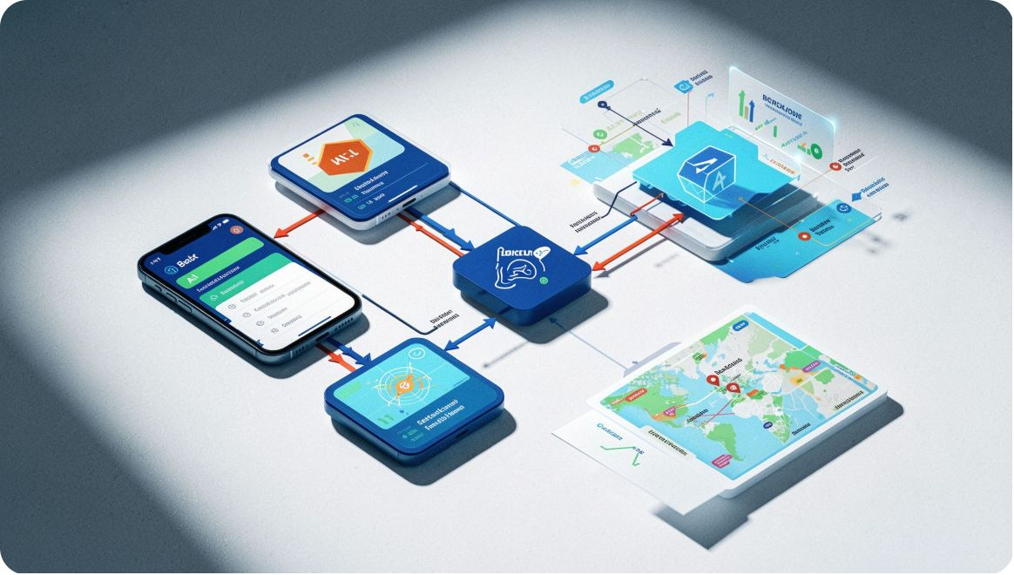
Technology Stack
Layer | Technologies | Purpose
Mobile Core | Flutter 3.x · Dart 3.12 · Riverpod 3.4.2 | 60fps native UI; reactive unidirectional state
Routing | GoRouter 17.4 | Declarative routing; role‑based guards
Backend & DB | Supabase · PostgreSQL 15 · PostGIS | Relational storage; spatial math; realtime websockets
Vision AI | NVIDIA NIM · Llama‑3.2 Vision | Zero‑shot hazard categorization
Maps & GIS | MapLibre GL · Ola Maps API | Custom dark vector styling; geocoding
Hardware | Geolocator · local_auth · Sensors Plus | 50Hz accelerometer, GPS, native biometrics
Security & Reliability
Quality gate: "Zero Dart Analyzer Warnings · 63/63 Automated Tests Passing · Fully Tree‑Shaken Release Build"
Hardware‑Backed Biometric Lock
Row‑Level Security (RLS)
Fingerprint and face unlock with device PIN fallback and lifecycle resume guards.
Strict PostgreSQL policies enforce least privilege per role (citizen, field worker, admin).
Atomic SECURITY DEFINER RPCs
Offline‑First Queue
Server‑side transactional integrity for claim handovers and status updates.
Disk‑backed cache with automatic flush and exponential backoff on reconnect.

Slide 4
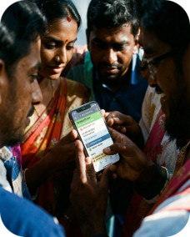
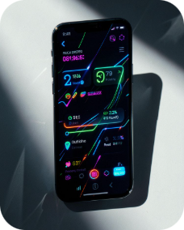
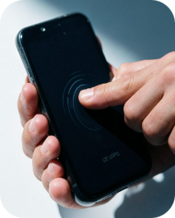
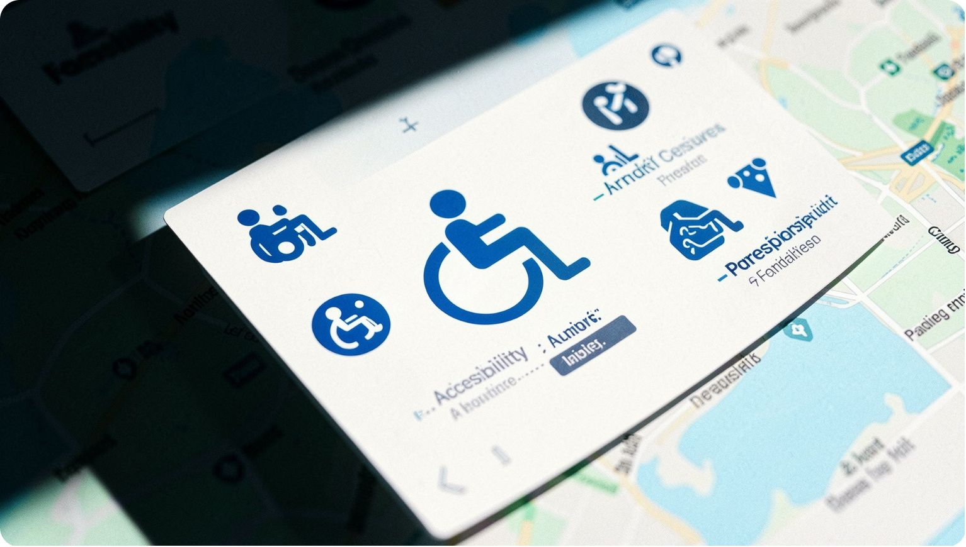

Accessibility, Taste & Human‑Centric Design
Tri‑lingual Experience
WCAG AAA Dark Glassmorphic Aesthetics
Natural Motion & Haptics
One‑tap switching between English, हिंदी (Hindi) and മലയാളം (Malayalam). Full localization across 19 civic categories; extended support for 22 scheduled languages with native typography.
Emil Kowalski spring dynamics: tactile haptics and physical scaling on tap for predictable, humane interactions.
Deep backgrounds with luminous accents ensure legibility in harsh daylight and night. Palette tuned for accessibility and brand: #84C1FA accent.
Screen Readers & TTS
Complete Semantics(...) metadata for every control, map layer and camera viewfinder. Built‑in TTS for emergency alerts and hazard updates. Fluid typography adapts to system scaling without clipping.
Design creed: "Accessible to the grandmother in rural Kerala, the commuter in Delhi, and the municipal worker in Bengaluru."

Slide 5
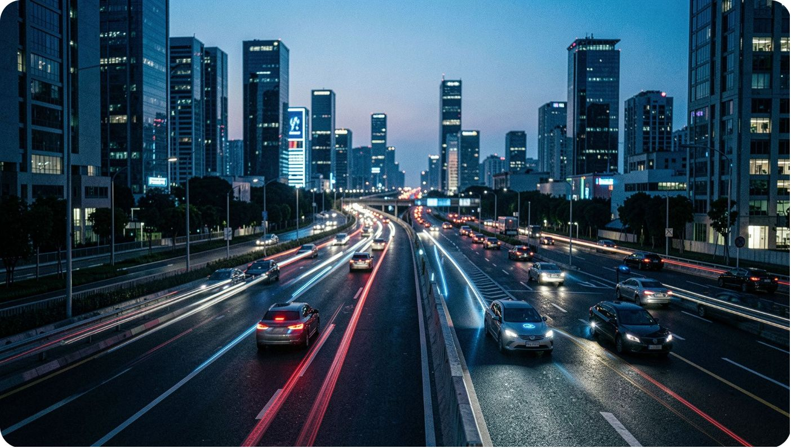
The Road Ahead
Real‑World Impact
Dashcam & Fleet Telemetry — integrate SensorWatch into public buses and delivery fleets for scale.
Municipal ERP Integration — direct API connectors to city bodies (BBMP, BMC, Smart City Mission).
Predictive Maintenance — AI forecasting to schedule repairs before potholes form.
Accident Prevention
Immutable After‑Repair Proof
Passive mapping of sinkholes and potholes before crashes occur — early detection from aggregated sensor telemetry and images.
100% of completed tickets include tamper‑resistant after‑repair photos and 3 citizen confirmations to prevent ghost closures.
Faster Municipal Response
Complaint filing time reduced from 5 minutes to essentially 0 seconds through passive capture and automated ingestion.
Deployment: Signed APK v1.0.65 available now; open codebase with documentation and schema migrations for rapid municipal pilots.

Slide 6
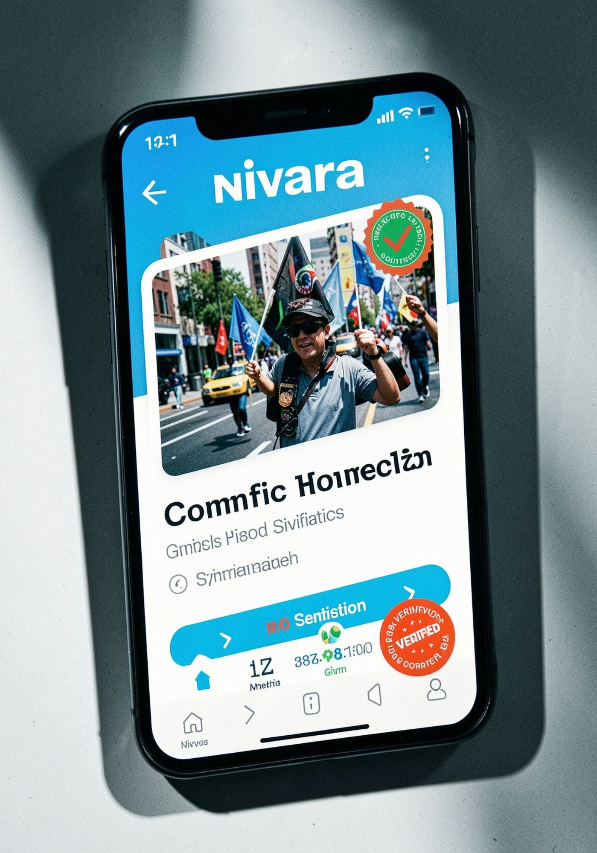
Conclusion & Next Steps
Nivara converts passive commuters into active city guardians by combining secure telemetry, vision AI, and tamper‑resistant proofing. Ready for municipal pilots and fleet integrations — production APK and source available.
GitHub
github.com/adithyen/Nivara-AppSprint-2026
APK
github.com/adithyen/Nivara-AppSprint-2026/releases/tag/v1.0.65
Contact
Adithyan H · Team Nivara · AppSprint 2026
Closing thought: "Nivara transforms passive commuters into active city guardians. Your City. Your Proof. Your Voice."

