Slide 1


APPSPRINT 2026 · CIVICTECH TRACK
PRODUCTION V1.0.65
NIVARA നിവാര / निवार
Autonomous Civic Intelligence & Closed‑Loop Municipal Accountability Network
Transforming everyday smartphones into passive, autonomous civic watchdogs that collect tamper‑resistant photographic proof and contextual telemetry. Core philosophy: "Your City. Your Proof. Your Voice."
Team Nivara
Track
AppSprint 2026 · CivicTech Track · Production Release v1.0.65
Developed by Adithyan H
Core Tech
Flutter 3.x · Supabase PostgreSQL 15 + PostGIS
· NVIDIA NIM Llama‑3.2 Vision AI · Ola Maps Vector Engine
Bridging the broken trust loop between citizens and municipal authorities through passive sensor telemetry and tamper‑proof photographic proof.

Slide 2
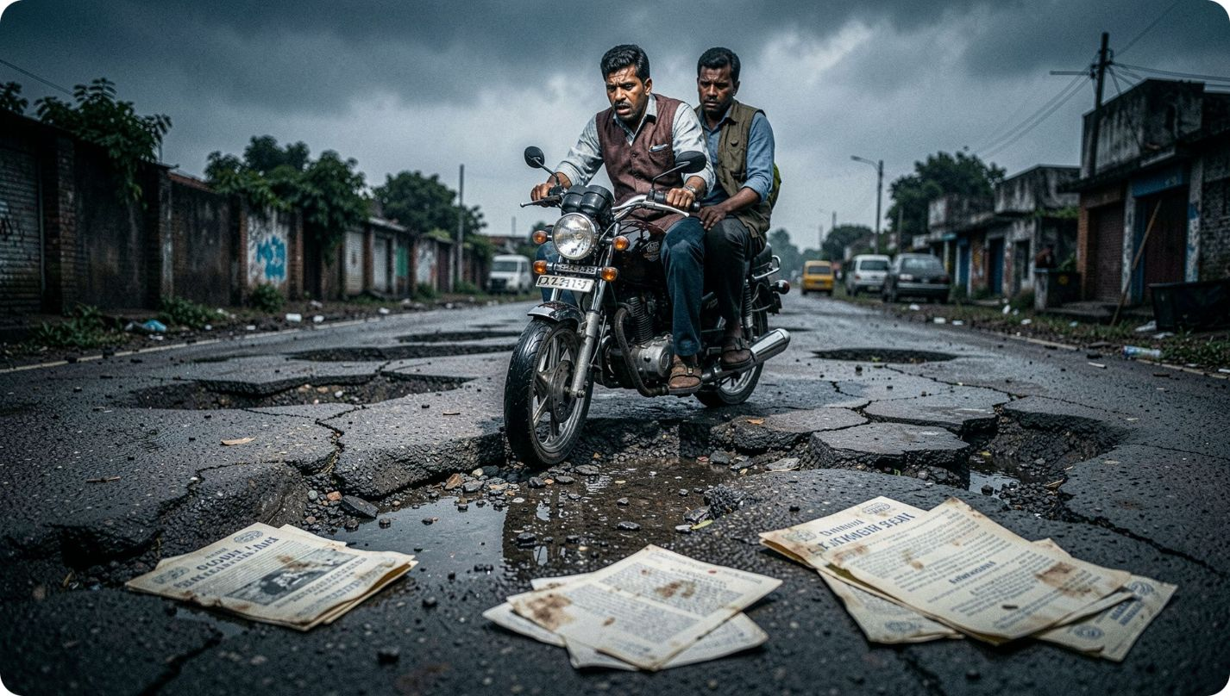

The Broken Urban Feedback Loop
Why Traditional Municipal Grievance Portals Fail Citizens Daily
Road Fatalities
Over 3,500 lives lost annually in India due to road potholes alone.
Bureaucratic Black Hole
78% of municipal complaints are unresolved or prematurely marked "closed" without physical proof.
Effort Burden
Complex reporting flows cause citizen apathy — most hazards go unreported.
Language & Tech Barrier
Identity Fraud Crisis
English-heavy forms digitally exclude millions of regional language speakers.
Lost credentials (Aadhaar, PAN, licenses) face weeks of delay and fraud risk.
3,500+ Annual Pothole Fatalities · 78% Unverified Closures · Zero Tamper-Proof Verification

Slide 3

Introducing Nivara: 3 Pillars of Civic Intelligence
A Frictionless, Verifiable, and Closed-Loop Civic Network
Pillar 1: SensorWatch
Pillar 2: Multilingual Voice AI
Runs silently in the background. High-frequency 50Hz accelerometer monitors road shocks (> 2.5g), automatically sealing an immutable SHA-256 cryptographic evidence package with GPS, speed, and waveform.
Instant spoken reporting in Malayalam, Hindi, and English. Continuous listening with live editable transcripts. Auto-extracts hazard categories, severity ratings, and landmarks.
Pillar 3: Closed-Loop Governance
Direct dispatch to certified municipal field crews by ward. Mandatory after-repair photographic proof required. 3 independent citizen votes needed before final case closure.
"Zero Friction for the Citizen · Tamper-Proof Truth for the Municipality · Certified Proof for the Community"

Slide 4
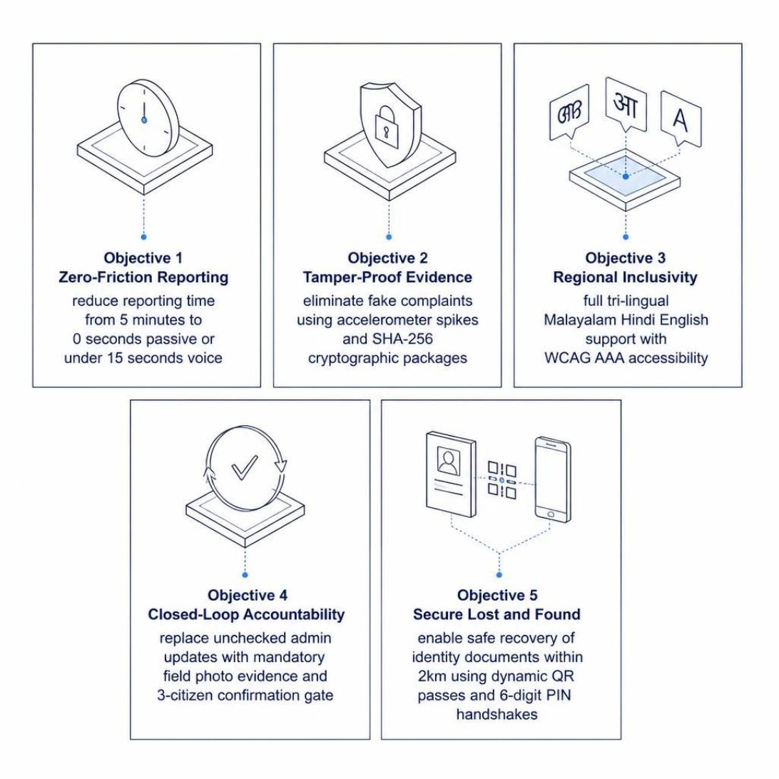
Project Objectives & Operational Scope
Measurable Goals Across Citizen, Municipal, and Community Tiers
Nivara's five objectives span the full civic lifecycle — from passive detection to community-certified resolution — serving everyday commuters, pedestrians, municipal admins, field crews, and local communities.
Zero-Friction Reporting
9
5 min → 90 sec (passive) or under 15 sec (voice)
Sensor-Backed Evidence
Hardware-fused accelerometer + SHA-256 crypto packages
Tri-Lingual Inclusivity
Malayalam, Hindi, English with WCAG AAA accessibility
Closed-Loop Accountability
Field photo proof + 3-citizen confirmation gate
Secure Lost & Found
2 km spatial window, dynamic QR + 6-digit PIN

Slide 5
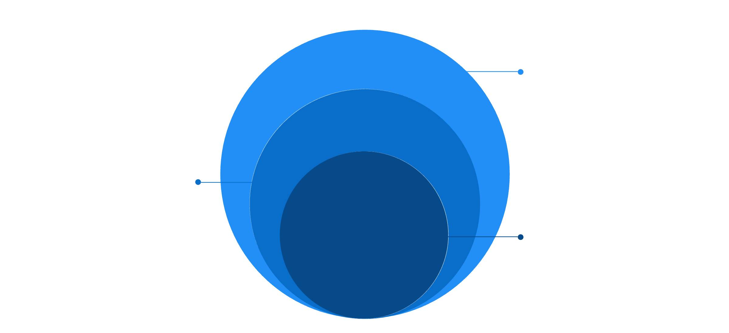
System Architecture & Data Pipelines
A 4-Tier Cloud & Edge Intelligence Topology
Cloud & External Intelligence
Supabase Postgres+PostGIS, RLS, NIM Llama-3.2 Vision
Edge AI & Telemetry
50Hz accel, gyro stabilization, speech-to-text
Core Mobile
Flutter 3.x, Riverpod 3.4.2, GoRouter 17.4
"Heavy compute on the edge, spatial queries in the cloud, offline-first fallback at all times."
Mobile Client
Edge AI Tier
Cloud Database
External Intelligence
Flutter 3.x · Riverpod 3.4.2 · GoRouter 17.4 · Haptic feedback
50Hz accelerometer · Gyro stabilization · Streaming speech buffers
Supabase + PostGIS · RLS policies · Realtime WebSocket channels
NVIDIA NIM Llama-3.2 Vision · Ola Maps vector tiles & geocoding

Slide 6
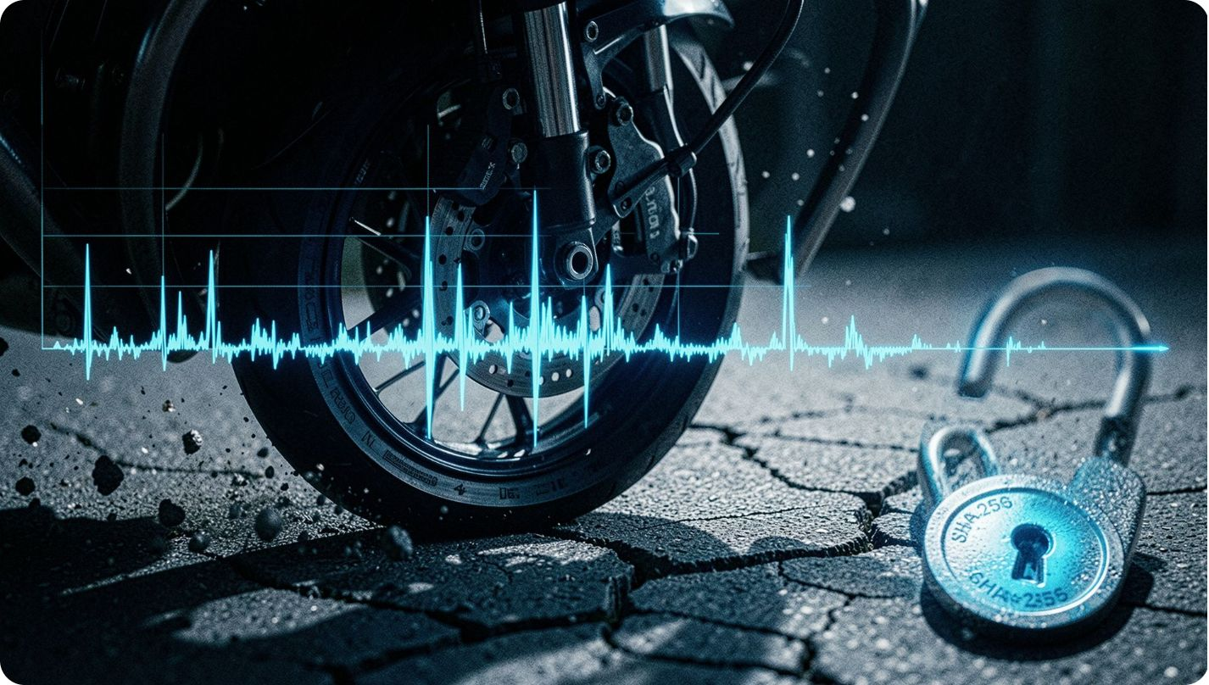

SensorWatch: Autonomous Road Hazard Telemetry
Converting Vehicle Shocks into Cryptographic Civic Evidence
Hardware-Fused Sensing
Samples userAccelerometerEventStream at 50Hz with gravity mathematically removed by hardware fusion.
Dynamic Shock Detection
Calculates 3D Euclidean magnitude. Triggers only when linear acceleration spike exceeds 2.5g.
Smart Noise Filters
GPS speed deadband (≥ 3 km/h), 1,500ms adaptive cooldown, and rolling baseline filter eliminate false positives.
Cryptographic Evidence Package
Auto-captures GPS, speed, timestamp, and peak waveform. Computes a deterministic SHA-256 hash stored in Supabase — preventing tampering or spoofing.

Slide 7
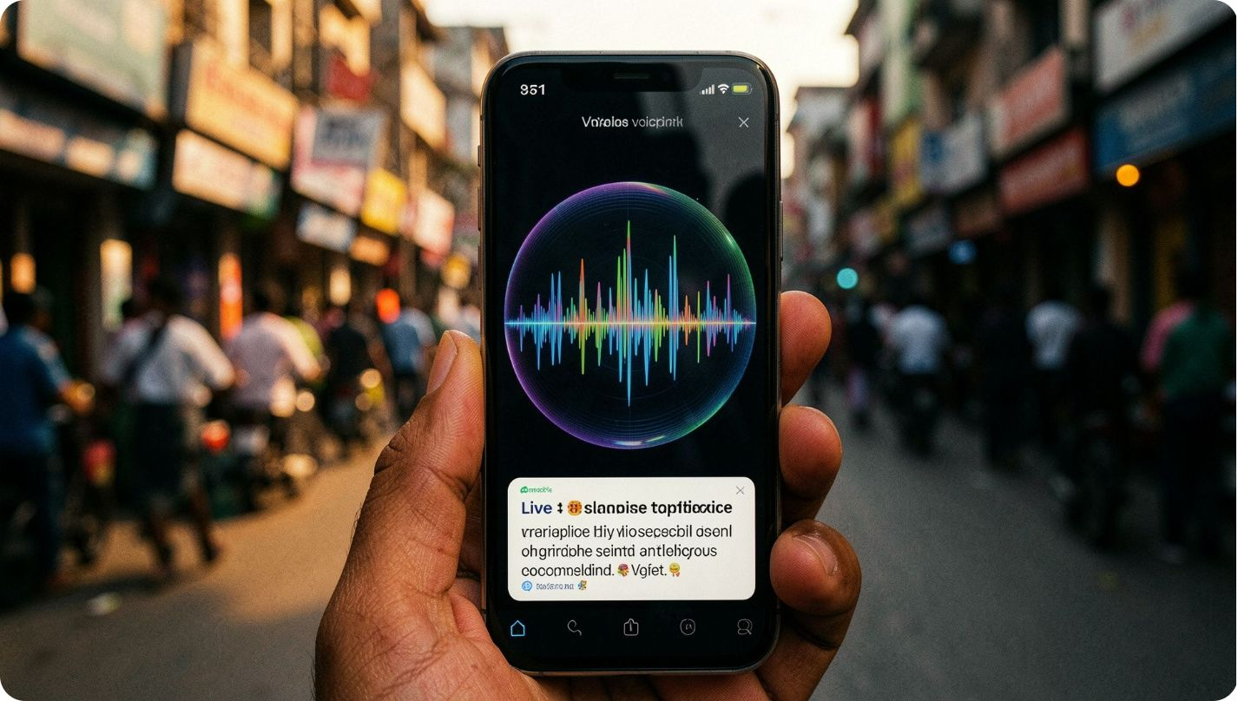
Multilingual Continuous Voice Reporting
Speaking to Your City Naturally in Malayalam, Hindi, and English
1
True Continuous Listening
Real-time waveform orb visualization. Allows pauses while thinking — no abrupt mic cutoffs.
2
Live Interactive Transcript
Spoken words appear instantly with direct cursor editing. Citizens can talk, edit, or dictate corrections seamlessly.
3
Automated Slot Extraction
Extracts civic category (19 types), severity rating (LOW → EMERGENCY), and landmarks (e.g. "near Pattom bridge").
4
Community & Lost/Found Controls
Contact sharing toggles, radius selector (5–50 km), and event/expiry date picker — all inside the voice sheet.
5
Mandatory Photo Proof Gate
Contextual prompt ensures physical evidence is attached before dispatch.
ENGLISH (EN-IN)
MALAYALAM (ML-IN)
HINDI (HI-IN)

Slide 8
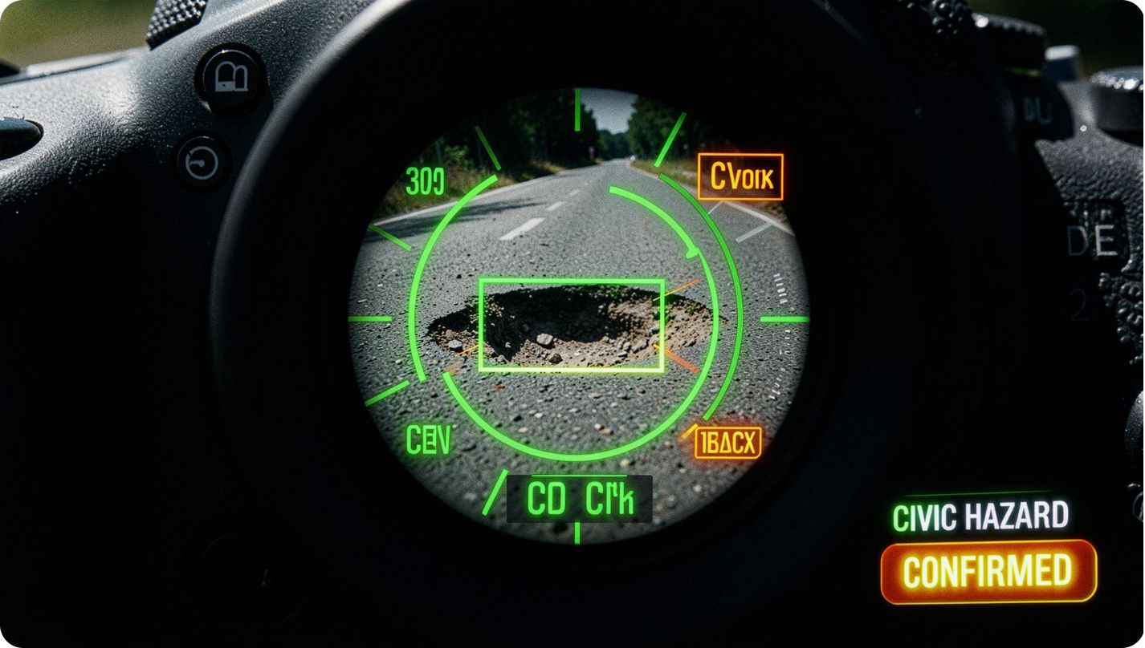
Steady-Lock Vision AI & Hazard Verification
Hardware Gyroscopic Stabilization Meets NVIDIA NIM Llama-3.2-11B
The Problem
Shaky, blurry citizen photos cannot be validated by field crews — undermining evidence integrity.
Hardware Gyro Steady-Lock Gate
Monitors gyroscope and accelerometer variance. Shutter unlocks only when physically steady for 600ms. Green HUD overlay confirms stability.
NVIDIA NIM Vision AI Inference
Leverages Meta Llama-3.2-11B Vision Instruct on NVIDIA NIM. Analyzes images in under 1.5 seconds, returning hazard category, bounding box, and confidence score.
Negative Hazard Detection Guard
Prevents bogus indoor submissions (desks, laptops, clean floors). Displays a polite rejection card rather than forcing a false classification.
"Hardware-stabilized shutter lock + Edge Vision Intelligence = Zero blurry photos, zero bogus tickets."

Slide 9
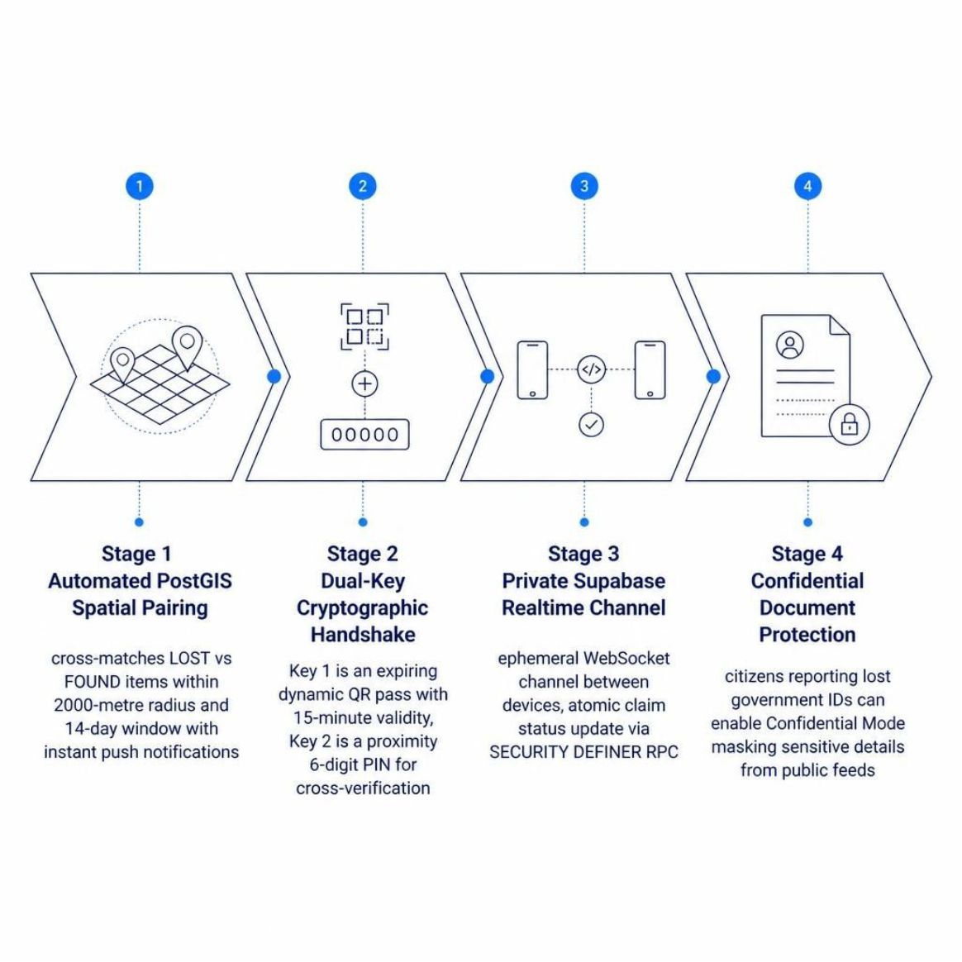

Proximity Lost & Found Network
PostGIS Spatial Matching & Cryptographic Dual-Key Handshakes
Nivara's Lost & Found network enables safe, fraud-resistant recovery of vital identity documents — Aadhaar, PAN cards, passports, and driving licenses — through spatial matching and cryptographic verification.
"No public identity leaks · No fraud claims · Mutual in-person cryptographic verification."
2 km Spatial Radius
Dynamic QR + 6-Digit PIN
Ephemeral WebSocket Channel
Confidential Mode
PostGIS continuously cross-matches LOST vs. FOUND reports within a 14-day window.
Two-factor cryptographic handshake prevents unauthorized claims and protects citizen safety.
Masks sensitive ID details from public feeds while enabling verified recovery.
Private handover:{claimId} channel atomically updates claim status via SECURITY DEFINER RPC.

Slide 10






Closed-Loop 3-Way Governance
From Citizen Detection to Field Repair and Community Certification
Stage 1: Detection
Stage 2: Triage & Dispatch
Stage 3: Field Execution
Hazard captured via SensorWatch, multilingual voice, or steady-lock AI camera.
Municipal Admin Console inspects severity and assigns task to ward field crew.
Field workers receive GPS-routed task cards and log on-site repair details.
Stage 4: Photographic Proof
Stage 5: Community Gate
Field worker must capture an after-repair photo at exact GPS coordinates before submitting.
Nearby citizens verify resolution. 3 independent confirmations required to officially close the ticket.
"A municipal ticket is only as real as the community that verifies it."

