Slide 1
INTERMITTENT WATER SUPPLY
Can reinforcement learning share scarce water fairly?
Equity-aware zone scheduling, tested in simulation against a tuned fixed daily schedule
[Team names] · [Course] · 2 November 2026
Notes:
Open with the question. Many cities supply water only a few hours a day. We asked whether a learned policy can decide which areas get water, so that more water is served and the worst-off area is protected. Short answer, which we will earn at the end: sometimes, not always, and we can say when. Fill in the team, course and date placeholders before presenting.

Slide 2
Water arrives for a few hours, so who gets it first matters
1
2
3
Supply is rationed
Households store water
Tanks can widen inequity
Zones receive water only some hours per day.
Roof tanks fill when water arrives. The utility cannot see their levels.
Households with better hydraulic access fill first (Hendrickson & Sela, 2024).
Can a learned policy serve more water and protect the worst-off zone?
Source: Hendrickson & Sela (2024), abstract
Notes:
Explain intermittent supply. The decision is: each hour, which zones are open. Stress the hidden household tanks: the utility sees pressure and flow, not what is in the tanks. Do not add a city example unless you have read a source for it.

Slide 3
We found no RL for equity in intermittent supply
Optimisation work
RL in water networks
Fair RL theory
Hendrickson & Sela (2024): Bayesian-optimised valve schedules with household tanks
Kurian et al. (2023): mixed-integer schedules for rural networks
A 2026 npj Clean Water paper on equitable supply is reported; not yet read
Pump scheduling: Pei 2025, Hajgató 2020
Pressure control: Belfadil 2024
Valves for contamination: Hu 2020
Objectives are cost or pressure, not equity
Siddique et al. (2020): generalized Gini welfare over per-user returns
Our equity bonus is simpler: a daily bonus on the worst zone
In our search we found no RL paper combining intermittent supply, zone scheduling, equity and household storage. The search was not exhaustive.
Source: docs/related_work.md (mostly abstract-level checks)
Notes:
Position the work. The closest prior work is optimisation, so our fair baseline is an optimised fixed schedule. Say 'in our search', never 'first'. Do NOT claim novelty over the 2026 npj Clean Water paper until someone has read it.

Slide 4
A 4-zone network with hourly open/close decisions
Network
Decision
Hidden state
EPANET Net3: 59 demand nodes in 4 zones.
Each hour, choose which zones are open (16 combinations).
Household roof tanks (0.3 to 0.8 days of use), not observed.
Budget
Reward
Episode
Daily source volume of 50 to 90% of demand, known one day ahead.
Minus unmet demand each hour, plus an end-of-day bonus for the worst zone (weight λ).
3 days = 72 decisions; EPANET pressure-dependent hydraulics.
Simulation only. Tank sizes, surge factor and budgets are assumptions (docs/assumptions.md)
Notes:
Walk through one hour: pick zones; households request water to refill tanks (up to alpha times normal demand); EPANET computes what actually arrives given pressure; tanks fill, households draw; reward. Mention partial observability: hidden tanks make this a POMDP. State clearly that tank sizes and the surge factor are assumptions.

Slide 5
v1 was too easy, so v2 makes the hydraulics bind
v1: saturated
v2: demand ×8
99%
0.56 to 0.72
of the budget ceiling reached by PPO (0.767 of 0.773)
mean supply across methods
Pressure thresholds of 10, 20 and 30 m gave identical results.
Opening every zone at once now starves the network, and pressure thresholds matter.
Source: docs/PROJECT_LOG.md, results_v2/. All following results are v2.
Notes:
A methodological point worth making: a result near the budget ceiling cannot show a method is good. We diagnosed that the first benchmark was saturated and changed it before drawing conclusions. Everything that follows is v2.

Slide 6
One test set, many methods
Group | Methods | Runs
Simple rules | random, all-open, rota, greedy k1 and k2 | 1 each
Privileged rule | greedy on hidden tank levels (not deployable) | 1
Tuned fixed schedule | cross-entropy search, 40 iterations, population 60 | 3
Reinforcement learning | PPO, PPO + domain randomisation, DQN, PPO without equity term | 5 seeds each
Recurrent RL | LSTM PPO, LSTM PPO + randomisation | 3 seeds each
Equity-weight sweep | PPO with λ = 0, 0.5, 1, 2, 4 | 2 to 5 seeds
Oracle | hindsight upper bound (uses the future) | 30 scenarios
Test scenarios use seeds 10000 and up, never used in training: 100 scenarios for the default condition, 50 for each other condition.
Orange = the tuned fixed schedule, the baseline to beat
Notes:
The tuned fixed schedule is the strong baseline an expert would build: a 24-hour timetable repeated every day, optimised on training scenarios. The oracle is only a reference: it sees the future.

Slide 7
On matching conditions, the tuned schedule is hard to beat
Method | Mean supply [95% CI] | Worst zone [95% CI]
Tuned fixed schedule (3) | 0.716 [0.706, 0.725] | 0.630 [0.623, 0.638]
PPO (5) | 0.716 [0.707, 0.725] | 0.601 [0.592, 0.609]
PPO + domain randomisation (5) | 0.711 [0.703, 0.720] | 0.612 [0.604, 0.621]
DQN (5) | 0.714 [0.705, 0.723] | 0.590 [0.582, 0.597]
PPO, no equity term (5) | 0.718 [0.709, 0.727] | 0.564 [0.553, 0.574]
Random | 0.672 [0.664, 0.680] | 0.527 [0.518, 0.537]
Mean supply
tie
PPO minus tuned: 0.000 [-0.001, 0.001]
Worst zone
-0.030
PPO is lower; CI [-0.031, -0.028]
Return
-0.52
PPO is lower; CI [-0.59, -0.46]
Paired differences versus the tuned schedule, 100 test scenarios
Source: results_v2/summary.csv, paired_vs_ce_tuned.csv. Numbers in brackets = training runs.
Notes:
Read the table in two sentences: RL matches the tuned timetable on how much water is delivered, but not on protecting the worst zone. Removing the equity term makes the worst zone clearly worse (0.564), so the equity term does something. Robustness check: every PPO run is below every tuned-schedule run on worst zone and return in the default condition. Seed variance is not in the confidence intervals.

Slide 8
Little headroom is left above the tuned schedule
Oracle
Tuned fixed schedule
PPO
-8.49
-9.15
-9.67
return, higher is better; future-aware bound
return, higher is better; deployable
return, higher is better; deployable
Mean supply: oracle 0.725 · tuned schedule 0.716. Worst zone: oracle 0.631 · tuned schedule 0.630.
Caveat: the oracle uses 30 scenarios and sees future budgets and hidden tanks. The other methods use 100 scenarios, so no exact "percent of gap closed" is claimed.
Source: results_v2/oracle.csv, README.md (M1 results table)
Notes:
The oracle is an upper bound that knows future budgets and the hidden tanks. The tuned schedule is already close to it on supply; some gap remains on the training objective (return). Do not state a percentage of gap closed because the sample sizes differ.

Slide 9
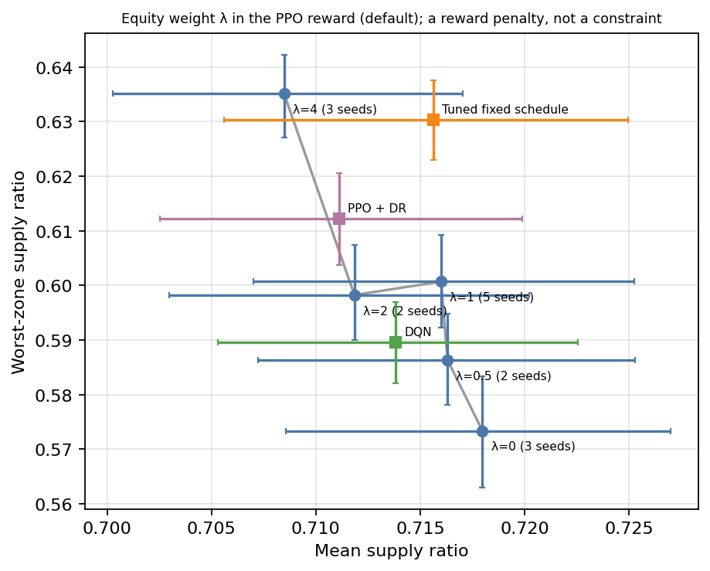
A larger equity weight lifts the worst zone at a small cost
Worst zone: 0.573 → 0.635 as λ goes from 0 to 4
Mean supply: 0.718 → 0.708
λ = 4 reaches the tuned schedule's worst zone (0.635 vs 0.630) for about 0.008 less mean supply
Handle with care: 2 to 5 seeds per point, not monotone (λ = 2 sits below λ = 1), intervals overlap. λ is a reward penalty, not a constraint.
Source: results_v2/summary.csv (default condition); figure: plots/out/pareto_lambda.png
Notes:
λ is the knob that trades efficiency for fairness. Do not call it Lagrangian or constrained RL. Our bonus is a max-min-style term and is NOT the generalized-Gini optimisation of Siddique et al.; say so if asked.

Slide 10
RL helps only when conditions move away from the tuning
Condition | PPO | PPO + DR | DQN
default | worse (-0.52) | worse (-0.77) | worse (-0.86)
alpha = 2 | better (+1.14) | better (+1.66) | better (+2.01)
alpha = 8 | worse (-0.20) | tie (+0.08) | worse (-0.81)
small tanks | tie (-0.15) | tie (+0.05) | better (+1.14)
other 6 conditions* | worse | worse | worse
Why alpha = 2 differs
A fixed timetable cannot adapt when the surge cap changes; a reactive policy can. Alpha = 2 is outside the randomisation range (3 to 6).
The schedule was tuned on the default condition only.
LSTM PPO is below PPO, and LSTM with randomisation reaches only 0.469 on the worst zone: a negative result.
Return versus the tuned schedule, with the paired 95% interval deciding better, worse or tie. *abundant, five days, large tanks, noisy demand, 10 m and 30 m pressure.
Source: results_v2/paired_vs_ce_tuned.csv. Overall PPO is worse in 8 of 10 non-scarce conditions, better in 1, tied in 1.
Notes:
A fixed timetable cannot adapt when the surge cap changes; a reactive policy can. That is the one place RL wins clearly. Overall PPO is worse in 8 of 10 non-scarce conditions, better in 1, tied in 1. The scarce condition is excluded because every method scores about the same for mean supply there.

Slide 11
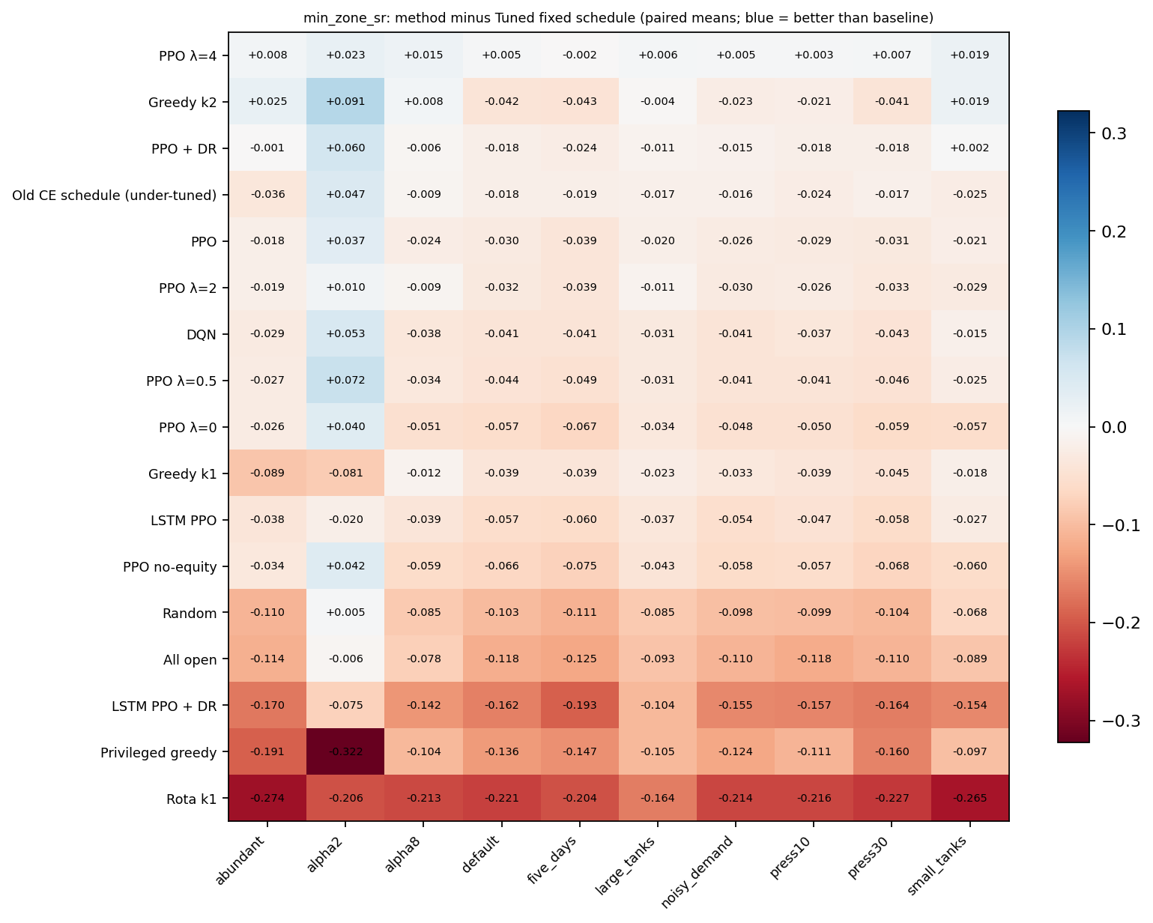
Almost every RL method trails on the worst zone
Blue = better than the tuned schedule, red = worse (paired means).
PPO with λ = 4 is the only RL row near or above zero in most conditions.
The alpha = 2 column is where RL clearly wins.
Source: results_v2/episodes.csv via plots/make_plots.py (scarce excluded)
Notes:
Point at the red block, then at the alpha2 column. This is the regime map: where RL helps and where it does not.

Slide 12
What this study cannot claim
1
2
3
One simulated network, no field data.
Tank sizes, surge factor and budgets are assumed; 0.3 to 0.8 days is probably below real storage.
2 to 5 training seeds per method; the oracle uses 30 scenarios.
4
5
6
The fixed schedule was tuned on one condition only.
The equity weight is a reward penalty, not a constraint.
Literature checked mostly at abstract level; forward-citation search not done.
Source: docs/assumptions.md, docs/STUDY_GUIDE.md section 10
Notes:
Examiners respect this slide. For each limit, say what it would change: one network limits generality; assumed tank sizes limit realism; few seeds mean the intervals understate uncertainty; a schedule tuned on one condition may look worse or better under other tuning.

Slide 13
What we can say
A tuned fixed daily schedule matches PPO on mean supply and beats it on worst-zone supply under matching conditions.
RL wins when the surge cap changes (alpha = 2) and, for DQN, with small tanks.
A larger equity weight raises worst-zone supply for a small loss in mean supply.
Not claimed: "first"; "RL beats optimised scheduling" without "under the shifts we tested"; "constrained RL".
Next: a second network, measured tank sizes, fairness as a constraint, a preference-conditioned policy.
Notes:
Repeat the three points, then the one-line takeaway: use a good timetable by default, and use RL where conditions change.

Slide 14
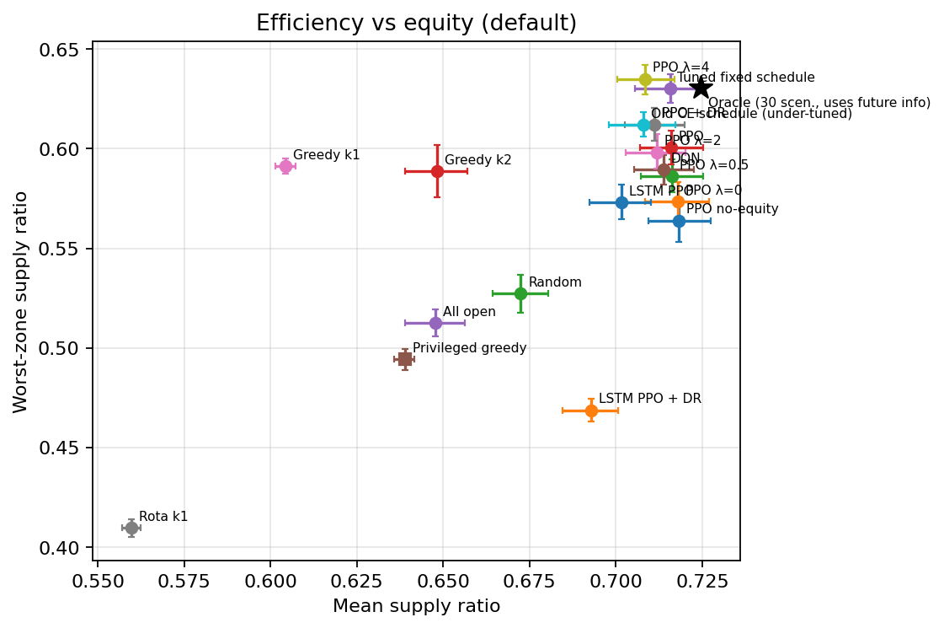
Backup: efficiency versus equity for all methods
Each point is a method family on the default condition (95% CI over scenarios). The star is the oracle (30 scenarios, uses the future).
Source: plots/out/scatter_mean_vs_worst.png
Notes:
Backup only. Use if asked for the full efficiency-versus-equity picture.

Slide 15
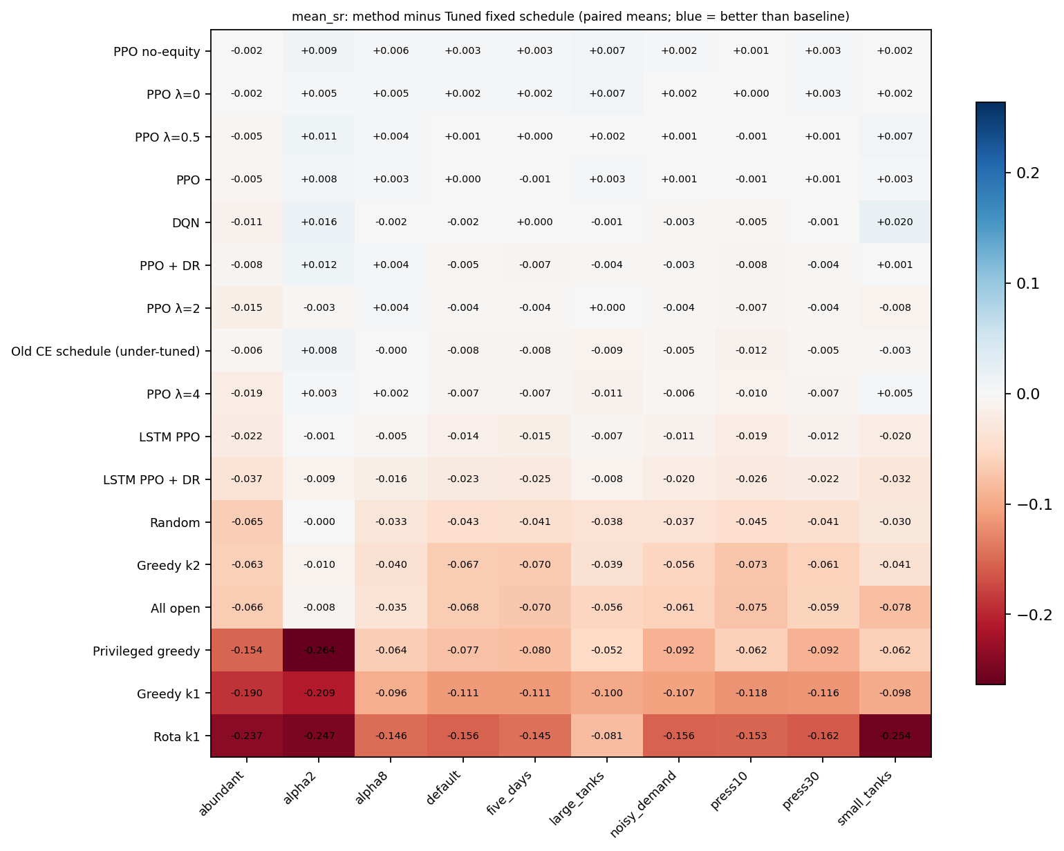
Backup: mean supply differs by only about ±0.01 for PPO
PPO's mean supply is within about 0.01 of the tuned schedule in every non-scarce condition; the differences that matter are on the worst zone and on return.
Source: plots/out/heatmap_mean_vs_baseline.png (paired means; scarce excluded)
Notes:
Backup only.

Slide 16
Backup: reward and tank balance
Hourly reward
− Σ unmet demand ÷ (average hourly consumption)
End-of-day bonus
+ λ · (worst zone's supply ratio that day) · 24 / Z (Z = 4 zones, λ = 1 by default)
Household tank
L ← L + delivered volume − overflow; served = min(L, want); unmet = want − served
Request
request = min(α · mean demand, refill need + use); EPANET returns the delivery
Source: iws_env.py, docs/STUDY_GUIDE.md section 4
Notes:
Backup only. Equations as implemented in iws_env.py.

