Slide 1
MID-REVIEW | 9-10 OCT 2026
SafeCharge-RL
Reinforcement Learning for EV Smart Charging when departure times cannot be trusted
RL problem area: constrained reinforcement learning for sequential decision-making
Team 32
Adithyan R | Adithya Rajesh | Balu M Krishna
Guide: Dr. Geetha M, Department of CSE (AI), Amrita Vishwa Vidyapeetham
Notes:
Speaker: Member 1 (0:30). We decide how much power each car gets at a shared charging station, every 15 minutes. Our twist: the departure time the driver reports can be wrong or faked.

Slide 2
The Problem: Who Gets Power, and When?
Many EVs share one transformer, so total power must stay under a grid limit
The scheduler only sees the departure time the driver reported
Reports are often wrong (about 3 h off) or could be faked to get served first
Why RL: the future is unknown and decisions are made step by step
Cost
1
Prices change by the hour
Deadlines
2
Cars must be charged before they leave
Battery wear
3
High power ages the battery
Problem statement: learn a charging policy that never exceeds the grid cap, serves every car, keeps cost low, and holds up when reported departure times are wrong.
Notes:
Member 1 (1:30). Think of a workplace car park behind one transformer. Electricity is cheap at night and expensive in the afternoon. The system decides who charges now; it cannot see the future and only knows what drivers typed in. RL fits because decisions are sequential and exact optimisation needs the whole day in advance. Research question: what happens to a learned policy when reports are wrong, and can a driver cheat it?

Slide 3
Existing Work and Our Gap
Work | What it does | Limitation
Li, Wan, He (2020) | Safe RL for EV charging | One charger, no shared grid cap
Chen, Shi (2022) | Lagrangian + SAC | One EV, synthetic data
Ting et al. (2024) | Station limit, early departures | Simulated EVs, noise only
Li, Sun (2023) | Real Caltech data; user times unreliable | Tiny station, not about misreporting
Ferragut et al. (2021) | Reporting early gets more service | Rule-based policies only
Our difference
A learned policy that drivers can game, tested on real sessions with a shared hard grid cap, against rules and a hindsight-optimal schedule.
Notes:
Member 1 (1:30). Safe and constrained RL for charging exists, but for single chargers or simulated cars. Departure uncertainty is treated as random noise. Ferragut showed that for simple rules a driver can gain by reporting early. To our search nobody checked whether a learned policy has the same weakness on real data. We do not claim a new RL algorithm.

Slide 4
MDP Design
Agent | The charging controller of the station
Environment | Simulator replaying real charging days, built by us
State | Per port: energy left, reported time left, laxity. Global: price, time of day, last power
Action | A fraction (0 to 1) of max power per port, then a safety cut to the grid cap
Reward | Minus electricity cost
Costs | Unmet energy at departure (budget 2%), battery-wear proxy (ports above 80% power)
Episode | One weekday = 96 steps of 15 min. The true departure is never shown
Laxity = time left until the reported departure minus the time needed at full power.
Notes:
Member 2 (2:00). Each day is one episode. At every step the agent sees the cars plugged in with remaining energy and the reported time left. It proposes a power fraction per port; a safety projection reduces the proposal so the total stays within the cap - a hard guarantee. Reward is the negative bill. Two extra costs have budgets: unmet energy, and a wear proxy because we have no battery data. Cars always leave at their true time, so an early report can cause unmet energy. Example of the projection: cap 20 kW, requests 12/10/8 kW, each cut by 3.33 kW.

Slide 5
RL Algorithm and Data
PPO-Lagrangian
Real ACN-Data
PPO plus one multiplier per cost. A multiplier rises when its budget is broken.
Caltech 31,424 and JPL 33,638 charging sessions
One day = 96 steps of 15 minutes
Our assumptions: summer time-of-use tariff, grid cap = 20% of the typical peak
Deep Sets network
One shared encoder per port, so it handles any number of cars in any order.
Chronological split (Caltech, weekdays)
Train: Jan-Aug 2019 (174 days)
Val 44 d
Test: Nov 2019-Feb 2020 (85 days)
Honest note: a behaviour-cloning warm start from a rule-based scheduler was added because learning was too slow without it. It is not in the submitted design.
Notes:
Member 2 (1:30). PPO is a standard stable method; the multipliers turn 'stay within budget' into a trade-off the policy learns. Deep Sets shares one small network across ports. Data are real charging sessions downloaded through the ACN API and verified against its totals. Price and grid cap are our assumptions because the data have neither. Be ready to say the warm start is not in the submitted design.

Slide 6
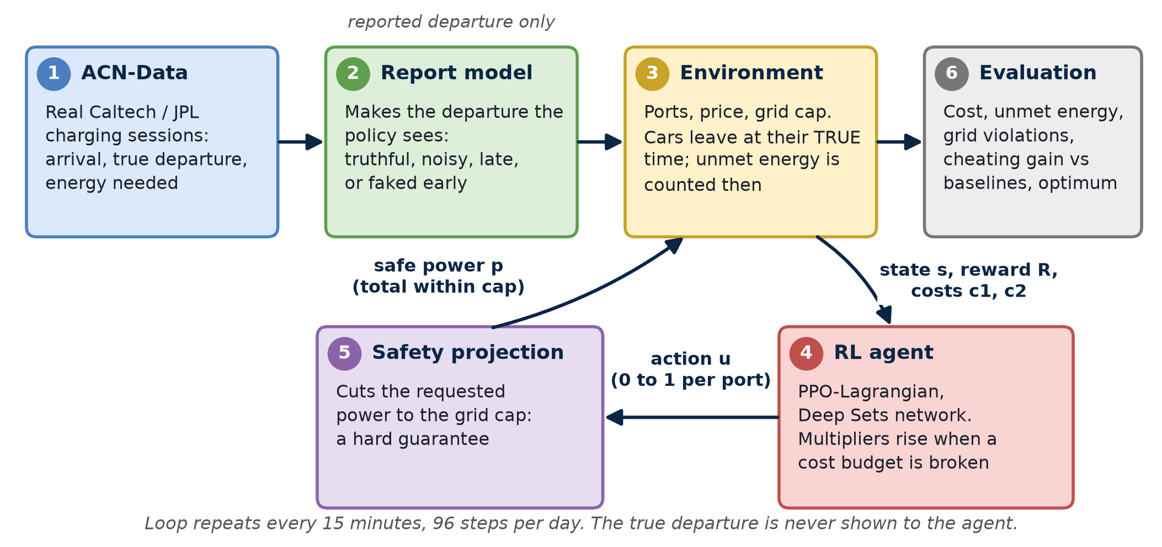
System Design
Notes:
Member 2 (1:00). Left to right: real sessions go through the report model, which makes the reported time truthful or misreported. The environment tracks ports, price and the grid limit. The agent proposes power, the projection enforces the cap, the applied power moves the environment forward and returns state and reward. Point at box 2 (our novelty) and box 5 (the guarantee).

Slide 7
Novel Components
1
2
3
Manipulable reports
Paired replay
Hard safety layer
Reported departure treated as something a driver can game, on real data
A measure of how much extra energy lying earns
Projection plus cost budgets for a shared station
4
5
6
Hindsight optimum
Testing the fix
Real report errors
Benchmark on real sessions; lower bound checked every day
Serve only until declared departure, tried on a learned policy
Recorded reports are common and 2-3 hours wrong
Notes:
Member 2 (1:00). The new part is not the algorithm but the question and the evaluation: can a driver game a learned policy? We measure it with paired replay. We also found that the submitted claim 'driver reports are rare' does not hold on the full data: 52% of Caltech and 94% of JPL sessions have one.

Slide 8
Results So Far
93-97%
of early reporters gain on the learned policy; rules: under 4%
2.6x
more unmet energy with wrong reports (rules 1.2-1.6x, MPC 30x)
0
grid-limit violations, for every method
Truthful reports: the learned policy ties EDF on cost and charges gently. Stopping service at the declared departure removes the gain.
Notes:
Member 3 (2:00). Under truthful reports the learned policy is not better than simple rules on cost; its strength is gentle charging at similar cost. With wrong reports it degrades more than the rules but far less than MPC. Main finding: it can be gamed - the gain is small in kWh but happens almost every time. A simple fix, stopping service at the declared departure, removes the incentive at the price of hurting honest early reports. Every number comes from a script and config: 5 seeds, 85 test days, 95% confidence intervals. Chart: normal grid cap (kappa 0.20), others truthful, 413 paired replays per point. Fails to transfer to JPL (28.6% unmet) - say so if asked.

Slide 9
Demo So Far and Next Plan
Live demo
Done
Next
Busy real test day: every method, no grid violation
Crowded day: report 1-2 h early and watch the gain
Simulator and safety layer
Baselines, optimum, MPC
PPO-Lagrangian, 5 seeds
Experiments E1-E3, E6, part of E4
108 tests passing, code on GitHub
Finish E4 variants (6 of 9 runs done)
E5 projection ablation
Unprojected-RL baseline
Optional SAC-Lagrangian
Final report
python scripts/demo.py 58 --plot
Notes:
Member 3 (3:00). (2 min demo) Here is one real busy day. The learned policy and EDF both hit the 34.6 kW cap and never exceed it; the learned policy runs cars at lower power. Now a crowded day: three cars report one hour early; rules give extra energy to some, the learned policy to more. (1 min) The implementation is complete up to the first four experiments and is on GitHub. What remains is finishing the E4 variants, the projection ablation and the report. Fallback if the live run fails: screenshots of the demo table and docs/briefing/fig/demo_day.png.

