Slide 1


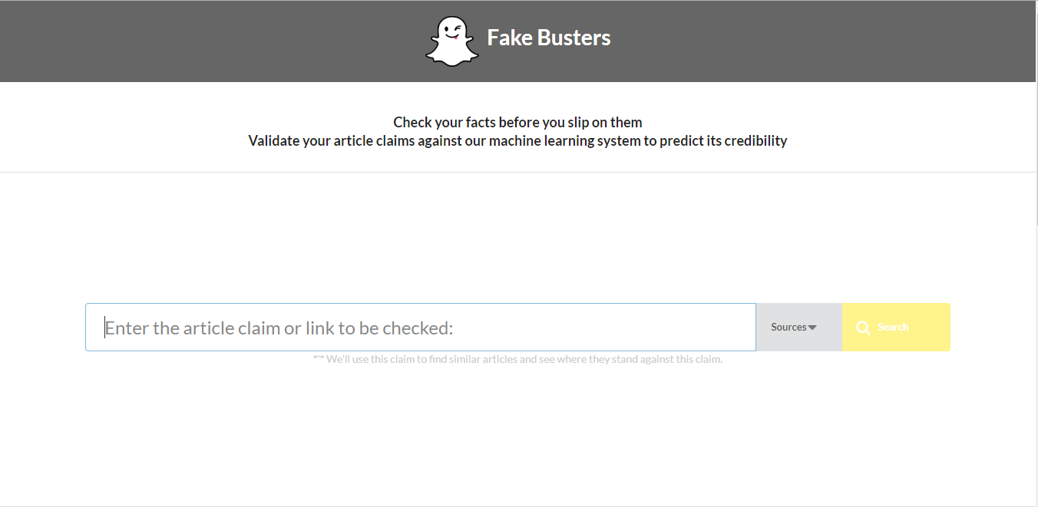
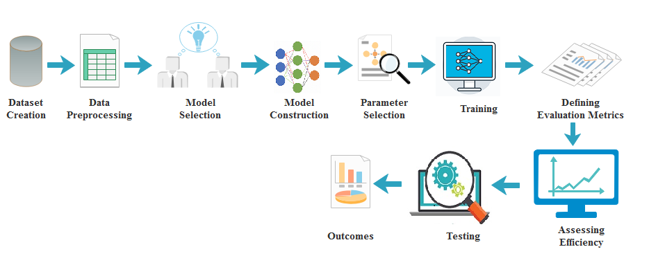
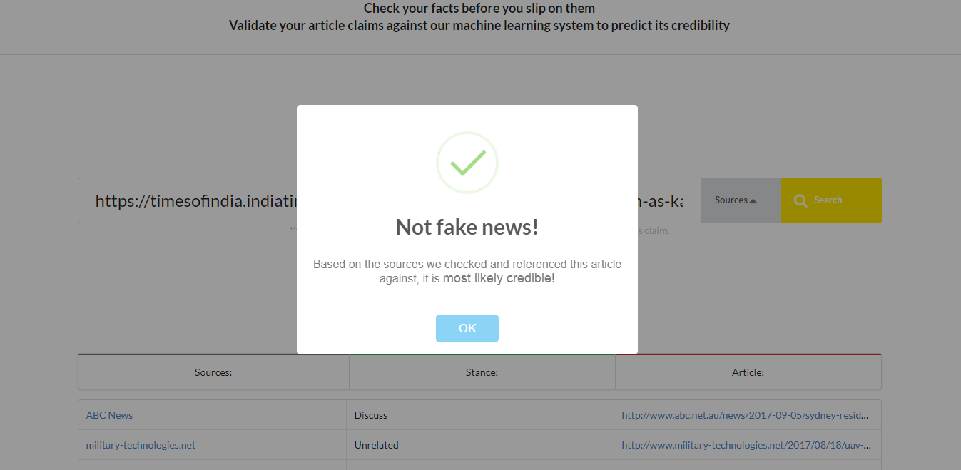
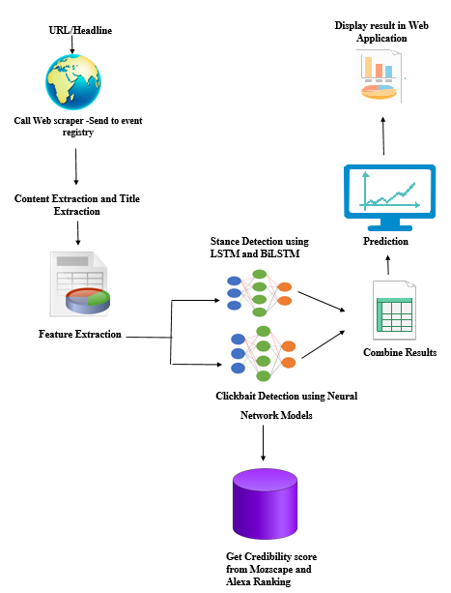
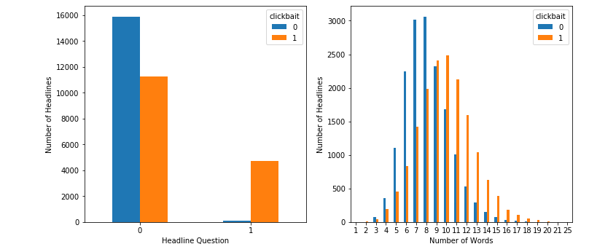
AUTOMATIC IDENTIFICATION OF FAKE NEWS
Saumya Pandey, Nikita Jain, Aditi Bhardwaj, Gagandeep Kaur
Department of CSE & IT Jaypee Institute of Information Technology, Noida, U.P.-201307
ABSTRACT
IMPLEMENTATION
Fig4: Fake Busters Web Application
Fig 5: Testing URL in Fake News
Fake Busters (FBS) that leverages machine learning models-LSTM, BiLSTM, Random Forest, Multi-layer perceptron, Logistic Regression and SVM to predict the stance between the headline and corresponding text and classify the article into four classes-“agrees, discusses, disagree and unrelated”. The same text is then supplied into the clickbait detection model which works on two models-the data is supplied to ML models and the URL is sent to Mozscape and Alexa API to get the credibility and reputation score.The results from both the models are used to predict the final result whether the news is fake or no. . The most disturbing part is that the fake news stories have become so prevalent due the level of anonymity that online media provides that it is sometimes published by reliable media sources. Therefore, it inhibits the ability of a daily news consumer to segregate fake news and real news [1].t.
Fig 2: Workflow diagram
Fig 2 shows the process of creation ,training and testing of the stance and clickbait detection. These models are serialized and deployed at the backend of the fake busters for predicting the genuinity of the news .Fig 3 portrays the working of Fake Busters.
INTRODUCTION
With advent of digital age, vast majority of people spend their time online, as a result the consumption of the news from the online sources has exponentially increased as compared to the conventional news media [1]. On one side, online media provides easy accessibility of information and is also cost efficient but on the flip side it has become a source of propagation of large scale poor quality news. The tectonic shift in the news consumption pattern poses a serious threat as social media has become hub for deliberately spreading fake news. From 2016 US Presidential elections to GPS chips in currency notes- were among the many incidences where fabricated news was used to mislead, influence, promote prejudices and manipulate the beliefs of vast majority of audience. Fabricated news is capable of not only tarnishing reputation of person/organization, but also causing huge revenue losses. In 2013 false news regarding bomb explosion in White House by AP (Associated Press) resulted in 1% decline in Standard & Poor 500 index along with causing US$136 Billion loss which highlights how fake news dissemination has many far reaching consequences.. The dataset was created by crawling the data from various websites like The Hindu, The NYT, The Guardian, Buzzfeed and The ViralNova, Scoopwhoop and Times of India which was stored in txt file
CONCLUSION
Social media and the rapidly increasing menace of fake news dissemination are two sides of the same coin that are highly correlated. Our research work conducted on the dataset created using various news sites is the proof of concept that deep learning models can provide an essential pathway towards successful flagging of fabricated news in the near future. In this research, BiLSTM with attention achieved an accuracy of 98.3% thereby proving to be fruitful in detecting the false news.
FUTURE WORKS
Fig 3: Workflow Diagram for Fake Busters
In the future, we wish to implement synthetic gradients for training the neural networks to greatly reduce the training time for the models. In addition, to this we want to deploy the application on web servers that can be accessed publicaly, and pitch the idea in a start-up submit to receive adequate funding, thereby fighting the battle against fake news on all platforms. Currently, the scope of study is restricted to detecting fake news for news media and doesn’t cover all the social media platforms to lack of adequate system for processing massive amount of data in real time on current 8GB RAM systems.
RESULTS
Through the screenshots we have made an effort to elucidate
the working of Fake Busters. Once the application starts
the user can enter the URL or the headline for any news
website and detect the news fabrication of the given article.
The application uses the reputation scores from Alexa and
Mozscape along with the stance detection neural network models to predict the authenticity of the news.
Fig 1: Dataset Characteristics
REFERENCES
1.Shu, K., Sliva, A., Wang, S., Tang, J., & Liu, H. (2017). Fake news detection on social media: A data mining perspective. ACM SIGKDD Explorations Newsletter, 19(1), 22-36.
2. Rocktäschel, T., Grefenstette, E., Hermann, K. M., Kočiský, T., & Blunsom, P. (2015). Reasoning about entailment with neural attention. arXiv preprint arXiv:1509.06664.
3. Chung, J., Gulcehre, C., Cho, K., & Bengio, Y. (2014). Empirical evaluation of gated recurrent neural networks on sequence modeling. arXiv preprint arXiv:1412.3555.

