Slide 1

TECH TALKS
ALGORAMMERS

Slide 2


Add the Theme here

Slide 3
PROBLEM STATEMENT
Tech interview preparation is often overwhelming due to scattered and unreliable resources. Candidates struggle to find real, first-hand experiences and practical advice in one place. Without a dedicated, community-driven platform, many feel underprepared and uncertain about what to expect. Dev Interview aims to bridge this gap by creating a space where people can share their experiences, offer tips, and support each other through the interview journey.
.
.

Slide 4
PROPOSED SOLUTION
A dedicated platform where users can share real tech interview experiences to help others prepare. Sections for practical tips, tricks, and preparation strategies contributed by the community. An interactive Q&A forum where users can ask questions and get peer support. Easy-to-use search and filter options by company, role, and tech stack for targeted preparation. A clean, responsive interface to ensure smooth and accessible user experience.

Slide 5

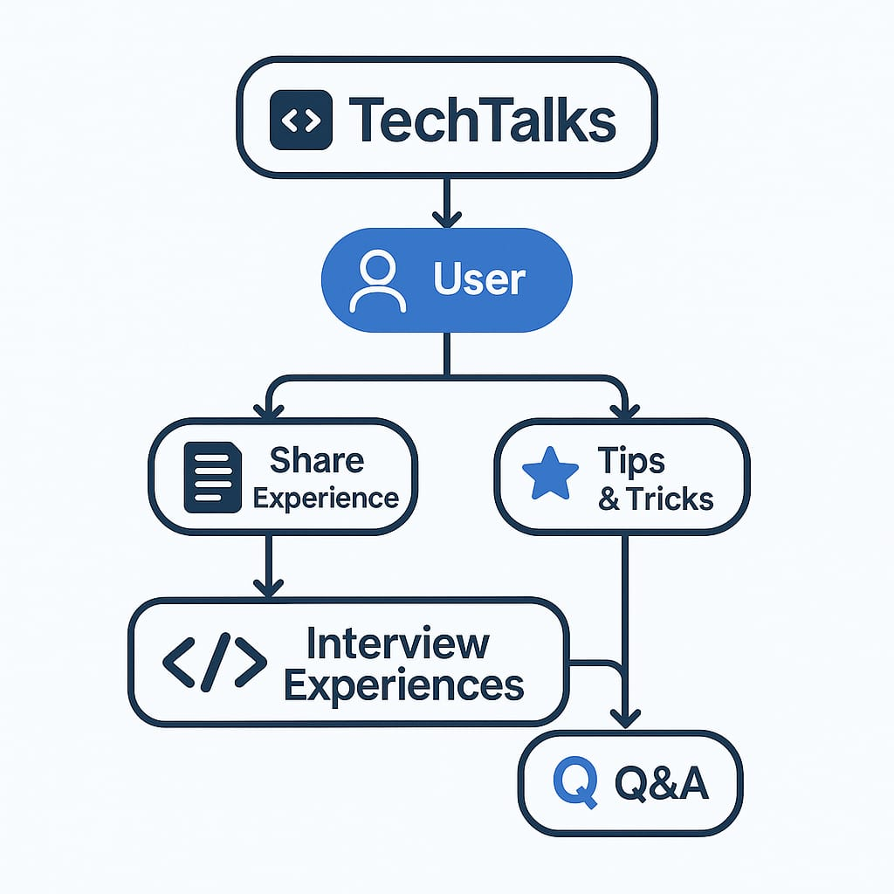
FLOWCHART/DIAGRAM

Slide 6
FLOWCHART/DIAGRAM
Users are the center of the TechTalks platform, driving all activities. Users can share detailed tech interview experiences to guide others. They can contribute useful tips and tricks for effective preparation. Users can ask questions and provide answers in the Q&A section. All shared stories create a searchable, organized interview library. The platform enables seamless sharing, learning, and community interaction.

Slide 7
FEATURES AND NOVELTY
FEATURES:
- Share real tech interview experiences.
- Community-driven tips and Q&A forum.
- Search by company, role, and tech stack.
NOVELTY:
Focused on real stories, not generic prep.
Combines sharing, tips, and discussion in one place.
Easy, searchable, and community-led platform.

Slide 8
FUTURE IMPROVEMENTS
User ProfilesPersonalized accounts for sharing and saving experiences.
Upvoting & RankingHighlight the most useful tips and answers
AI SuggestionsRecommend relevant experiences and tips.
Mobile AppEasy access through a dedicated mobile application.
Role-Based PreparationSeparate sections for specific job roles and levels.

Slide 9
ALGORAMMERS
TEAM MEMBERS:
Aditi Agrawal (8269002096, 24cs10ad9@mitsgwl.ac.in)
Riya Kaurav (7869674993, 24io10ri62@mitsgwl.ac.in)

Slide 10

THANK YOU

