Slide 1
Introduction to Computer Applications
Introduction to MS Excel

Slide 2
Summary of the Last week
Exploring & identifying MS Excel user interface elements.
Moving around worksheets.
Selecting cells, rows, and columns.
Editing & formatting worksheets.
Inserting & deleting rows and columns.
Deleting rows & columns.
Changing row heights & column widths.
Hiding & unhiding rows & columns.
Selecting worksheets
Navigating between worksheets
Renaming worksheets
Inserting & deleting worksheets
Moving & copying worksheets
Switching between MS Excel views
Freezing & unfreezing panes
Using templates

Slide 3
Learning Objectives
Understand and apply the following skills:
How to enter a formula.
How to edit a formula.
How to use parentheses to change the operators precendence.
How to copy/paste a formula.
How to choose between the paste options (Paste,Values, Formulas, Formatting, and Pase Special).
How to insert a function.
How to use the count functions (Count, Countif, and Countifs).
How to use the sum functions (Sum, Sumif, and Sumifs).
How to use the logical functions (If, And, and Or).
How to use the statistical functions (Average, Averageif, Median, Mode, Standard Deviation, Min, Max, Large, and Small).

Slide 4
Outlines
Formulas and Functions
Entering a Formula
Editing a Formula
Changing the Operators Precedence
Copying/Pasting a Formula
Paste Options
Paste
Values
Formulas
Formatting
Pase Special
Inserting a Function
Count Functions (Count, Countif, Countifs)
Sum Functions (Sum, Sumif, Sumifs)
Logical Functions (If, And, Or)
Statistical Functions (Average, Averageif, Median, Mode, Standard Deviation, Min, Max, Large, and Small).

Slide 5
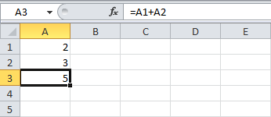
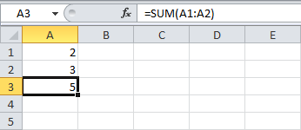
Formulas and Functions
A formula is an expression which calculates the value of a cell.
Functions are predefined formulas, and are already available in Excel.
For example, cell A3 below contains a formula which adds the value of cell A2 to the value of cell A1.
For example, cell A3 below contains the SUM function which calculates the sum of the range A1:A2

Slide 6
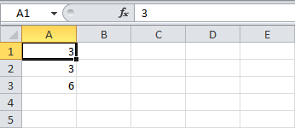
Entering a Formula
To enter a formula, execute the following steps.
1. Select a cell.
2. To let Excel know that you want to enter a formula, type an equal sign (=).
3. For example, type the formula A1+A2.
Tip: instead of typing A1 and A2, simply select cell A1 and cell A2.
4. Change the value of cell A1 to 3.
Excel automatically recalculates the value of cell A3. This is one of Excel's most powerful features!

Slide 7
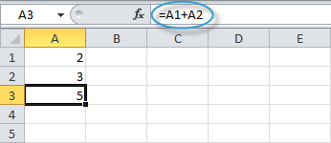
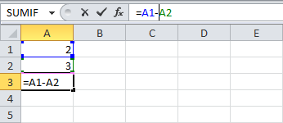
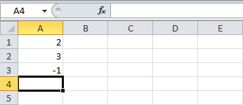
Editing a Formula
When you select a cell, Excel shows the value or formula of the cell in the formula bar.
To edit a formula:
1. click in the formula bar and change the formula.
2. Press Enter

Slide 8
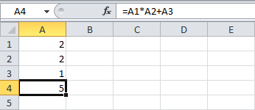
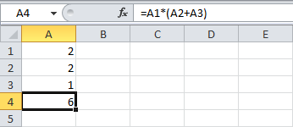
Operator Precedence
Excel uses a default order in which calculations occur. If a part of the formula is in parentheses, that part will be calculated first. It then performs multiplication or division calculations. Once this is complete, Excel will add and subtract the remainder of your formula. See the example below.
First, Excel performs multiplication (A1 * A2). Next, Excel adds the value of cell A3 to this result.
Another example,
First, Excel calculates the part in parentheses (A2+A3). Next, it multiplies this result by the value of cell A1.

Slide 9
Copying/Pasting a Formula
When you copy a formula, Excel automatically adjusts the cell references for each new cell the formula is copied to. To understand this, execute the following steps.

Slide 10
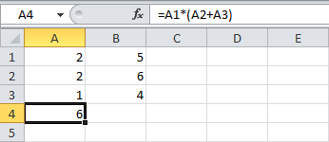
Copying/Pasting a Formula
When you copy a formula, Excel automatically adjusts the cell references for each new cell the formula is copied to. To understand this, execute the following steps.
1. Enter the formula shown below into cell A4.

Slide 11
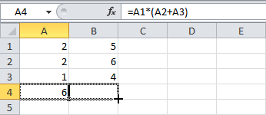
Copying/Pasting a Formula
When you copy a formula, Excel automatically adjusts the cell references for each new cell the formula is copied to. To understand this, execute the following steps.
1. Enter the formula shown below into cell A4.
2. Select cell A4, right click, and then click Copy (or press CTRL + c), and then select cell
B4, right click, and then click Paste under 'Paste Options:' (or press CTRL + v).Or You can also drag the formula to cell B4. Select cell A4, click on the lower right corner of cell A4 and drag it across to cell B4. This is much easier and gives the exact same result!

Slide 12
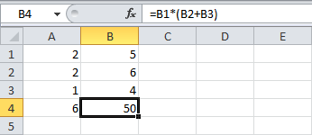
Copying/Pasting a Formula
When you copy a formula, Excel automatically adjusts the cell references for each new cell the formula is copied to. To understand this, execute the following steps.
1. Enter the formula shown below into cell A4.
2. Select cell A4, right click, and then click Copy (or press CTRL + c), and then select cell
B4, right click, and then click Paste under 'Paste Options:' (or press CTRL + v).Or You can also drag the formula to cell B4. Select cell A4, click on the lower right corner of cell A4 and drag it across to cell B4. This is much easier and gives the exact same result!
Result. The formula in cell B4 references the values in column B.

Slide 13

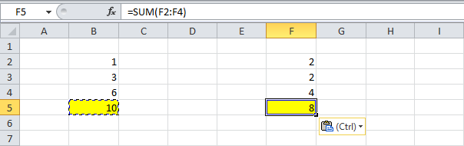
Paste Options - the Paste Option
The Paste option pastes everything.
1. Select cell B5, right click, and then click Copy (or press CTRL + c).
2. Select cell F5, right click, and then click Paste under 'Paste Options:' (or press CTRL + v).
Result

Slide 14

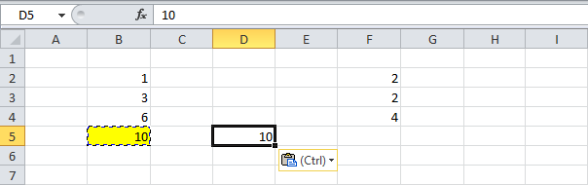
Paste Options - the Values Option
The Values option pastes the result of the formula.
1. Select cell B5, right click, and then click Copy (or press CTRL + c).
2. Select cell D5, right click, and then click Values under 'Paste Options:'
Result

Slide 15

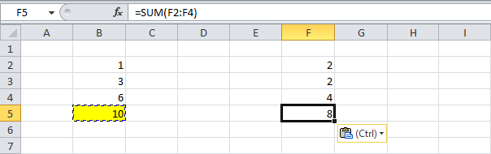
Paste Options - the Formulas Option
The Formulas option only pastes the formula.
1. Select cell B5, right click, and then click Copy (or press CTRL + c).
2. Select cell F5, right click, and then click Formulas under 'Paste Options:'
Result

Slide 16

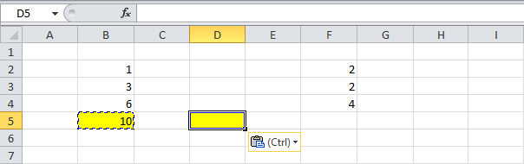
Paste Options – the Formatting Option
The Formatting option only pastes the formatting.
1. Select cell B5, right click, and then click Copy (or press CTRL + c).
2. Select cell D5, right click, and then click Formatting under 'Paste Options:'
Result
Note: the Format Painter copy/pastes formatting even quicker.

Slide 17
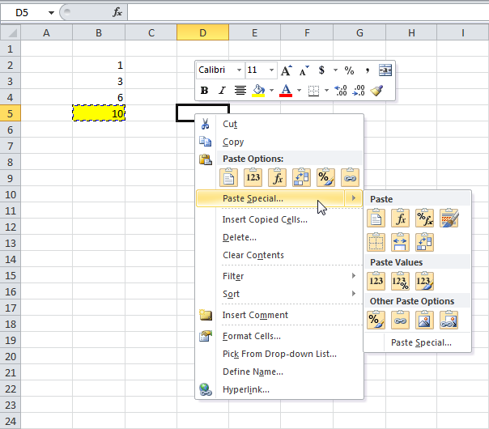
Paste Options – the Paste Special Option
The Paste Special dialog box offers many more paste options. To launch the Paste Special dialog box, execute the following steps.
Select cell B5, right click, and then
click Copy (or press CTRL + c).
2. Next, select cell D5, right click, and then
click Paste Special.

Slide 18
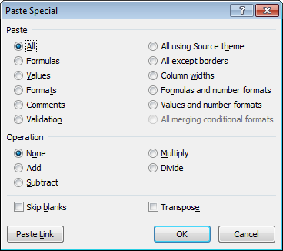
Paste Options – the Paste Special Option
The Paste Special dialog box offers many more paste options. To launch the Paste Special dialog box, execute the following steps.
Select cell B5, right click, and then
click Copy (or press CTRL + c).
2. Next, select cell D5, right click, and then
click Paste Special.
3. The Paste Special dialog box appears.
4. Choose the option that fits you, then click OK.

Slide 19
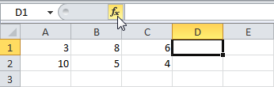
Inserting a Function
To insert a function, execute the following steps.
1. Select a cell.
Notes:
Every function has the same structure. For example, SUM(A1:A4). The name of this function is SUM. The part between the brackets (arguments) means we give Excel the range A1:A4 as input. This function adds the values in cells A1, A2, A3 and A4. It's not easy to remember which function and which arguments to use for each task. Fortunately, the Insert Function feature in Excel helps you with this.

Slide 20
Inserting a Function
To insert a function, execute the following steps.
1. Select a cell.
2. Click the Insert Function button.
Notes:
Every function has the same structure. For example, SUM(A1:A4). The name of this function is SUM. The part between the brackets (arguments) means we give Excel the range A1:A4 as input. This function adds the values in cells A1, A2, A3 and A4. It's not easy to remember which function and which arguments to use for each task. Fortunately, the Insert Function feature in Excel helps you with this.

Slide 21
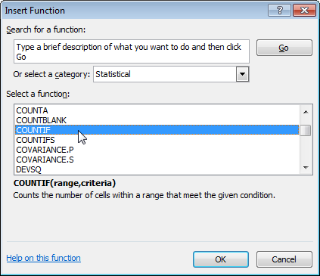
Inserting a Function
To insert a function, execute the following steps.
1. Select a cell.
2. Click the Insert Function button.
3.The Insert Function dialog box appears, search for a function or select a function from a category.
For example, choose COUNTIF from the Statistical category.
Notes:
Every function has the same structure. For example, SUM(A1:A4). The name of this function is SUM. The part between the brackets (arguments) means we give Excel the range A1:A4 as input. This function adds the values in cells A1, A2, A3 and A4. It's not easy to remember which function and which arguments to use for each task. Fortunately, the Insert Function feature in Excel helps you with this.

Slide 22
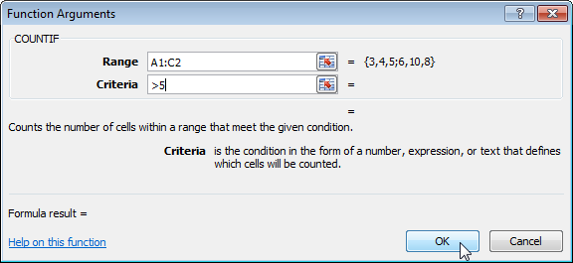
Inserting a Function
To insert a function, execute the following steps.
1. Select a cell.
2. Click the Insert Function button.
3.The Insert Function dialog box appears, search for a function or select a function from a category.
For example, choose COUNTIF from the Statistical category.
4. Click OK, the Function Arguments dialog box appears.
5. Click in the Range box and select the range A1:C2.
6. Click in the Criteria box and type >5.
Notes:
Every function has the same structure. For example, SUM(A1:A4). The name of this function is SUM. The part between the brackets (arguments) means we give Excel the range A1:A4 as input. This function adds the values in cells A1, A2, A3 and A4. It's not easy to remember which function and which arguments to use for each task. Fortunately, the Insert Function feature in Excel helps you with this.

Slide 23
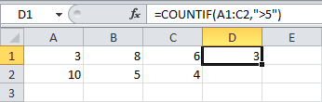
Inserting a Function
To insert a function, execute the following steps.
1. Select a cell.
2. Click the Insert Function button.
3.The Insert Function dialog box appears, search for a function or select a function from a category.
For example, choose COUNTIF from the Statistical category.
4. Click OK, the Function Arguments dialog box appears.
5. Click in the Range box and select the range A1:C2.
6. Click in the Criteria box and type >5.
7. Click OK.
Result. Excel counts the number of cells that are higher than 5.
Notes:
Every function has the same structure. For example, SUM(A1:A4). The name of this function is SUM. The part between the brackets (arguments) means we give Excel the range A1:A4 as input. This function adds the values in cells A1, A2, A3 and A4. It's not easy to remember which function and which arguments to use for each task. Fortunately, the Insert Function feature in Excel helps you with this.

Slide 24
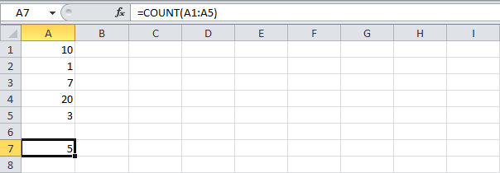
Count Functions- the COUNT Function
To count the number of cells that contain numbers, use the following COUNT function.
Notes:
The most used functions in Excel are the functions that count and sum. You can count and sum based on onecriteria or multiple criteria

Slide 25
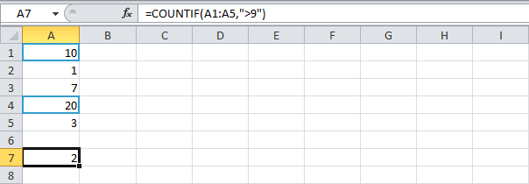
Count Functions – the COUNTIF Function
To count cells based on one criteria (for example, higher than 9), use the following COUNTIF function.
Note: in contrast to the COUNT function, cells can contain text as well.
Notes:
The most used functions in Excel are the functions that count and sum. You can count and sum based on onecriteria or multiple criteria

Slide 26
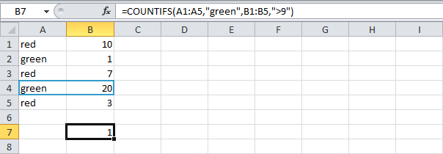
Count Functions – the COUNTIFS Function
To count cells based on multiple criteria (for example, green and higher than 9), use the following COUNTIFS function.
Notes:
The most used functions in Excel are the functions that count and sum. You can count and sum based on onecriteria or multiple criteria

Slide 27

Sum Functions - the SUM Function
To sum a range of cells, use the following SUM function.
Notes:
The most used functions in Excel are the functions that count and sum. You can count and sum based on onecriteria or multiple criteria

Slide 28
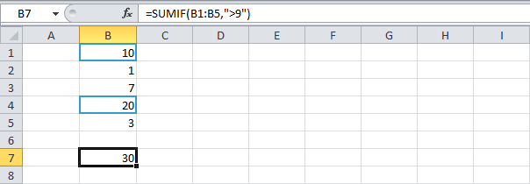
Sum Functions - the SUMIF Function
To sum cells based on one criteria (for example, higher than 9), use the following SUMIF function (two arguments).
Notes:
The most used functions in Excel are the functions that count and sum. You can count and sum based on onecriteria or multiple criteria

Slide 29
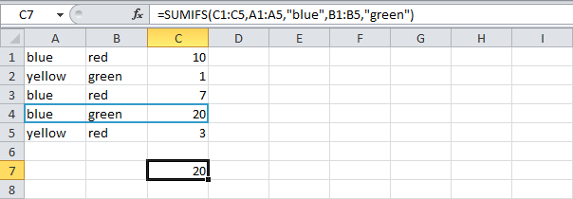
Sum Functions - the SUMIFS Function
To sum cells based on multiple criteria (for example, blue and green), use the following SUMIFS function (first argument is the range to sum).
Notes:
The most used functions in Excel are the functions that count and sum. You can count and sum based on onecriteria or multiple criteria

Slide 30
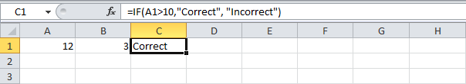
Logical Functions - the IF Function
The IF Function checks whether a condition is met, and returns one value if TRUE and another value if FALSE.
Select cell C2 and enter the following function.
The IF function returns Correct because the value in cell A1 is higher than 10.
Notes:
The most used functions in Excel are the functions that count and sum. You can count and sum based on onecriteria or multiple criteria

Slide 31
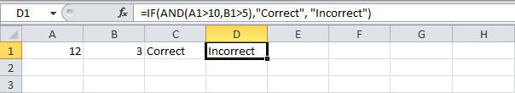
Logical Functions - the AND Function
The AND Function returns TRUE if all conditions are true and returns FALSE if any of the conditions are false.
Select cell D2 and enter the following formula.
The AND function returns FALSE because the value in cell B2 is not higher than 5. As a result the IF function returns Incorrect.
Notes:
The most used functions in Excel are the functions that count and sum. You can count and sum based on onecriteria or multiple criteria

Slide 32
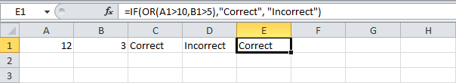
Logical Functions - the OR Function
The OR Function returns TRUE if any of the conditions are TRUE and returns FALSE if all conditions are false.
Select cell E2 and enter the following formula.
The OR function returns TRUE because the value in cell A1 is higher than 10. As a result the IF function returns Correct.
General note: the AND and OR function can check up to 255 conditions
Notes:
The most used functions in Excel are the functions that count and sum. You can count and sum based on onecriteria or multiple criteria

Slide 33
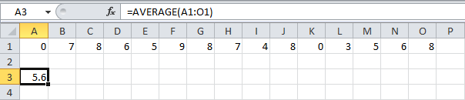
Statistical Functions – the AVERAGE Function
To calculate the average of a range of cells, use the following AVERAGE function.

Slide 34
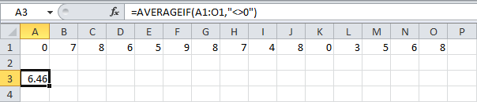
Statistical Functions – the AVERAGEIF Function
To average cells based on one criteria, use the following AVERAGEIF function.
For example, to calculate the average excluding zeros.
Note: <> means not equal to

Slide 35

Statistical Functions – the MEDIAN Function
To find the median (or middle number), use the following MEDIAN function.
Check:

Slide 36

Statistical Functions – the MODE Function
To find the most frequently occurring number, use the following MODE function

Slide 37
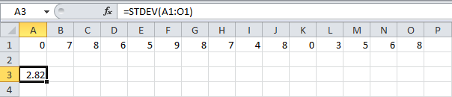
Statistical Functions – the STEDV Function
To calculate the standard deviation, use the following STEDV function.

Slide 38

Statistical Functions – the MIN Function
To find the minimum value, use the efollowing MIN function.

Slide 39

Statistical Functions – the MAX Function
To find the maximum value, use the following MAX function.

Slide 40

Statistical Functions – the LARGE Function
To find the third largest number, use the following LARGE function.
Check:

Slide 41

Statistical Functions – the SMALL Function
To find the second smallest number, use the following SMALL function
Check:

