Slide 1
SKEWNESS
&
KURTOSIS

Slide 2
Concept of Skewness
A distribution is said to be skewed-when the mean, median and mode fall at different position in the distribution and the balance (or center of gravity) is shifted to one side or the other i.e. to the left or to the right.
Therefore, the concept of skewness helps us to understand the relationship between three measures-
Mean.
Median.
Mode.

Slide 3
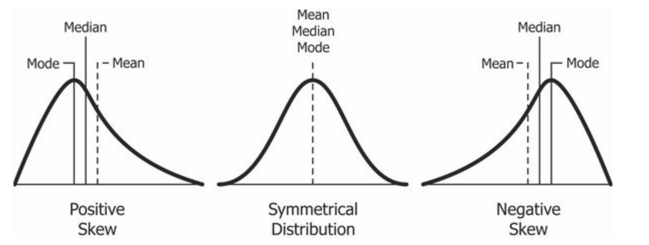
Symmetrical Distribution
A frequency distribution is said to be symmetrical if the frequencies are equally distributed on both the sides of central value.
A symmetrical distribution may be either bell – shaped or U shaped.
In symmetrical distribution, the values of mean, median and mode are equal i.e. Mean=Median=Mode

Slide 4
Skewed Distribution
A frequency distribution is said to be skewed if the frequencies are not equally distributed on both the sides of the central value.
A skewed distribution may be-
  Positively Skewed
  Negatively Skewed

Slide 5
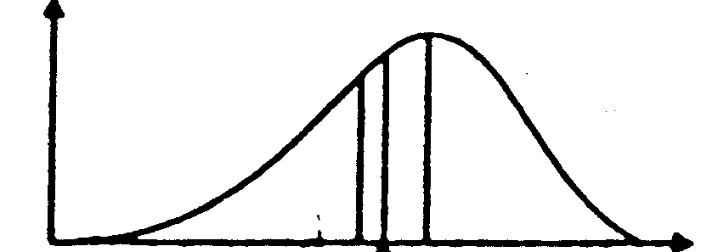
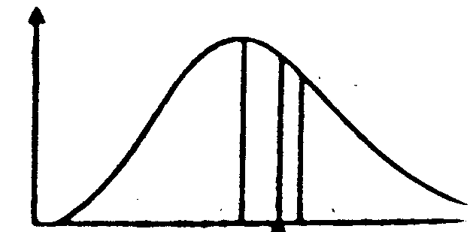
Skewed Distribution
Negatively Skewed
In this, the distribution is skewed to the left (negative)
Here, Mode exceeds Mean and Median.
Positively Skewed
In this, the distribution is skewed to the right (positive)
Here, Mean exceeds Mode and Median.
Mean<Median<Mode
Mode<Median<Mean
Notes:
Mean = 64; Median =64.8 and Mode= 65.2....... Negatively Skewed
Mean>Median>Mode.... Positively skewed

Slide 6
Tests of Skewness
In order to ascertain whether a distribution is skewed or not the following tests may be applied. Skewness is present if:
The values of mean, median and mode do not coincide.
When the data are plotted on a graph they do not give the normal bell shaped form i.e. when cut along a vertical line through the center the two halves are not equal.
The sum of the positive deviations from the median is not equal to the sum of the negative deviations.
Quartiles are not equidistant from the median.
Frequencies are not equally distributed at points of equal deviation from the mode.

Slide 7
Graphical Measures of Skewness
Measures of skewness help us to know to what degree and in which direction (positive or negative) the frequency distribution has a departure from symmetry.
Positive or negative skewness can be detected graphically (as below) depending on whether the right tail or the left tail is longer but, we don’t get idea of the magnitude
Hence some statistical measures are required to find the magnitude of lack of symmetry
Mean> Median> Mode
Mean=Median=Mode
Mean<Median<Mode
Symmetrical
Skewed to the Left
Skewed to the Right

Slide 8
Statistical Measures of Skewness
Absolute Measures of Skewness
Relative Measures of Skewness
Following are the absolute measures of skewness:
Skewness (Sk) = Mean – Median
Skewness (Sk) = Mean – Mode
Skewness (Sk) = (Q3 - Q2) - (Q2 - Q1)
There are four measures of skewness:
β and γ Coefficient of skewness
Karl Pearson's Coefficient of skewness
Bowley’s Coefficient of skewness
Kelly’s Coefficient of skewness

Slide 9
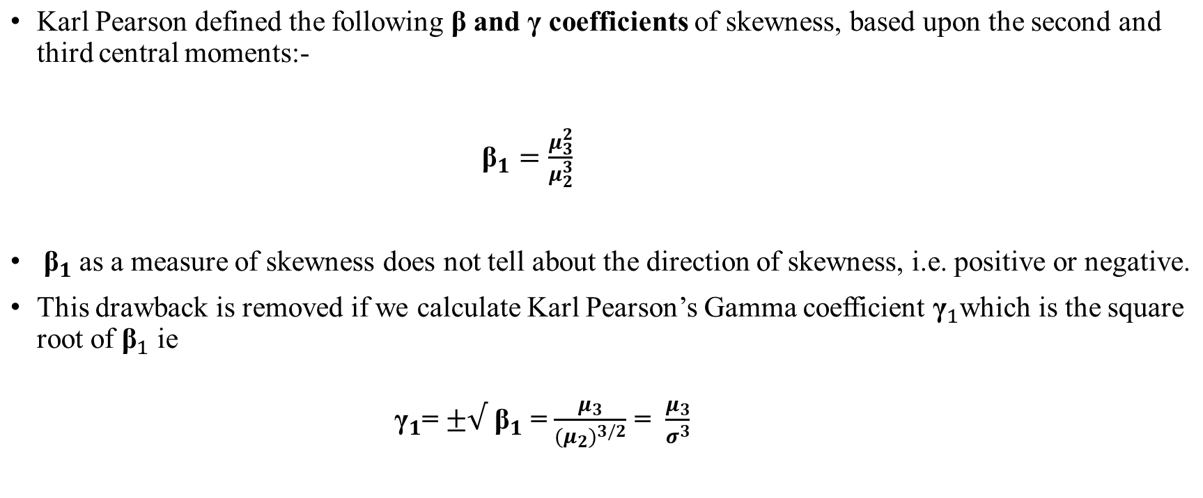
β and γ Coefficient of Skewness

Slide 10
Karl Pearson's Coefficient of Skewness……01
This method is most frequently used for measuring skewness. The formula for measuring coefficient of skewness is given by
SK_{P} =
Mean – Mode
σ
Where,
SK_{P} = Karl Pearson's Coefficient of skewness,
σ = standard deviation.
Normally, this coefficient of skewness lies between -3 to +3.
Notes:
Mode = 3 Median – 2 Mean

Slide 11
Karl Pearson's Coefficient of Skewness…..02
In case the mode is indeterminate, the coefficient of skewness is:
Mean – (3 Median - 2 Mean)
σ
SK_{P} =
Now this formula is equal to
3(Mean - Median) σ
SK_{P}
=
The value of coefficient of skewness is zero, when the distribution is symmetrical.
The value of coefficient of skewness is positive, when the distribution is positively skewed.
The value of coefficient of skewness is negative, when the distribution is negatively skewed.
Notes:
If Sk = + or – 3: Perfectly Positively/Negatively Skewed. If Sk = +/- 2 to 2.99 : High degree Positive/Negative skewness
If Sk = +/- 1 to 1.99 : Moderate degree Positive/Negative skewness; If Sk = +/- 0.1 to 0.99 : Low degree Positive/Negative skewness

Slide 12
Bowley’s Coefficient of Skewness……01
Bowley developed a measure of skewness, which is based on quartile values.
The formula for measuring skewness is:
(Q₃ – Q₂) – (Q₂ – Q₁) (Q₃ – Q₁)
SK_{B} =
Where,
SK_{B} = Bowley’s Coefficient of skewness,
Q₁ = Quartile first Q₂ = Quartile second
Q₃ = Quartile Third

Slide 13
Bowley’s Coefficient of Skewness…..02
The above formula can be converted to-
SK_{B} =
Q₃ + Q₁ – 2Median (Q₃ – Q₁)
The value of coefficient of skewness is zero, if it is a symmetrical distribution.
If the value is greater than zero, it is positively skewed distribution.
And if the value is less than zero, it is negatively skewed distribution.

Slide 14
Kelly’s Coefficient of Skewness…..01
Kelly developed another measure of skewness, which is based on percentiles and deciles.
The formula for measuring skewness is based on percentile as follows:
P₉₀ – 2P₅₀ +
^{P}90 ^{– P}10
^{P}10
SK_{k} =
Where,
SK_{K} = Kelly’s Coefficient of skewness,
^{P}90 ^{P}50 ^{P}10
= Percentile Ninety.
= Percentile Fifty.
= Percentile Ten.

Slide 15
Kelly’s Coefficient of Skewness…..02
This formula for measuring skewness is based on percentile are as follows:
SK_{k} =
D₉ – 2D₅ + D₁ D₉ – D₁
Where,
SK_{K} = Kelly’s Coefficient of skewness,
D₉ = Deciles Nine.
D₅ = Deciles Five. D₁ = Deciles one.

Slide 16
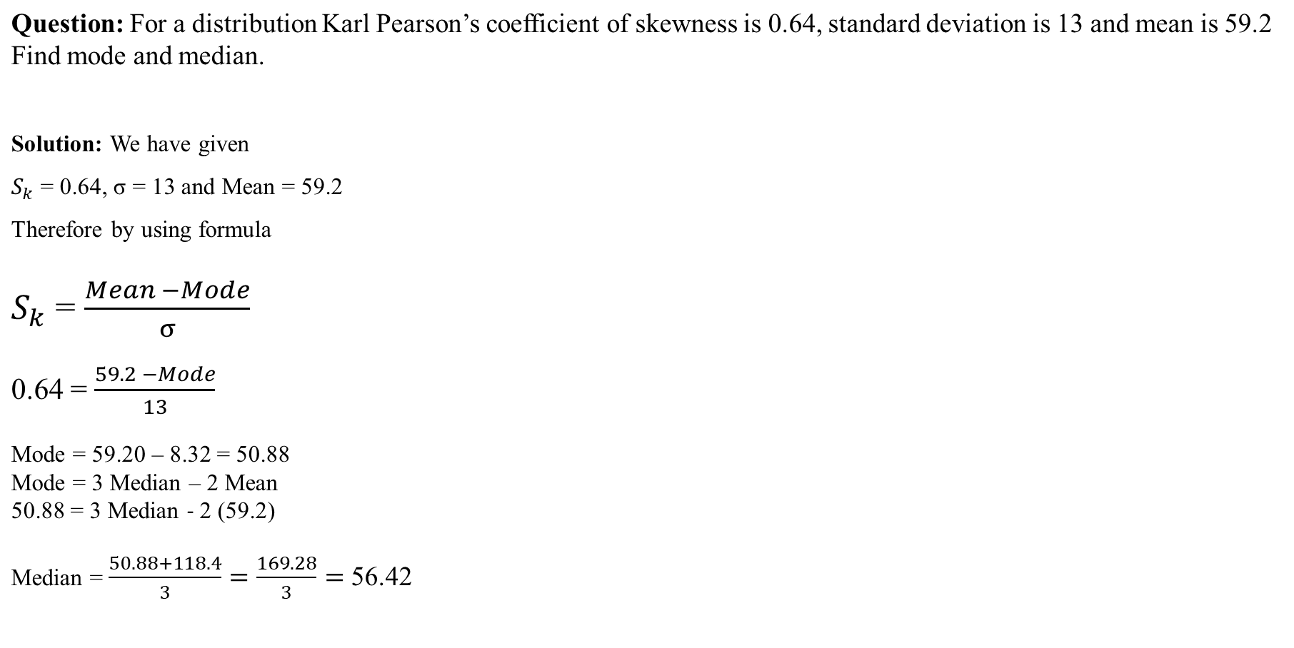
Example:

Slide 17
Homework:
Ques: The following are the marks of 150 students in an examination. Calculate Karl Pearson’s coefficient of skewness.
Marks | No. of Students
0-10 | 20
10-20 | 10
20-30 | 40
30-40 | 0
40-50 | 15
50-60 | 20
60-70 | 15
70-80 | 10
80-90 | 30

Slide 18
Moments:
In Statistics, moments is used to indicate peculiarities of a frequency distribution.
The utility of moments lies in the sense that they indicate different aspects of a given distribution.
Thus, by using moments, we can measure the central tendency of a series, dispersion or variability, skewness and the peakedness of the curve.
The moments about the actual arithmetic mean are denoted by μ.
The first four moments about mean or central moments are following:-

Slide 19
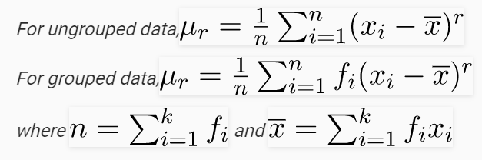
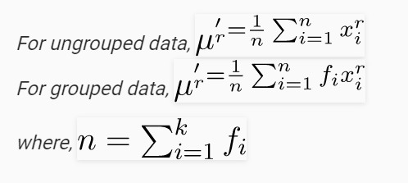
Moments:
Moments around Mean
Moments around any Arbitrary No

Slide 20
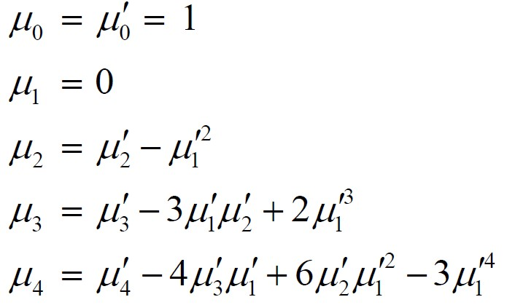
Conversion formula for Moments
(Mean)
1st moment:
2nd moment:
3rd moment:
4th moment:
(Variance)
(Skewness)
(Kurtosis)

Slide 21
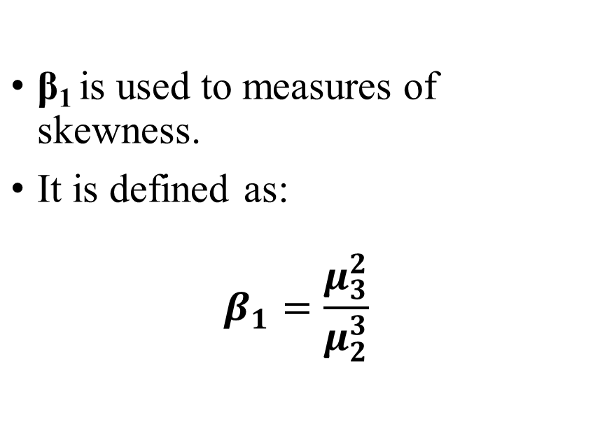
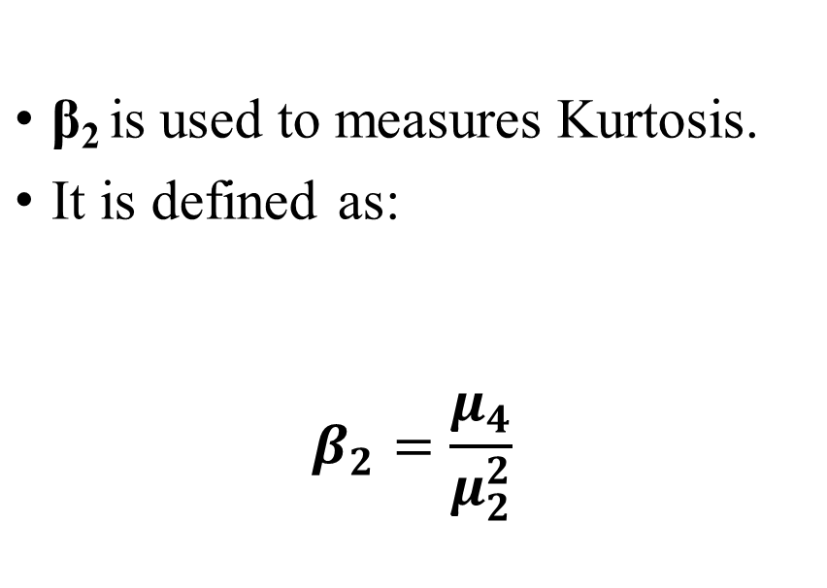
Two important constants calculated from μ_{2,} μ₃ and μ₄ are:-
β₁ (read as beta one)
β₂ (read as beta two)

Slide 22
Kurtosis
Kurtosis is another measure of the shape of a frequency curve. It is a Greek word, which means bulginess.
While skewness signifies the extent of asymmetry, kurtosis measures the degree of peakedness of a frequency distribution.
Karl Pearson classified curves into three types on the basis of the shape of their peaks. These are:-
  Leptokurtic
  Mesokurtic
  Platykurtic

Slide 23
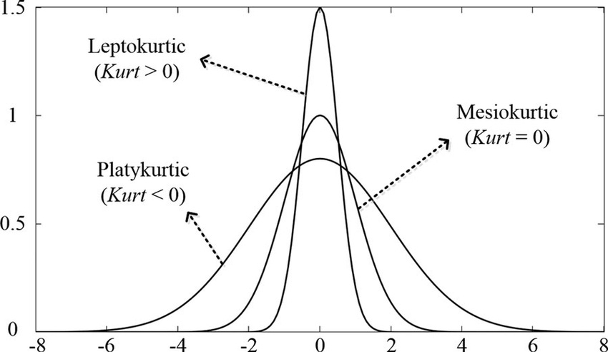
Kurtosis
When the peak of a curve becomes relatively high then that curve is called Leptokurtic.
When the curve is flat-topped, then it is called Platykurtic.
Since normal curve is neither very peaked nor very flat topped, so it is taken as a basis for comparison.
This normal curve is called Mesokurtic.

Slide 24
Measure of Kurtosis
There are two measure of Kurtosis:
Karl Pearson’s Measures of Kurtosis
Kelly’s Measure of Kurtosis

Slide 25
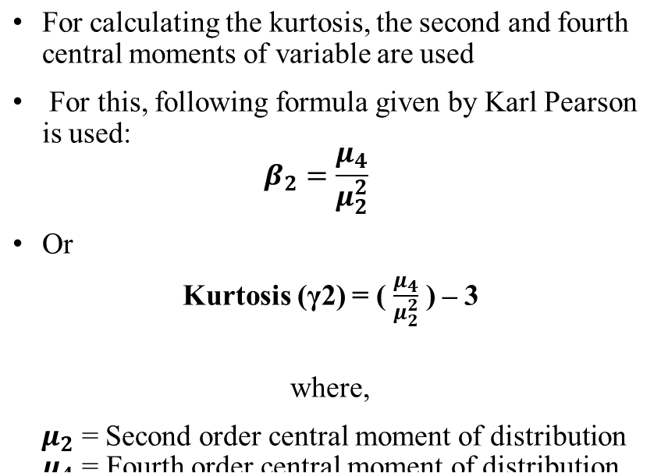
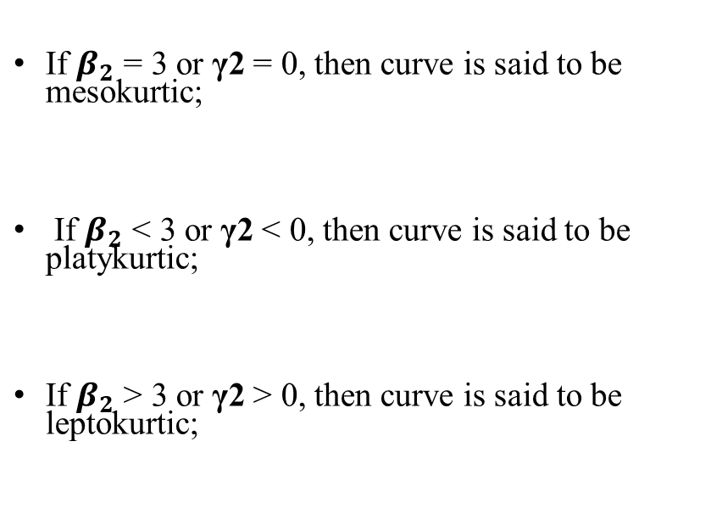
Karl Pearson’s Measures of Kurtosis
Formula
Result:

Slide 26
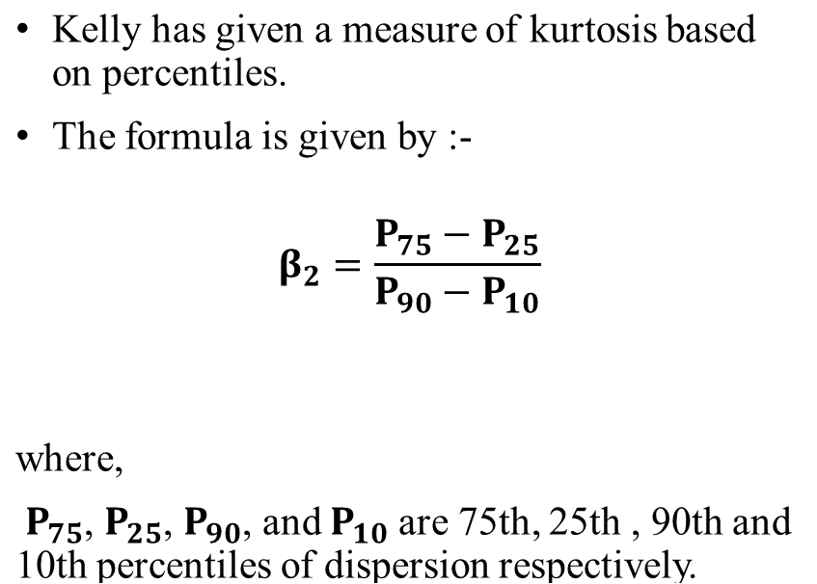
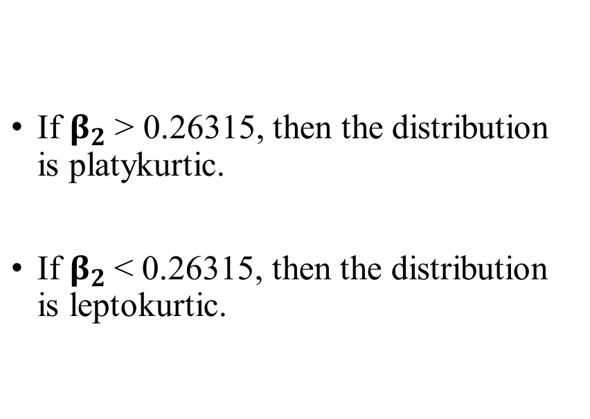
Kelly’s Measure of Kurtosis
Formula
Result:

Slide 27
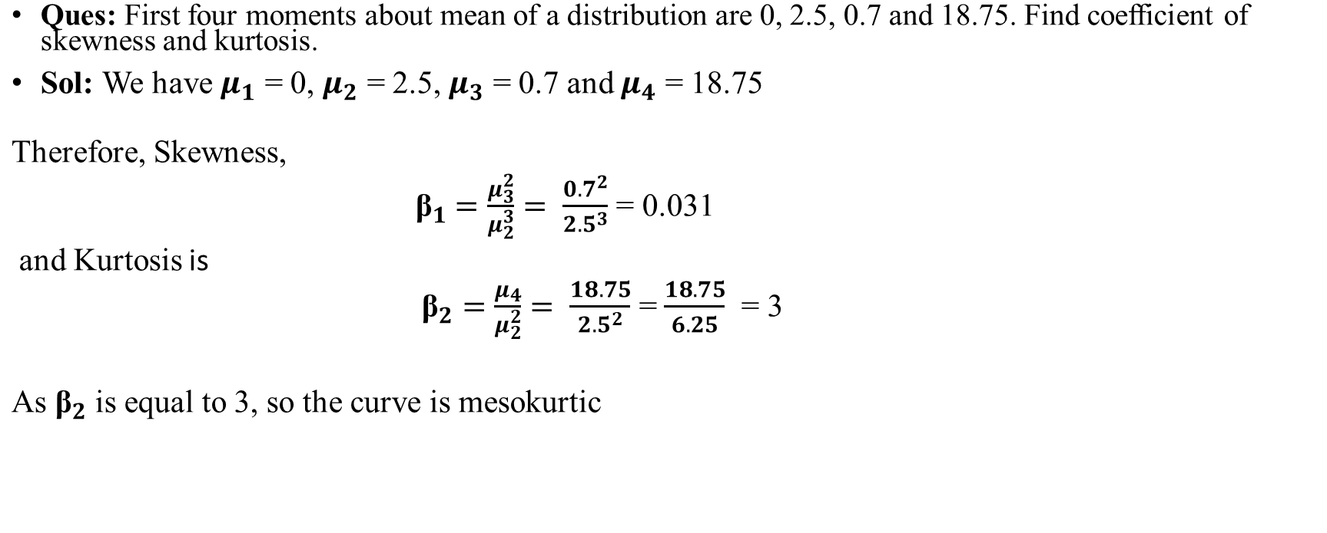
Example:

Slide 28
Homework:
Ques: The first four raw moments of a distribution are 2, 136, 320, and 40,000. Find out coefficients of skewness and kurtosis.

