Slide 1
Airflow

Slide 2
Why & What is Apache Airflow?
Managing workflows manually is error-prone
Need for automation, scheduling, dependency tracking
Airflow = “Cron on steroids” for data/ML pipelines
Open-source workflow orchestration platform
Created at Airbnb, now under Apache Foundation
Defines workflows as Python code using DAGs (Directed Acyclic Graphs)

Slide 3
Key Concepts
Term | Meaning
DAG | Workflow structure – defines the order of tasks
Task | A unit of work – usually a Python function or script
Operator | Template to run a specific kind of task (Python, Bash, etc.)
Scheduler | Decides when to run tasks
Executor | Decides how to run tasks (sequential, parallel, distributed)

Slide 4
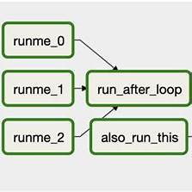
DAG – Directed Acyclic Graph
No loops, always moves forward
Defines dependencies clearly
Visualize DAGs in the UI
Simple example:
with DAG('my_dag', schedule_interval='@daily') as dag:
task1 >> task2 >> task3

Slide 5
Understanding the DAG Structure
Nodes (Boxes): Each box represents a task within the workflow.
Edges (Arrows): Arrows indicate dependencies between tasks, dictating the execution order.
Sequential Flow: Tasks like runme_0 → runme_1 → run_after_loop demonstrate a linear progression.
Parallel Tasks: Tasks such as runme_1 and runme_2 can execute simultaneously if they don't depend on each other.
Converging Paths: Multiple tasks leading into a single task, like also_run_this, indicate that it will execute after all upstream tasks are complete.

Slide 6
Creating a DAG in Airflow:
from airflow import DAG
from airflow.operators.bash import BashOperator
from datetime import datetime
with DAG(
dag_id='example_dag',
start_date=datetime(2023, 1, 1),
schedule_interval='@daily',
catchup=False
) as dag:
task1 = BashOperator(
task_id='runme_0',
bash_command='echo "Task 1"'
)
task2 = BashOperator(
task_id='runme_1',
bash_command='echo "Task 2"'
)
task3 = BashOperator(
task_id='run_after_loop',
bash_command='echo "Final Task"'
)
task1 >> task2 >> task3
In this script:​Apache Airflow+7Apache Airflow+7blog.adnansiddiqi.me+7
task1 executes first.
Upon successful completion of task1, task2 runs.
Finally, task3 executes after task2 completes.

Slide 7
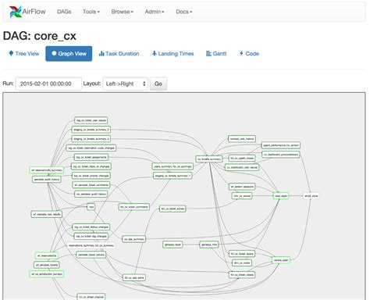
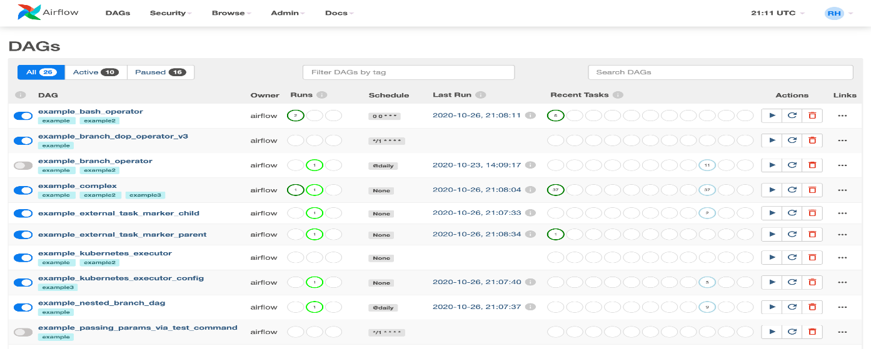
Sample DAG

Slide 8
Airflow Architecture
Web Server: UI to monitor pipelines
Scheduler: Triggers DAGs
Executor: Runs the tasks
Metadata DB: Stores DAG/task state
Workers: (Celery/Kubernetes) run the actual code

Slide 9
Types of Operators
Operator | Description
PythonOperator | Runs a Python function
BashOperator | Executes Bash commands
EmailOperator | Sends emails
DummyOperator | Placeholder
DockerOperator, KubernetesPodOperator | Run containers

Slide 10
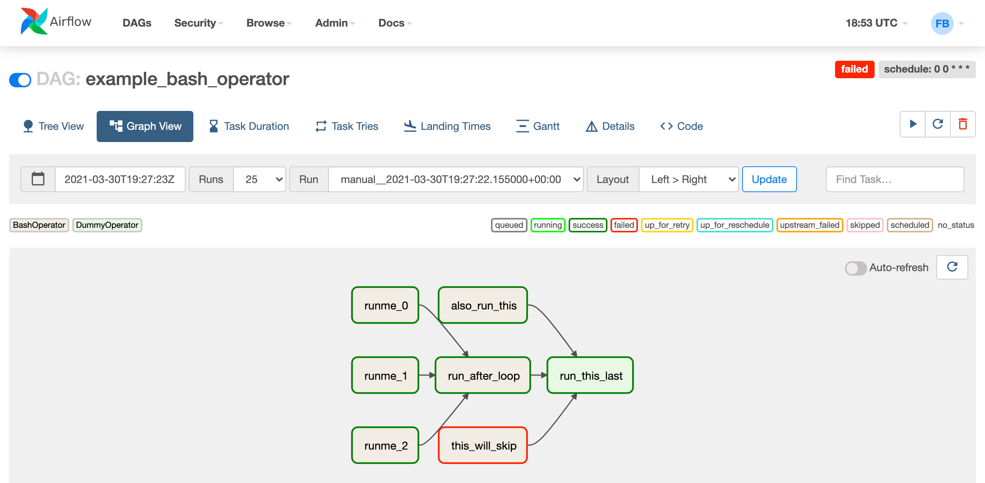
Scheduling and Triggers, Airflow UI & Monitoring
Set with schedule_interval (e.g., @hourly, @daily, cron)
Airflow runs tasks after the scheduled interval
Can run backfills or manually trigger
View DAG status, logs, task details
Retry, skip, or mark tasks as success
Useful for debugging and audit trails
Key Elements in the Graph View:
Nodes: Each box represents a task within the DAG.
Edges: Arrows indicate the dependencies and execution order between tasks.
Status Indicators: Colors reflect the current state of each task (e.g., green for success, red for failure).

