Slide 1


The Top 5 Categories

Slide 2


Today's agenda
Project recap
Problem
The Analytics team
Process
Insights
Summary

Slide 3

Social Buzz has engaged Accenture analytics to uncover insights from their social media data to inform strategic decisions.
The Accenture team will identify key trends around audience engagement, demographics, messaging, and content resonance.
Project Recap

Slide 4

Problem
Social Buzz has experienced massive growth in recent years to over 500M monthly active users
This rapid scaling has outpaced internal capabilities needed to leverage data insights
Over 100K pieces of daily user content is highly unstructured and complex to analyze
The engineering team is overallocated managing technology and infrastructure
Business strategy is suffering without analytics support
Lack of data-driven insights limits their ability to engage users and partners

Slide 5



Andrew Fleming
Chief Technical Architect
The Analytics team
Marcus Rompton
Senior Principle
Aditi Neema
Data Analyst

Slide 6
Process
1
Understanding Objective/Problem
2
Data Cleaning
3
Data Modeling
4
Data Analysis
5
Get Insights

Slide 7

Insights
1987 Engagement with Animals
January
with most posts
sfja
16
Categories

Slide 8
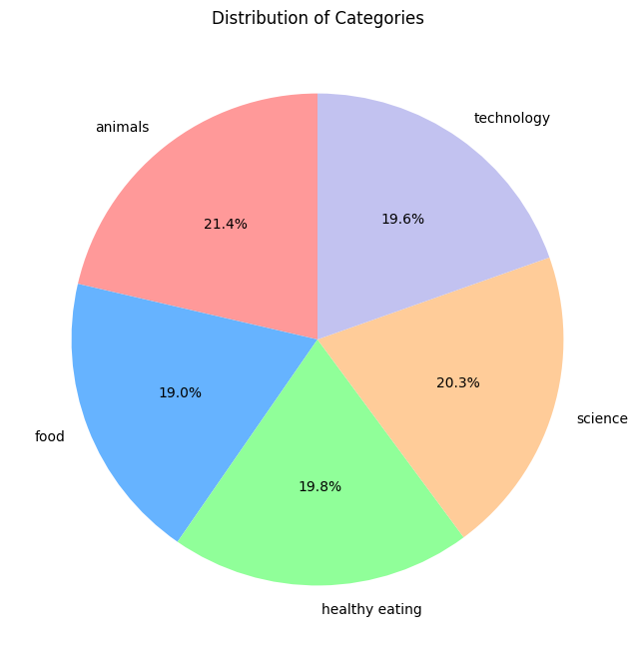

Slide 9
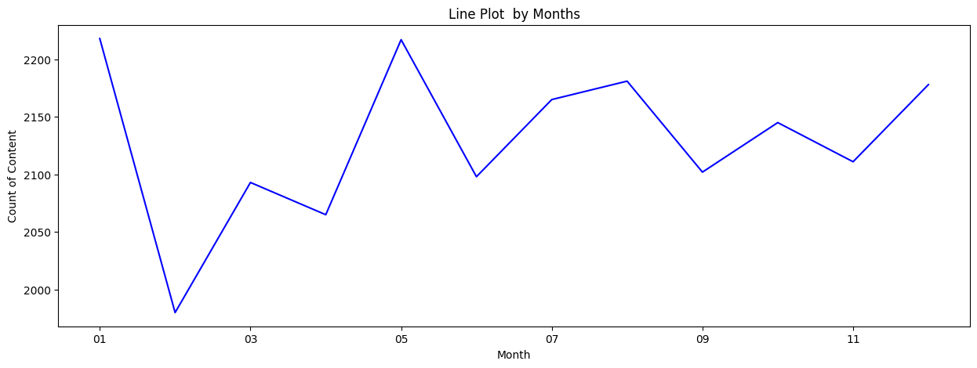

Slide 10

Category Appeal:
Content related to animals and technology stands out as consistently popular, reflecting specific interests within the audience.
Content-Type Dynamics:
Audio Content Dominance: Audio content takes the lead in user interaction, particularly with informative audio or music, providing a convenient, multitasking-friendly experience.
Versatility of Photo Content: Following closely, photo content exhibits versatility, accommodating a diverse range of topics—from memes and animals to science/tech visuals.
Seasonal Peaks:
Engagement peaks during summer and winter breaks, notably in January, March, and December. This temporal pattern suggests a substantial student demographic, capitalizing on leisure time during academic breaks.
Reaction Landscape:
Audio Engagement: High reactions for "want," "interested," and "heart" signify profound engagement, potentially tied to compelling, informative audio content.
Rich Palette for Photos: Photo engagement, while second, presents a rich palette with diverse reactions ("want," "interested," "heart," etc.), indicating a broad appeal encompassing memes, animal content, and informative visuals.
Summary

Slide 11
Thank you!
ANY QUESTIONS?

