Slide 1

Conversion
of raw sentence to
grammatical
sentence.
Aditi (BE/15086/17), CSE
Salvi Verma (BE/15048/17), CSE

Slide 2
CONTENTS
OBJECTIVE
INTRODUCTION
2.1 INTRO TO PHRASE-BASED SMT
MATHEMATICAL ANALYSIS
WORKFLOW
LANGUAGE MODEL TRAINING
TRAINING TRANSLATION SYSTEM
TUNING
TESTING
RESULTS
REFERENCES
THANK YOU NOTE

Slide 3
OBJECTIVE
The main objective is to transform the raw headline sentence into grammatically correct sentence.
Example:
Raw headline: 11 bitten by dog in Kollam
Grammatically transformed: 11 were bitten by a dog in kollam

Slide 4
INTRODUCTION
Statistical machine translation (SMT) is a machine translation paradigm where translations are generated on the basis of statistical models whose parameters are derived from the analysis of parallel corpora.
Moses is an implementation of the statistical (or data-driven) approach to machine translation (MT).
In phrase-based machine translation, Moses takes in the parallel data and uses occurrences of words and segments (known as phrases) to infer translation correspondences between continuous sequences of words.

Slide 5
INTRO TO PHRASE BASED SMT
The phrase-based approach has the ability to directly describe relation between strings of different lengths and improves modeling considerably.
This provides a direct relation between the source context and the target word selection. In addition, the phrases provide a much better model for local reordering than the distortion probability.
In translation, some source words seem to be deleted in translation, and some target words seem to appear out of nowhere. Deletions and insertions are dependent lexically on their context.

Slide 6
In the phrase based models many of the aspects of translation are modeled implicitly.
Phrase translation model: Given the availability of phrase correspondence (tˆ,sˆ), its probability is calculated as maximum likelihood estimation.
Distortion Model: Suppose, ai is the starting word position of the source phrase that is translated into the i th phrase position of the target sentence, and bi−1 is the ending word position of the source phrase that is translated into the i − 1 th position. The below function states the distortion model of PB-SMT.
Lexical weighting model: A phrase pair can be evaluated based on the probability of the alignments of the internal words. First, a word translation probability distribution is calculated from a word alignment of the parallel corpus using maximum likelihood estimation.
Word penalty: This model keeps into account the addition of the target word. This helps in language pairs where sentence in one language is shorter/longer.
Phrase penalty: This model either rewards or punishes each time a phrase pair is used. For example, this model helps in promoting the use of longer phrases by keeping into account the used phrase pair

Slide 7
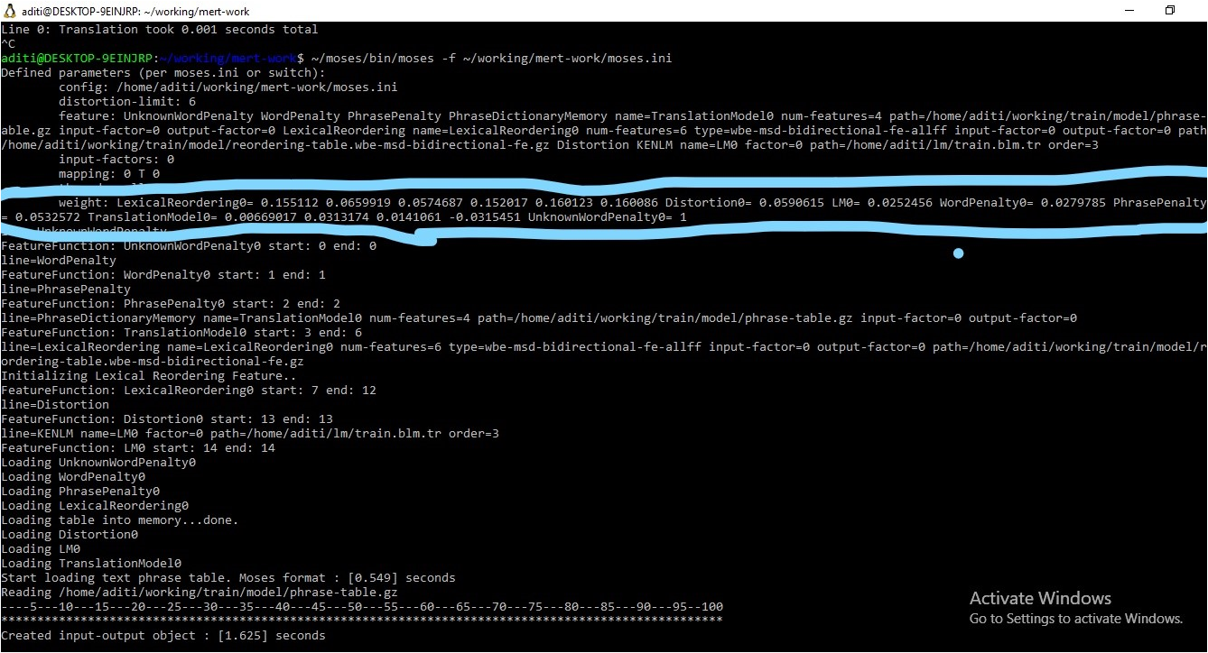

Slide 8
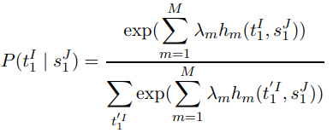

MATHEMATICAL FORMULATION
Instead of employing the Bayesian Theorem, the posterior probability P(t1 I / s1J ) is expressed as a set of M submodels hm(t1 I , s1J ), which are weighted by a model parameter λm.
Since the normalizing denominator only depends on the source sentence, it has no influence on the maximization of the entire probability. This leads to the following equation.
The model is also known as the log-linear model.

Slide 9
WORKFLOW
Compiling moses, GIZA++ in "moses" & "giza-pp" folder in Home directory respectively.
This link contains all the commands that has been used for moses installation.
https://drive.google.com/file/d/1oXTbNcmBp4hJeb86Brl_05tuE-0aQW6t/view?usp=sharing
Tokenizing, truecasing, cleaning and splitting data (randomizing) in 70-15-15 ratio as Training-Validation-Test sets.
Data files should be present in "corpus/split" folder in home directory as Train.clean.rw, Train.clean.tr, Validate.clean.rw, Validate.clean.tr, Test.clean.rw, Test.clean.tr
Language Model Training, Training Translation System, Tuning and Testing are done.
This link contains all the commands for this purpose.
https://drive.google.com/file/d/1CY19_eHamh-Bpp2N98jB9wt670EQ2Fl6/view?usp=sharing

Slide 10
LANGUAGE MODEL TRAINING
Moses includes the KenLM language model creation program, lmplz.
The language model (LM) is used to ensure fluent output, so it is built with the target sentence (i.e Translated Sentences in our case).
We have build a 3-gram language model using below commands.
~/moses/bin/lmplz -o 3 --discount_fallback <~/corpus/train.tok.tr > train.tok.arpa.tr
Then we binarised (for faster loading) the *.arpa.en file using KenLM.
~/moses/bin/build_binary train.tok.arpa.tr train.blm.tr

Slide 11
TRAINING TRANSLATION SYSTEM
To do this, we run word alignment (using GIZA++), phrase extraction and scoring, create lexicalized reordering tables and create a Moses configuration file, all with a single command.
nohup nice ~/moses/scripts/training/train-model.perl -root-dir train -corpus ~/corpus/split/train.clean -f rw -e tr -alignment grow-diag-final-and -reordering msd-bidirectional-fe -lm 0:3:$HOME/lm/train.blm.tr:8 -external-bin-dir ~/moses/tools >& training.out &

Slide 12
TUNING
Tuning requires a small amount of parallel data, separate from the training data. In our case 15% of the dataset has been used for tuning.
nohup nice ~/moses/scripts/training/mert-moses.pl ~/corpus/split/validate.clean.rw ~/corpus/split/validate.clean.tr ~/moses/bin/moses train/model/moses.ini --mertdir ~/moses/bin/ --decoder-flags "-threads all" &> mert.out &
The end result of tuning is an ini file with trained weights.

Slide 13
TESTING
We can now run Moses with
~/moses/bin/moses -f ~/working/mert-work/moses.ini
and type in our raw sentence for a query. To get the result press enter.
To test the model on our test data which comprises of 15% of our dataset
nohup nice ~/moses/bin/moses -f ~/working/train/model/moses.ini < ~/corpus/split/test.clean.rw > ~/working/test.translated.tr 2> ~/working/test.out
This creates a test.translated.tr file which can we viewed using any editor.

Slide 14
RESULTS
~/moses/scripts/generic/multi-bleu.perl -lc ~/corpus/split/test.clean.tr < ~/working/test.translated.tr
This is the exact command we used to compare the files test.clean.tr and test.translated.tr and to calculate the BLEU score.
The translated sentences obtained were fairly accurate.
METRIC
The BLUE Score obtained was 72. 60%.

Slide 15
REFERENCES:
Moses Installation Manual
http://www.statmt.org/moses/manual/manual.pdf
Mathematics of Statistical machine translation
http://luthuli.cs.uiuc.edu/~daf/courses/Signals%20AI/Papers/MIL-CSP/J93-2003.pdf
Transfer Grammar Engine and Automatic Learning of Reorder Rules in Machine Translation
http://web2py.iiit.ac.in/publications/default/download/mastersthesis.pdf.834564b3218a17d9.4176696e6573682d5468657369732e706466.pdf

Slide 16
THANK YOU!

