Slide 1
ONLINE FOOD DELIVERY SYSTEM
Team Members
Nikita Mane - EBEON1222703288
Aditi Pawar - EBEON1222703280
Rashmi Shingate - EBEON1222703290
Sapana Shinde - EBEON1222703323
Vaishnavk Dhanawade -
Guided by
Varadharajan sir

Slide 2
Online Food Delivery System
Login Module
Admin Module
Home Page
Add to Cart/ Order module
View product module
Address/Payment module
Bill module
About us , Contact us

Slide 3
Online Food Delivery System
1)Login module:
a)User Registration
b)Forgot Password
2)Admin module:
a)product:
1)View Product
2)Add Product
b)Order :
1)View All Orders
2)View Pending Orders
3)View Delivered orders
3)Home Page:
a)View All Product

Slide 4
Module
ADMIN MODULE
Admin Login
New Product
Edit Product
Message Received
Cancel orders
Delivered orders

Slide 5
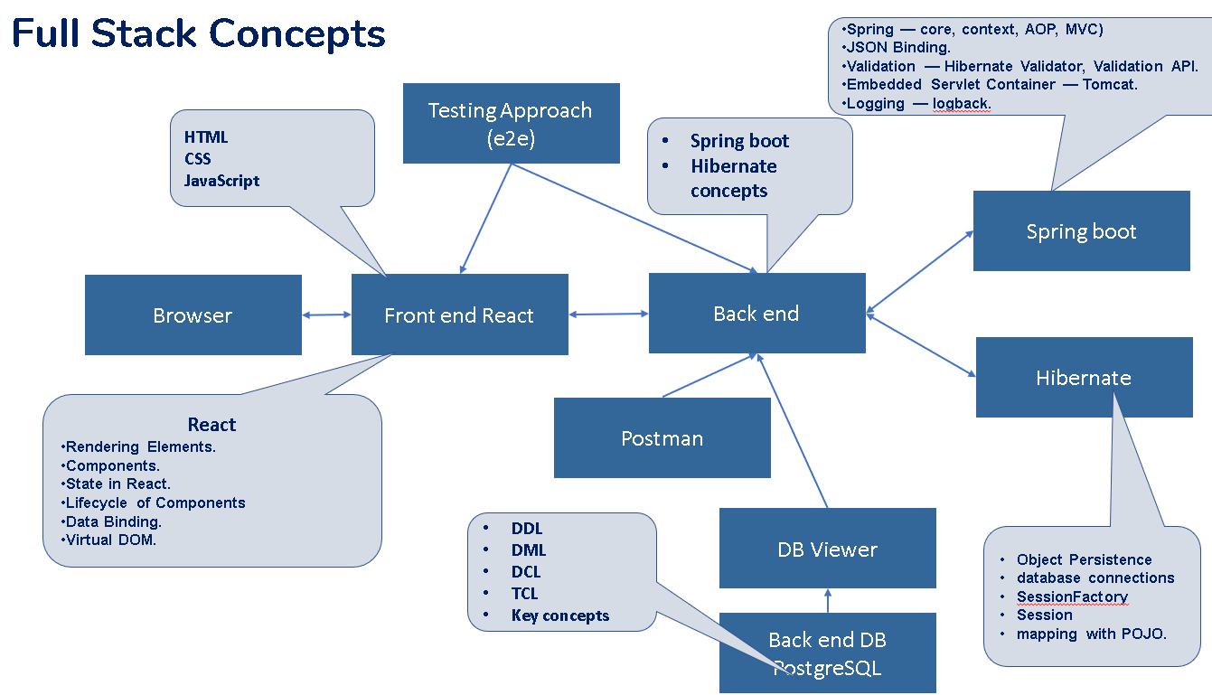
Tech architecture
TECHNOLOGY
JAVA
HTML
CSS
MYSQL
USED:
ECLIPSE
MYSQL DB
TOMCAT SERVER

Slide 6
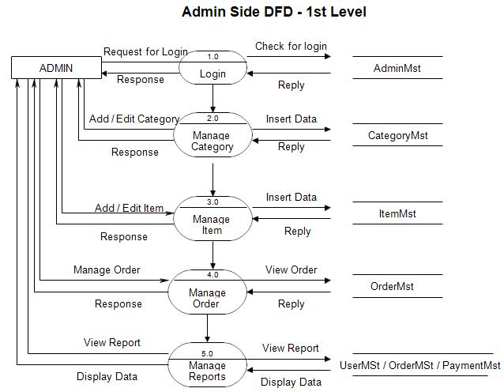
Project overview

Slide 7
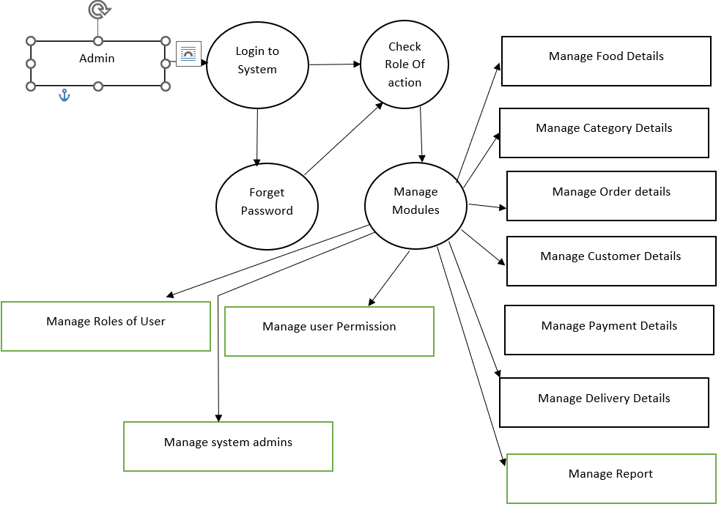
Dataflow diagram

Slide 8
Challenging issues
1) While Running project port no. problem
2)Issues faced during database connectivity
3)Changes made in code are not reflected into live Project

Slide 9
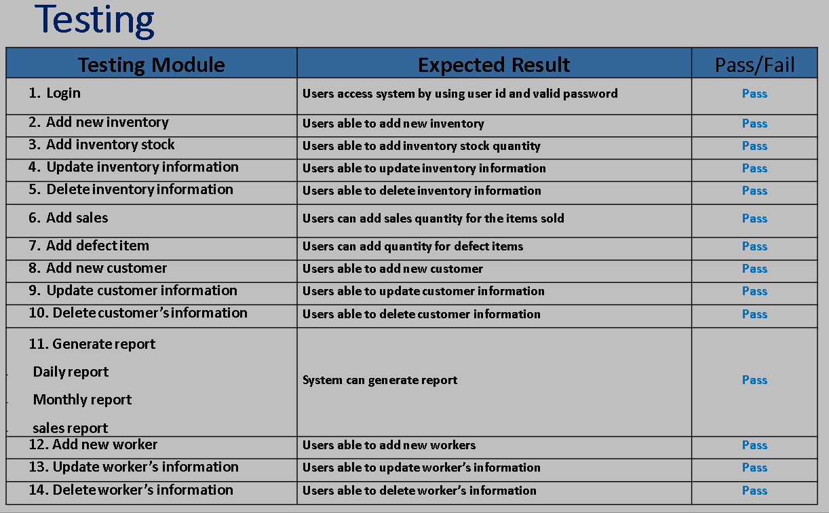
Testing
Tested result
Testing tools approach information
Zero defect certification information
Refer the example

Slide 10
Features about the module
Admin can Add new items
Admin can edit items present in the database if changes are requires
Admin can view messages from users.
Admin can view Process of product delivery
Admin can cancel/deliver order status from his side of the products.

Slide 11
Future enhancement
1. Real-Time GPS Tracking
Real-time GPS tracking is one of the essential features of food delivery apps that enable customers to track the location of their food in real-time. The purpose of GPS is to offer two-way tracking as well as functioning.
2. Social Media Integration
There’s no doubt that in the past few years, social media has contributed a lot to online marketing. It is one of those unpretentious viewpoints which improve customers’ decisions. With social media integration, customers can easily share photos or videos of their favorite dishes with friends and family
3. Order scheduling and pickup
The order scheduling and pickup feature are handy for such situations. Using it, they can schedule the order at their convenience and pick it up on the way home from the office. This way, they can save precious time and ensure they enjoy a warm, romantic dinner with their significant other.

Slide 12
Conclusion
Online food delivery websites are becoming increasingly popular due to their convenience and time-saving features.
This project is made in such a way that it is easy to use/ handle for new users
Person with little technical knowledge can also use/ interact with this project
User Friendly GUI.

