Slide 1
AI AUTOMATION & APPLICATIONS OF AI
AI-Powered HR
Recruitment Automation
Aditi Dwivedi 2520981505
Chahat Verma 2520981517
Isha Soni 2520981531
Vishavjeet Singh 2220931506
Simple HR Recruitment Workflow using n8n + Power BI
MBA Programme | AI Automation & Applications of AI

Slide 2




THE PROBLEM
Manual Recruitment is Broken
Time-Consuming Sorting
Human Error
HR teams spend 6–8 hours/day manually screening CVs and sorting candidates by experience.
Manual data entry leads to misfiled applications, missed candidates, and inconsistent decisions.
Delayed Notifications
No Visibility
Candidates wait days or weeks for updates — harming employer brand and candidate experience.
No real-time dashboard means hiring managers make decisions without data.
Result: HR teams lose 40% of productive time to administrative recruitment tasks.

Slide 3
THE SOLUTION
AI-Powered Recruitment Pipeline
01
02
03
Google Form
Google Sheets
n8n Trigger
Candidates apply via structured form
Data stored automatically in real-time
New row detected → workflow fires
04
05
06
AI Logic
Email Alert
Power BI
Auto-categorize: Shortlisted or General Pool
HR team notified instantly
Live dashboard for data-driven hiring

Slide 4




CANDIDATE DATA OVERVIEW
Real responses from our batch — April 2026
23
10
13
6.4
Total Applicants
Shortlisted (≥5 yrs)
General Pool (<5 yrs)
Avg. Years Experience
Top Shortlisted Candidates
Shortlisted vs General Pool
Candidate | Exp (yrs) | Status
Kriti Dwivedi | 5 | ✓ Shortlisted
Harshit | 5 | ✓ Shortlisted
Isha Soni | 5 | ✓ Shortlisted
Shashi Prabha | 23 | ✓ Shortlisted
Viraj | 6 | ✓ Shortlisted
Jaskirat Singh Rangi | 12 | ✓ Shortlisted

Slide 5
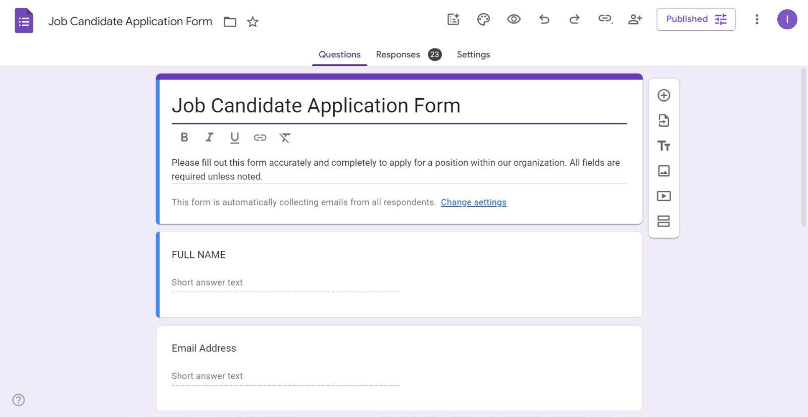

Slide 6
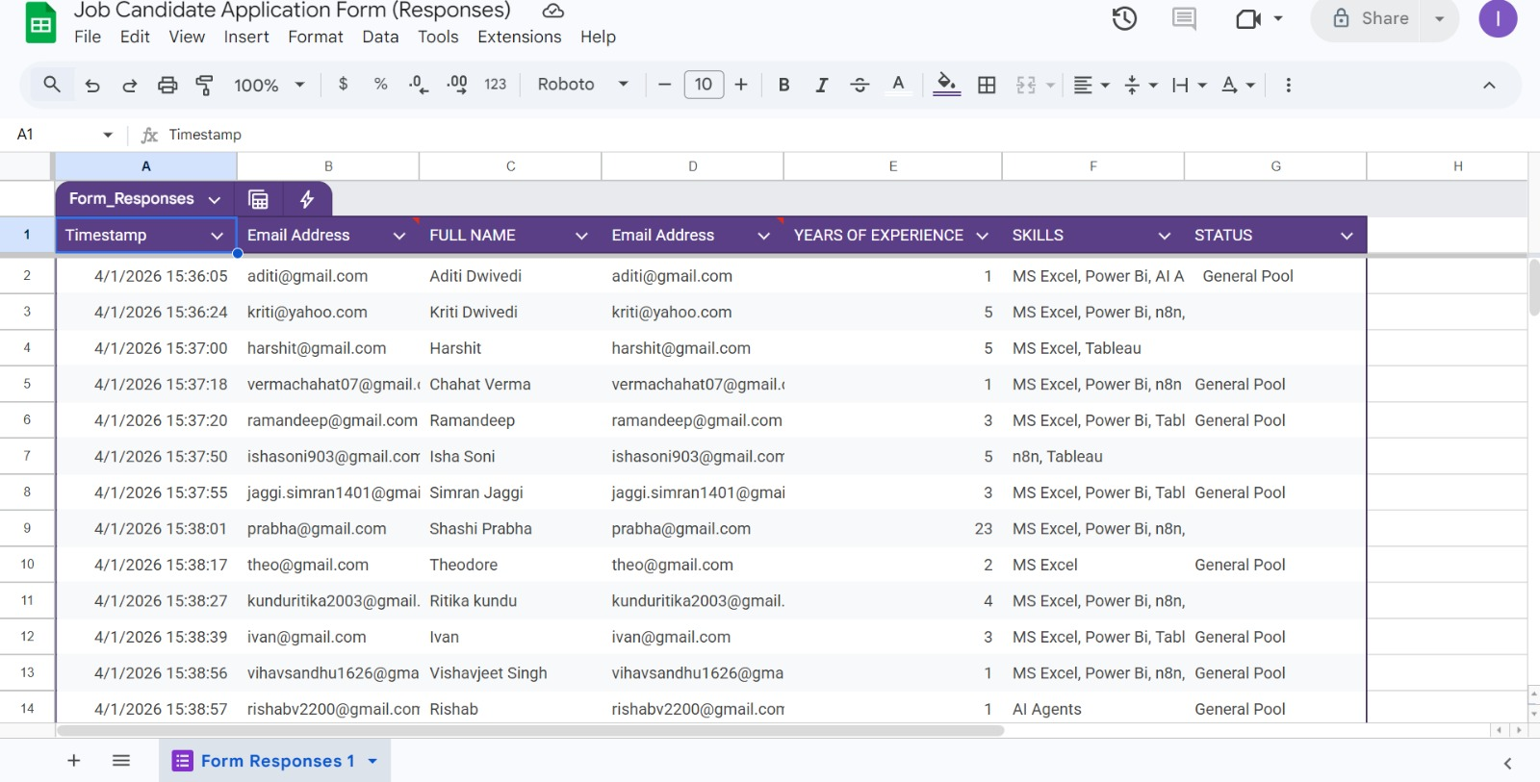

Slide 7
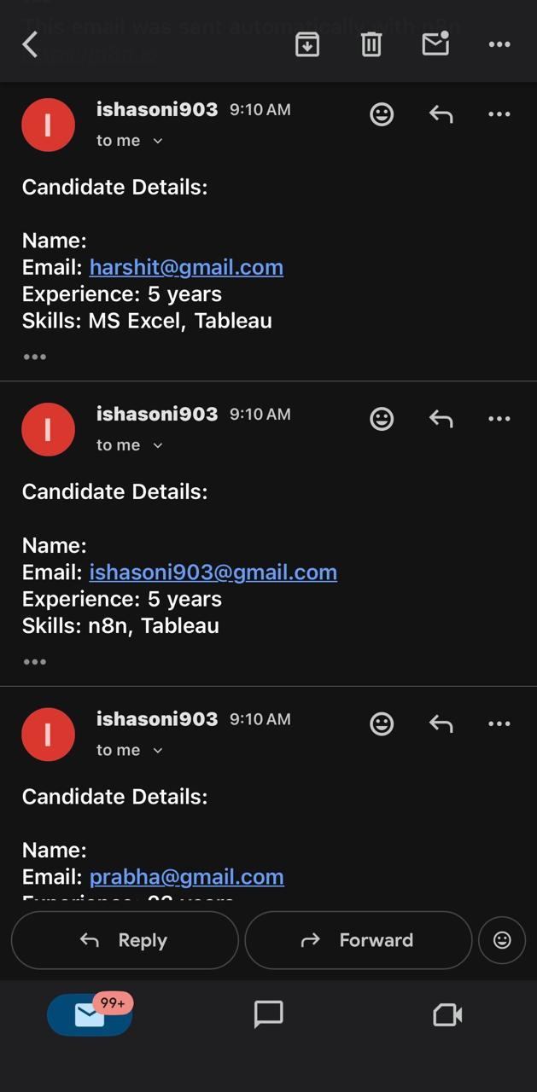

Slide 8





THE n8n WORKFLOW
Google Sheets
Trigger
IF Node
Experience ≥ 5?
Label Node
Shortlist / Pool
Email Node
Notify HR
Write Node
Update Sheet
▶
▶
▶
▶
Fires on new row
Branching logic
Auto-categorize
Instant alert
Status updated
SHORTLIST RULE:
Candidates with ≥ 5 Years of Experience → Shortlisted | < 5 Years → General Pool
Key Workflow Facts
3–4 nodes only — simple, maintainable workflow
Triggers in real-time — no manual polling needed
100% automated — zero HR intervention required
Scalable to 1,000+ applicants per batch
3–4 nodes only — simple, maintainable workflow
Triggers in real-time — no manual polling needed
100% automated — zero HR intervention required
Scalable to 1,000+ applicants per batch

Slide 9
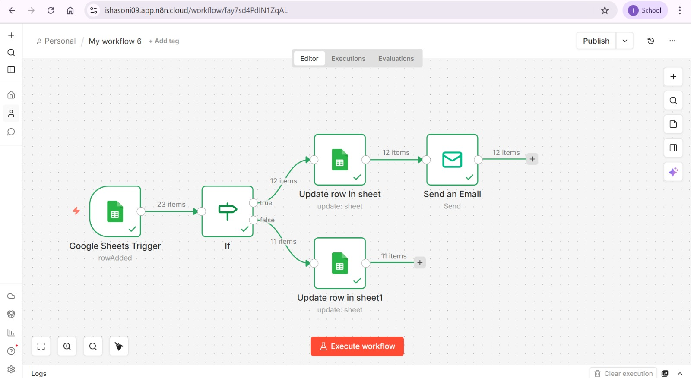

Slide 10
CATEGORIZATION RESULTS — BATCH APRIL 2026
Skills in Applicant Pool
MS Excel
20
Power BI
14
Tableau
16
n8n
9
AI Agents
8
Flowwise
5
Green = Shortlisted (≥5 yrs) | Grey = General Pool (<5 yrs)
43% Shortlisted | 57% General Pool

Slide 11
POWER BI DASHBOARD
Data-Driven Hiring Decisions
23
10
13
6.4 yrs
Total Applicants
Shortlisted
General Pool
Avg Experience
Recruitment Funnel
Avg Exp by Category
Applications Received (23)
Reviewed by n8n (23)
Shortlisted (≥5 yrs) (10)
General Pool (13)
Connected live via Google Sheets → Power BI refresh — real-time hiring intelligence

Slide 12
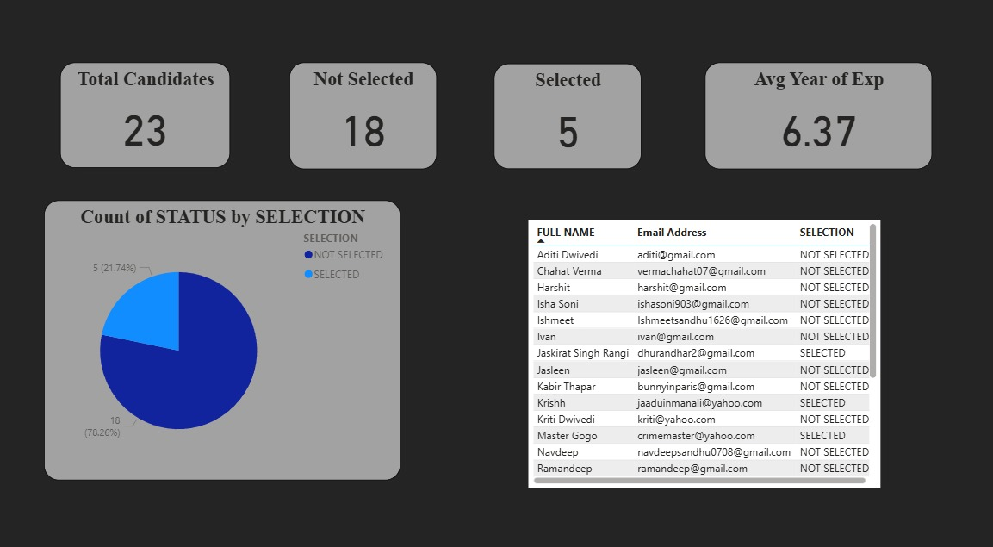

Slide 13
TIME SAVINGS
Manual vs. Automated Recruitment — Time Comparison
Task | Manual Process | With n8n Automation | Time Saved
Reviewing each CV | 5–8 min/CV | 0 min (automated) | ~5–8 min/CV
Sorting 23 applicants | 2–3 hours | < 30 seconds | ~2.5 hours
Updating spreadsheet | 1–2 hrs/day | Instant (real-time) | ~1.5 hrs/day
Sending notifications | 30–60 min/day | 0 min (auto-email) | ~45 min/day
Generating HR report | 2–4 hrs/week | Live Power BI dashboard | ~3 hrs/week
TOTAL (per 23 applicants) | ~8–10 hours | < 5 minutes | ~97% reduction
⏱ 8–10 hours → under 5 minutes
97% reduction in screening time per batch

Slide 14
COST SAVINGS ANALYSIS
Assumptions: HR Manager salary ₹8 LPA (₹42/min) | 4 hiring cycles/year | 100 applicants/cycle | 10 HR hours/cycle saved
Period | Manual Cost | Automated Cost | Cost Saved | Saving %
Per Hiring Cycle | ₹25,200 | ₹2,100 | ₹23,100 | 92%
Year 1 (4 cycles) | ₹1,00,800 | ₹8,400 | ₹92,400 | 92%
Year 3 | ₹3,02,400 | ₹25,200 | ₹2,77,200 | 92%
Year 5 | ₹5,04,000 | ₹42,000 | ₹4,62,000 | 92%
₹4.62L
~2x
92%
5-Year Cost Savings
ROI on Automation Cost
Reduction in HR Admin Cost

Slide 15





FUTURE BUSINESS IMPACT
What AI Automation Really Changes for HR
Faster Time-to-Hire
Higher Quality Hires
Improved Candidate Experience
Average recruitment cycle drops from 30–45 days to 10–15 days. First shortlist ready within minutes of application deadline.
Consistent, bias-free rule enforcement ensures only experienced candidates reach interview stage. No human error in screening.
Automated emails confirm receipt and status instantly. 78% of candidates prefer companies that communicate quickly (LinkedIn, 2024).
−60% hiring time
Zero screening errors
78% prefer fast response
HR Team Refocused
Data-Driven Decisions
Scalable for Growth
HR shifts from administrative work to strategic activities — culture building, interviews, and onboarding. Higher-value work.
Power BI dashboard gives management real-time visibility into the pipeline — no more 'gut feel' hiring decisions.
The same n8n workflow handles 23 or 2,300 applicants without additional HR headcount. Built to scale.
40% more strategic time
100% data-backed
0 marginal cost to scale

Slide 16
BEFORE VS. AFTER AUTOMATION
BEFORE — Manual Process
AFTER — n8n + Power BI
HR manually reads every CV
Data entered into Excel by hand
Errors in categorisation common
Notifications sent manually (batch)
No real-time dashboard
8–10 hours per hiring cycle
₹25,200 cost per cycle
Decisions based on intuition
n8n reads & categorises automatically
Google Sheets updated in real-time
Rule-based: 100% consistent decisions
Email sent instantly on application
Live Power BI dashboard always-on
< 5 minutes per hiring cycle
₹2,100 cost per cycle
Decisions backed by live data
Same outcome. Fraction of the time. A fraction of the cost. Zero human error.

Slide 17
KEY TAKEAWAYS
AI Automation Transforms
Recruitment — Permanently.
97% reduction in screening time — from 8–10 hrs to < 5 mins
₹4.62 lakh saved over 5 years — at zero additional headcount
Consistent, bias-free shortlisting using ≥5 year experience rule
Real-time Power BI dashboard enables data-driven hiring
Scalable: same workflow works for 23 or 2,300 applicants
Module: AI Automation & Applications of AI | MBA Programme | April 2026

