Slide 1
Waste Water Management
INDUSTRY NAME: Fun Water Parks
INDUSTRY ID: IN6S248F
DAILY ALLOWANCE: 600 Litres
Water Quality | Water Flow Rate | Credits Earned | Time Stamp
12

Slide 2
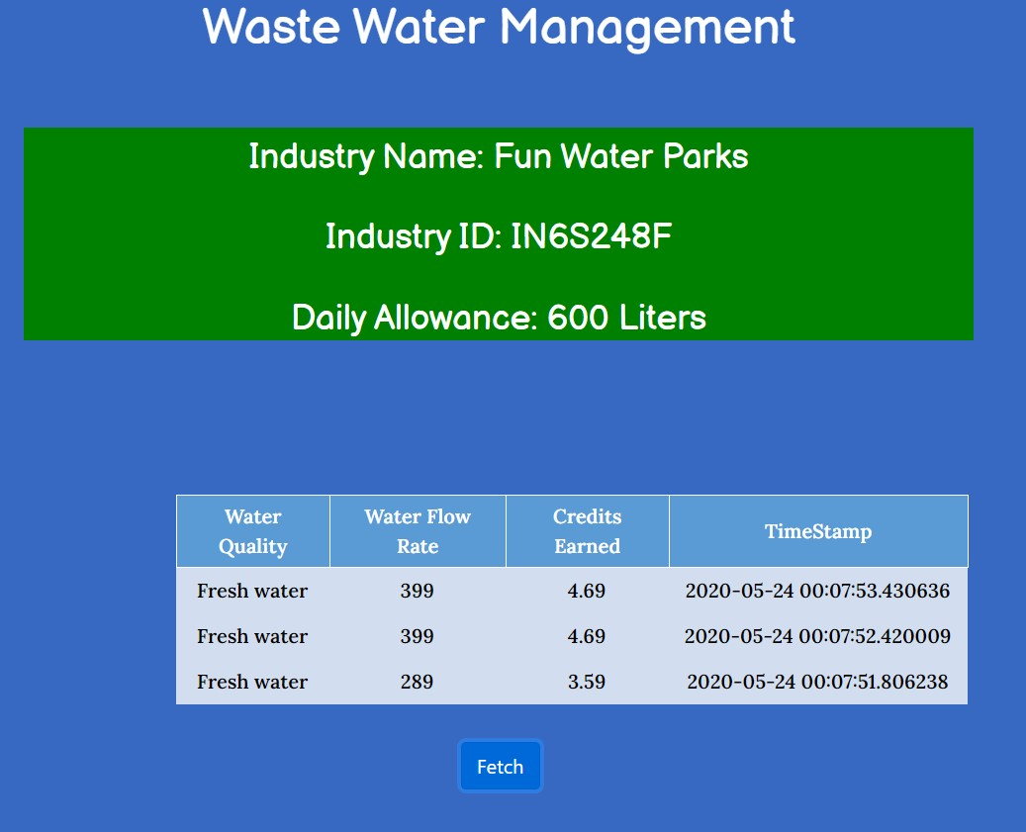
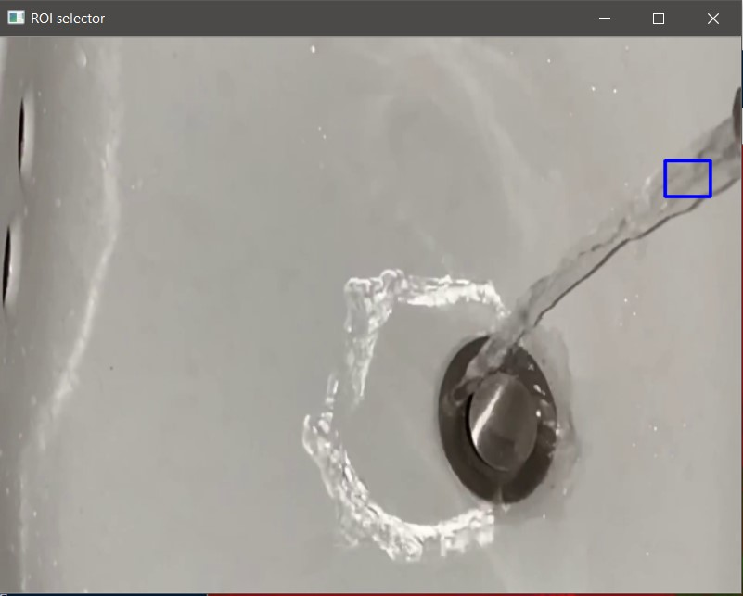
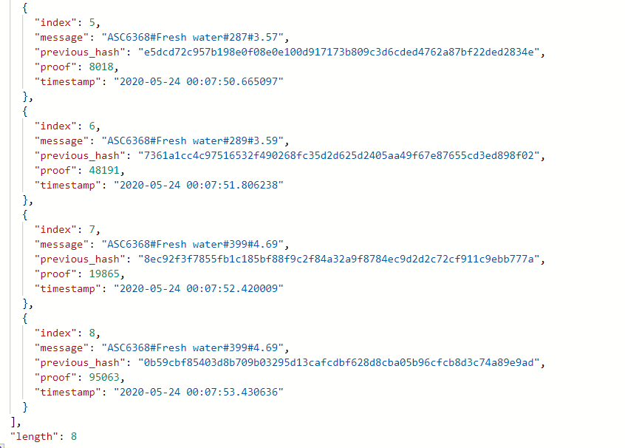
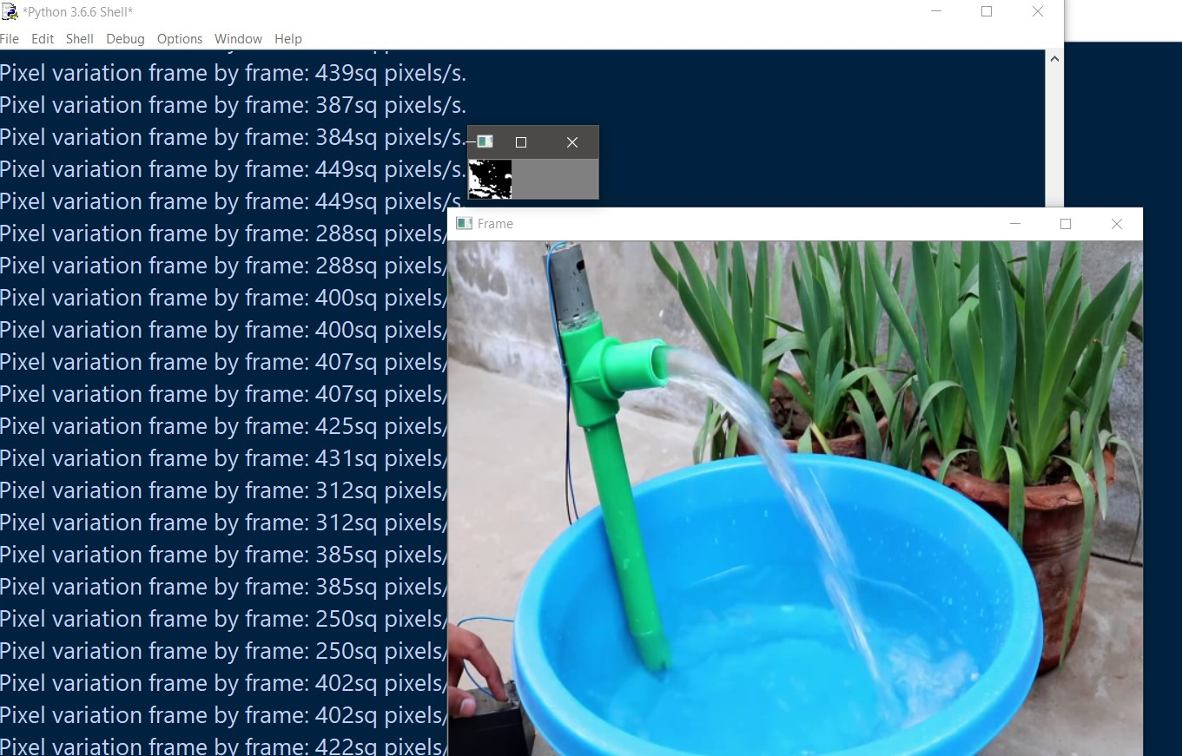
Block-Squid
Managing Waste water with Blockchain

