Slide 1
PROJECT TITLE
CAPSTONE PROJECT
Presented By:
Student Name : Secure Data Hiding in Image Using Steganography
College Name & Department : Government College of Engineering Awasari , Pune [ENTC]

Slide 2
OUTLINE
Problem Statement
Technology used
Wow factor
End users
Result
Conclusion
Git-hub Link
Future scope

Slide 3
Problem Statement
The problem is to design and implement a system that enables the hiding of confidential or secret data within an image using steganographic techniques.
The system should allow for embedding hidden information (text, files, etc.) into an image without noticeably altering the image’s appearance.
Ensure that the hidden data is concealed in such a way that it is not easily detectable by unauthorized individuals.
By solving this problem, the system can provide a secure means of communicating confidential data, which is useful in various fields

Slide 4
Technology used
VS code
Python Liberies
Tkinter : It is a thin object-oriented layer on top of the Tcl/Tk GUI toolkit and provides a simple way to build windows, dialogs, buttons, labels, and more, allowing developers to create desktop applications with ease.We use filedialoug and messagebox from this Libery
Pillow : Pillow provides a wide range of image manipulation capabilities, such as opening, manipulating, and saving various image file formats, making it ideal for tasks like image editing, creation, and transformation.
Os : It allows you to perform operations such as file and directory manipulation, environment variable handling, and working with processes.
Stengo : This library in Python is a simple and easy-to-use library for performing steganography — the technique of hiding information (like text or files) inside images. It allows you to embed secret messages within images, making it useful for privacy and communication applications.

Slide 5
Wow factors
Encryption adds a layer of security to the hidden data. Before embedding a message or a file inside an image, encrypt it using a secure encryption algorithm. This ensures that even if the hidden data is extracted, it remains unreadable without the correct decryption key.
In some advanced steganographic techniques, data can be hidden across multiple layers or locations within an image (also called spread spectrum or multi-layered steganography). This technique can disperse the data across multiple pixels or color channels in a way that makes it difficult to detect the hidden data.
Using high-resolution or complex images to hide data can help obscure the presence of hidden information. By embedding data in large images with minimal visual changes, it becomes harder for someone to detect the hidden message.

Slide 6
End users
The end users of data hiding in images using steganography are typically individuals, organizations, or systems that require secure communication and data protection.
Private Individuals
Cybersecurity Professionals
Governments and Law Enforcement
Journalists and Activists
Corporate and Enterprise Users
Cryptocurrency Users

Slide 7
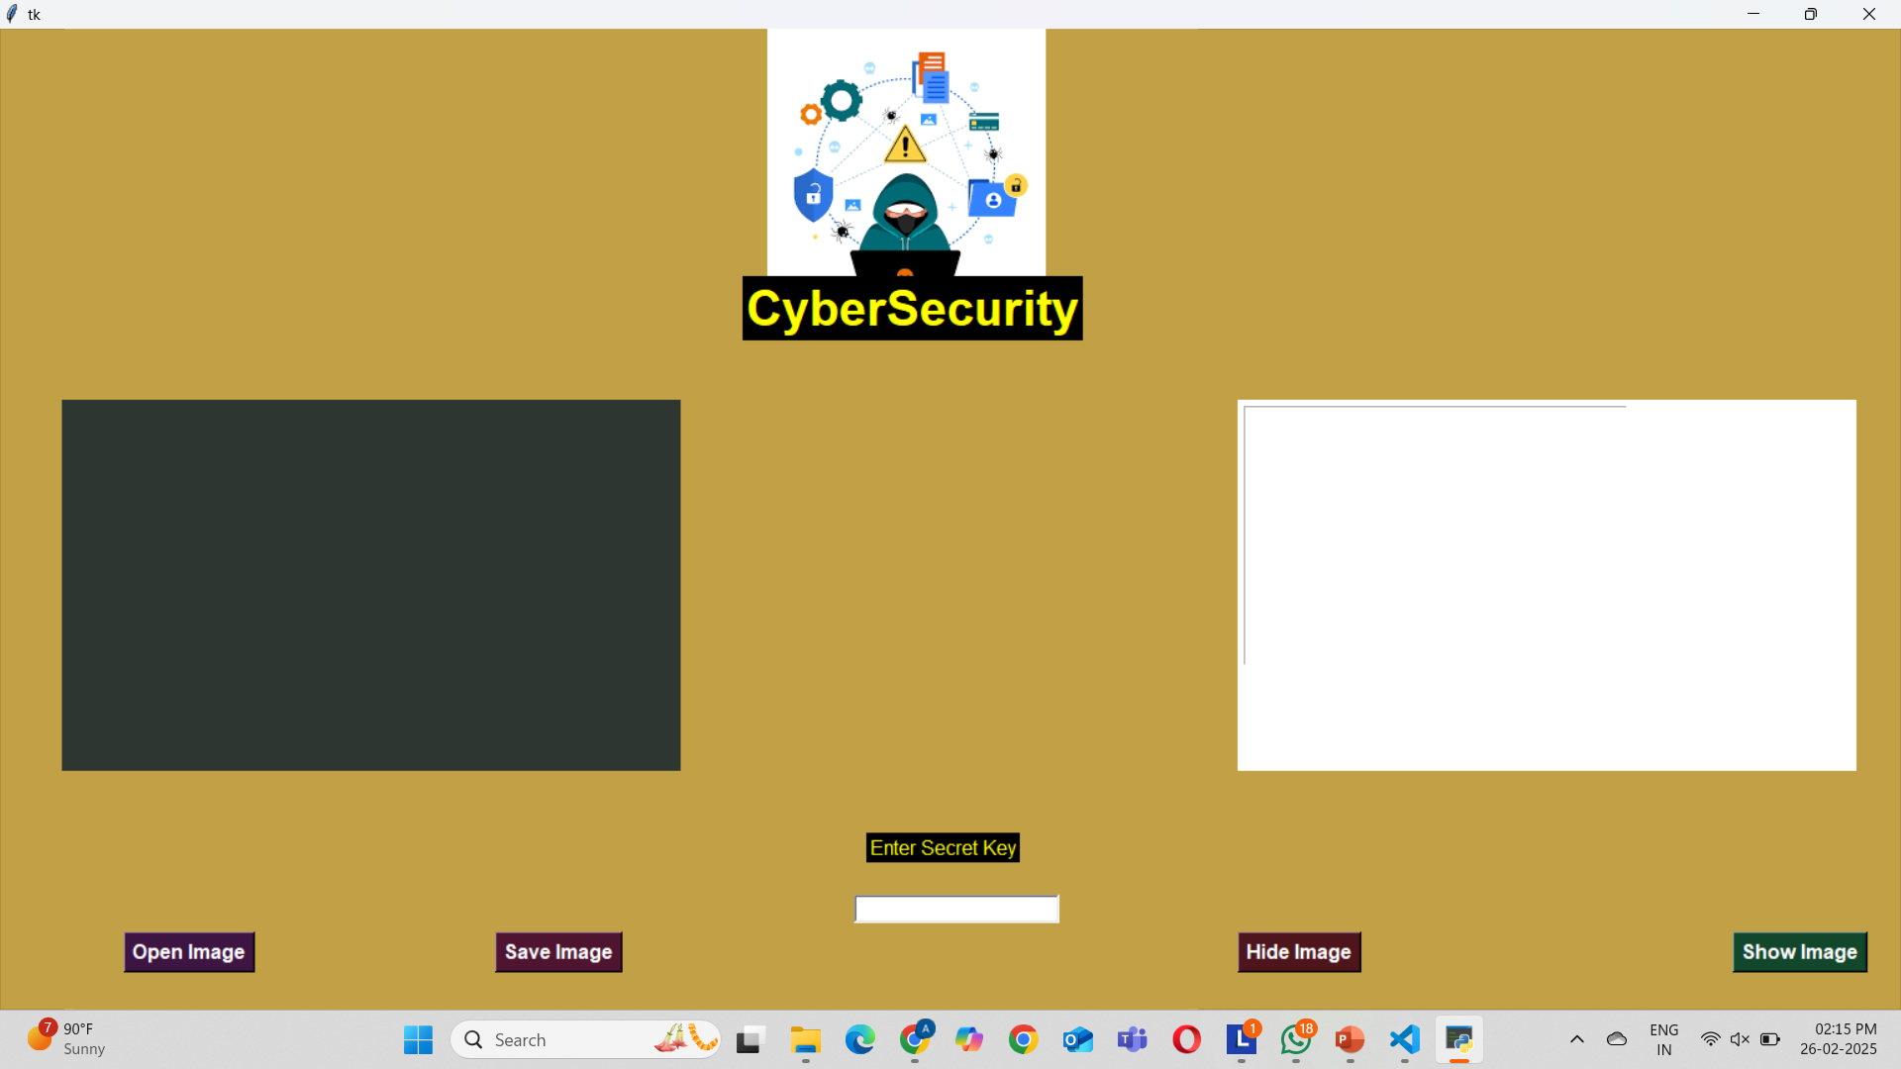
Results

Slide 8
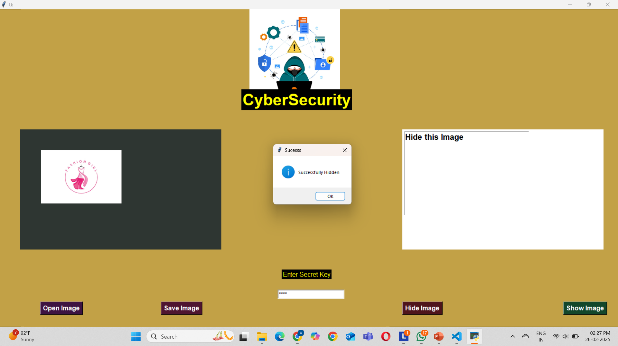
Data hidden Successfully

Slide 9
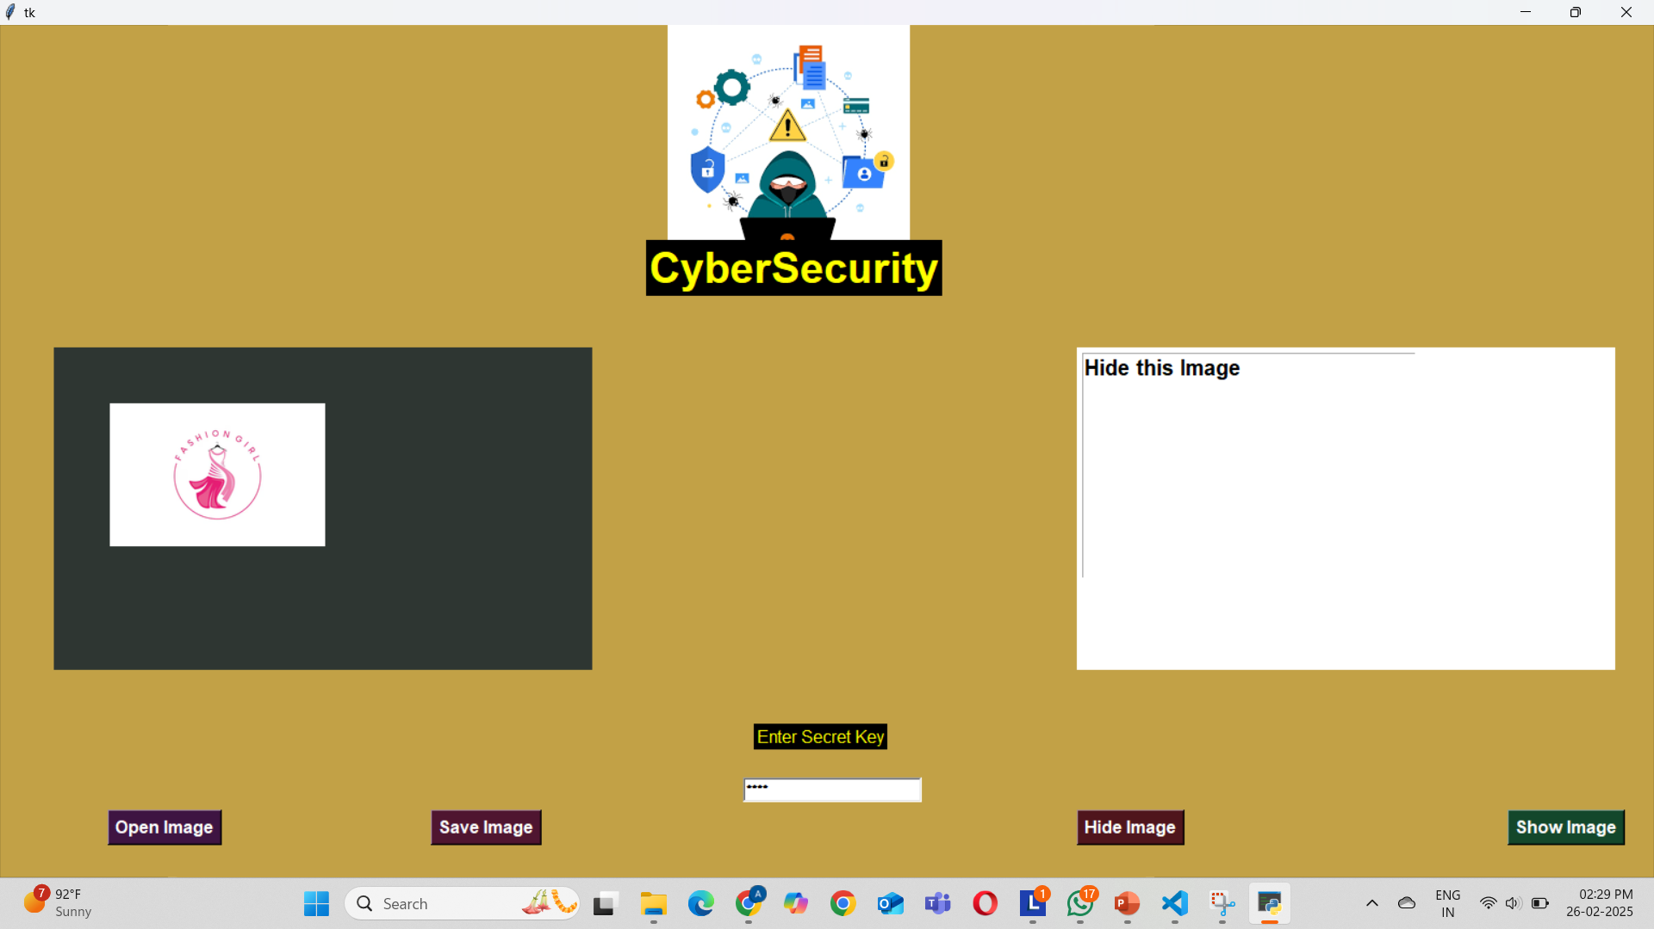
View of text

Slide 10
Conclusion
,
Steganography, the practice of hiding data within images, offers a unique and powerful method for securing sensitive information across various domains. The technology is used by a diverse range of end users, including private individuals, cybersecurity professionals, governments, law enforcement agencies, journalists activists, corporate entities, military personnel, cryptocurrency enthusiasts, and digital forensics experts.
By embedding secret messages or files within digital images, steganography ensures that data remains
concealed from unauthorized access while providing secure communication and privacy.
The use of advanced techniques such as encryption, error detection, multi-layered embedding, and randomized hiding locations enhances the security and robustness of hidden data, making it harder for adversaries to detect or extract the information.

Slide 11
As digital threats continue to evolve, the importance of steganography will grow, particularly in contexts where confidentiality, integrity, and secure communication are crucial. From protecting personal privacy to safeguardingsensitive corporate or government data, steganography provides a valuable tool for maintaining privacy and security in an increasingly digital world. Ultimately, the unique feature of steganography lies in its ability to seamlessly integrate security into everyday digital images,making it an essential technique for anyone who requires covert, reliable, and resilient methods of data hiding and protection.

Slide 12
GitHub Link
Github Link : https://github.com/aditi15122003/secure-data.git

Slide 13
THANK YOU

