Slide 1

CS229
HUMAN ACTIVITY
RECOGNITION
UNDER MENTORSHIP OF:
Dr. Jimson Mathew
Associate Professor
IIT Patna
PROJECT BY:
Aditi Goel
1901CS04
IIT PATNA

Slide 2
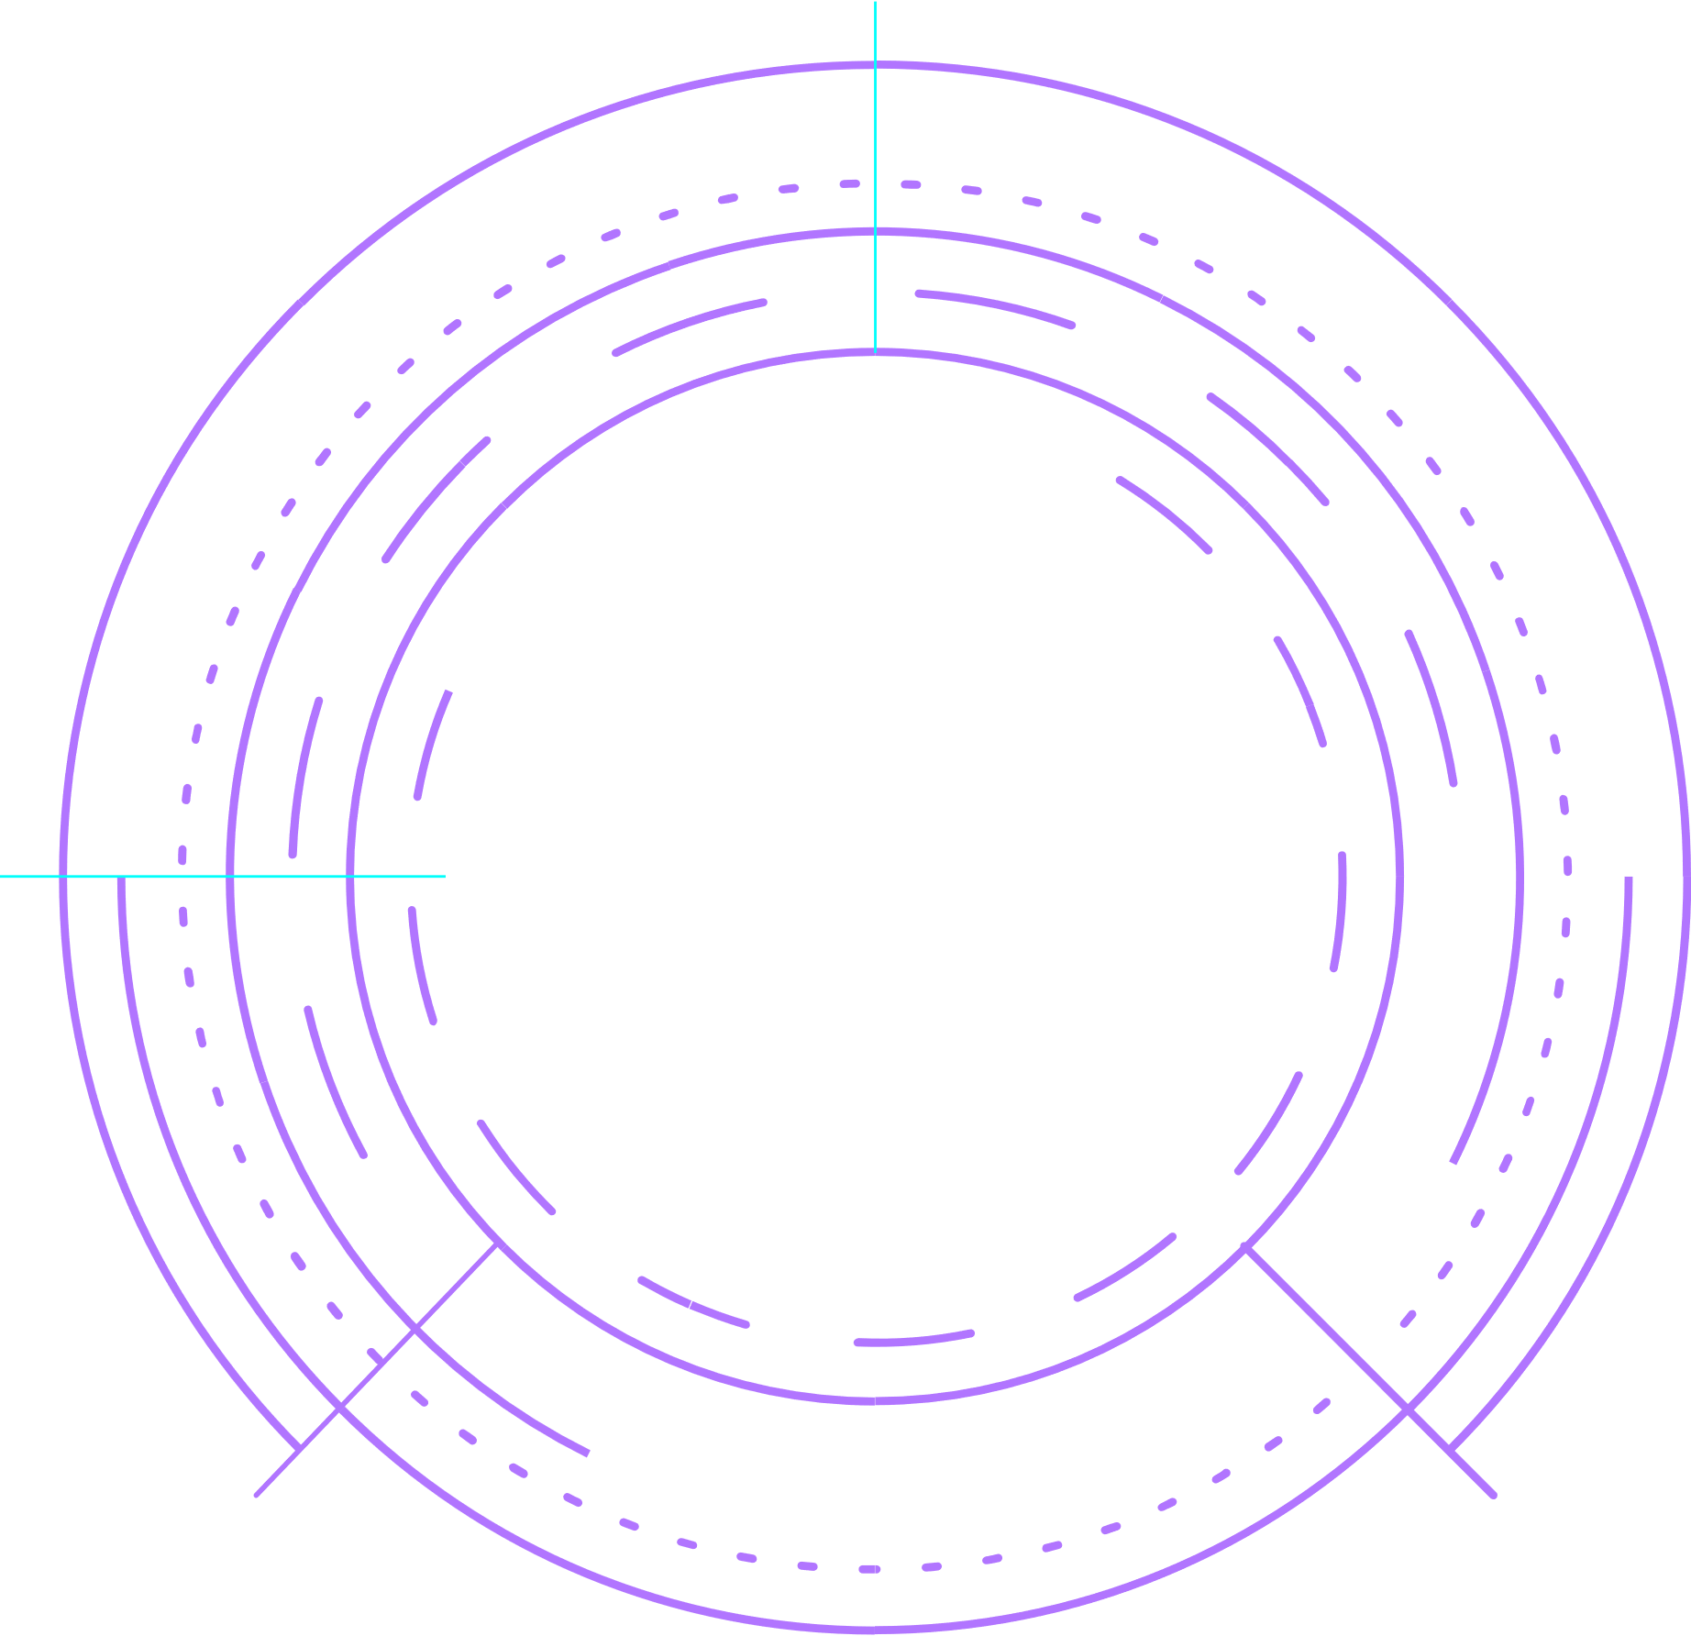
Automatic activity recognition systems aim to capture the state of the user and its environment by exploiting sensors, and permit continuous monitoring of the subject's body. This can be immensely useful in healthcare applications, for automatic and intelligent daily activity monitoring for elderly people.
PROBLEM
STATEMENT

Slide 3





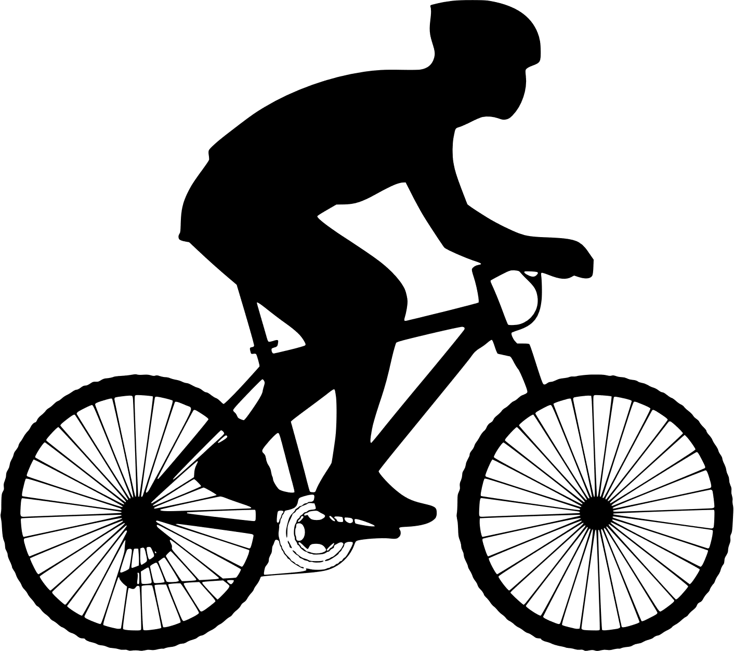



DETECTS 7 HUMAN ACTIVITIES
JOGGING
WALKING
SITTING
UPSTAIRS
STANDING
BIKING
DOWNSTAIRS
Notes:
The objective is to classify activities into one of the seven activities
(WALKING, UPSTAIRS, DOWNSTAIRS, SITTING, STANDING, JOGGING, BIKING)
performed based on the data collected from sensor signals (accelerometer, linear acceleration and gyroscope) of the smartphones

Slide 4
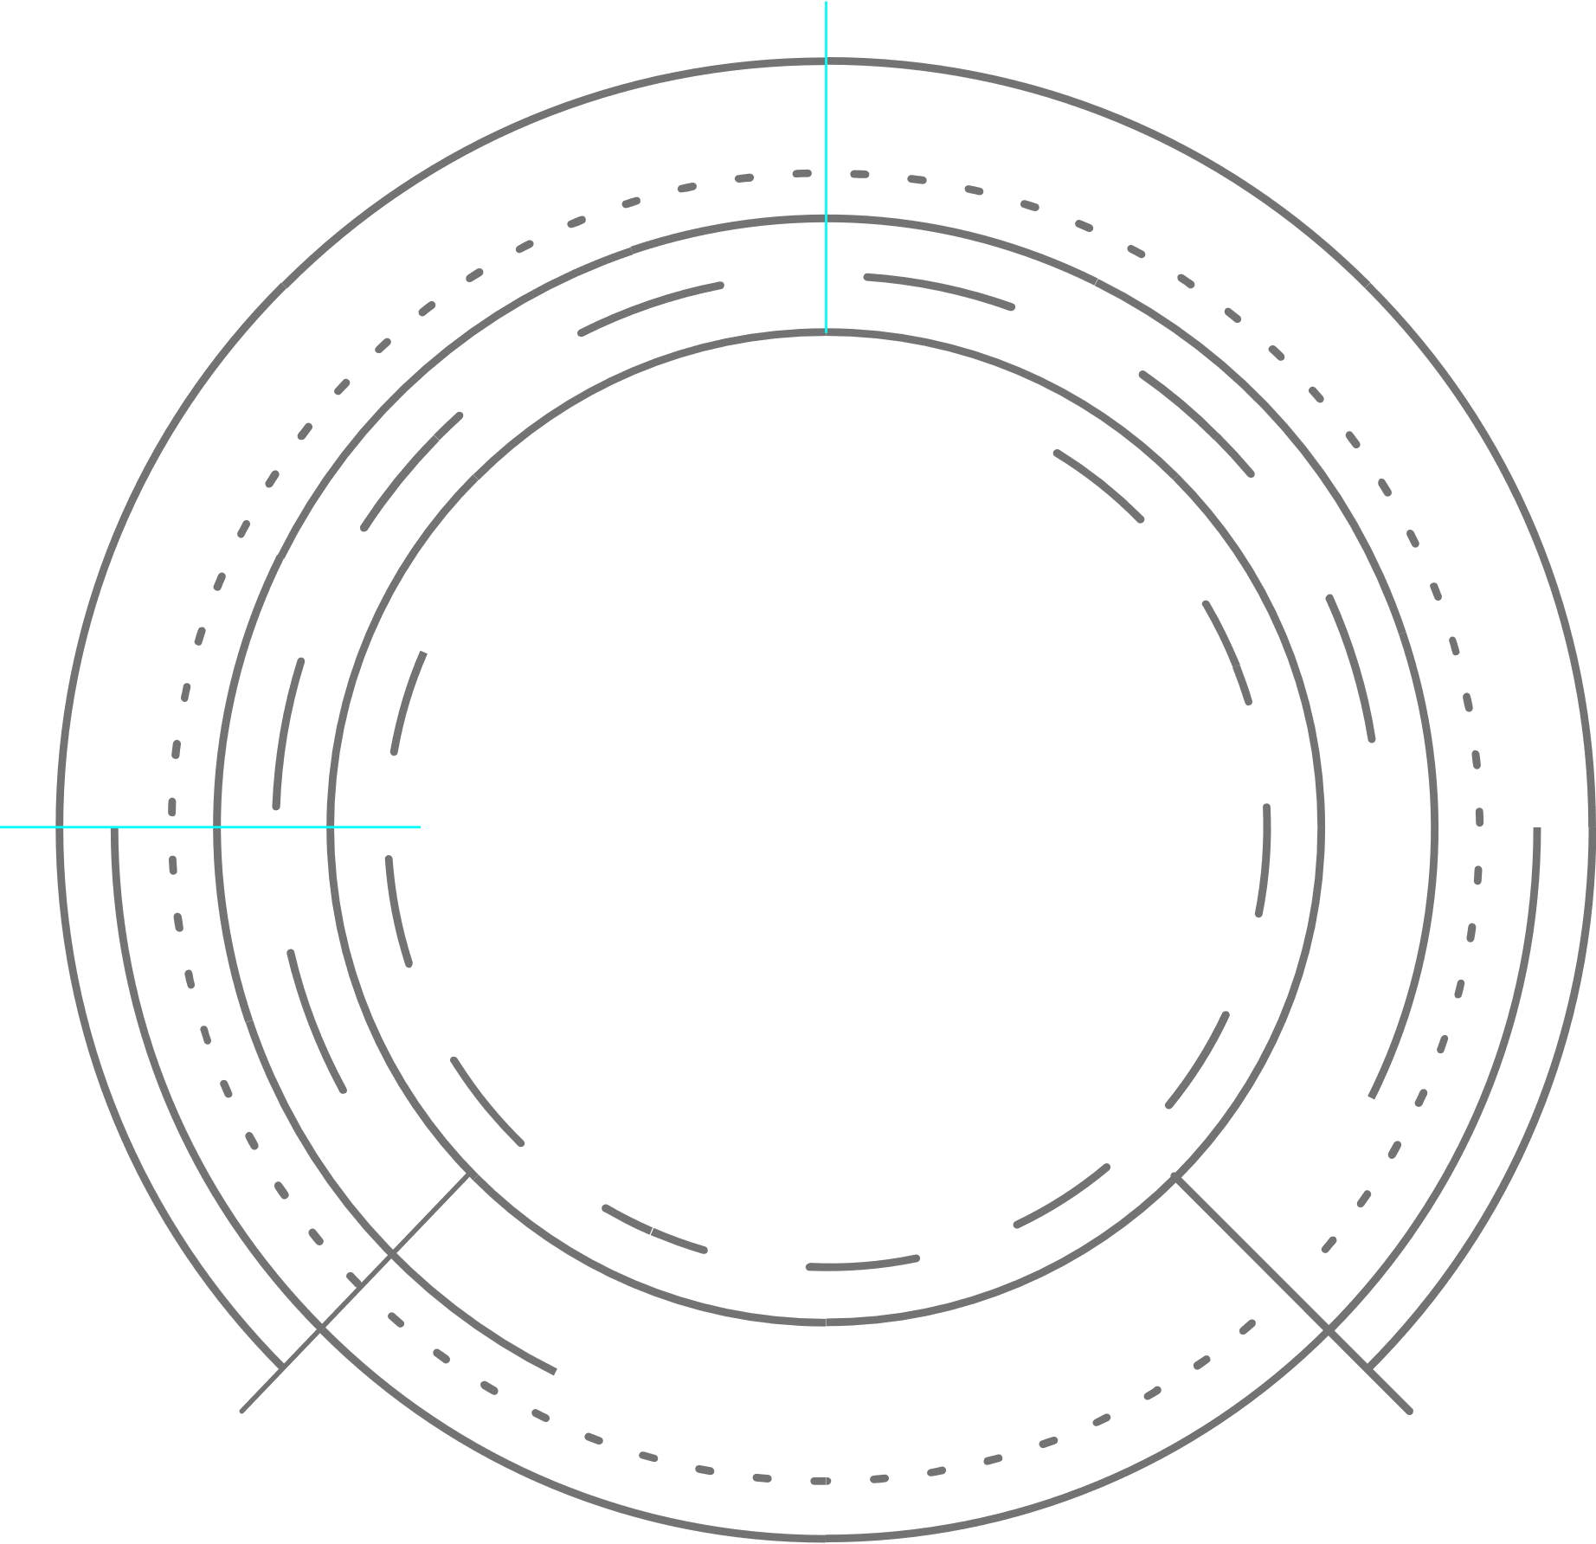



DIVISION OF PROJECT
TRAINING ML MODEL BASED ON LSTM
BUILDING ANDROID APP TO COLLECT DATA
EXPORTING MODEL TO THE APP

Slide 5
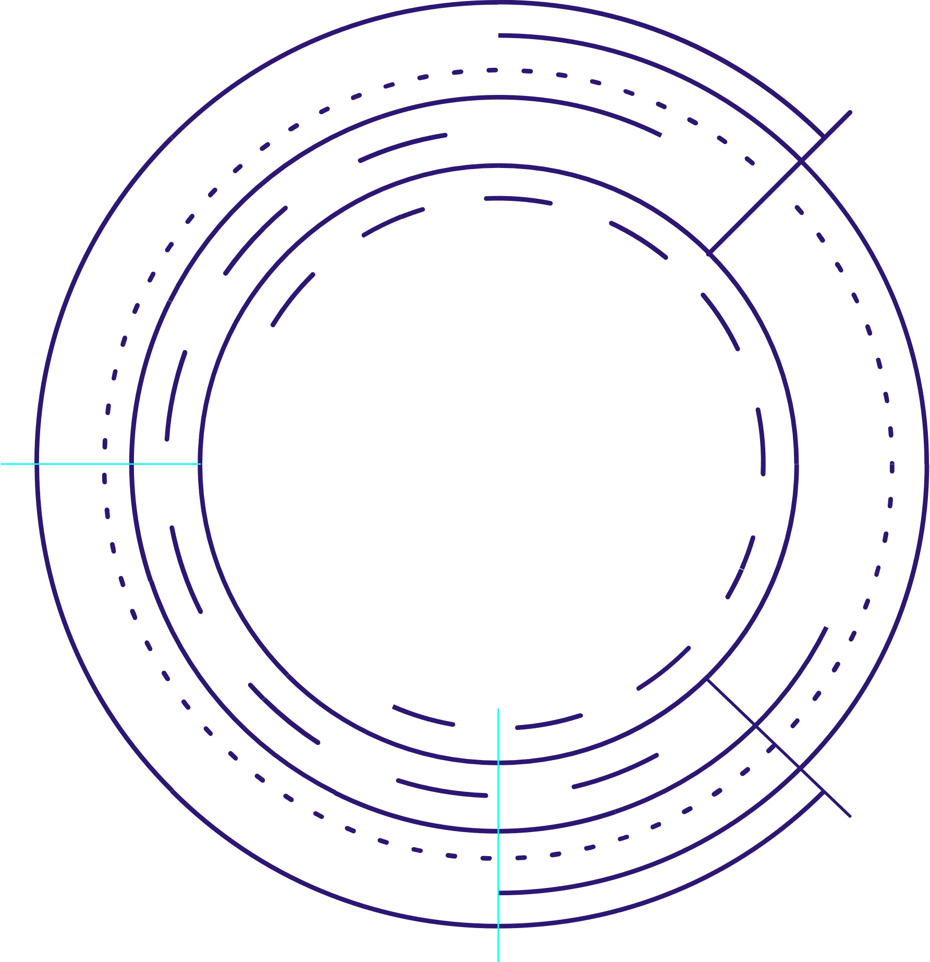
DATASET
There were ten participants involved in data collection
experiment who performed each of these 7 activities for 3-4 mins.
Each of these participants was equipped with five smartphones on
five body positions:
1. One in their right jean’s pocket.
2. One in their left jean’s pocket.
3. One on belt position towards the right leg using a belt clipper.
4. One on the right upper arm.
5. One on the right wrist.
The data was collected at a rate of 50 samples/sec, which is enough to recognize human physical activities.
The data was collected for an accelerometer, a gyroscope, and a linear acceleration sensor.

Slide 6
THE 3 SENSORS
01
02
03
Accelerometer
Gyroscope
Linear Acc.
a 3D vector representing
rate of
acceleration
along each device axis
a 3D vector representing
rate of rotation along each
device axis
a 3D vector representing acceleration along each device axis, excluding gravity
Notes:
linear acc = acc - gravity
therefore acc data provides us with the orientation of the device since it includes components of gravity in each direction

Slide 7
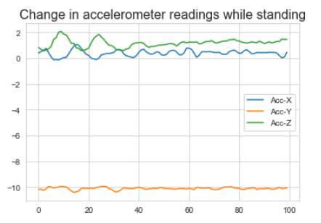
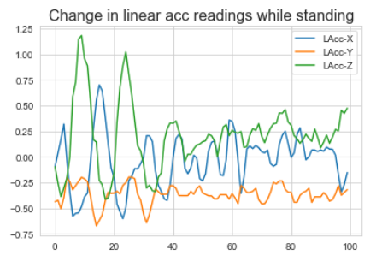
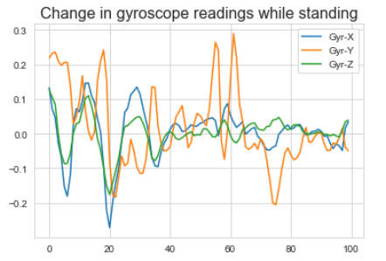
CHANGE IN VALUES OF READINGS OF ONE ACTIVITY

Slide 8
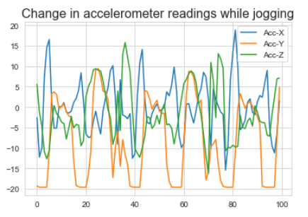
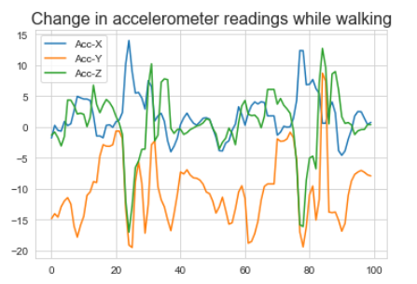
CHANGE IN ACCELEROMETER READINGS OF DIFFERENT ACTIVITIES

Slide 9
MODEL ARCHITECTURE
LAYER 1
LAYER 3
The first layer is a LSTM layer for learning from sequence of 100 points at each timestamp and returns the sequence mapping as well
LAYER 2
From this layer, the classifier part is starting which is a Dense layer that takes flatten output from above layer and passes it to next
LAYER 4
Flattens by converting 2D output (No. of timestamps, No. of features) from above LSTM layer and into 1D vector
This is softmax layer taking input from Layer 3 and predict the probability corresponding to each activity

Slide 10
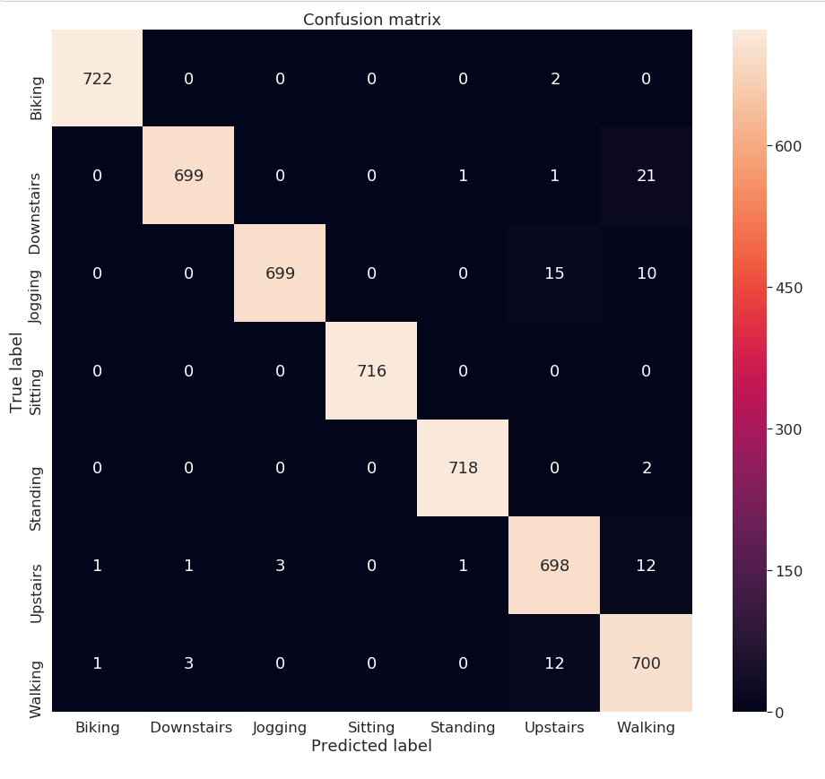
CONFUSION
MATRIX

Slide 11
EXPORTING
Exported Hadoop (h5) format file to Proto Buffer file (.pb) because it is lightweight and supported by Tensorflow Mobile for deployment in Android devices.
This proto buffer file is included in the app to use this trained model for making predictions on real time data.

Slide 12

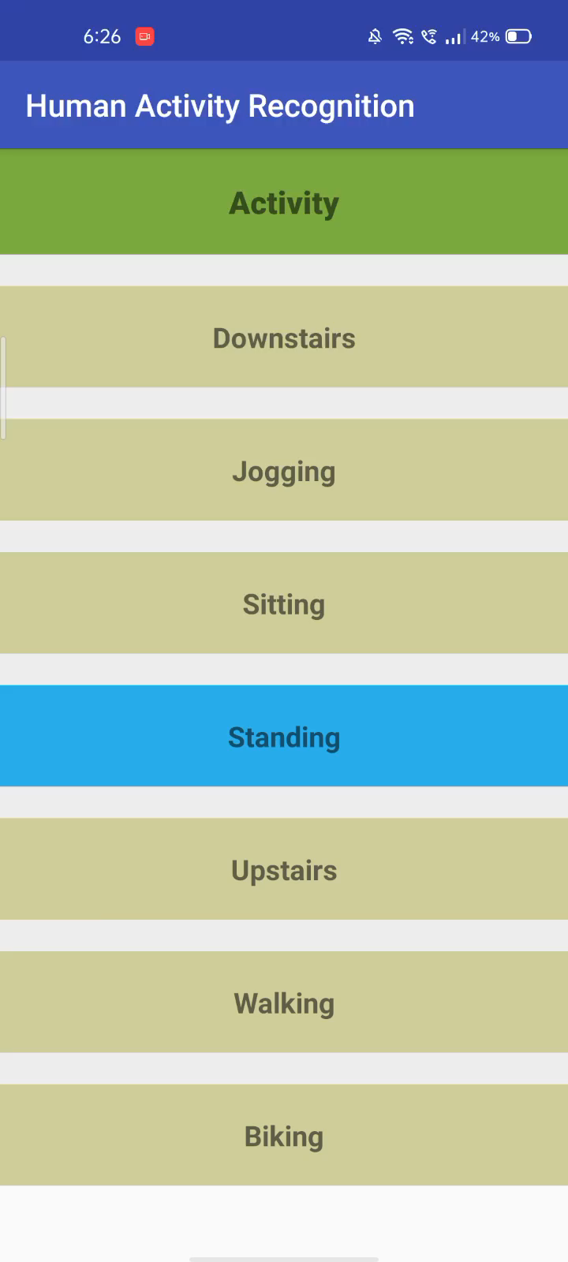
ANDROID APP
A simple UI which shows the seven activities: DOWNSTAIRS, JOGGING, SITTING, STANDING, UPSTAIRS, WALKING, BIKING
Highlights the activity which the model predicts with highest probability

Slide 13
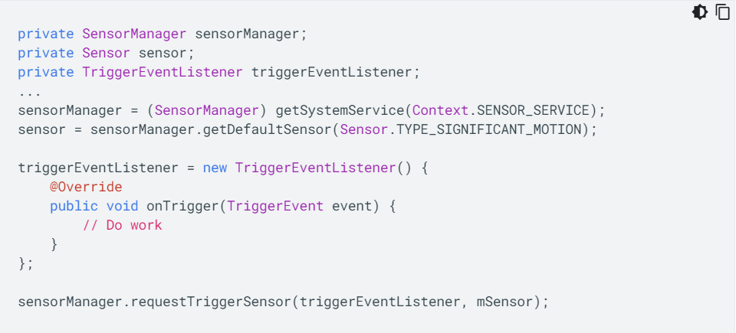
ADDING A MOTION SENSOR
The code shows how to get an instance of the default significant motion sensor and how to register an event listener:
Notes:
The following code shows you how to get an instance of the default significant motion sensor and how to register an event listener:

Slide 14

RELATIONSHIP WITH TECHNOLOGY
APK FILE
https://drive.google.com/drive/folders/14mL7ry5cVXC1xWURVs1hXkoXVVscl9-N
GITHUB
https://github.com/aditi17goel/ActivityRecognition

Slide 15
USE CASES
CAR ACCIDENT DETECTION
EPILEPSY SEIZURE DETECTION
By anomaly detection in accelerometer data
Based on EEG signal classification
MONITOR DAILY ACTIVITY OF PATIENTS
GESTURE RECOGNITION
With 3D Accelerometer
By tracking their activities

