Slide 1
Network Alignment
B. Tech. Project
under the guidance of
Dr. Joydeep Chandra
Aditi Goel
1901CS04

Slide 2
Structure of Presentation

Slide 3
Problem
Problem definition and overview
Pre-Midsem
Overview of pre-midsem work
Solution Setup
Description of the solution to the problem
Results
Comparison of our results with the state-of-the-art models
Background
Background work and definition of important terms
Post-Midsem

Slide 4
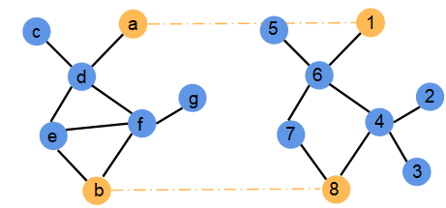
Network Alignment
Networks are often multi-sourced
To find node correspondence across networks

Slide 5
Problem Definition
We formally represent a network as a graph G = (V, E, X).
Given: source network Gs = (Vs, Es, Xs), target network Gt = (Vt, Et, Xt)
Output: alignment matrix S
S[u,v], represents the similarity between the nodes u ∈ Vs and v ∈ Vt
Self-supervised

Slide 6
Network Alignment
Network alignment has two phases:
Generating a low-dimensional vector space representation of nodes of each network
Their utilization for node matching across networks.

Slide 7
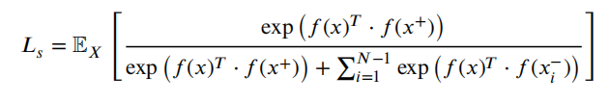
Background
Contrastive Learning
Notes:
shru

Slide 8
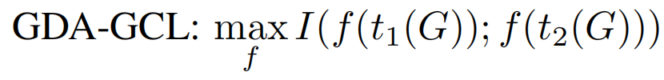

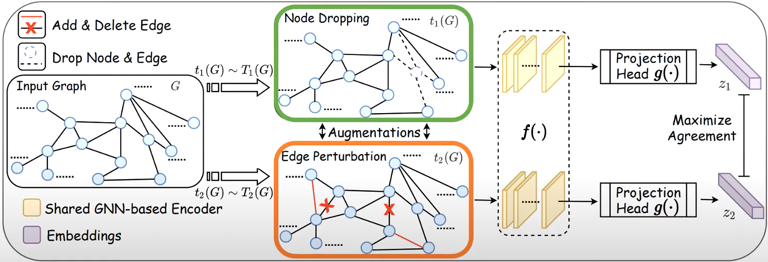
2. Graph Data Augmentation - Graph Contrastive Learning
Notes:
adgcl

Slide 9
Pre-Midsem Work
Dynamic Graph Alignment
Experiments studying the dynamic nature of networks
( KL Divergence)
Background research
Static Graph Alignment
Background research
Conceptualization
1

Slide 10
Post-Midsem Work

Slide 11
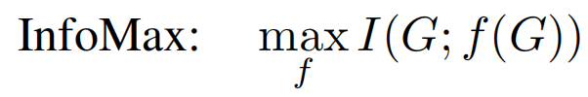
Problems with InfoMax principle
Aim is not to capture the full information from the data but to let the encoder f be strong enough to keep the identity of the nodes/input graph.
Issues:
Noise/ Irrelevant Information w.r.t downstream task may be captured by the encoder f.
Infact, this irrelevant information can lead to maximal mutual information.
Notes:
2:40

Slide 12

An alternative: Graph Information Bottleneck
Help avoid capturing noisy/irrelevant information from the data, and pushes to capture task relevant information
Requires knowledge of Y, and thus is not self supervised
Notes:
4:44

Slide 13
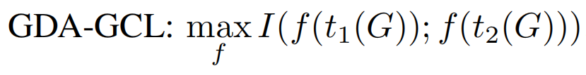
Generalize GIB to GCL
Previous ways to generate graph augmentation Ti
Propose a collection of ways to perturb and evaluate extensively (You et al., WWW 2021)
Domain knowledge required, dataset specific, etc (K. Hassani and A. H. Khasahmadi, ICML 2021)
Node dropping, edge dropping, subgraph sampling, attribute masking etc
If we let the way to generate graph be learnable…
In an adversarial way -> the graph information bottleneck principle

Slide 14
Step 1 : Network Embedding

Slide 15
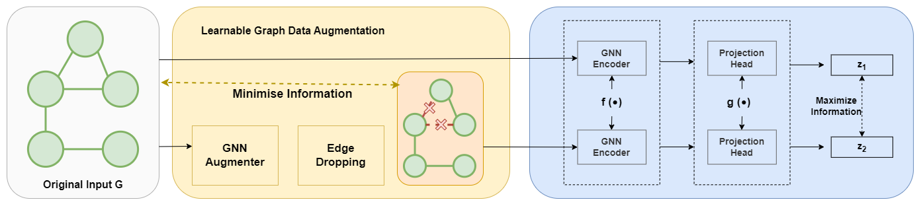
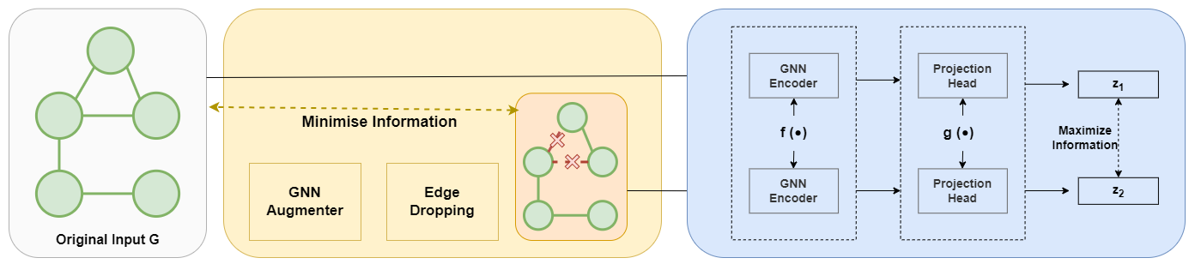
Adversarial Graph Contrastive Learning
Learn the Graph Augmentation Process so that the encoder can capture the minimal information that is necessary to identify nodes
Notes:
4:44

Slide 16
Adversarial Graph Contrastive Learning
Notes:
4:44

Slide 17
Adversarial Graph Contrastive Learning
Minimal Information -> Largest Randomness/Perturbation
Notes:
4:44

Slide 18
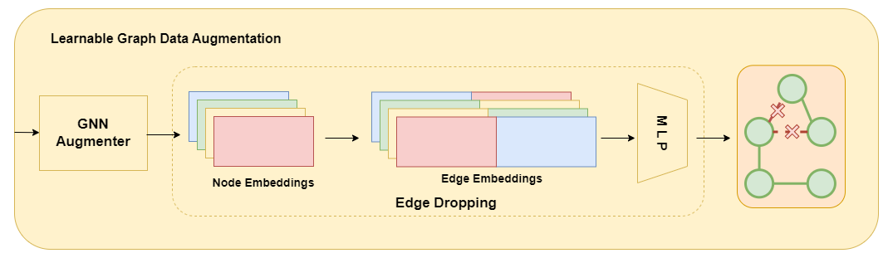
Edge Dropping Instantiation
Notes:
4:44

Slide 19
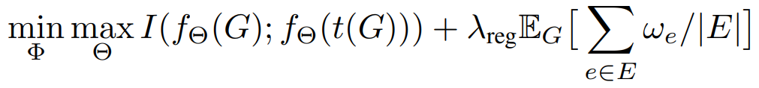
Regularization

Slide 20
Step 2 : Network Alignment

Slide 21
Network Alignment
Source Graph Embeddings : Z_{s}
Target Graph Embeddings: Z_{t}
Alignment matrix : S = Z_{s} ( Z_{t}) ^{T}
Highest value in the row S (𝑢) corresponds to the most similar node in the target network, and is regarded as its anchor
Notes:
4:44

Slide 22
Experimental Setup - Datasets
Douban Online vs Douban offline
Allmovie vs Imdb
Networks | #Nodes | #Edges | #Attributes
Douban Online | 3906 | 8164 | 538
Douban Offline | 1118 | 1511 | 538
Allmovie | 6011 | 124709 | 14
Imdb | 5713 | 119073 | 14
Notes:
4:44

Slide 23
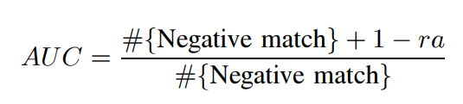
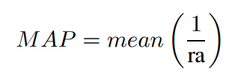
Evaluation Metrics
Acc@1
Acc@10
AUC
MAP

Slide 24
Results
Dataset | Metric | FINAL | REGAL | GAlign | Proposed Method
Allmovie - IMDB | Acc@1 | 0.765 | 0.095 | 0.775 | 0.810
 | Acc@10 | 0.950 | 0.386 | 0.874 | 0.870
 | MAP | 0.846 | 0.188 | 0.812 | 0.798
 | AUC | 0.989 | 0.988 | 0.993 | 0.994

Slide 25
Results
Dataset | Metric | FINAL | REGAL | GAlign | Proposed Method
Douban Online -Offline | Acc@1 | 0.465 | 0.045 | 0.445 | 0.452
 | Acc@10 | 0.750 | 0.226 | 0.774 | 0.790
 | MAP | 0.546 | 0.098 | 0.512 | 0.578
 | AUC | 0.987 | 0.948 | 0.990 | 0.991

Slide 26
Contribution
Adversarial based Graph Contrastive Learning for Network Alignment
Learnable Graph Augmentation Process for Network Alignment
Experiments show that model performs better than the mentioned baselines
Notes:
4:44

Slide 27
Thank you!

