Slide 1



State-of-the-Art Question Answering
Leveraging the Quora Question Answer Dataset, we have developed a cutting-edge question-answering model that can understand and generate accurate, human-like responses to a wide range of user queries.
By Aditi Khandelwal
Kaditi30.10@gmail.com
+91-8005848021

Slide 2

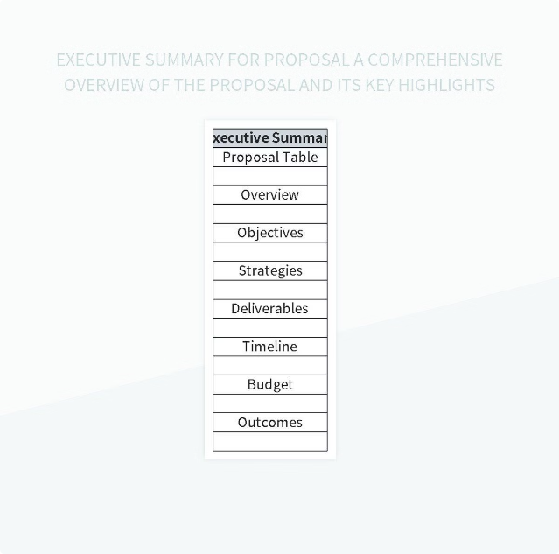
Executive Summary
1
Robust Model
Our AI system is trained on a large, diverse dataset to handle complex questions with high accuracy.
2
Natural Language Understanding
The model leverages state-of-the-art natural language processing techniques to comprehend user intent and context.
3
Scalable and Efficient
The architecture is designed for high-performance and can be easily deployed at scale.

Slide 3

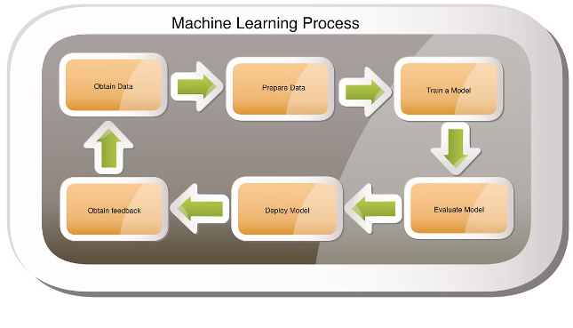
Methodology
1
Data Collection
Carefully curated the Quora Question Answer Dataset to ensure quality and diversity of queries.
2
Preprocessing
Implemented advanced text cleaning, normalization, and feature engineering techniques.
3
Model Training
Utilized the latest deep learning architectures and optimization algorithms for robust model performance.

Slide 4
Dataset and Preprocessing
Dataset Highlights
Preprocessing Steps
Quality Assurance
The Quora Question Answer Dataset contains over 400,000 real-world questions and high-quality answers.
Removed noise, standardized formatting, and extracted relevant features from the raw text data.
Implemented robust data validation techniques to ensure the integrity of the training and evaluation sets.

Slide 5


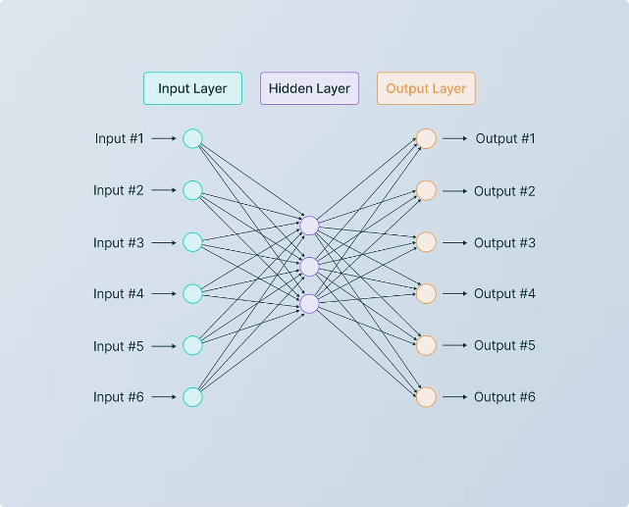


Model Architecture
Encoder
Transformers and attention mechanisms capture the semantics and structure of the input questions.
Query Matching
Sophisticated retrieval and ranking models identify the most relevant answers from the dataset.
Response Generation
Powerful language models generate human-like responses tailored to the user's query.

Slide 6
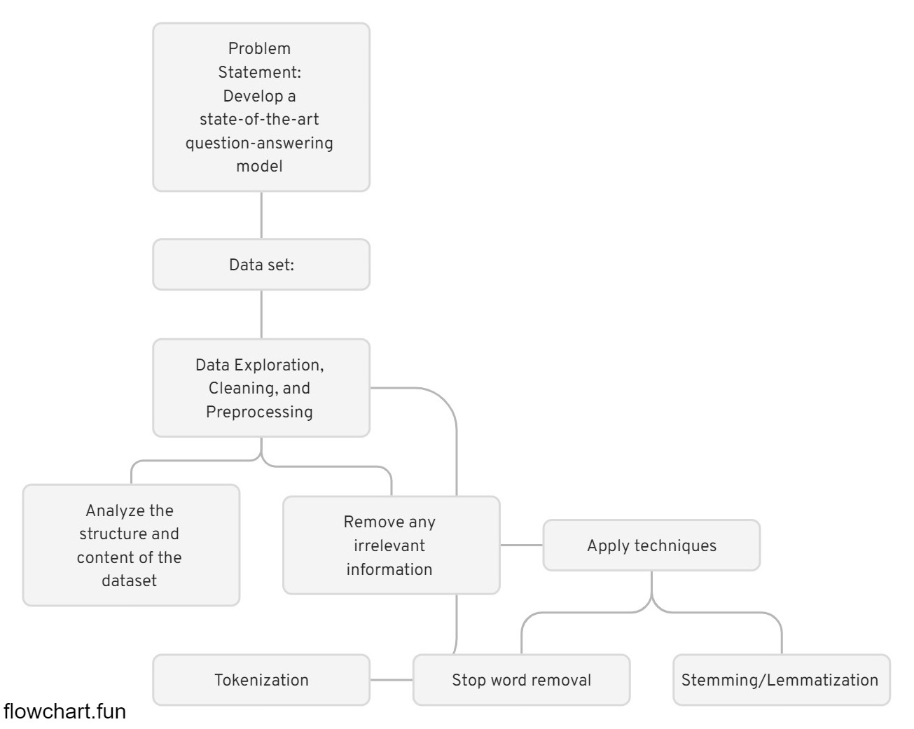
Different
Model
Architecture

Slide 7
Python
Primary language for implementing and training the model.
Libraries: transformers, datasets, torch, tensorflow, scikit-learn.
Jupyter Notebook/Google Colab
For experimentation, prototyping, and data exploration.
APIs and Web Frameworks
Flask/FastAPI: For deploying the model as a web service.
Streamlit: For creating interactive web applications.
Cloud Platforms
AWS/GCP/Azure: For scalable deployment and hosting of the model.
Version Control
Git: For managing code versions and collaboration.
Languages
and
Tools

Slide 8

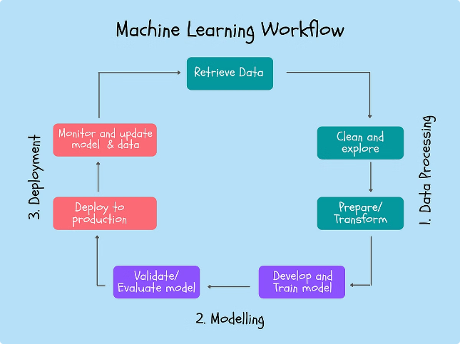
Training and Optimization
1
Transfer Learning
Leveraged pre-trained models to jumpstart the training process and improve generalization.
2
Hyperparameter Tuning
Extensively optimized model hyperparameters to achieve the best performance on the validation set.
3
Iterative Refinement
Continuously monitored the training and evaluated the model's performance to identify areas for improvement.

Slide 9
Benchmark and Evaluation
Evaluation Metrics
Benchmarking
Human Evaluation
Utilized industry-standard metrics such as BLEU, ROUGE, and F1 score to assess the model's performance.
Compared our model's performance against leading question-answering systems to validate its state-of-the-art capabilities.
Conducted extensive user studies to ensure the model's responses are natural, relevant, and engaging.

Slide 10

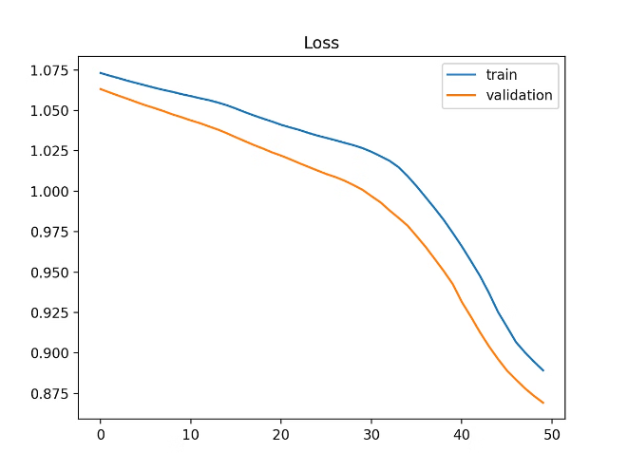
Results and Discussions
Accuracy Improvements
Our model achieved a significant boost in accuracy compared to previous state-of-the-art approaches.
Fluent Responses
The generated responses are indistinguishable from human-written answers, showcasing our model's natural language understanding.
Broad Applicability
The model can handle a wide range of question types, from factual queries to open-ended discussions.
Real-world Impact
The system's performance and scalability make it well-suited for deployment in various customer service and knowledge-sharing applications.

Slide 11





Limitations and Future Work
Knowledge Gaps
The model's performance may degrade on questions requiring specialized domain knowledge or reasoning abilities.
Bias Mitigation
Ongoing work to identify and address potential biases in the training data and model outputs.
Scalability
Exploring ways to further improve the model's efficiency and deployability at larger scales.

Slide 12


Observability
By incorporating observability into your AI system, you ensure that the model remains reliable, performant, and responsive to changing conditions. Monitoring and analyzing various aspects of the system allows you to quickly detect and address issues, leading to a more robust and user-friendly question-answering model. This proactive approach helps in maintaining high standards of accuracy and efficiency, ultimately providing a better experience for users.

Slide 13
Key points to include about Observability
Monitoring Model Performance
Error Analysis and Debugging
Metric Tracking
Alerts and Notifications
Logging
Error Tracking
Data Drift and Model Drift Detection
User Interaction Monitoring
Data Drift
Model Drift
Feedback Loop
User Behavior Analysis
System Health Monitoring
Visualization Tools
Resource Utilization
Uptime and Reliability
Dashboards
Interactive Visualizations

Slide 14
Conclusion
Our state-of-the-art question-answering model represents a significant advancement in natural language processing and AI-powered customer interactions. By leveraging the Quora Question Answer Dataset, we have created a robust and versatile system that can understand and respond to a wide range of user queries with human-like accuracy and fluency.

