Slide 1


Content analysis of Reddit posts
TEAM(73):
Aditi Tiwari
Vikas Soni
Chimakurthy Lakshmi Durga
MENTORS:
Dr.Tapas Badal
Mr.Apar Garg

Slide 2
Introduction
Reddit is a website which comprises user-generated content including photos, videos, links, and text-based posts.
Our task was to create a model for Topic Modelling . It is the task of using unsupervised learning to extract the main topics (represented as a set of words) that occur in our reddit posts.
We worked on the reddit/india/politics dataset (5 columns and 93504 rows ) and performed “Pre Processing” on it .

Slide 3
Dataset Used
Reddit/india dataset containing posts from 2016 to 2020 which have a domain as ‘Politics’.
Collected from Kaggle.
Dataset Size- Before Pre-processing- 5 columns and 93504 rows
After pre-processing -9 columns and 93504 rows.
We mainly worked on ‘Title’ column to preprocess , analyse and model our data.

Slide 4
Methodology / Model Used
1) ​Data Pre- Processing : Applying regex function on ‘Title’ Column to remove certain characters , line breaks and tabs.
Next , we tokenized our title column and applied stopword removal and lemmatization on the same using nltk library.
Creating 3 more columns - Len , word_count ,Polarity and title_pp.
2)EDA: We analysed data on the basis of no. of stop words , uppercase words etc. Made distributions functions on the basis of length of title , year , polarity etc.We used CountVectorizer to find most common/rare words in posts title.

Slide 5
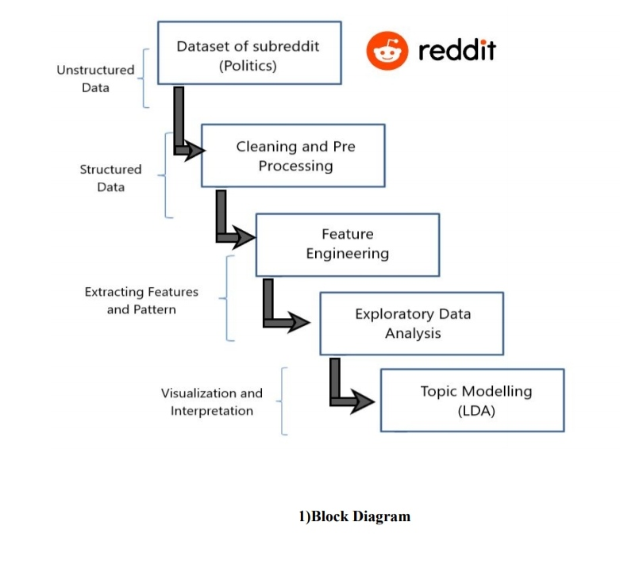
4)Topic Modelling:
We used Latent Dirichlet Allocation (LDA) for this purpose .
LDA is used to classify text in a document to a particular topic.
It builds a topic per document model and words per topic model, modeled as Dirichlet distributions
5) Parameters:
Parameters used to build our model include:
Number_of_topics (Number of Unique Topics in our document)
no_top_words(Number of top words used to calculate unique topics)
Random state
6)Architecture:

Slide 6
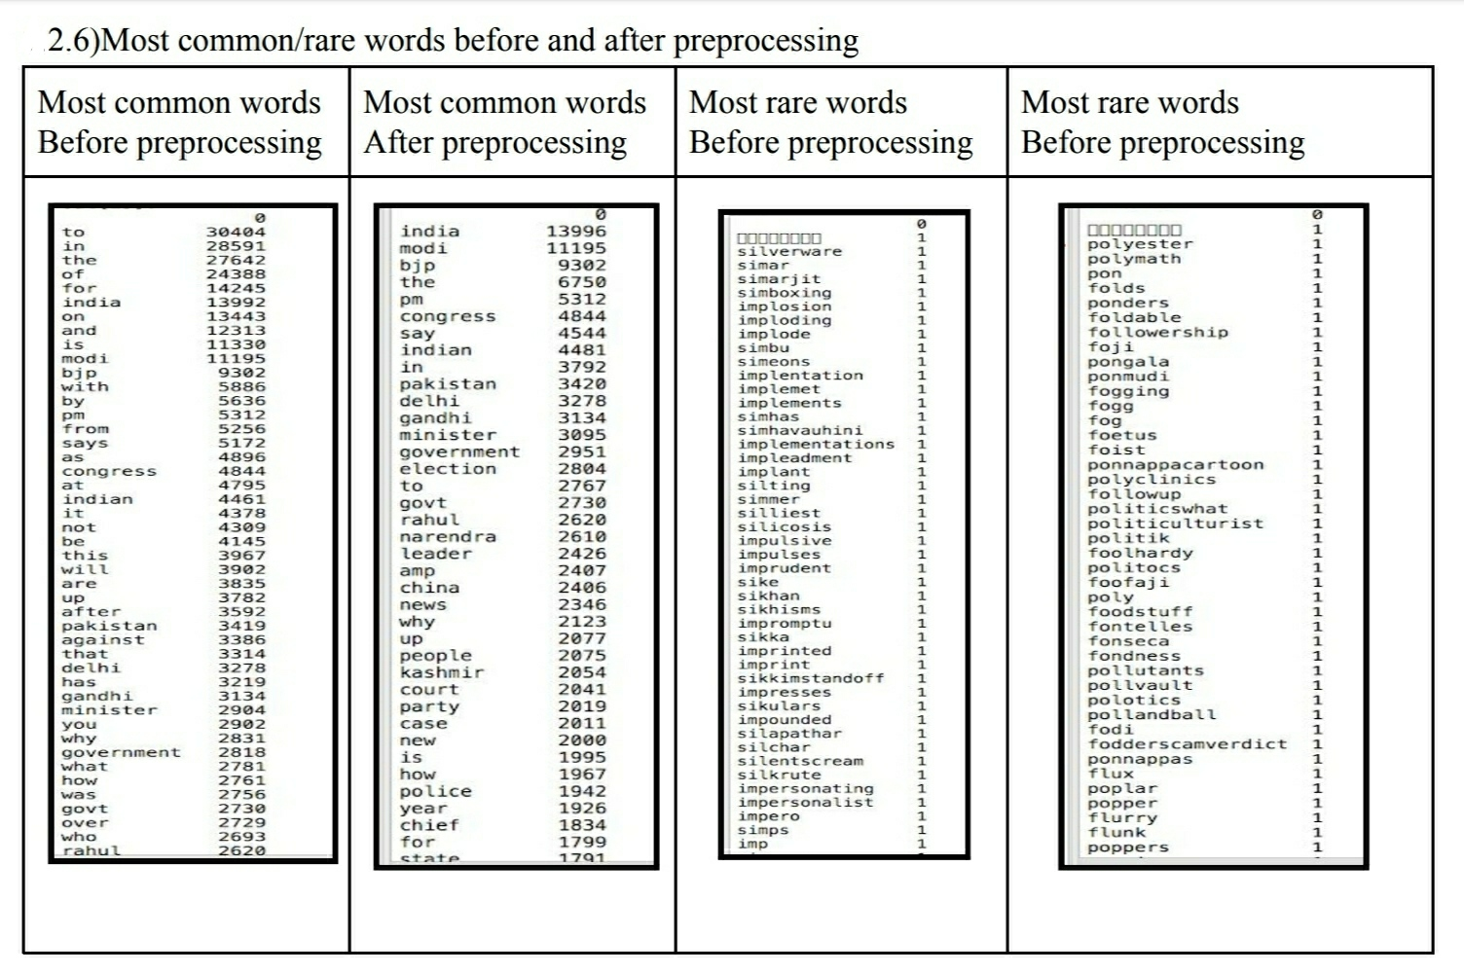
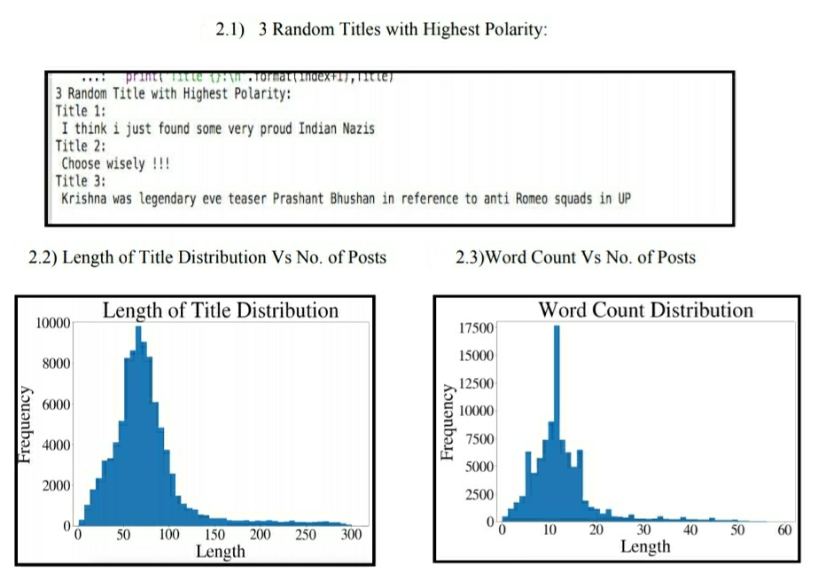
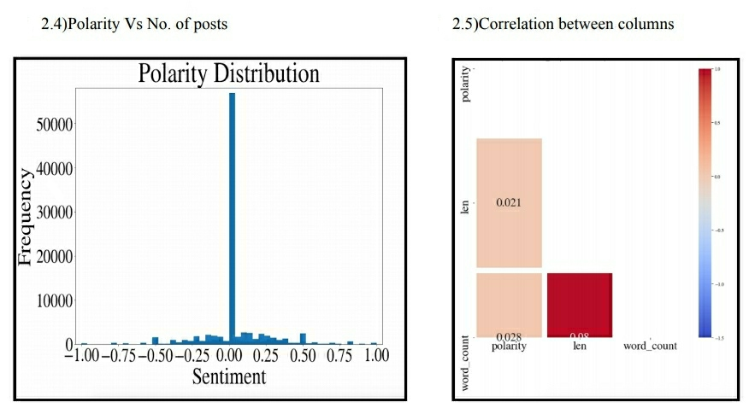
RESULTS
1)Result of EDA :

Slide 7
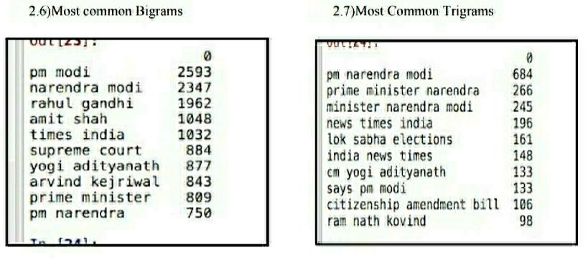
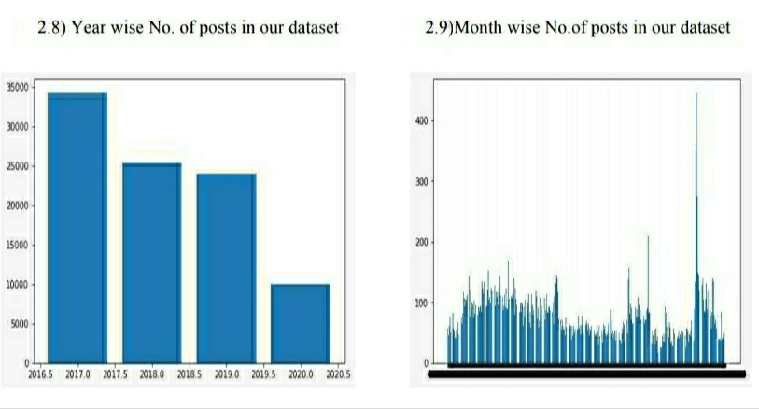
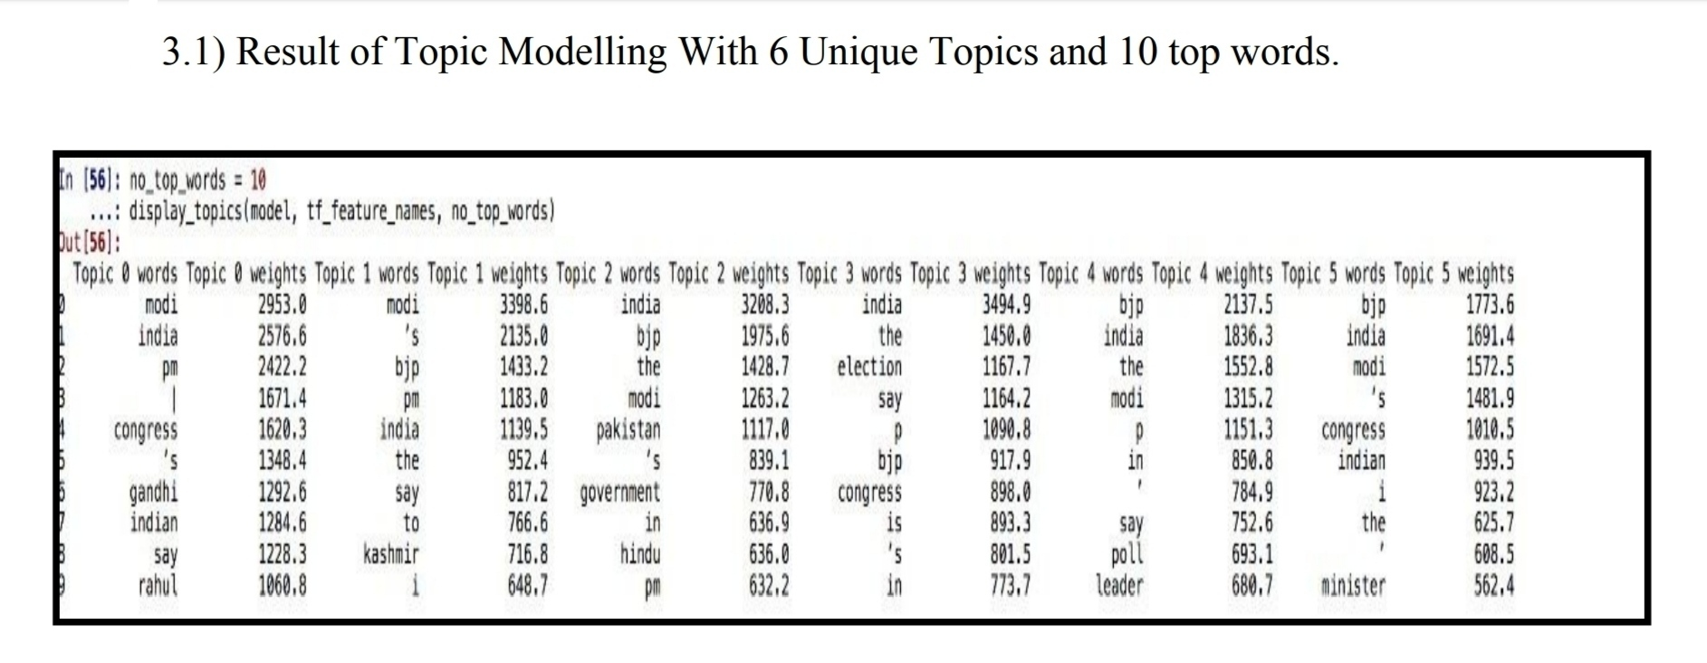
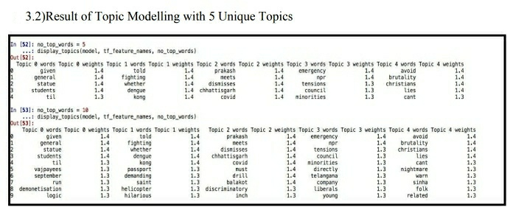
2)Result of Topic Modelling with different Parameters:

Slide 8
Conclusion
We implemented the different techniques of NLP to analyse various ways in which reddit data could be analysed.
We were able to decide the domain on which we wanted to work through preprocessing of data. Through EDA we got the idea regarding which words , bi grams , tri grams etc were more common(Modi and Prime Minister were in clear lead) and the type of length , Number of words in a post.
We were able to analyse the time frame where more number of posts were made.
The most optimum output from the LDA model is a 6 topics each categorized by a series of top 10 words. LDA doesn’t give a topic name to those categories and it is for us humans to interpret them.
The model runs very quickly , we were able to extract common topics in a few seconds .
Limitations :
Our model assumes that there are distinct topics in the data set. Since our data set contains only data from one particular domain-’Politics’ , the result might not be very easily interpretable. Choosing best parameters depends a lot on the human perception

Slide 9
References
Rising Odegua, (2019,December). Data Pre-processing and Visualization. https://towardsdatascience.com/https-medium-com-risingdeveloper-easy-d ata-analysis-visualization-and-modeling-using-datasist-part1-8b26526dbe01
Kavitha Ganesan,(2019,February).Data Pre-processing and Visualization https://towardsdatascience.com/all-you-need-to-know-about-text-preprocessing-for-nlp-and-machine-learning-bc1c5765ff67
Prasad Patil,(2018,March).Exploratory Data Analysis. https://towardsdatascience.com/exploratory-data-analysis-8fc1cb20fd15
Susan Li,(2019,March).Exploratory Data Analysis. https://towardsdatascience.com/a-complete-exploratory-data-analysis-and-visualization-for-text-data-29fb1b96fb6a
Shivam Bhansal,Topic Modelling. https://www.kaggle.com/shivamb/seconds-from-disaster-text-eda-and-analysis
Shubham Jain,(2018,February).Topic Modelling. https://www.analyticsvidhya.com/blog/2018/02/the-different-methods-deal-text-data-predictive-python/
Shivam Bhansal,(2016,August).Latent Dirichlet Allocation for Topic Modeling analyticsvidhya.com/blog/2016/08/beginners-guide-to-topic-modeling-in-python/ THANK YOU

