Slide 1
Post-Quantum Single Secret Leader Election (SSLE) from Re-randomizable Commitments
Dan Boneh Aditi Partap Lior Rotem
Stanford University

Slide 2






Leader Election Protocols
Leader Election Protocol
Enables a set of parties to elect a leader
Fundemental to distributed computing and consensus protocols
Notes:
Lets start with looking at leader election protocols. As the name suggests, these protocols allow a set of parties to come together and jointly elect a leader. These protocols are fundamental to distributed computing and consensus protocols.

Slide 3
In Blockchains
Notes:
for example, leader election is instrumental in Blockchains, here, at a very high level, we can think of the leader as the person who adds the next block to the chain.

Slide 4
In Blockchains

Slide 5
Desired Properties
Fairness
All parties have the same probability of being elected
Uniqueness
Only one party is elected
Notes:
For these applications, lets see what properties would we want from a secure leader election protocol

Slide 6
Desired Properties
Fairness
All parties have the same probability of being elected
Uniqueness
Only one party is elected
Notes:
First, the leader election protocol should be fair, meaning that all the parties should have an equal chance of being elected the leader.

Slide 7
Desired Properties
Fairness
All parties have the same probability of being elected
Uniqueness
Only one party is elected
Notes:
Secondly, we would like to choose only a single leader. Now the question is, if there exist leader election protocols that satisfy both these properties?

Slide 8
In Proof-of-Work Blockchains
Notes:
Turns out, proof of work implicitly has leader election with both these properties.

Slide 9

In Proof-of-Work Blockchains
Solved it!
Notes:
Here, each party gets a cryptographic puzzle, and the first party to solve the puzzle becomes the leader.

Slide 10
In Proof-of-Work Blockchains
Solved it!
+ solution to
Notes:
This leader proposes the next block, and also attaches the puzzle solution to the block, so that anyone can verify that the solution is valid, meaning that this party should indeed be the leader.

Slide 11
In Proof-of-Work Blockchains
The leader election is baked in to the PoW mechanism
When moving to proof of stake, need a separate solution for leader election
+ solution to
Notes:
So, leader election is baked into the Proof of work mechanism, and it satisfies both fairness and uniqueness. But, when we move to proof of stake, there is no such implicit mechanism, meaning that we now need a separate protocol for leader election!

Slide 12

The Trivial Leader Election Protocol
Say we have a randomness beacon
The beacon randomly selects the leader
Trivially fair and unique
Notes:
Lets try to construct a leader election protocol, lets assume that we have a good randomness beacon, that’s also publicly verifiable.
With this beacon, Turns out that we have a trivial leader election protocol,
we can simply use the beacon to randomly select one leader out of the list of parties. This is trivially fair and unique, if we use a good beacon.

Slide 13
Back to Proof-of-Stake Blockchains
Notes:
So we can use this in Proof of stake blockchains, The party selected by the beacon can publish the next block. And since the beacon is publicly verifiable, anyone can check that this is indeed the chosen leader.

Slide 14

Back to Proof-of-Stake Blockchains
The leader becomes a target for attacks (for example, DoS)
A liveness issue
Notes:
But, there is a problem here – since everyone can see the beacon output, the future leader becomes a target for attacks, e.g. an adv could do a denial of service attack on this future leader -- This is bad for the chain’s liveness.

Slide 15
Back to Proof-of-Stake Blockchains
The issue is that the leader’s identity is known before the block is published
This is not a problem in PoW consensus
The leader becomes a target for attacks (for example, DoS)
A liveness issue
Notes:
The underlying reason for this issue, is that the leader’s identity is known to everyone before the leader publishes the block.
This is in contrast to proof of work, where the leader identity is revealed only when the leader publishes a new block, so there's no way to attack a future leader.

Slide 16
Desired Properties
Fairness
All parties have the same probability of being elected
Uniqueness
Only one party is elected
Unpredictability
The leader is secret until they reveal themselves
Notes:
There are a Few ways to tackle the issue.

Slide 17
S
Desired Properties
Fairness
All parties have the same probability of being elected
Uniqueness
Secret Single Leader Election
(SSLE) [Boneh-Eskandarian-Hanzlik-Greco-20]
Only one party is elected
Unpredictability
The leader is secret until they reveal themselves
Notes:
What we do, is that we require an additional property from the leader election protocol, which we call unpredictability.
This property at a high level means that the leader is secret until they reveal themselves. A protocol satisfying all 3 is called SSLE, or single secret leader election, and this was formally defined by Boneh et al in 2020.

Slide 18
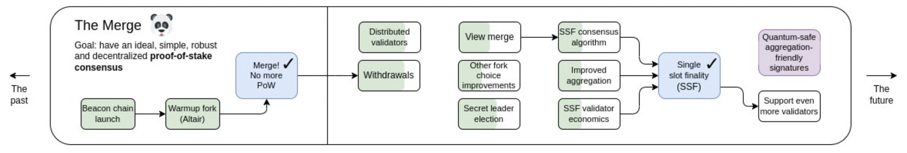
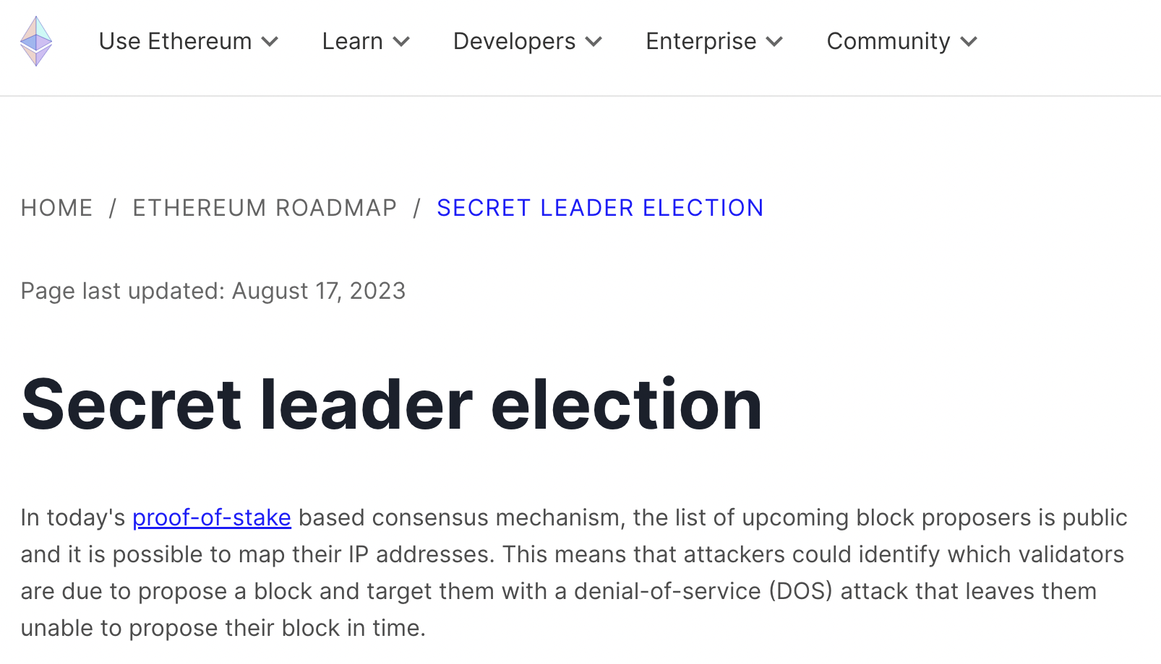
Ethereum Roadmap
Notes:
This liveness issue is quite an important problem, here we can see the Ethereum roadmap from a few months ago that includes secret leader election as the solution for the liveness problem.
// Also in various RFPs (Aztec, Protocol Labs)

Slide 19
Constructing SSLE
DLOG groups and pairings: [BEHG20], [CFG21,22], [Whisk22]
Notes:
There has been a lot of work in constructing SSLE protocols since the 1st paper in 2020. there’s many efficient construction based on discrete log hard groups, including the BEHG paper,

Slide 20
Constructing SSLE
DLOG groups and pairings: [BEHG20], [CFG21,22], [Whisk22]
EF proposal
Notes:
and Whisk, which is the Ethereum proposal that builds on BEHG.

Slide 21



Constructing SSLE
Post-quantum secure?
DLOG groups and pairings: [BEHG20], [CFG21,22], [Whisk22]
Using MPC: [BBHP22]
Using Threshold-FHE: [BEHG20], [FTBTSSK23]
Using Isogenies: [Sanso22]
Efficient lattice-based constructions?
Notes:
There are other constructions based on MPC, threshold FHE and isogenies. but the question we focus on today is post quantum security.
The dlog based schemes are not post quantum secure.
for MPC-based protocols, it depends on what assumptions you use to instantiate MPC.
Threshold FHE and isogenies are believed to be post quantum secure,
but, there are no efficient lattice-based SSLE constructions so far.
it is important to have lattice-based alternatives for SSLE since we have a far better understanding of lattices and their hardness assumptions than isogenies.

Slide 22
This Work
We construct a practical lattice-based SSLE protocol
Two lattice-based RRC constructions
Generalize the BEHG protocol
LWE
New notion:
Re-randomizable Commitments (RRCs)
Ring-LWE
Notes:
This brings us to our work, where we construct an efficient lattice-based SSLE protocol,

Slide 23
This Work
We construct a practical lattice-based SSLE protocol
Two lattice-based RRC constructions
Generalize the BEHG protocol
LWE
New notion:
Re-randomizable Commitments (RRCs)
Ring-LWE
Notes:
And we do so in 2 steps, first, we generalize the BEHG protocol, and introduce a new notion of re-randomizable commitments.

Slide 24
This Work
We construct a practical lattice-based SSLE protocol
Two lattice-based RRC constructions
Generalize the BEHG protocol
LWE
New notion:
Re-randomizable Commitments (RRCs)
Ring-LWE
Notes:
Next, we give two lattice-based constructions of re-randomizable commitments, by relying on the learning with errors assumption (i.e. LWE) and its ring variant. Both of these are standard assumptions.

Slide 25
This Work
We construct a practical lattice-based SSLE protocol
Two lattice-based RRC constructions
Generalize the BEHG protocol
LWE
New notion:
Re-randomizable Commitments (RRCs)
Ring-LWE
Notes:
Lets start with the generalized view of the BEHG protocol

Slide 26
The BEHG Protocol: An Abstract View
Building block: a “special” commitment scheme
The idea: Commit-and-shuffle

Slide 27
The BEHG Protocol: An Abstract View
Building block: a “special” commitment scheme
The idea: Commit-and-shuffle
will be defined shortly
Notes:
It uses a special commitment scheme as the building block, we’ll define this in a bit.

Slide 28
The BEHG Protocol: An Abstract View
Building block: a “special” commitment scheme
The idea: Commit-and-shuffle
will be defined shortly
Notes:
And then, we run a commit and shuffle type approach

Slide 29
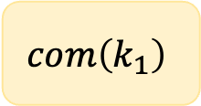

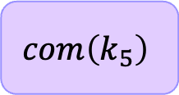
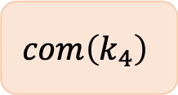


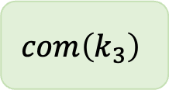

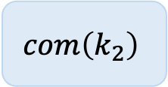

The BEHG Protocol
$$H\left(k_{1}\right)$$
$$H\left(k_{2}\right)$$
$$H\left(k_{3}\right)$$
$$H\left(k_{4}\right)$$
$$H\left(k_{5}\right)$$
Commitment step
$$com\left(k_{1}\right)$$
$$com\left(k_{2}\right)$$
$$com\left(k_{3}\right)$$
$$com\left(k_{4}\right)$$
$$com\left(k_{5}\right)$$
Notes:
In more detail, we partition the BEHG protocol into 3 steps, the 1st one is the commitment step: here, each party samples a random value k, commits to this value using the special commitment, and also publishes the hash of k, we'll see why we need this later.

Slide 30



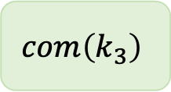

The BEHG Protocol
$$H\left(k_{1}\right)$$
$$H\left(k_{2}\right)$$
$$H\left(k_{3}\right)$$
$$H\left(k_{4}\right)$$
$$H\left(k_{5}\right)$$
$$com\left(k_{1}\right)$$
$$com\left(k_{2}\right)$$
$$com\left(k_{3}\right)$$
$$com\left(k_{4}\right)$$
$$com\left(k_{5}\right)$$
$$com\left(k_{1}\right)$$
$$com\left(k_{4}\right)$$
$$com\left(k_{5}\right)$$
Commitment step
$$com\left(k_{1}\right)$$
$$com\left(k_{2}\right)$$
$$com\left(k_{3}\right)$$
Shuffle & Rerandomize
Notes:
The 2nd step is shuffle & re-randomize, here each party takes turns to shuffle and randomize the list of commitments,
In more detail, the first party starts with shuffling the list , meaning, it applies a random permutation to the list of commitments,

Slide 31
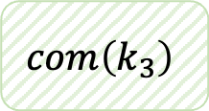
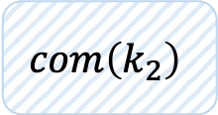
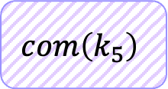
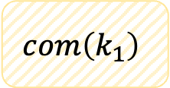
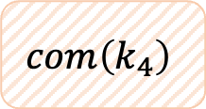
The BEHG Protocol
$$H\left(k_{1}\right)$$
$$H\left(k_{2}\right)$$
$$H\left(k_{3}\right)$$
$$H\left(k_{4}\right)$$
$$H\left(k_{5}\right)$$
$$com\left(k_{3}\right)$$
$$com\left(k_{4}\right)$$
$$com\left(k_{5}\right)$$
Commitment step
$$com\left(k_{1}\right)$$
$$com\left(k_{2}\right)$$
$$com\left(k_{5}\right)$$
Shuffle & Rerandomize
$$com\left(k_{2}\right)$$
$$com\left(k_{1}\right)$$
$$com\left(k_{5}\right)$$
$$com\left(k_{4}\right)$$
$$com\left(k_{3}\right)$$
Proof of correct shuffle
Notes:
then, it re-randomizes all the commitments. What we mean by re-randomizing is that, the new commitment to k2, for example, is a fresh commitment to k2, i.e. independent of the original commitment to k2, this should also hold for all other commitments. Then, this party also publishes a zero-knowledge proof that they shuffled and randomized the list correctly.

Slide 32
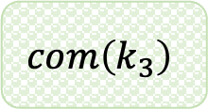

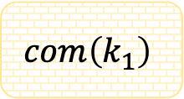
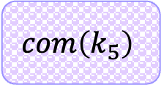
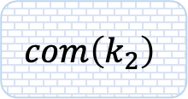

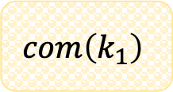
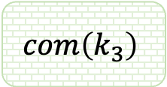
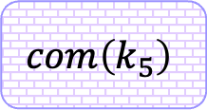
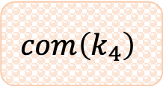
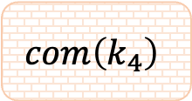
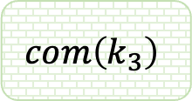
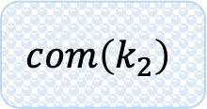

The BEHG Protocol
$$H\left(k_{1}\right)$$
$$H\left(k_{2}\right)$$
$$H\left(k_{3}\right)$$
$$H\left(k_{4}\right)$$
$$H\left(k_{5}\right)$$
Commitment step
$$com\left(k_{1}\right)$$
$$com\left(k_{2}\right)$$
$$com\left(k_{3}\right)$$
$$com\left(k_{4}\right)$$
$$com\left(k_{5}\right)$$
Shuffle & Rerandomize
$$com\left(k_{2}\right)$$
$$com\left(k_{1}\right)$$
$$com\left(k_{5}\right)$$
$$com\left(k_{4}\right)$$
$$com\left(k_{3}\right)$$
$$com\left(k_{5}\right)$$
$$com\left(k_{3}\right)$$
$$com\left(k_{2}\right)$$
$$com\left(k_{1}\right)$$
$$com\left(k_{4}\right)$$
. . .
. . .
$$com\left(k_{4}\right)$$
$$com\left(k_{3}\right)$$
$$com\left(k_{1}\right)$$
$$com\left(k_{5}\right)$$
$$com\left(k_{2}\right)$$
Random Selection
$$com\left(k_{3}\right)$$
Proving Leadership
$k_{3}+$Opening to
$$π$$
$$com\left(k_{3}\right)$$
Notes:
Then the 2nd party does the same thing and so on, till everyone has done this once. The main thing to note here, is that if we have even a single honest party, then, at the end of this step, no coalition can link the final commitments to their corresponding original commitments.
The 3rd step is just random selection, here, we use the randomness beacon to randomly select a commitment from this list, lets say it chooses the 2nd commitment.
Now, each party can try opening this commitment with its k value. party 3 will see that it is indeed the leader, but no one else will know that party 3 is the leader.
Finally, this party can publish the next block, along with a proof pi. this proof will include the value k3 and the opening for this commitment. Anyone can check that this opening is valid for the chosen commitment, and also check that k3 is consistent with the hash value published in step1.

Slide 33
S
Reminder: Desired Properties
Fairness
All parties have the same probability of being elected
Guaranteed by the beacon and proof of correct shuffle
Uniqueness
Only one party is elected
Unpredictability
The leader is secret until they reveal themselves
Notes:
Now, lets see if this protocol satisfies the 3 properties that we want: fairness is guaranteed by the beacon and the proof of correct shuffle. But for uniqueness and unpredictability, we would need to use a commitment scheme with special properties…

Slide 34











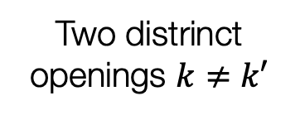

Re-randomizable Commitments (RRCs)
What properties does the commitment need to satisfy?
S
NOT possible:
Given two commitments
$$com\left(k\right)$$
$$com\left(k_{1}\right)$$
$$com\left(k_{2}\right)$$
Does not require knowing $k$
$$com$$
$$com\left(k\right)$$
A re-randomization
$$com\left(k_{1}\right)$$
Opening to
can open randomized commitments
Two distrinct openings $k≠k′$
should be unlinkable to the commitment it came from
$$com\left(k\right)$$
Re-randomizable
Binding
Unlinkability
$⇒$ Correctness
$⇒$ Uniqueness
$⇒$ Unpredictability
Notes:
This leads us to the notion of re-randomizable commitments: lets see what properties it would need to satisfy:

Slide 35
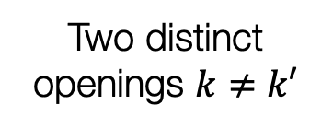
Re-randomizable Commitments (RRCs)
What properties does the commitment need to satisfy?
S
NOT possible:
Given two commitments
$$com\left(k\right)$$
$$com\left(k_{1}\right)$$
$$com\left(k_{2}\right)$$
Does not require knowing $k$
$$com$$
$$com\left(k\right)$$
A re-randomization
$$com\left(k_{1}\right)$$
Opening to
can open randomized commitments
Two distinct openings $k≠k′$
should be unlinkable to the commitment it came from
$$com\left(k\right)$$
Re-randomizable
Binding
Unlinkability
$⇒$ Correctness
$⇒$ Uniqueness
$⇒$ Unpredictability
Notes:
First, it must be publicly re-randomizable, what that means is that, if I commit to some value k, then, anyone else should be able to re-randomize this commitment without knowing my secret k. Additionally, I should still be able to open the new commitment, even though I don’t know the randomness used to re-randomize my commitment. this property is important for correctness of the SSLE protocol.

Slide 36
Re-randomizable Commitments (RRCs)
What properties does the commitment need to satisfy?
S
NOT possible:
Given two commitments
$$com\left(k\right)$$
$$com\left(k_{1}\right)$$
$$com\left(k_{2}\right)$$
Does not require knowing $k$
$$com$$
$$com\left(k\right)$$
A re-randomization
$$com\left(k_{1}\right)$$
Opening to
can open randomized commitments
Two distinct openings $k≠k′$
should be unlinkable to the commitment it came from
$$com\left(k\right)$$
Re-randomizable
Binding
Unlinkability
$⇒$ Correctness
$⇒$ Uniqueness
$⇒$ Unpredictability
Notes:
Secondly, the commitment should be binding, which is a standard notion for commitments, this means that an adversary should not be able to come up with a commitment and two different openings k and k’ that are both valid. This property is essential for our SSLE protocol to have uniqueness.

Slide 37
Re-randomizable Commitments (RRCs)
What properties does the commitment need to satisfy?
NOT possible:
Given two commitments
$$com\left(k\right)$$
$$com\left(k_{1}\right)$$
$$com\left(k_{2}\right)$$
Does not require knowing $k$
$$com$$
$$com\left(k\right)$$
A re-randomization
$$com\left(k_{1}\right)$$
Opening to
can open randomized commitments
Two distinct openings $k≠k′$
should be unlinkable to the commitment it came from
$$com\left(k\right)$$
Re-randomizable
Binding
Unlinkability
$⇒$ Correctness
$⇒$ Uniqueness
$⇒$ Unpredictability
Notes:
Finally, we want that the bottom list of commitments should be unlinkable to the original list of commitments. We formalize this notion of unlinkability, and define it by saying that given 2 commitments, if I re-randomize one of them, then, you shouldn’t be able to tell if I re-randomized the left one or the right one. This notion is necessary for unpredictability of SSLE.

Slide 38


RRCs from DDH [BEHG20]
Perfectly binding
DDH $⇒$ Unlinkable
Not post-quantum
Notes:
Boneh et al constructed an RRC based on DDH. It is perfectly binding, unlinkable, but NOT post quantum secure.

Slide 39
This Work
We construct a practical lattice-based SSLE protocol
Two lattice-based RRC constructions
Generalize the BEHG protocol
LWE
New notion:
Re-randomizable Commitments (RRCs)
Ring-LWE
Notes:
In our work, we build 2 lattice based RRC-constructions, one based on LWE, which I’ll now describe at a high level.

Slide 40


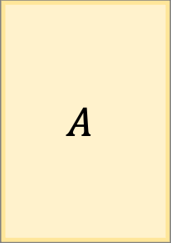



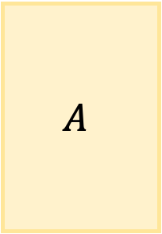



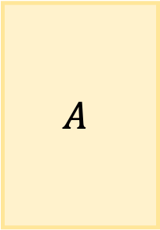



Lattice RRCs: A First Attempt
short noise vector
$$A$$
$$\vec{b}$$
$$A$$
$$A$$
$$\vec{μ}$$
$$\vec{k}$$
$$+$$
Commit:
$$=$$
,
,
uniform in $ℤ_{q}^{m×n}$
uniform in $ℤ_{q}^{n}$
$$A$$
$$\vec{b}$$
$$\vec{k}$$
$$\vec{k}$$
Provide
Anyone can test that
Open:
$$≈$$
Notes:
Ok, we’ll start with a flawed attempt, and we’ll see how to fix it if we have time. Alright, so, the random value k that each party samples, is a vector in Zq^n. To commit to such a vector k, we use the standard lattice-based commitment scheme: wherein, we sample a random tall matrix A, in Zq^m by n, then the commitment is a tuple, with the first coordinate being just the matrix A, and the second coordinate is A times k + mu, where mu is a short noise vector. Mu is usually sampled from a gaussian distribution, concentrated around vectors with low norm.
To open such a commitment, I can just give you the vector k. Anyone can check if it’s a valid opening by testing if A times k is close to the second coordinate b. This will hold for an honest commitment because mu has low norm.

Slide 41


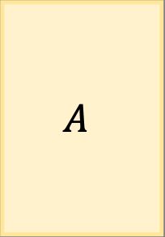



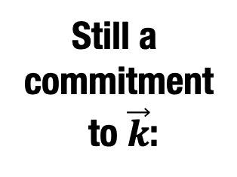

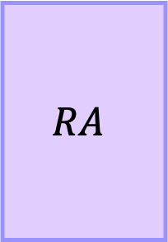
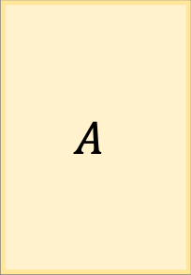

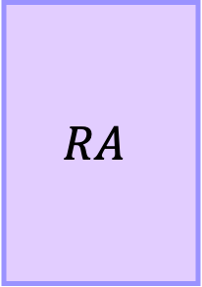



A First Attempt: Re-randomization
$$A$$
$$\vec{b}$$
$$R$$
$$A$$
$$R$$
$$\vec{b}$$
,
,
uniform in ${\left\{−1,1\right\}}^{m×m}$
$$RA$$
$$RA$$
$$R$$
$$\vec{μ}$$
Recall: $\vec{b}=A⋅\vec{k}+ \vec{μ}$
Still a commitment to $\vec{k}$:
$$\vec{k}$$
$$+$$
A short vector
,
Notes:
Lets see how we can re-randomize such a commitment. We sample a random Bernoulli matrix R, of size m*m, this is a square matrix, then we multiply both coordinates with this matrix. I claim that this new commitment is still a valid commitment to k. to see that, lets denote R times A by RA, then, the new commitment is equal to RA, RA times k + R times mu. Since R has small entries and mu is low norm, R times mu will still be short, hence, RA times k will still be close to the second coordinate. this means that k is a valid opening for the randomized commitment as well.

Slide 42
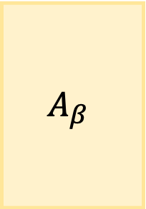
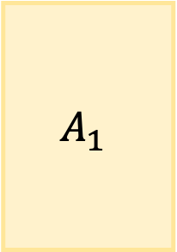

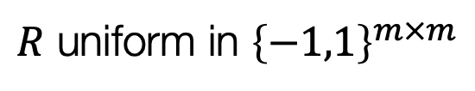
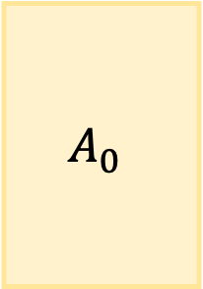





A First Attempt: Unlinkability
$$A_{0}$$
$$\vec{b_{0}}$$
$$A_{1}$$
$$\vec{b_{1}}$$
Want to argue:
,
,
Cannot distinguish between
$β=0$ from $β=1$
$$R$$
$$A_{β}$$
$$R$$
$$\vec{b_{β}}$$
We show that this follows from LWE + Leftover Hash Lemma
,
$R$ uniform in ${\left\{−1,1\right\}}^{m×m}$
Notes:
Next, lets look at unlinkability. Recall that unlinkability means that if we have two commitments, and if I re-randomize one of them, then you shouldn’t be able to tell whether I randomized the left or the right commitment. We prove that this commitment scheme is unlinkable based on LWE and the leftover hash lemma.

Slide 43

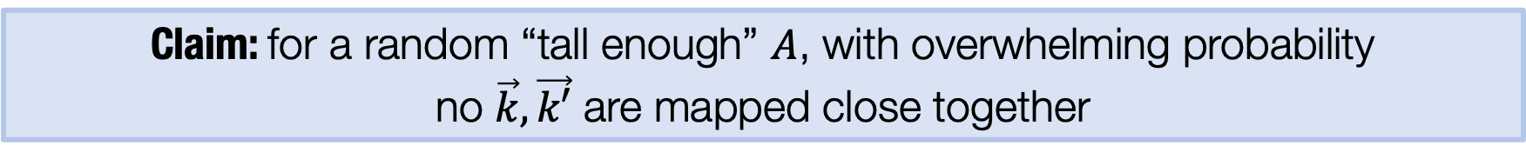
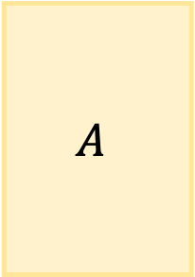

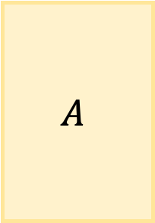



The Problem: Binding
To break binding,
needs to find $\left(A,\vec{b}\right),\vec{k},\vec{k′}$ such that
$$A$$
$$\vec{b}$$
$$A$$
$$\vec{k}$$
$$≈$$
$$≈$$
$$\vec{k′}$$
Claim: for a random “tall enough” $A$, with overwhelming probability no $\vec{k},\vec{k′}$ are mapped close together
Problem: $A$ is not random! can choose it! Not just a problem in the proof… There is an attack on the SSLE Protocol!
Notes:
But the problem is binding! Recall that to break binding, the adv needs to find a commitment A,b along with two vectors k and k’ such that both k,k’ are valid openings, meaning that, both A times k and A times k’ are close to b,
We might hope to get binding, because of this claim, which says that for a random tall enough matrix A, with high probability, there are no two vectors k and k’ that are mapped close together by A. but the reason why we cannot use this claim is that A is actually not random. Since its part of the commitment, the adversary can choose a bad matrix A and k, k’ such that A times k is close to A times k’. hence this scheme is not binding. This is not just a problem in the proof, this issue leads to an attack on the SSLE protocol!

Slide 44

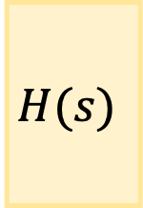


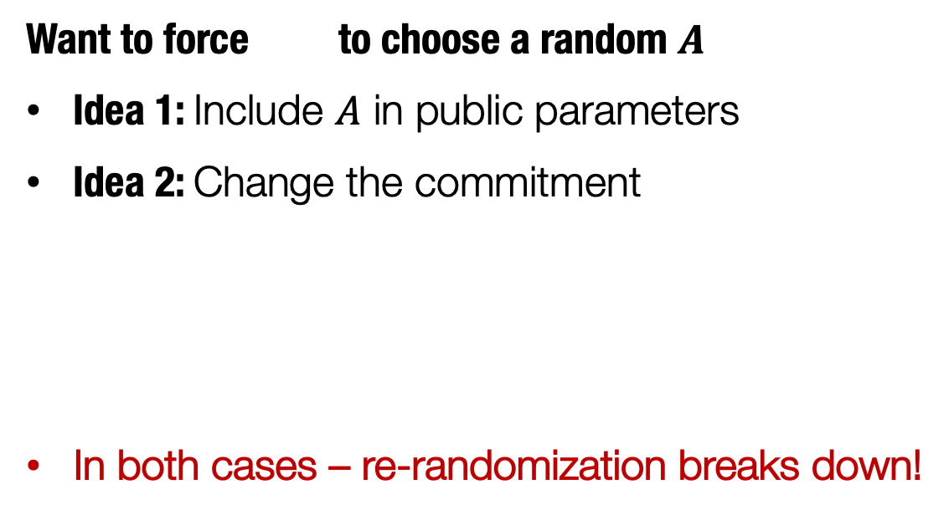

Simple Fixes Do Not Work
Claim: for a random “tall enough” $A$, with overwhelming probability no $\vec{k},\vec{k′}$ are mapped close together
Want to force to choose a random $A$
Idea 1: Include $A$ in public parameters
Idea 2: Change the commitment
In both cases – re-randomization breaks down!
$$H(s)$$
$$\vec{μ}$$
$$\vec{k}$$
,
$$+$$
$$s$$
Notes:
I want to now explain why this is not an easy problem to solve. We’ll try some simple methods and see that they don’t work. So we want to force the adversary to choose a random A:
One way to do that could be to include A in the public parameters, so the adv has no control over A,
Another way would be to force the adv to choose A via a hash function, so the commitment can be a seed s, and Hash of s times k + mu.
But now the problem is that we don’t know how to re-randomize these commitments. The nice structure we had in our original commitment is not there anymore.

Slide 45

A Key Observation
Claim: for a random “tall enough” $A$, with overwhelming probability no $\vec{k},\vec{k′}$ are mapped close together
For random $\vec{k},\vec{k′}$ very few matrices $A$ map $A\vec{k}≈A\vec{k′}$
Intutition - amplification: If we choose random $\vec{k_{1}},\vec{k_{2}}$ and $\vec{k_{1}^{′}},\vec{k_{2}^{′}}$ even fewer matrices map $A\vec{k_{1}}≈A\vec{k_{1}^{′}}$ and $A\vec{k_{2}}≈A\vec{k_{2}^{′}}$
We show: If we choose random $\vec{k_{1}},…,\vec{k_{ℓ}}$ and $\vec{k_{1}^{′}},…,\vec{k_{ℓ}^{′}}$ for $ℓ≈n$, then w.h.p no matrix $A$ maps $A\vec{k_{i}}≈A\vec{k_{i}^{′}}$ for every $i$
Idea: Force random choices of $\vec{k_{1}},…,\vec{k_{ℓ}}$ using a hash function
Notes:
Here’s the key observation that we use to solve this issue: we saw this claim before, that for random A, k, k’, Ak will not be close to Ak’ with high probability. In particular, this implies that for random k and k’, there are very few matrices A that map k and k’ close together. Now, we can amplify this, if we choose two random vectors instead of one, i.e. k1, k2, and k1’ k2’, there are even fewer matrices such that Ak1 is close to Ak1’ and Ak2 is also close to Ak2’. We show that If we choose around n vectors, then with high probability, there’s no matrix A that maps all n pairs of vectors close together.
Lastly, how do we force the adv to choose random k vectors? Well, we can use a hash function.
This is enough to get a commitment scheme that is binding as well as unlinkable, you can find the details in our paper.

Slide 46
We’re not done yet…
Notes:
Unfortunately, there’s one more issue that we need to deal with:

Slide 47

Re-randomizable Commitments (RRCs)
What properties does the commitment need to satisfy?
NOT possible:
Given two commitments
This is not enough for SSLE!
$com\left(k_{1}\right)$ and/or $com\left(k_{2}\right)$might have been re-randomized by a corrupted party
In the paper:
Stronger definition
Augmented constructions
$$com\left(k\right)$$
$$com\left(k_{1}\right)$$
$$com\left(k_{2}\right)$$
Does not require knowing $k$
$$com$$
$$com\left(k\right)$$
A re-randomization
$$com\left(k_{1}\right)$$
Opening to
can open randomized commitments
Two distrinct openings $k≠k′$
should be unlinkable to the commitment it came from
$$com\left(k\right)$$
Re-randomizable
Binding
Unlinkability
$⇒$ Correctness
$⇒$ Uniqueness
$⇒$ Unpredictability
Notes:
recall that we defined unlinkability as if we have two commitments, and I randomize one of them, then you shouldn’t be able to tell which one I randomized. But this is actually not enough for unpredictability of SSLE. The issue is that,
these commitments might be randomized by an adversary, so we need a stronger definition where unlinkability holds even if an adv randomizes commitments.
You can see our paper for the stronger definition and the constructions that achieve strong unlinkability.

Slide 48
RRCs from Ring-LWE
We construct a practical lattice-based SSLE protocol
Two lattice-based RRC constructions
Generalize the BEHG protocol
More efficient
(see the paper)
LWE
Also in the paper: A lattice-based proof of shuffle based on [CMM19]
New notion:
Re-randomizable Commitments (RRCs)
Ring-LWE
Notes:
In our paper, we also have a re-randomizable commitment based on ring-LWE, which is more efficient. Lastly, We build an efficient lattice-based proof of shuffle, based on a recent work by
Costa, Martinez, Morillo.

Slide 49
Conclusions
SSLE: useful when moving from PoW to PoS
We construct a practical SSLE protocol from lattice-based assumptions (LWE, ring-LWE)
Believed to be post-quantum secure
New notion: re-randomizable commitments (RRCs)
Open:
Additional applications of RRCs?
More efficient approaches for SSLE?
Notes:
To conclude, SSLE can be useful when moving from proof of work to proof of stake. We built a practical SSLE protocol from lattice based assumptions, which are believed to be post quantum secure, and we also introduced the notion of re-randomizable commitments.
There are still many open questions, the first being if the notion of RRCs can be used in other applications, and secondly, coming up with different, hopefully more efficient approaches for SSLE.

Slide 50
Thank you!
Notes:
Thankyou for listening!

