Slide 1


Data Availability Sampling with Repair
Dan Boneh, Joachim Neu, Valeria Nikolaenko, Aditi Partap
https://eprint.iacr.org/2025/1414

Slide 2
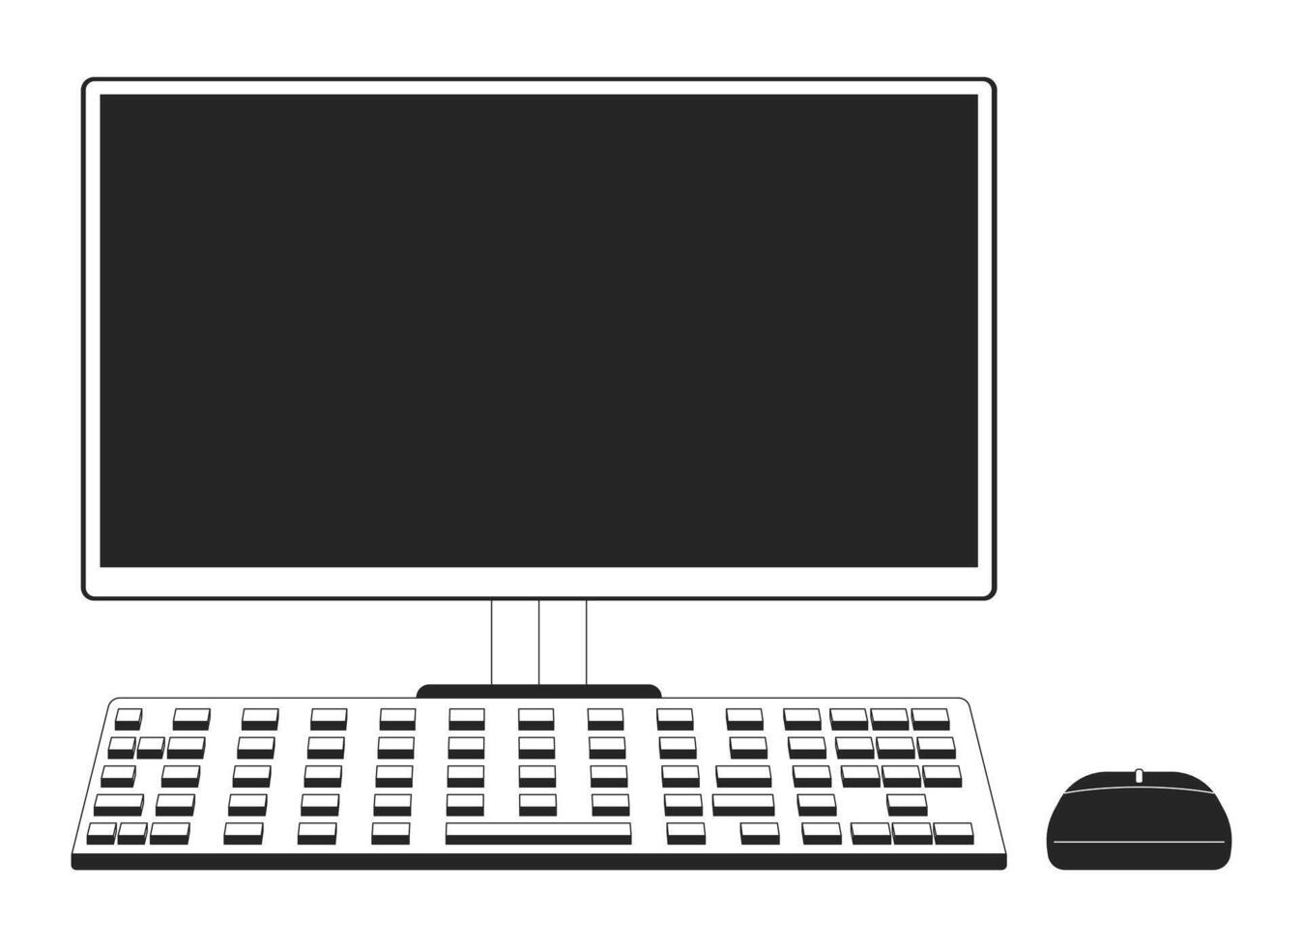



The need to scale Consensus
Execution
Validators
Notes:
consensus forms the core of any blockchain – at a high level, we have a bunch of validators that look at a pool a transactions from the network, and they output an ordering over these transactions – the execution engine of the blockchain can take this order and execute the txns.

Slide 3

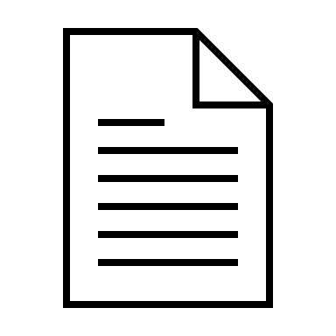

The need to scale Consensus
Execution
Validators
Notes:
But the problem is, as we try to scale the blockchain to handle more transactions, the consensus layer quickly becomes the bottleneck – this is because all consensus protocols have atleast a quadratic overhead.
Hence, we need to design scalable consensus protocols to make a high-throughput blockchain.

Slide 4



Solution: Decouple Ordering from Dissemination
Execution
Validators
Retrieval
Dispersal
Verify
Verifiable Distributed Storage
Notes:
One commonly-used solution to this problem is to decouple ordering of txns from dissemination. Lets see what I mean by that: we have a bunch of validators as before, and we have a pool of txns on the left.
but now, instead of running consensus on the full txns, we only run it on references to the txns: here the paperclip represents a reference.
In parallel, the validators will run a verifiable distributed storage service, and the txns will be dispersed through this system for storage.
So for consensus, the validators will only see a reference, and before voting for the txns, the validators can Verify with the distributed storage that the txn w.r.t. these references are indeed being stored. Then finally we get an ordering on the references as the output. The execution engine can then look at this order, and for each ref, retrieve the corresponding txn from the storage.
This is a foundational technique that allows scaling consensus to handle high throughput.

Slide 5
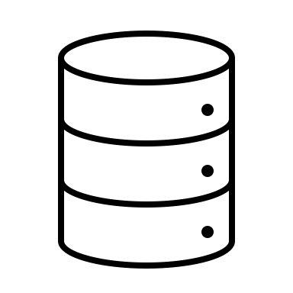




Verifiable Distributed Storage
Verifiably store data among storage nodes, so that each node communicates and stores only a small part
Disperse
Retrieve
Dispersor
(Block builder)
Storage nodes (Validators)
Retrievor
Verify
Public reference
Verifiors
(Validators)
Notes:
Now lets dive into VDS in a bit more detail
At a high level: it’s a system that allows us to …
We have storage nodes, these are basically the validators. we have the disperser here, which gets a large setof txns, it then runs something called Dispersal, wherein it gives a small chunk of the data to each storage node. And we also have a public reference to this data.
Then, anyone can verify whether the data is actually being stored by the nodes by running a Verify protocol. This is what the validators will run before they vote on this data.
Lastly, if someone wants to actually get the data, they can run a Retrieval protocol with the storage nodes.

Slide 6






Example: Verifiable Information Dispersal (VID)
Used in:
Verify is non-interactive:
Disperse
Dispersor
$$σ_{1}$$
$$σ_{2}$$
$$σ_{3}$$
$$σ_{4}$$
Verify: Output 1 if enough valid signatures
Notes:
We see two incarnations of verifiable dist storage:
The first one is VID, which stands for verif info disp. This is also known as AVID, or ACeD. at a very high level, the vf is done via signatures: sp. Each storage node publishes a signature if it gets its chunk of the data.
Then the verifier just checks these signatures and output 1 if enough sigs are valid.
Here, note that security depends on the threshold honesty assumption: i.e. most of the validators are indeed honest.

Slide 7

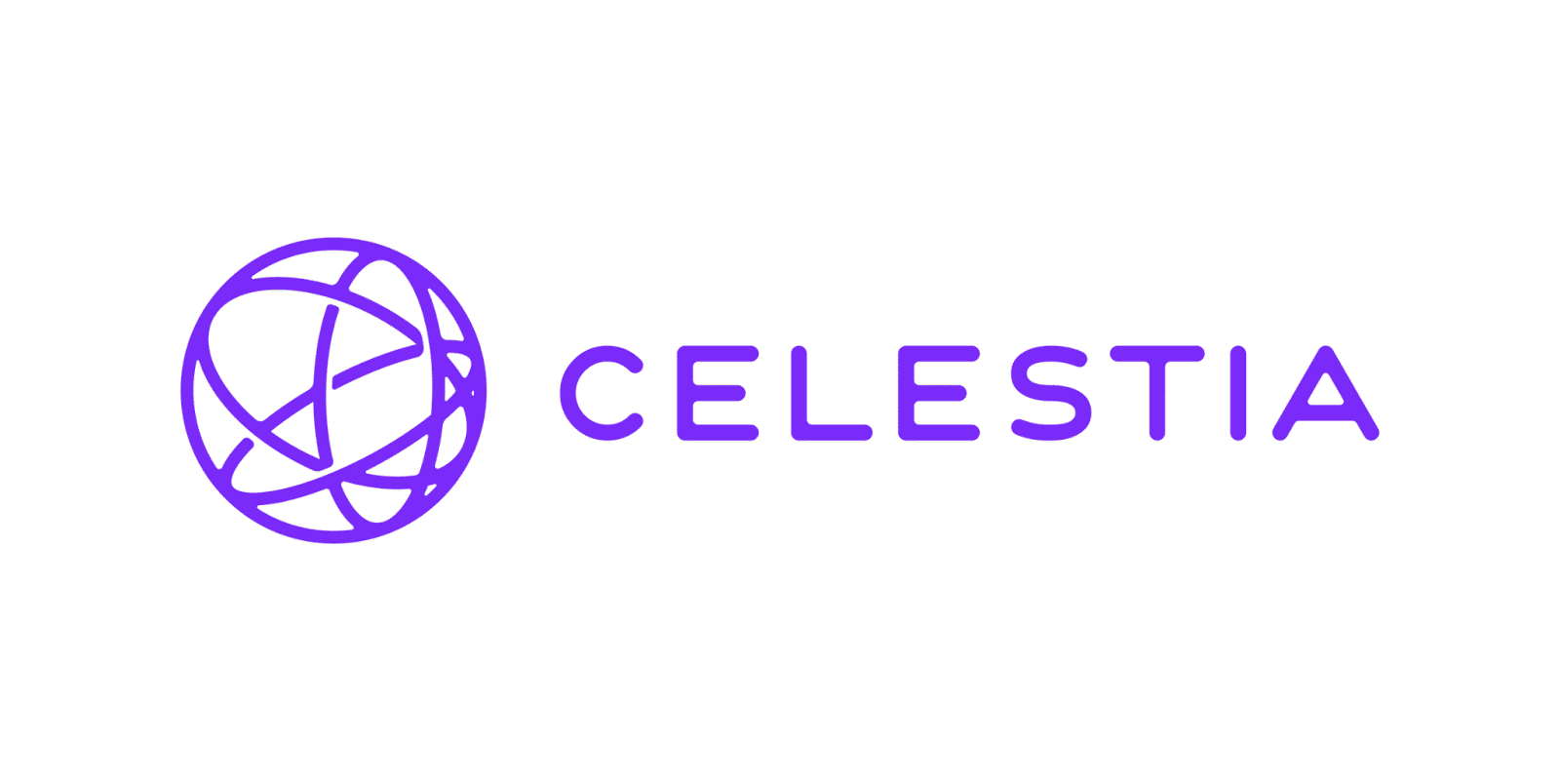
Example: Data Availability Sampling (DAS)
Used in:
Verify is interactive:
Disperse
Dispersor
Verify:
‘Sample’ random chunks of data
Output 1 if all chunks available
Focus of today’s talk
Notes:
The second incarnation is called data availability sampling, where vf is interactive. Specifically, the verifier samples random chunks of the data, and queries the nodes for it. And outputs 1 only if it finds all of those chunks. Generally, VID is good for permission systems with a small #of validators, whereas DAS works well for permissionless systems with dynamic committees. DAS is being implemented by eth and celestia.
This will the focus of today’s talk but note that all of our techniques apply to VID as well.

Slide 8
How to repair lost chunks?
What if some node loses its chunk?
Disperse
Dispersor
Storage nodes (Validators)
Notes:
But in our work, the question we ask is what happens when some node loses its chunk

Slide 9

How to repair lost chunks?
What if some node loses its chunk?
Or, What if the dispersor never dispersed its chunk?
Disperse
Dispersor
Storage nodes (Validators)
Notes:
Or worse, what if the dispersor is adversarial and never published this chunk?

Slide 10
How to repair lost chunks?
What if some node loses its chunk?
Or, What if the dispersor never dispersed its chunk?
Disperse
Retrieve
Dispersor
Storage nodes (Validators)
Retrievor
Verify
Need some way to repair lost chunks!
Verifiors
(Validators)
Notes:
This is problematic because missing chunks are bad for the performance and fault tolerance of the system, e.g. the Verification and retrieval protocols depend on querying storage nodes for their chunks – but if many nodes don’t have their chunks, everyone will have to now contact the small set of nodes that do have their chunks, and if any of those nodes go down, we might lose the data forever. Hence, we need some way to repair lost chunks.

Slide 11
This work
New definitions for Data Availability Sampling (DAS), strengthening [HASW23] to formalize:
Repair
Retrieval
New framework for building DAS with repair, from
New Construction using the framework with
Codes with locality
Erasure code commitment with locality
Can be used for Private Information Retrieval (PIR)
Multiplicity codes
New Polynomial commitment scheme
Notes:
With this motivation in mind, we make two main contributions in our work:
Give new definitions for data availability sampling. Specifically, we generalize defns given in HASW23, and we formalize the notion of repair, which says that it should be possible to repair any chunk efficiently.
Additionally, we also give the first formal definition for retrieval, which says that it should be possible to retrieve the full data in the future if everything goes well,
Second, we give a new framework for building DAS schemes with repair, from two building blocks: a code with locality + an erasure code commitment for the same code with locality.
lastly, we give a new construction of DAS with efficient repair: we use our framework, with multiplicity codes and a New polynomial commitment scheme!!!! This is an erasure code commitment for mult codes with locality.
Lastly, I do wanna mention that this commitment scheme may be of independent interest – e.g. it can be used for PIR schemes based on mult codes.

Slide 12
Defining Repair for Data Availability Sampling
Repair protocol:
Disperse
Retrieve
Dispersor
Repair
Retrievor
Verify
Public reference
Verifiors
Notes:
Just very briefly, in terms of defns, we define a repair protocol: so if this node loses its chunk, it can interact with a few other nodes to repair its chunk.

Slide 13
Our Construction
 | Ethereum Fulu DAS | Our Construction
Node storage | 8.18 KB | 0.23 KB [35x better]
Notes:
Ok so here’s a comparison of our construction with the Ethereum DAS scheme that’s included as part of the fulu hard fork.
All of the numbers are for a single blob, which in Ethereum is a list of 4096 field elems.
Starting with node storage, which denotes how much data does each node have to store, in eth: this is 8KB, whereas for our design, this is only 0.23KB : i.e. each node has to store 35 times less data in our scheme.

Slide 14
Our Construction
 | Ethereum Fulu DAS | Our Construction
Node storage | 8.18 KB | 0.23 KB [35x better]
Repair complexity: Total bandwidth | 128 KB | 21.3 KB [6x better]
Repair complexity: Number of subnets | 64 | 91 [1.4x worse]
Notes:
Next, to compare repair, we define two metrics: the first one is total amt of bandwidth that you need to use over the NW to repair one chunk. For eth, this is 128KB, whereas we only need about 21 KB, i.e. 6 times lower load on the network for repair.
The second metric is the number of gossip subnets one node need to join to repair its chunk. So for this comparison, i'm assuming that we use a gossip protocol for dispersal, where there may be a separate subnet or topic for each chunk.
For eth this is 64, its slightly higher for our scheme, but we believe this is a reasonable tradeoff.

Slide 15
Our Construction
 | Ethereum Fulu DAS | Our Construction
Node storage | 8.18 KB | 0.23 KB [35x better]
Repair complexity: Total bandwidth | 128 KB | 21.3 KB [6x better]
Repair complexity: Number of subnets | 64 | 91 [1.4x worse]
Sampling bandwidth | 16.37 KB* | 9.14 KB [1.8x better]
Dispersor work (Multi-threaded) | 0.3s | 0.42s [1.4x worse]
Notes:
Next, we compare sampling b.w which denotes how much should one verifier need to sample to get some assurance that the data is indeed available: this is about 16 KB for eth, but for our scheme, we only use about 9KB bandwidth for sampling – this is almost 2 times better than eth. Also There’s an asterisk cuz actually Ethereum’s scheme does not achieve the same level of security as we do.
Next, dispersor work: amt of compute that the block builder needs to do to disperse the data. This is about 0.3s for eth, and for us, this is about 0.42s assuming the disperser has enough cpu cores. Again this is slightly higher but a reasonable tradeoff to get good repair.

Slide 16
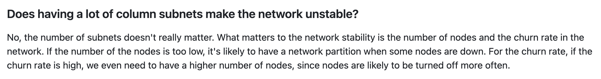
Our Construction
 | Ethereum Fulu DAS | Our Construction
Node storage | 8.18 KB | 0.23 KB [35x better]
Repair complexity: Total bandwidth | 128 KB | 21.3 KB [6x better]
Repair complexity: Number of subnets | 64 | 91 [1.4x worse]
Sampling bandwidth | 16.37 KB* | 9.14 KB [1.8x better]
Dispersor work (Multi-threaded) | 0.3s | 0.42s [1.4x worse]
#Subnets for Dispersal | 128 | 9216 [72x worse]
🤔
Notes:
Lastly, we have #gossip subnets that we need over the network to do dispersal of the data.
Eth: 128, our scheme actually requires a large number of subnets. Now, apparently, as per the FAQs in Ethereum’s specs, this number does not matter.

Slide 17
Our Construction
Our construction
with batching:
 | Ethereum Fulu DAS | Our Construction
Node storage | 8.18 KB | 0.23 KB [35x better]
Repair complexity: Total bandwidth | 128 KB | 21.3 KB [6x better]
Repair complexity: Number of subnets | 64 | 91 [1.4x worse]
Sampling bandwidth | 16.37 KB* | 9.14 KB [1.8x better]
Dispersor work (Multi-threaded) | 0.3s | 0.42s [1.4x worse]
#Subnets for Dispersal | 128 | 9216 [72x worse]
1.9 KB [4.3x better]
60 KB [2.1x better]
32 [2x better]
24.4 KB [1.5x worse]
1225 [9.5x worse]
Notes:
But just in case it does matter, we also have an alternate construction in the paper where we use some batching techniques -- this is almost 2x better than the Ethereum DAS, and only needs about a 1000 subnets for dispersal, which is much more reasonable. For simplicity, I will only focus on the first construction, but U can see the paper for details on this alternate construction.

Slide 18
Our Construction: Building Blocks
New DAS framework from
Apply framework to:
Code with locality
Erasure code commitment with locality
Multiplicity Codes
New Multivariate Polynomial Commitment scheme
Notes:
Alright. So for our construction, we have three key building blocks. First, we have a new framework to construct DAS with repair, which uses a code with locality + an erasure code commit with locality. I will explain wut these are in a bit. Then, we get our construction by applying this framework to mult codes + a new multivariate poly commit scheme.

Slide 19










Framework for Data Availability Sampling [HASW23]
Disperse
Encode using Erasure code
$$E$$
$$E_{1}$$
$$E_{2}$$
$$E_{3}$$
$$E_{n}$$
$$…$$
Verify
$$E_{3}^{′}$$
$$E_{n}^{′}$$
$$E_{1}^{′}$$
Query random positions of encoding
How can the verifier check that $E_{1}^{′}$ is correct?
Notes:
Before we describe our framework, lets start with the existing framework for DAS which was formalized by hall Anderson el al:
To disperse the data, we first encode it using an erasure code: here E denotes the encoding.
Then, Each node stores one symbol of the encoding: node 1 stores the first position
For simplicity, im assuming that the length of encoding is the same as #nodes n.
Next, to verify, the verifier will sample random positions of the encoding, and query the nodes for those positions – e.g. here, we query symbol 1, and we get back E1’, similarly we get back E3’ for position 3 and so on. But how can the verifier check that the symbols it got are indeed correct?

Slide 20
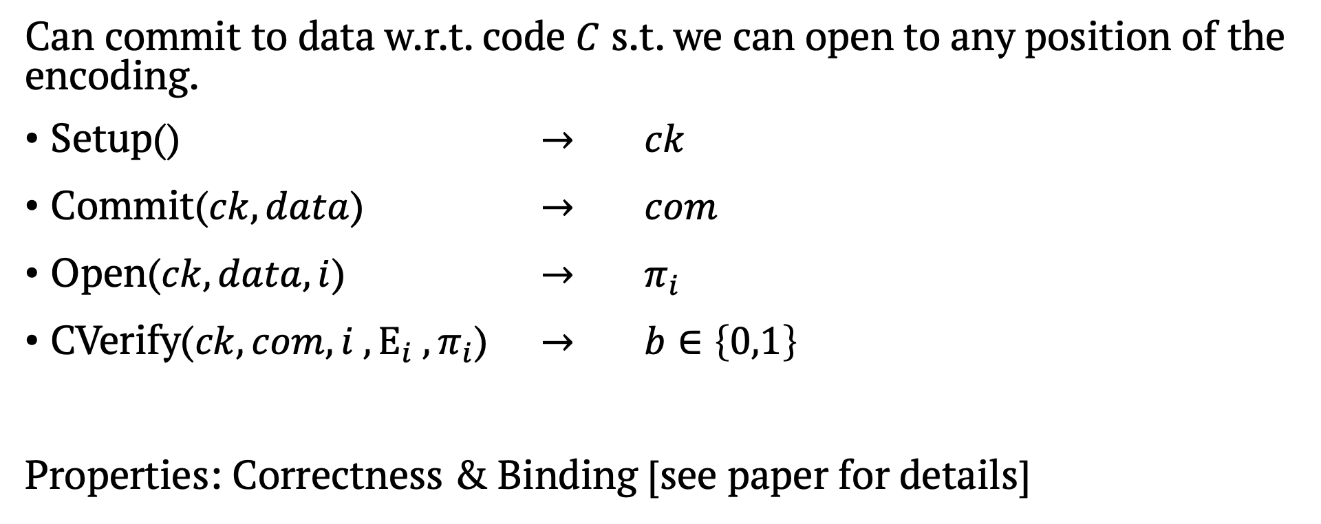
Erasure Code Commitment [HASW23]
Can commit to data w.r.t. code $C$ s.t. we can open to any position of the encoding.
Setup() $→$ $ck$
Commit($ck, data$) $→$ $com$
Open($ck,data,i$) $→$ $π_{i}$
CVerify($ck, com, i , E_{i} , π_{i}$) $→$ $b∈\left\{0,1\right\}$
Properties: Correctness & Binding [see paper for details]
Notes:
To solve this issue, we need some way of committing to the data so we can check these symbols w.r.t the commitment.
this was formalized by HAsw23 the notion of an erasure code commitment: at a high level, they allow committing to data w.r.t. a code C s.t. we can …

Slide 21








Framework for Data Availability Sampling [HASW23]
Commit using Erasure code commitment
$$com$$
Disperse
Encode using Erasure code
$$E$$
$$E_{1}$$
$$E_{2}$$
$$E_{3}$$
$$E_{n}$$
Compute openings for all positions
$$π_{1}$$
$$π_{2}$$
$$…$$
$$π_{n}$$
$$…$$
Verify
Query random positions of encoding
$$E_{3}^{′} , π_{3}$$
$$E_{1}^{′} , π_{1}$$
$$E_{n}^{′} , π_{n}$$
Output 1 if proof is valid w.r.t.
for all queried positions
Notes:
Now, in Disperse, along with encoding the data, the dispersor also computes a commitment com using the ECCom – u can think of this as the public reference to this data.
Next, the dispersor also computes the opening proofs pi1 to pin for all positions. Node 1 then gets the symbol E1 along with proof pi1 as its chunk.
The verifier will now get symbols and corresponding proofs when it queries for random positions, and it can verify these proofs w.r.t. the commitment, and output 1 only if all of them are valid.

Slide 22
Example: Ethereum Fulu DAS
Summary:
Ethereum Fulu DAS roughly follows the same framework:
Erasure code
Erasure code commitment
DAS
Reed-Solomon code
KZG Polynomial commitment
Fulu DAS
Notes:
To summarize, u can construct a DAS scheme from a erasure code + a erasure code commit for the same code. E.g. ehtereum Fulu DAS follows this framework with RS code + KZG commitment.

Slide 23
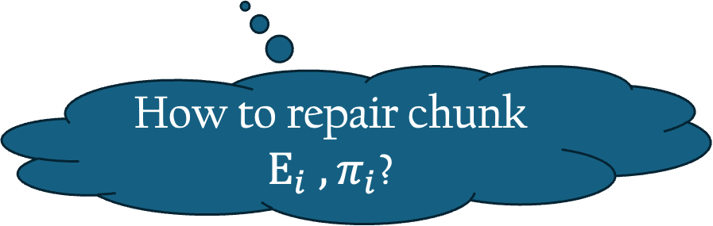
How to repair lost chunks?
Commit using Erasure code commitment
$$com$$
Disperse
Encode using Erasure code
$$E$$
$$E_{1}$$
$$E_{2}$$
$$E_{3}$$
$$E_{n}$$
Compute openings for all positions
$$π_{1}$$
$$π_{2}$$
$$…$$
$$π_{n}$$
$$…$$
Verify
Query random positions of encoding
$$E_{3}^{′} , π_{3}$$
$$E_{1}^{′} , π_{1}$$
$$E_{n}^{′} , π_{n}$$
How to repair chunk $E_{i} , π_{i}$?
Output 1 if proof is valid w.r.t.
for all queried positions
Notes:
But now, the key question is how to repair lost chunks? So in this design, what happens if a node loses its symbol Ei and proof pi_i?

Slide 24
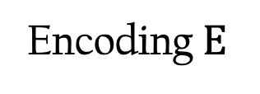





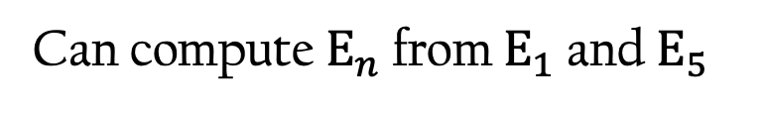
New Framework: Using Codes with Locality
Locally Correctable codes: Can repair any position of the encoding by querying only $r≪n$ random positions
Encoding$E$
$$E_{1}$$
$$E_{2}$$
$$E_{3}$$
$$E_{n}$$
Can compute $E_{n}$ from $E_{1}$ and $E_{5}$
Notes:
To solve this issue, the key observation we make is that we should use codes with locality, specifically, locally correctable codes: these are special erasure codes wherein, we can repair …

Slide 25
New Framework for Data Availability Sampling
Commit using Erasure code commitment
$$com$$
Disperse
Encode using
Locally correctable code
$$E$$
$$E_{1}$$
$$E_{2}$$
$$E_{3}$$
$$E_{n}$$
Compute openings for all positions
$$π_{1}$$
$$π_{2}$$
$$…$$
$$π_{n}$$
$$…$$
Verify
Query random positions of encoding
$$E_{3}^{′} , π_{3}$$
$$E_{1}^{′} , π_{1}$$
$$E_{n}^{′} , π_{n}$$
Output 1 if proof is valid w.r.t.
for all queried positions
Notes:
Here’s the updated framework where evt remains the same, but we just use a LCC to encode the data. Verify is the same as before.

Slide 26
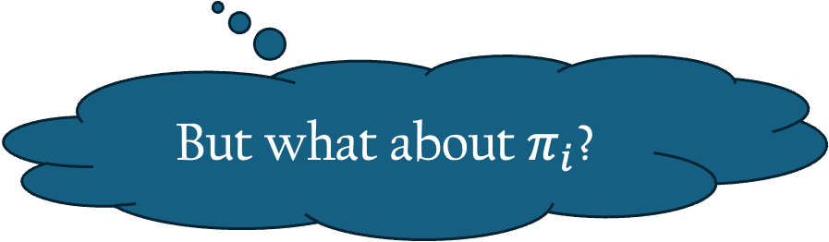
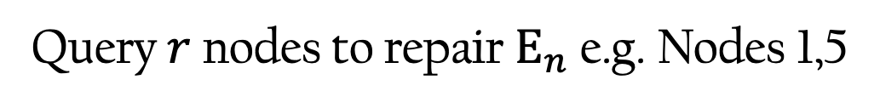
New Framework for Data Availability Sampling
Commit using Erasure code commitment
$$com$$
Disperse
Encode using
Locally correctable code
$$E$$
$$E_{1}$$
$$E_{2}$$
$$E_{3}$$
$$E_{n}$$
Compute openings for all positions
$$π_{1}$$
$$π_{2}$$
$$…$$
$$π_{n}$$
$$…$$
But what about $π_{i}$?
Query $r$ nodes to repair $E_{n}$ e.g. Nodes 1,5
Repair
Notes:
Now, for repair, if lets say node n loses its chunk, we can use local correction of the code: we can query r nodes to repair En: in our example, we’ll just need to query nodes 1 and 5.
But, what about the proof pi_n?how can this node repair the opening proof for its symbol?

Slide 27
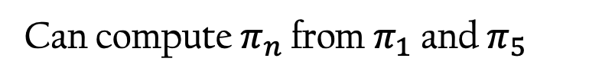

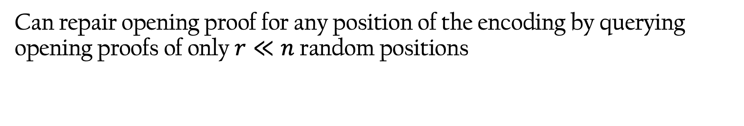



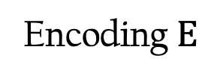
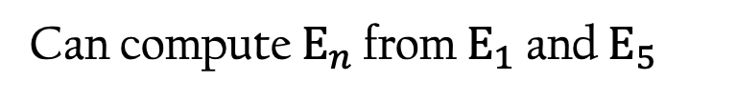
New: Erasure Code Commitment with Local correction
Can repair opening proof for any position of the encoding by querying opening proofs of only $r≪n$ random positions
Encoding$E$
$$E_{1}$$
$$E_{2}$$
$$E_{3}$$
$$E_{n}$$
Can compute $E_{n}$ from $E_{1}$ and $E_{5}$
Opening Proofs
$$π_{1}$$
$$π_{2}$$
$$π_{3}$$
$$π_{n}$$
Can compute $π_{n}$ from $π_{1}$ and $π_{5}$
Notes:
To be able to repair toe opening proofs, we also need the erasure code commitment scheme to have some notion of locality: specifically, we define ECCom with local correction, wherein, we can repair opening proof for any position …

Slide 28
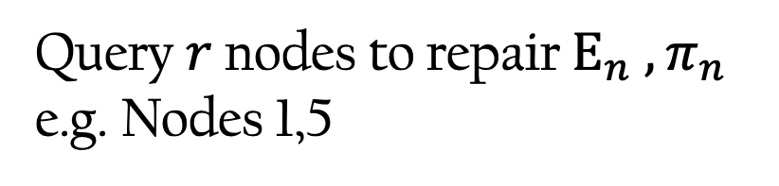
New Framework for Data Availability Sampling
Commit using Erasure code commitment
$$com$$
With local correction
Disperse
Encode using Locally correctable code
$$E$$
$$E_{1}$$
$$E_{2}$$
$$E_{3}$$
$$E_{n}$$
Compute openings for all positions
$$π_{1}$$
$$π_{2}$$
$$…$$
$$π_{n}$$
$$…$$
Query $r$ nodes to repair $E_{n} , π_{n}$
e.g. Nodes 1,5
Repair
Notes:
Now the dispersor will use an ECCom with local correction to commit to the data.
Iif the last node loses its chunk, it can query lets say nodes 1 and 5, and now it can repair both the symbol En and the proof pi_n. this is a high level overview of the new framework.

Slide 29
Summary of our DAS Framework
Locally correctable code
Erasure code commitment with local correction
*Formalize peer-to-peer gossip network for dispersal
Data Availability Sampling with repair
Notes:
To summarize, we show that we can get a secure DAS with repair by using a LCC and a ECCom with local correction. You can find the proofs in the paper.
Note that, for the proofs, we also formalize the use of peer-to-peer gossip N/W for dispersal : we use this to provide guarantees about the DAS scheme.

Slide 30
Efficiency of Constructions using DAS Framework
Locally correctable code
Erasure code commitment with local correction
Node storage: One symbol of encoding + One opening proof
Dispersor work: Encoding + Opening proofs for all positions
Repair complexity: Local correction + Local correction for opening proofs
Sampling bandwidth: Distance
Notes:
Ok so we now know that we need to use a locally correctable code + a corresponding commit scheme to construct DAS. Now the question is what sort of code and commitment should we use, for that lets look at all the efficiency metrics that we care about: e.g. node storage: each node has to store 1 symbol of the encoding + 1 opening proof: so we would need a commitment scheme with short opening proofs, next, dispersor work: includes encoding data using the code, and also computing opening proofs for all positions:
Lastly, for sampling bandwidth, we show in our paper that one should use codes with good minimum distance.

Slide 31
Our Construction: Building Blocks
New DAS framework from
Apply framework to:
Code with locality
Erasure Code Commitment with locality
Multiplicity Codes
New Multivariate Polynomial Commitment scheme
Notes:
Keeping this in mind, for our construction, we use mult codes + a new multivar poly commit scheme. Now I’ll give a high level overview of mult codes, and why they're a good choice for constructing DAS.

Slide 32
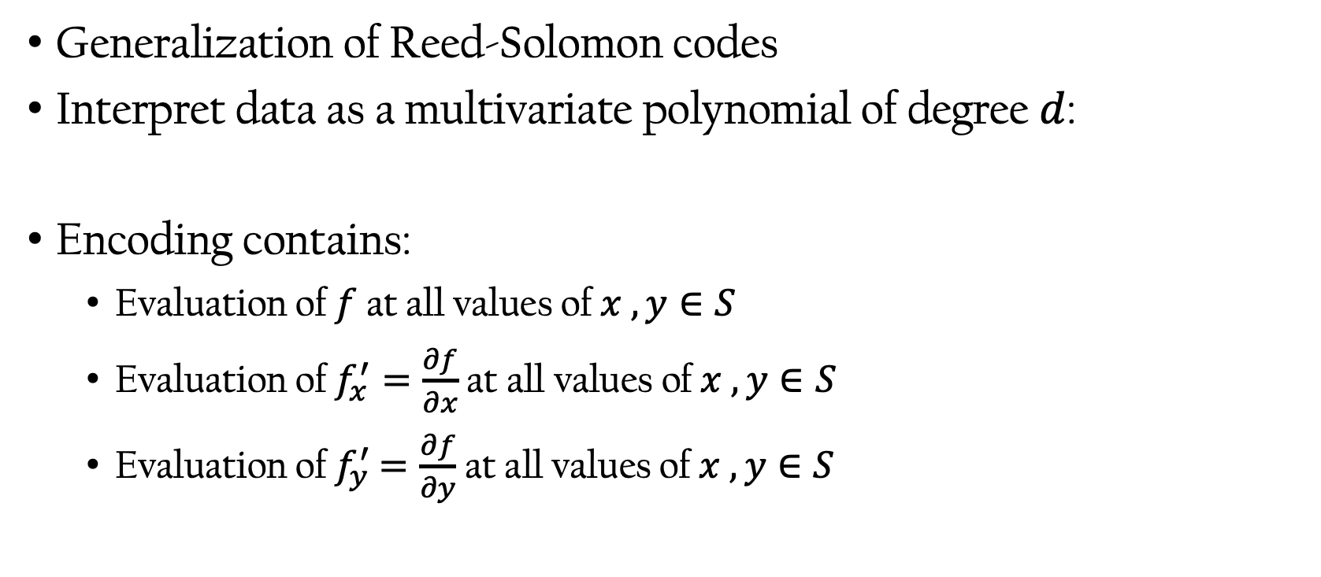

Multiplicity Codes [KSY14]
Generalization of Reed-Solomon codes
Interpret data as a multivariate polynomial of degree $d$:
Encoding contains:
Evaluation of $f$ at all values of $x , y∈S$
Evaluation of $f_{x}^{′}=\frac{∂f}{∂x}$at all values of $x , y∈S$
Evaluation of $f_{y}^{′}$ $=\frac{∂f}{∂y}$ at all values of $x , y∈S$
$$data=f(x,y)$$
Notes:
So mult codes were proposed by Kopparty et al in 2014, and they can be seen as a generalization of RS. At a high level, we can interpret the data as a multivariate poly of deg d. for simplicity, I will take the example of a bivariate poly. So data = f(x,y).
Next, the encoding of this data will include, evaluations of the poly f at all values of x,y in a set S: this is similar to reed Solomon, but the key thing that’s different in mult codes is that we also store evaluations of derivatives of f. here, we have f’x which is the first derivative w.r.t.x and f’y, and the encoding contains the evals of f, and both these derivates at all vals of x,y.

Slide 33
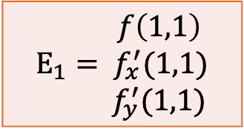
Multiplicity Codes [KSY14]
$$f\left(1,1\right)$$ $${E_{1}= f}_{x}^{′}(1,1)$$ $$f_{y}^{′}(1,1)$$
Notes:
As an example, The first symbol of the encoding for polynomial f will contain the eval of f at 1,1, eval of derivative f’x and f’y at 1,1. this is what the 1st node will store.

Slide 34
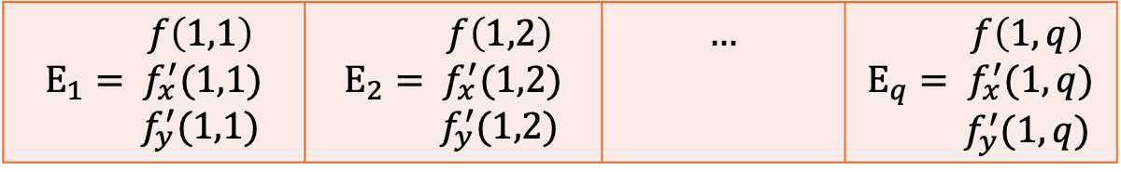

Multiplicity Codes [KSY14]
$$f\left(1,1\right)$$ $${E_{1}= f}_{x}^{′}(1,1)$$ $$f_{y}^{′}(1,1)$$ | $$f\left(1,2\right)$$ $${E_{2}= f}_{x}^{′}(1,2)$$ $$f_{y}^{′}(1,2)$$ | $$…$$ | $$f\left(1,q\right)$$ $${E_{q}= f}_{x}^{′}(1,q)$$ $$f_{y}^{′}(1,q)$$
$$…$$
Notes:
Similarly the second symbol has evals at 1,2… and so on til 1,q.

Slide 35
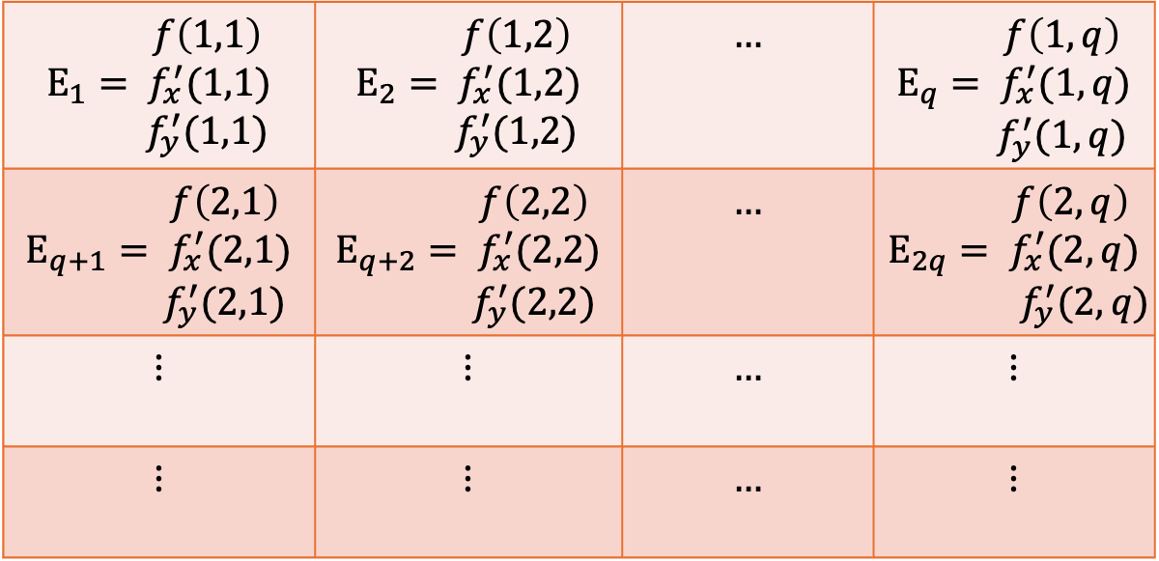
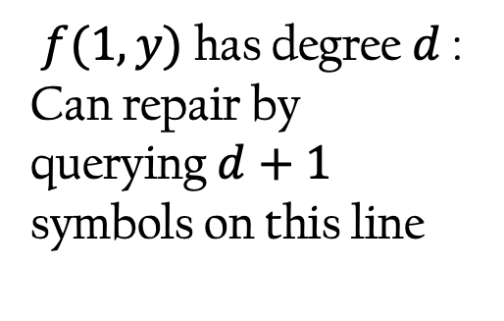
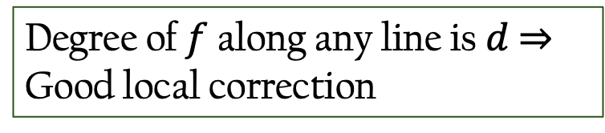
Multiplicity Codes [KSY14]
Derivatives provide redundancy ⇒ Good distance
Degree of $f$ along any line is $d$ ⇒
Good local correction
$$f\left(1,1\right)$$ $${E_{1}= f}_{x}^{′}(1,1)$$ $$f_{y}^{′}(1,1)$$ | $$f\left(1,2\right)$$ $${E_{2}= f}_{x}^{′}(1,2)$$ $$f_{y}^{′}(1,2)$$ | $$…$$ | $$f\left(1,q\right)$$ $${E_{q}= f}_{x}^{′}(1,q)$$ $$f_{y}^{′}(1,q)$$
$$f\left(2,1\right)$$ $${E_{q+1}= f}_{x}^{′}(2,1)$$ $$f_{y}^{′}(2,1)$$ | $$f\left(2,2\right)$$ $${E_{q+2}= f}_{x}^{′}(2,2)$$ $$f_{y}^{′}(2,2)$$ | $$…$$ | $$f\left(2,q\right)$$ $${E_{2q}= f}_{x}^{′}(2,q)$$ $$f_{y}^{′}(2,q)$$
$$⋮$$ | $$⋮$$ | $$…$$ | $$⋮$$
$$⋮$$ | $$⋮$$ | $$…$$ | $$⋮$$
$f(1,y)$ has degree $d$ : Can repair by querying $d+1$ symbols on this line
Notes:
We can form a matrix of evaluations, i.e. for all points I,j in 1 to q.
I wanna highlight Two key properties of mult codes: 1) cuz we’re storing derivatives: we have more redundancy, hence mult codes achieve good distance.
Second, they also have good local correction: lets take an example: lets say a node loses the symbol Eq. lets focus on the first row of the matrix: we can think of it as a Univar poly f(1,y), and this poly has deg d. this means that we can repair this symbol by simply querying any d+1 points on this row. This also works for the derivatives. And we can actually do this along any line: e.g. the diagonal, or the column.
In our paper, we also give efficient systematic encoding algorithms for mult codes.

Slide 36
Our Construction: Building Blocks
New DAS framework from
Apply framework to:
Code with locality
Erasure Code Commitment with locality
Multiplicity Codes
New Multivariate Polynomial commitment scheme
Notes:
But Note that to be able to use mult codes with the framework, we do need a commitment scheme that supports multivariate polynomials, and also allows opening evaluations of derivatives. Hence, in our work, we construct a new poly commit scheme that has all these properties.

Slide 37
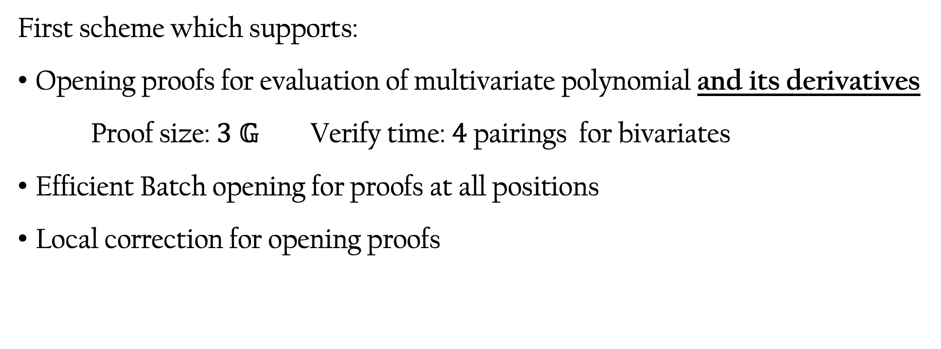
New Multivariate Polynomial Commitment
Generalize PST Commitment
First scheme which supports:
Opening proofs for evaluation of multivariate polynomial and its derivatives
Proof size: $3 𝔾$ Verify time: $4$ pairings for bivariates
Efficient Batch opening for proofs at all positions
Local correction for opening proofs
Generalize Khovratovich-Feist to multivariates and their partial derivatives
Notes:
Specifically, it is the first poly commit scheme that supports 1)…

Slide 38
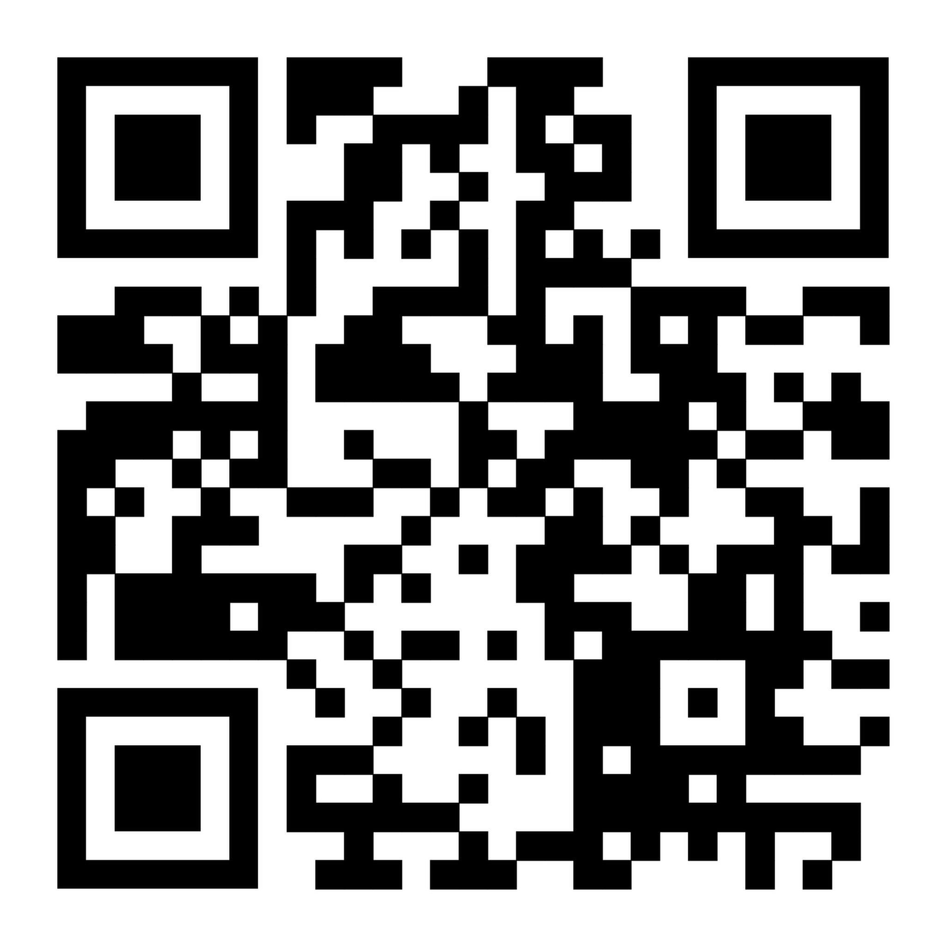
Conclusion
Repair in Data Availability Sampling is an important problem
New DAS with repair using
Multiplicity Codes
New Multivariate Polynomial commitment scheme
https://eprint.iacr.org/2025/1414
Notes:
To conclude, hopefully I’ve convinced u today that repair in DAS schemes is an important problem. And in our paper, we proposed a new framework for constructing DAS with repair, and we also have an efficient const using mult codes + a new poly commit scheme.
Thankyou for listening, and I’d be happy to take questions.

Slide 39
Open Questions
Using other locally correctable codes to build DAS with repair
Expander codes
Folded Reed-Solomon codes
Designing mechanisms to incentivize honest nodes to store their data chunks
Notes:
Lastly,
Require new commitment schemes!

