Slide 1



Student Campus Pulse Dashboard
Interactive Student Satisfaction & Campus Analytics System

Slide 2
Project Details
Submitted By
Under
Aditi Patidar
TCS iON Industry Project
Institute
Duration
Jawaharlal Institute of Technology Vidya Vihar, Borawan
02/04/2026 – 30/04/2026

Slide 3
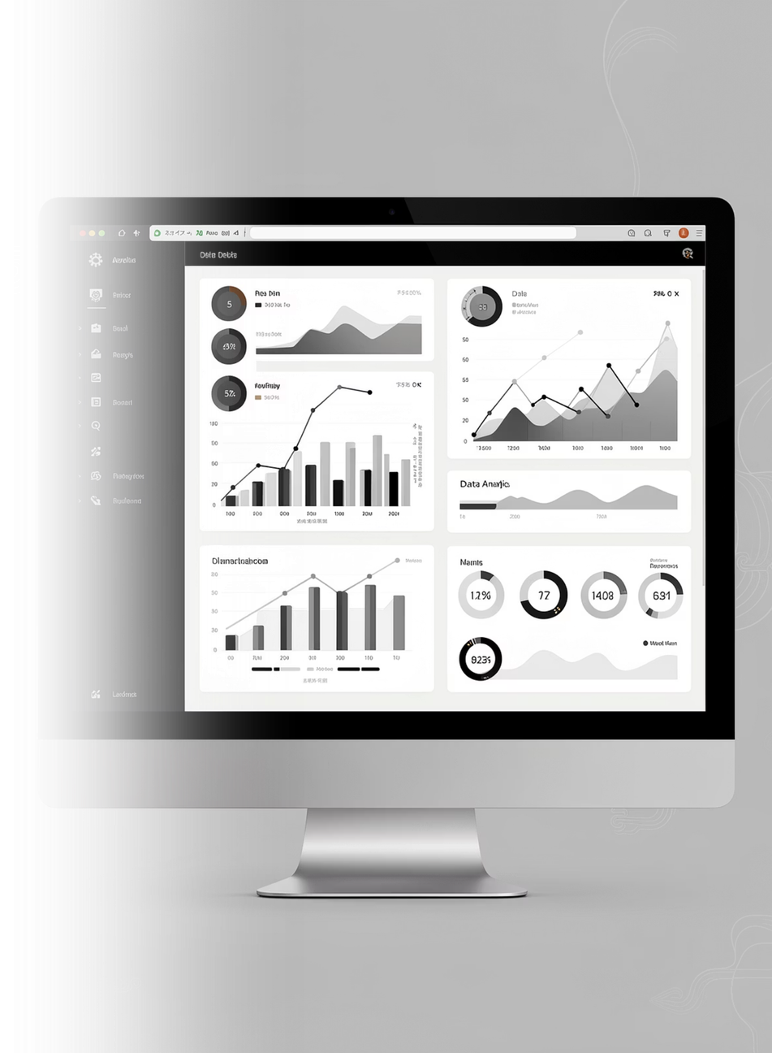
Project Overview
Introduction
Goal
Student satisfaction is essential for evaluating educational quality. Raw student survey data is often messy and difficult to analyze.
To create a full-stack analytics system for student satisfaction monitoring.
This project transforms survey data into meaningful insights through:
Data Cleaning
Backend API Development
Interactive Dashboard Visualization

Slide 4

Problem Statement
Challenges in Existing System
Missing values in survey data
Duplicate records
Inconsistent formatting
Manual Excel analysis
Static reports
Limited decision-making support
Core Problem
Raw educational survey data lacks structured analysis and interactive insights.

Slide 5





Project Objectives
Clean and preprocess raw Excel data
Transform messy data into structured format
Build Flask APIs for dynamic analytics
Develop responsive dashboard
Generate actionable institutional insights

Slide 6




Project Scope
Who Can Use It?
College administrators
Placement departments
Academic coordinators
Student welfare committees
Impact
Better decision-making
Improved campus services
Student-centric institutional planning

Slide 7




Tools & Technologies Used
Data Cleaning
Backend
Python
Pandas
NumPy
OpenPyXL
Flask
Flask-CORS
Frontend
Development
HTML
CSS
JavaScript
Chart.js
Jupyter Notebook
VS Code

Slide 8






Project Journey / Workflow
Raw Excel Data
Data Cleaning & Transformation
cleaned_data.xlsx
Flask Backend APIs
Frontend Dashboard
Insights & Analytics
Key Journey: Data → Processing → Development → Visualization → Decision Support

Slide 9

Data Cleaning Process
Steps Performed
01
02
03
Missing value handling
Data type correction
Category standardization
04
05
Duplicate removal
Export cleaned dataset
Output
cleaned_data.xlsx

Slide 10
Backend Development
Flask API Features
Filter APIs
KPI generation
Satisfaction analysis
Placement distribution
Heatmap generation
Major Endpoints
/filters
/kpi
/yearly_satisfaction
/facility_satisfaction
/correlation_heatmap

Slide 11
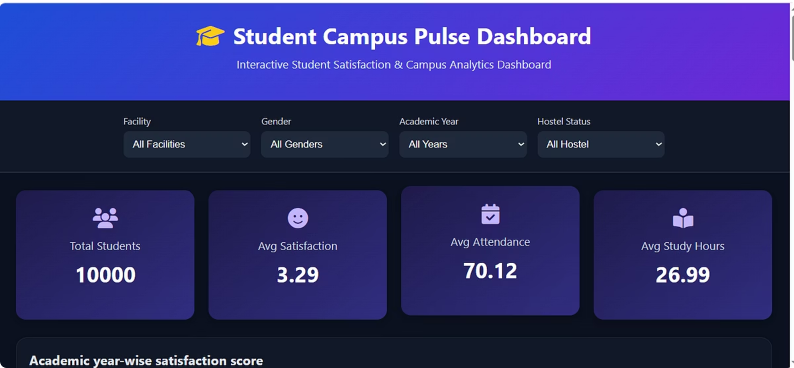
FRONTEND DASHBOARD
Dashboard Features:
KPI Cards
Filters
Line Chart
Bar Charts
Pie & Doughnut Charts
Correlation Heatmap
User Benefits:
Real-time filtering
Easy interpretation
Interactive analysis

Slide 12
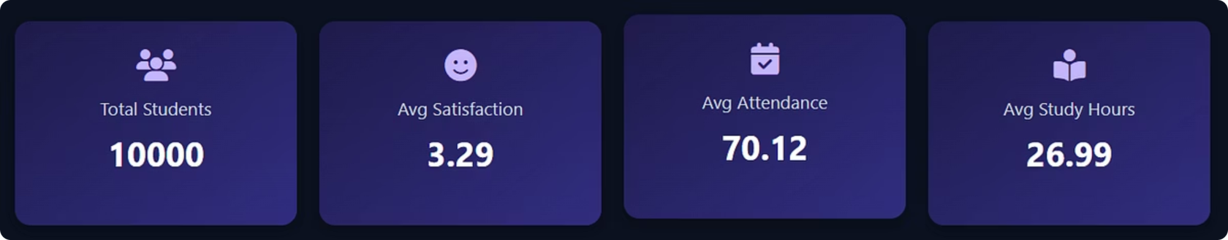
KEY KPI METRICS
KPIs:
Total Students
Average Satisfaction
Average Attendance
Average Study Hours
Why Important:
Provides quick overview of institutional performance.

Slide 13
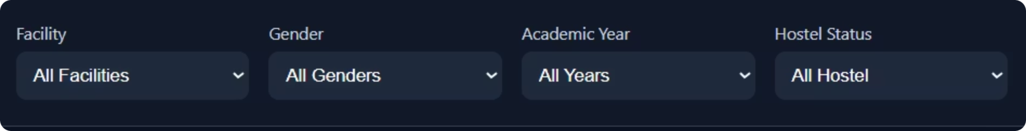
KEY FILTERS
Facility
Gender
Academic Year
Hostel status
why
show dynamic charts distribution amongst different options

Slide 14
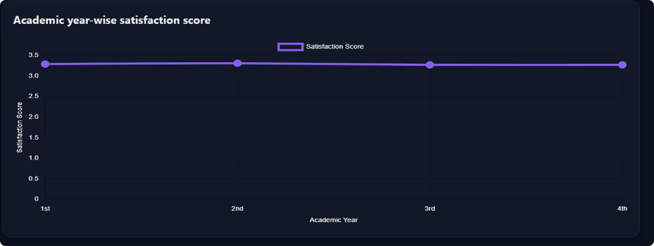
KEY INSIGHTS – SATISFACTION ANALYSIS
Academic Year-wise Satisfaction:
Shows:
Student satisfaction trend across years
Helps:
Detect year-based dissatisfaction
Improve final-year support

Slide 15
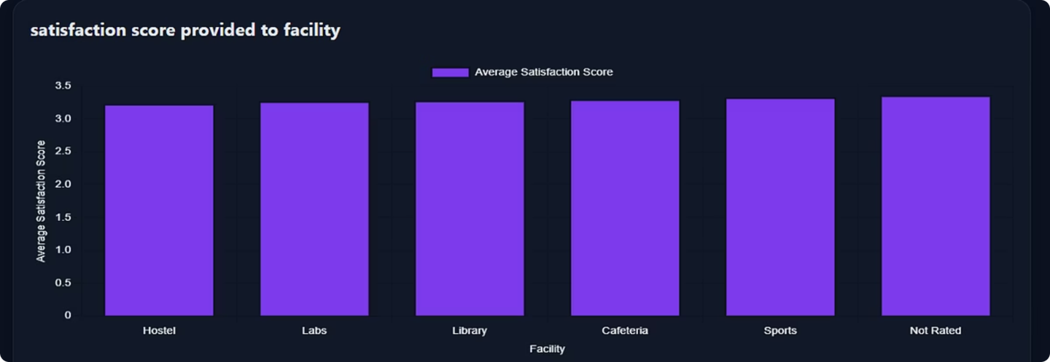
FACILITY ANALYSIS
Facility Satisfaction:
Shows:
Average ratings for Library, Hostel, WiFi, Labs, etc.
Helps:
Identify weak facilities
Prioritize improvements
Example:
Low WiFi score → Improve internet infrastructure

Slide 16
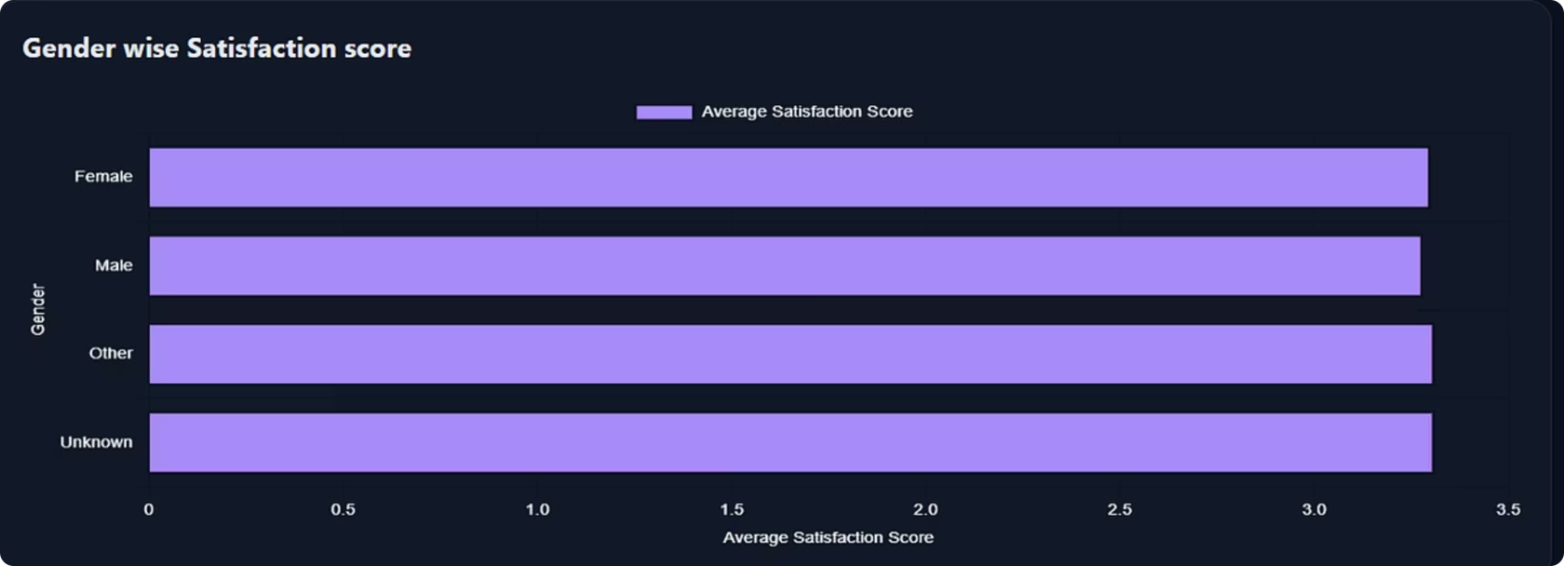
KEY INSIGHTS – GENDER-WISE ANALYSIS
Gender Satisfaction:
Compares student experience by gender
Supports inclusive planning

Slide 17
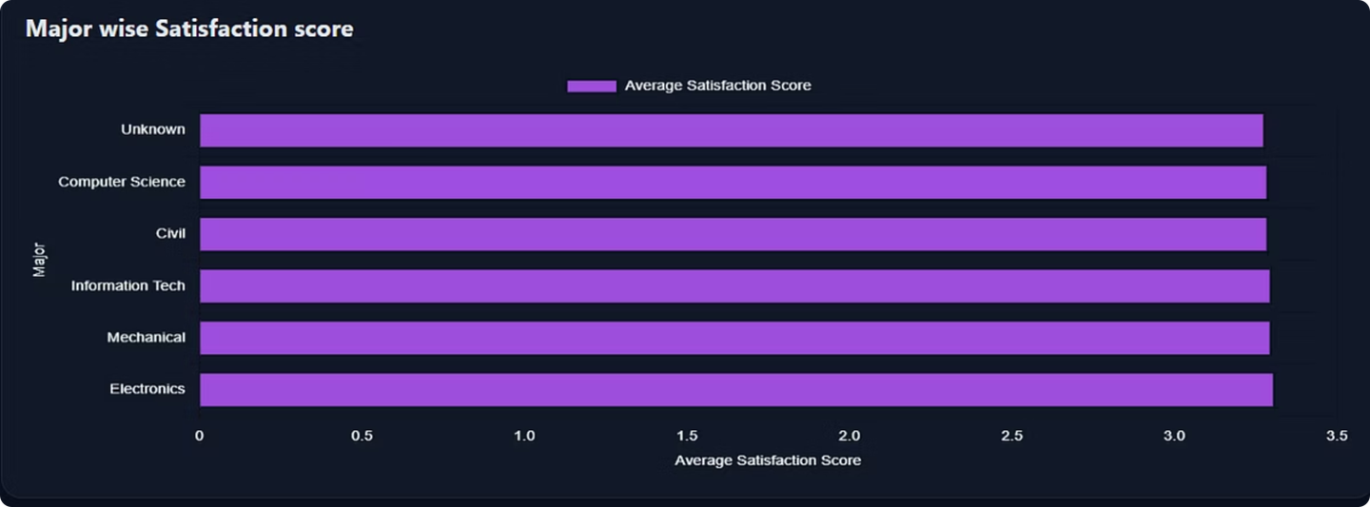
KEY INSIGHT- MAJOR-WISE SATISFACTION
Major Satisfaction:
Department-specific trends
Academic strategy support

Slide 18
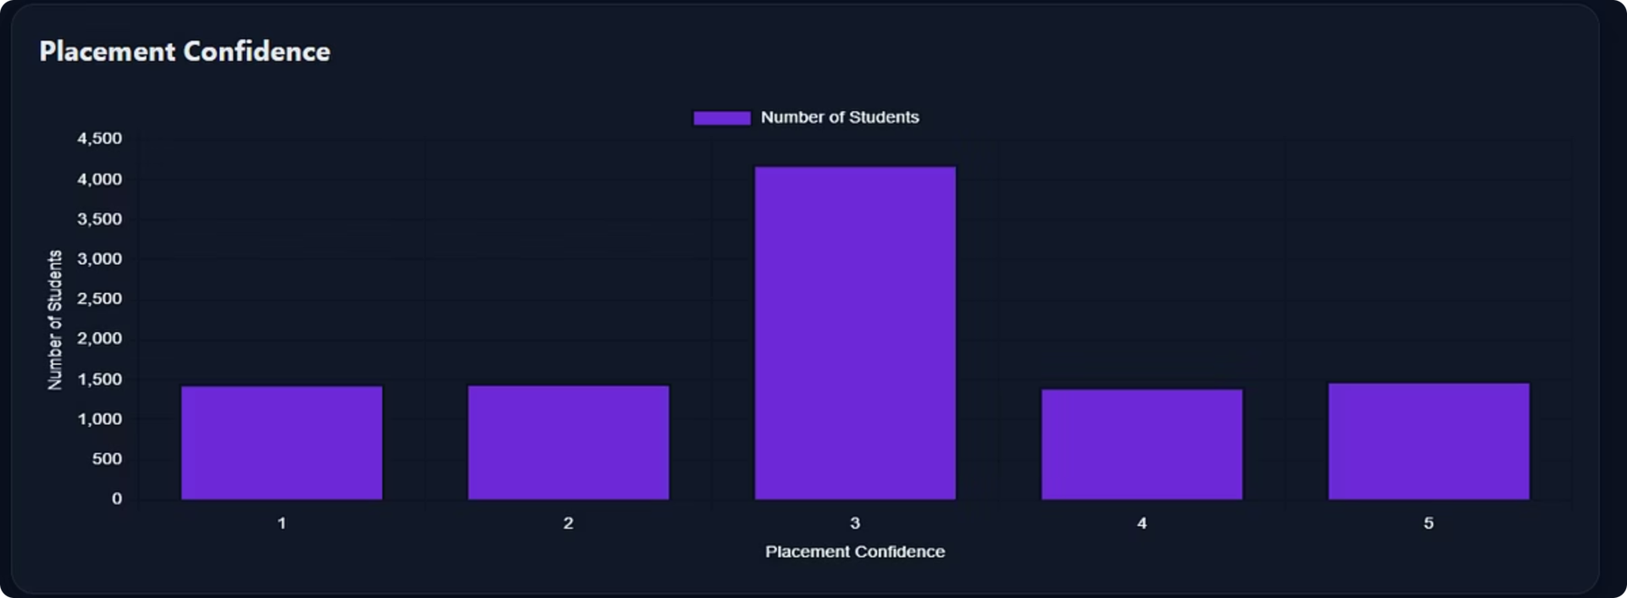
KEY INSIGHTS – PLACEMENT RELATED
Placement Confidence:
Student trust in placements
Helps placement strategy

Slide 19
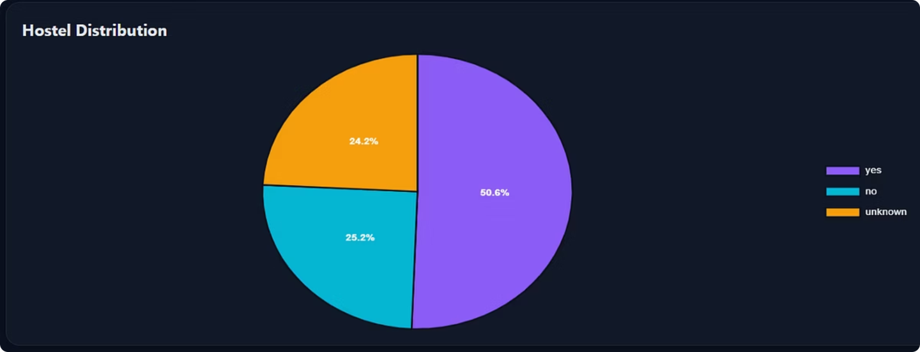
KEY INSIGHTS -HOSTEL DISTRIBUTION
Hostel Distribution:
Residential student trends
Resource planning

Slide 20
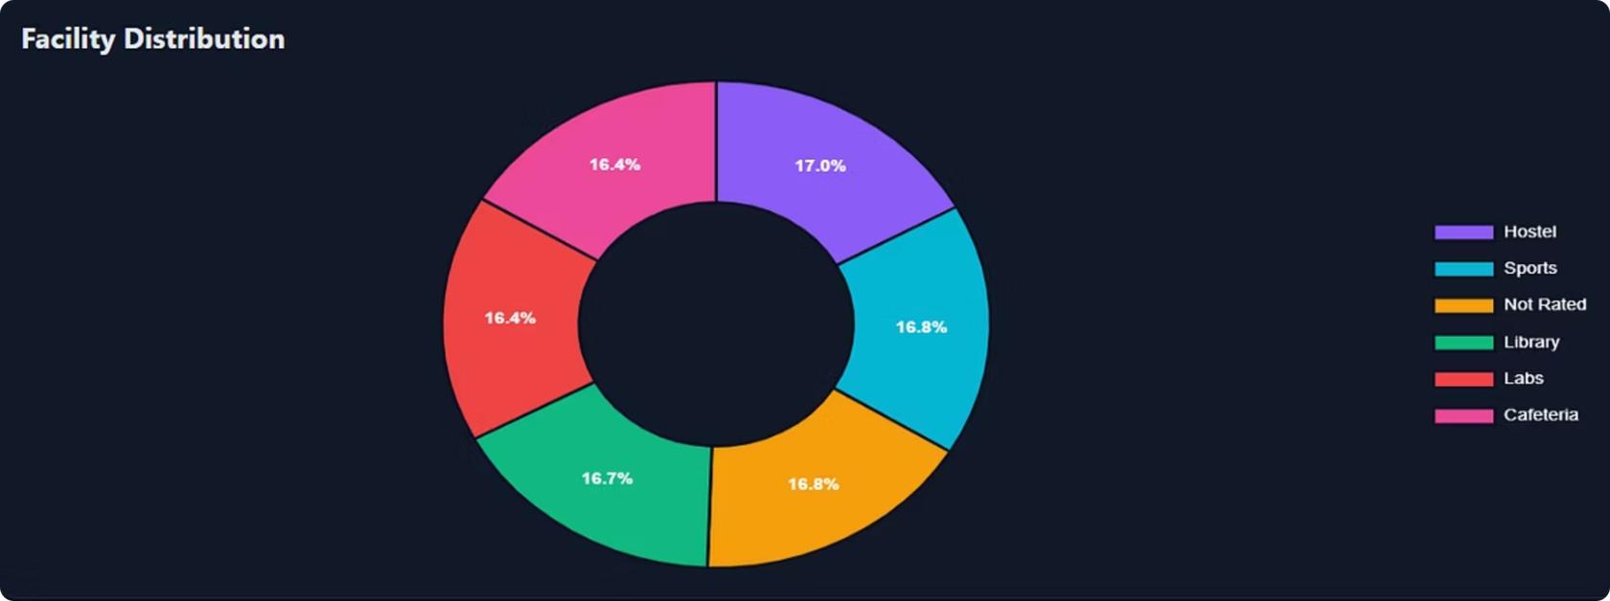
KEY INSIGHTS -FACILITY DISTRIBUTION
Facility Distribution:
Shows which facility rated most
IShows what facility student like most amongst other ones

Slide 21
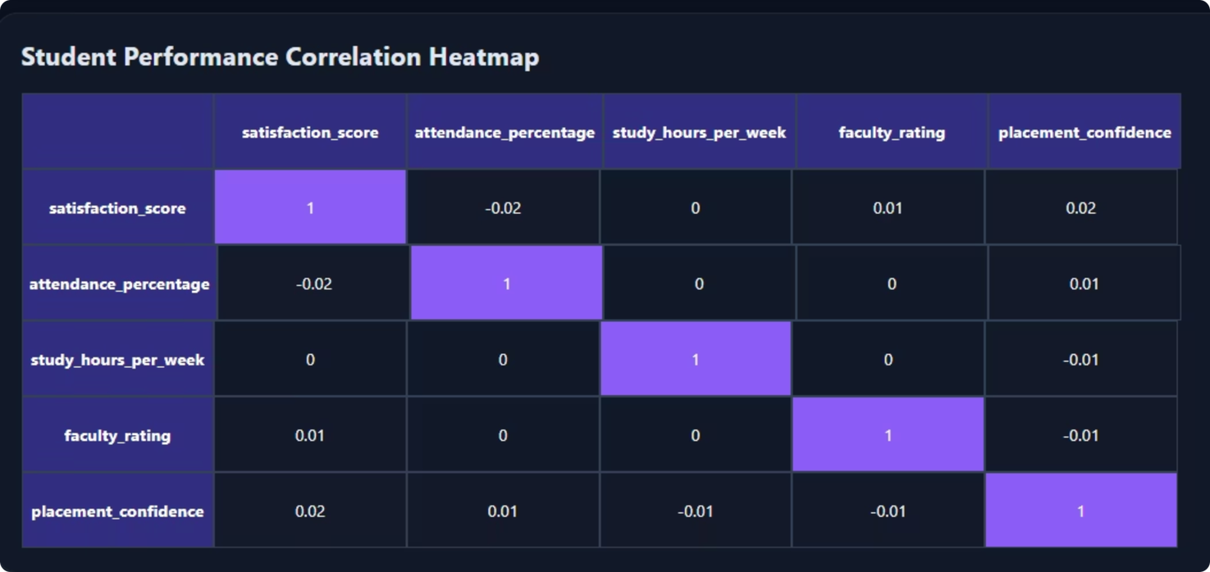
KEY INSIGHTS -CORRELATION HEATMAP
Shows:
Relationship between:
Satisfaction
Attendance
Study Hours
Faculty Rating
Placement Confidence
Key Benefit:
Identifies strong influencing factors
Example:
High faculty rating correlation = Faculty impacts satisfaction strongly

Slide 22
Challenges Faced(Major Challenges)
Messy raw dataset
Missing values
Duplicate records
Frontend chart duplication
Backend integration debugging
Responsive UI design

Slide 23
SOLUTIONS IMPLEMENTED
Structured cleaning pipeline
Pandas preprocessing
Dynamic Flask filtering
Chart destroy/re-render logic
Responsive CSS grid

Slide 24
KEY LEARNINGS
Technical Learnings:
Personal Growth:
Data preprocessing
Data transformation
API development
Dashboard development
Data storytelling
Problem-solving
Debugging
Full-stack project execution

Slide 25
Recommendations
Improve low-rated facilities
Strengthen placement support
Regular satisfaction monitoring
Expand digital analytics systems

Slide 26
FUTURE ENHANCEMENTS
Future Scope:
Login authentication
Database integration
Machine learning prediction
NLP sentiment analysis
Cloud deployment

Slide 27
PROJECT OUTCOME
Final Outcome:
Converted raw data into meaningful insights
Built a full-stack dashboard
Created decision-support system
Improved institutional analytics capability

Slide 28
CONCLUSION
The Student Campus Pulse Dashboard successfully integrates:
Data Analytics + Backend Development + Frontend Visualization
It transforms educational survey data into an actionable platform for institutional growth and better student experiences.

Slide 29
Thank You
Submitted Under:
Submitted By:
TCS ION Industry Project
Aditi Patidar

