Slide 1
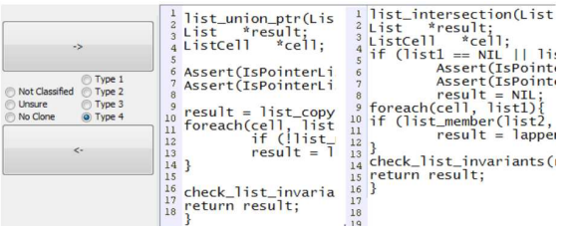
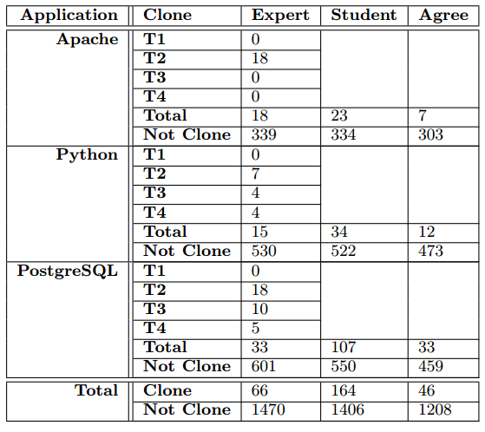
A Code Clone Oracle
Daniel E. Krutz & Wei Le
Introduction
CloneInspection Tool
Code clones are functionally equivalent portions of code which may be syntactically different. The four types of code clones range from the simple type-1 clones, to the most complex type-4 clones. While there are a wide variety of tools and detection techniques, there are no large, agreed upon oracles to objectively evaluate each technique. This work represents the largest known publicly available oracle.
Developed tool to assist with manual clone identification.
Loaded each clone candidate side by side.
Reviewer selected if it was a clone, or the type or clone.
Significantly reduced the required time for manual analysis.
Available from our website.
Publicly Available Dataset
http://phd.gccis.rit.edu/weile/data/cloneoracle/
All project information and materials are publicly available

