Slide 1
Experiencing Disruptive Behavior in a Team Using “Moles”
Daniel E. Krutz & James R. Vallino
RIT

Slide 2
RIT Software Engineering
Has offered an undergraduate degree in SE since 1996
~ 400 students
Focus on process not programming
Teamwork is stressed
Focus on preparing students for the industry

Slide 3
About Freshman Seminar Course
All SE Freshman must take the course
Goal is to get students interested in SE
Become acclimated with SE
Designed to be fun & engaging

Slide 4
Problem Statement
Students work in teams in both academia and industry.
Students have trouble identifying positive and negative team dynamics.
Problems invariably arise.
Students do not know how to deal with these problematic team members.
Students do not know when they are being one of these problematic team members.
Must learn how to tackle these issues in a constructive manner.
Notes:
SE students constantly state that team related issues are a significant problem.

Slide 5
Problem Statement
Students state that team related issues are a constant problem
Members not contributing
Not spending time wisely
How to resolve disagreements

Slide 6
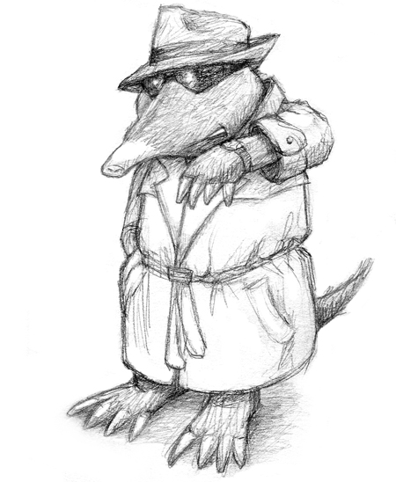
Fall 2011
Notes:
We came up with the mole activity

Slide 7
What is a mole?
Someone acting in a covert manner
Usually for ulterior or malicious reasons

Slide 8
Moles Activity Outline
Identify moles and break into groups
Instruct moles
Perform Activity
Expose moles
Subsequent Discussion

Slide 9
Pre-Activity Actions
Select roles before the start of class
Break students into groups of 4-5
Give them token activity
Hold back “moles” under the guise of another reason
Excuse the teams except for the moles
Give the moles their roles

Slide 10
Mole Roles
Absentee – Is not present for most team activities
Disagreer – Do not go along with the rest of the team’s decisions.
Disruptor – Sidetrack team in as many ways as possible.
Know it all – Be an expert in all areas and lead team, even when they are not qualified to do so.
Non-Contributor – Be present, but not interact with the team’s activities.

Slide 11
Mole Selection Notes
Good idea to let students assign their own roles.
IE if someone has a brand new iPhone, let them be the destructor.
Try to pick students which would be good actors.

Slide 12
Activity
Moles rejoin their teams.
Should take ~20-40 minutes
Instructor should observe at a distance
Be careful not to give things away.

Slide 13
Exposure of moles
Once teams come back to classroom, moles are exposed.
Import to expose so classmates do not feel bad about speaking about the moles.

Slide 14
Post Activity Discussion
Instructor should act as moderator
Guide the students in thinking, instructor should not do the thinking.

Slide 15
Activity
Moles generally play their roles very well
Students never really caught on what the real motive of the activity was
Many apologies

Slide 16
Student Feedback
Enjoyed the nature of the activity.
“Taught us how to deal with problematic team members.”

Slide 17
Future Work and Improvements
More types of moles
How to keep it a secret across years and sections
Adapt to more classes than just Software Engineering
How instructor can observe at more of a distance
Measurable results

Slide 18
Conclusion
We’ve found this to be a very educational and fun activity.
Keeps students interested
Students have stated that it has helped them in previous courses.

Slide 19

Questions

