Slide 1
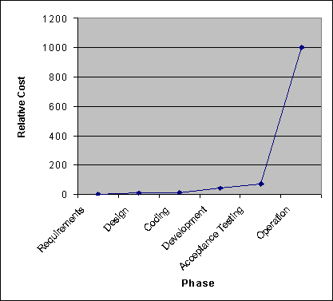
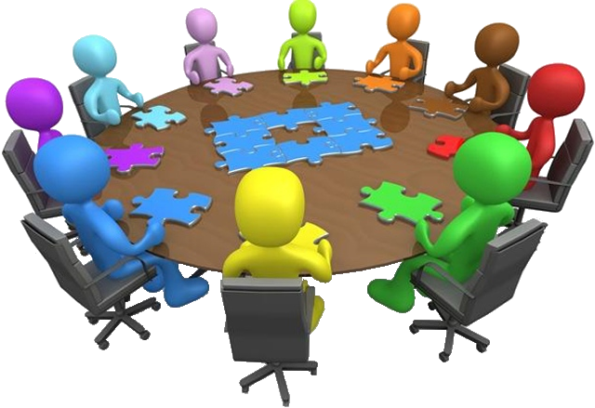


Enhancing the Educational Experience for Deaf and Hard of Hearing Students in Software Engineering
Daniel E. Krutz, Rochester Institute of Technology Jayme Kaplan, St. Mary’s School for the Deaf
BACKGROUND AND INTRODUCTION
WHAT IS SOFTWARE ENGINEERING?
Working at RIT/NTID, all departments need to be cognizant of Deaf and Hard of Hearing (D/HoH) learners. RIT/NTID houses departments which specialize in providing services to students who are D/HoH. However, communication breakdowns, specifically in group work, continue to be an area of difficulty within many departments.
We want to determine:
What services our Software Engineering (SE) students currently utilize?
How can we improve group dynamics?
How can we make the SE educational experience more functional and accessible for D/HoH students?
Software Engineering is a highly team based field with rigorous, time sensitive interactions in both academia and industry; driven to develop software for real world use.
Due to the necessary collaboration within SE groups, our goal is to improve the communication process within all group work. Specifically, in groups where hearing and D/HoH students are working collaboratively.
Software engineers play different and important roles on development teams.
Miscommunications are more expensive to fix as the software project progresses.
INITIAL OBSERVATIONS
ONGOING DATA COLLECTION
INITIAL RECOMMENDATIONS
Instructors and students alike prefer to work within their communication comfort zone.
Communication breakdowns often occur due to technological terminology.
Students who are hearing and D/HoH ask for technology proficient interpreters.
Despite available resources, instructors may not be prepared to break down communication barriers.
Students who are D/HoH may be excluded from teamwork and/or leadership roles.
Computing has the capability of being non-personal, and may cause further communication breakdowns.
Email
Text Messages
Social Media
Anonymous Surveys
1:1 Interviews
Recognize that students who are D/HoH may use a variety of different communication methods and strategies.
Speak to/address them directly, not the interpreter.
Pre-teach technical vocabulary to student(s) and/or interpreter.
Utilize access services on campus (C-print, notetaker, FM).
Encourage interaction amongst all group members.
Establish roles, responsibilities, and expectations in group interactions.
Developing communication rules or ‘communication courtesy’ within a group.
acknowledge speaker
one person speaks at a time
limit interjections and distractions
utilize a note taker in the group
consider environment and lighting
Surveys and interviews
Faculty
Deaf/HoH
Hearing
Staff
Students
Deaf/HoH
Hearing

