Slide 1


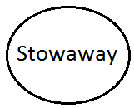

Static Analysis
.git & .apk
Metadata
code
apk
Data Collection
Semantically organized analytical data (Code, commits, bugs, security issues)
Notes:
Semantically organized data

