Slide 1
A Dataset of Open-Source Android Applications
http://androsec.rit.edu
Daniel Krutz, Mehdi Mirakhorli, Sam Malachowsky

Slide 2
Overview
Analyzed open source Android Apps from F-Droid
Download apps & metadata
Static Analysis on Apps
Sonar - Code assessment & bugs
Stowaway - Over & Under Permissions
Androrisk - Vulnerability risk assessment
Results on website & SQLiteDB

Slide 3
Publicly Available
http://androsec.rit.edu
Website Analytics
SQLite DB for your own analysis
Notes:
Give a broad overview how users may use the site and info. Drive home the benefits

Slide 4
Version Control Stats
 | Value | Count
Totals | Apps | 1,179
 | Versions | 4,416
 | Committers | 4,535
 | Commits | 435,680
Largest | Versions | 48
 | Committers | 202
 | Commits | 65,110
Notes:
General overview of the stats

Slide 5
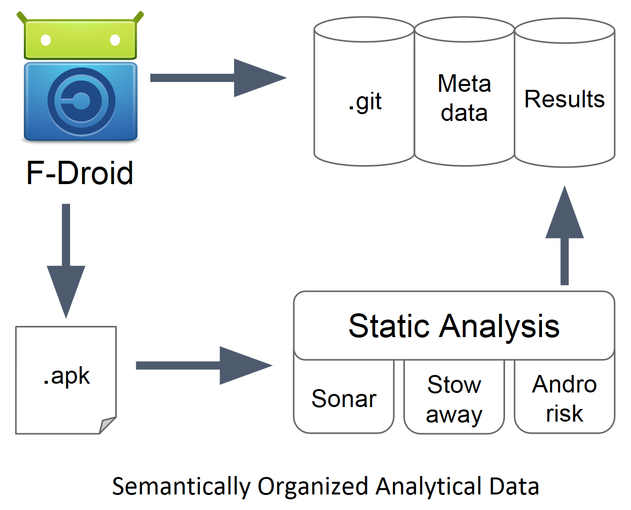
Collection Process

Slide 6
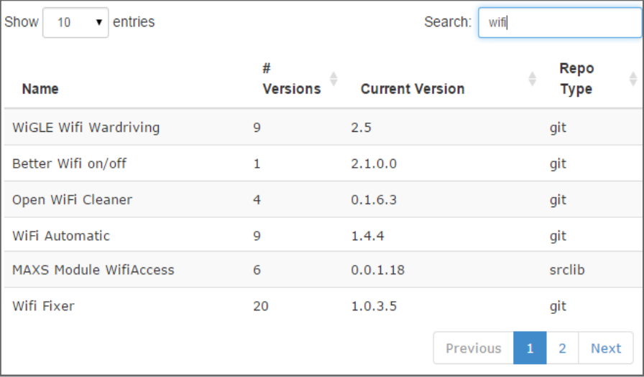
Website: Search for App

Slide 7
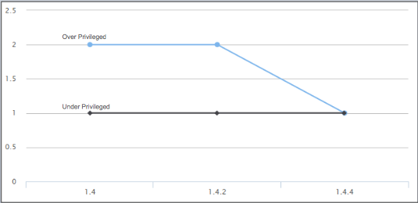
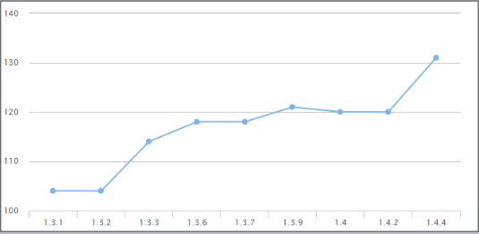
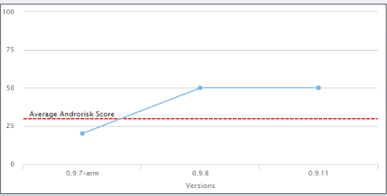
Website: Some Results
Over & Under Privileges
Violations per LOC
Androrisk
Notes:
Just briefly talk about the different stats here

Slide 8
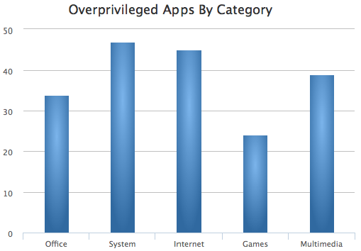
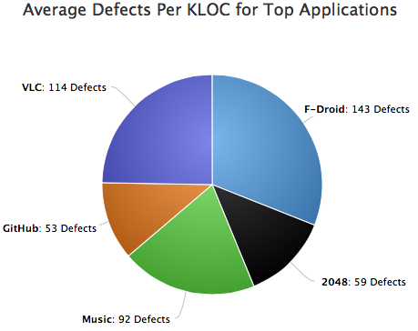
Aggregate App Results
More Results on website

Slide 9
Thank you
http://androsec.rit.edu
Notes:
This is the concluding slide

