Slide 1
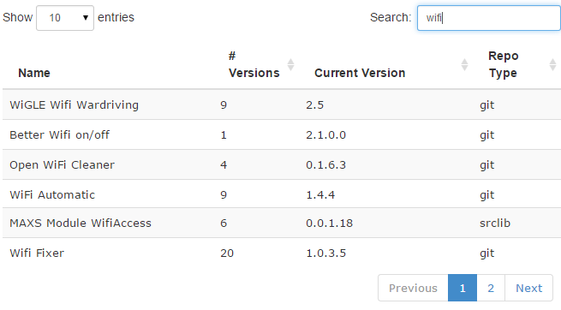
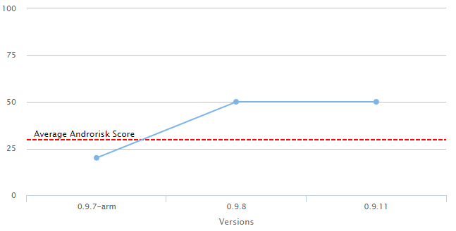
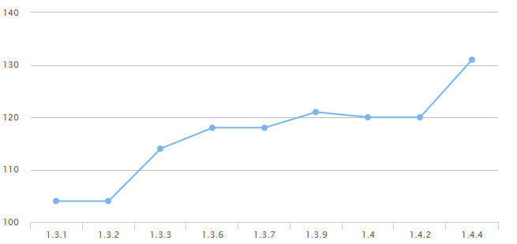
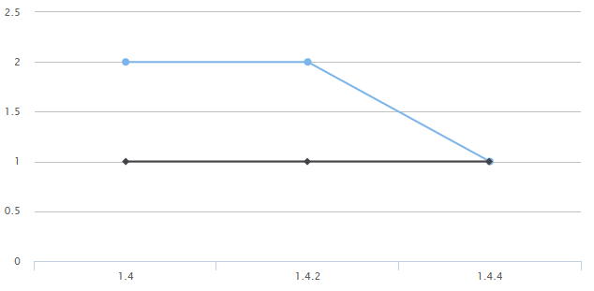

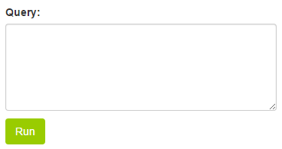
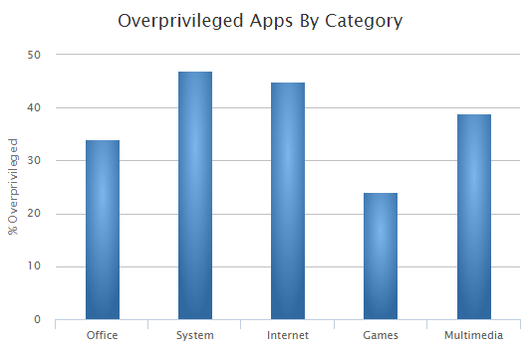
A Dataset of Open Source Android Applications
Daniel E. Krutz, Mehdi Mirakhorli, and Samuel A. Malachowsky
http://androsec.rit.edu
INTRODUCTION
WEBSITE
Began by collecting open source Android apps from F-Droid
Analyzed Git Histories and performed static analysis using
Androrisk: App vulnerability level
Sonar: Coding metrics
Stowaway: Over & Under Privilege level
Collected 1,179 apps with 4,416 versions
435,680 Version Control commits
Data is publicly available on website and through SQLite Database
Search for app ‘FBReader’
Androrisk Scores
Average Androrisk Score - 29.66
Over Privileged
APPROACH
Under Privileged
Collected data from F-Droid, open source Android website (APK & Git Info)
Analyzed using various static analysis tools
Violations per KLOC - Per Version Average Violations/KLOC - 113
Over & Under Privileged Rate Under Priviledged Rate- 1.66, Average Over Privileged - 0.66
.git
Meta data
Results
DATA
 | Value | Count
Totals | Apps | 1,179
 | Versions | 4,416
 | Committers | 4,535
 | Commits | 435,680
Largest | Versions | 48
 | Committers | 202
 | Commits | 65,110
F-Droid
select * from table
Static Analysis
.apk
Sonar
Stow away
Andro risk
Semantically Organized Analytical Data
Overall Stats
Write Your Own Query
Aggregate Statistics

