Slide 1
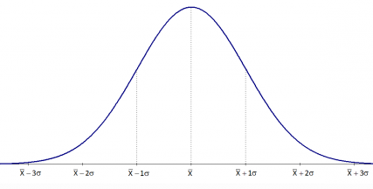
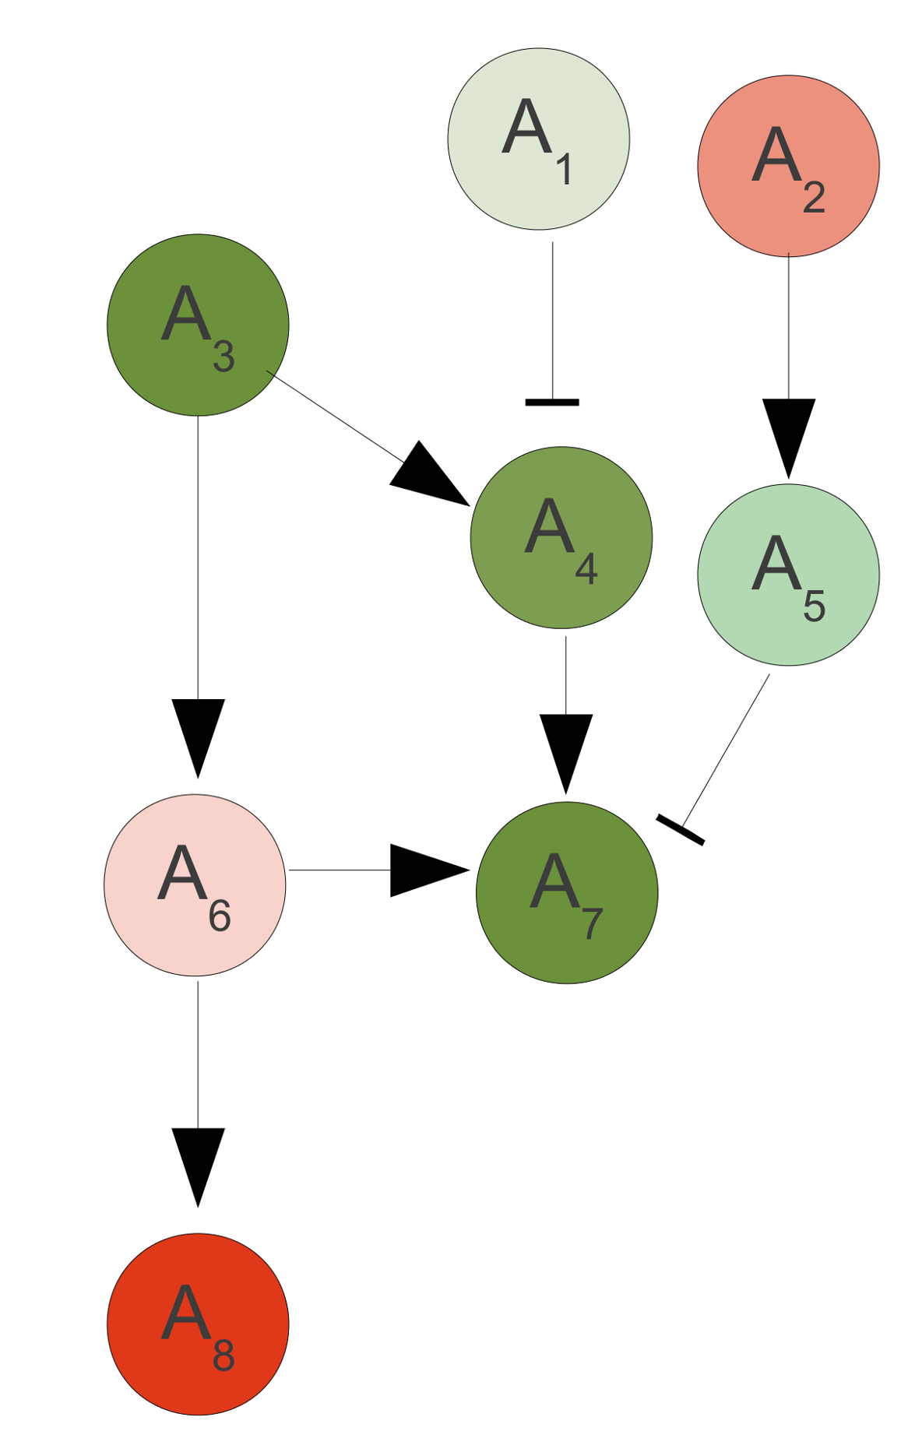
DiffPath
Bin log(fold change) into finite labels
u: under expressed
o: over expressed
Overlay gene-expression labels onto pathway genes
uuu
uu
u
o
oo
ooo
o
Log (fold change) distribution
oo
Output subgraphs that are significantly differentially expressed at the desired FDR level
u
o
uu
Randomize gene-expression labels 1000 times and regenerate connected subgraphs from all pathways
Generate a graph database of all connected subgraphs of size n (n: number of genes/nodes)

