Slide 1

FDAP INC
By: Lea Concannon, Mahek Sandhu, Aditi Tiwari, Sam Tweedale, Tirth Kansara

Slide 2
Our Hypothesis
Why and how do you think your firm attribute should correlate with differential effects of interest rate changes in your industry?
We believe that as interest rates increase it will positively affect the returns on the banking companies that have a low debt to equity ratio and negatively affect the banks that have higher D/E ratios as they deal with increased costs.

Slide 3




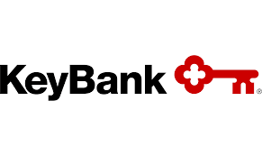

D/E ratios of selected companies
Above 9.82
High
TD Bank, JP Morgan
Bank of America, Citigroup
Medium
US Bancorp, Wells Fargo
PNC, Fifth Third Bancorp
Low
M&T Bank, Citizens Financial
Truist Financial, Goldman Sachs
Morgan Stanley
Regions Financial Corp
KeyCorp
In Between
7.89 and 9.35
Below 7.81

Slide 4
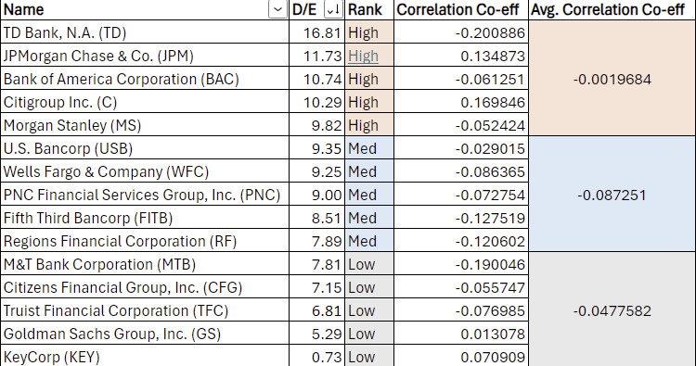
Relative performance as a function of interest rate changes
Calculated the Correlation between interest rate changes and returns from January 2021- April 2024
All three of our portfolios were negative with the medium portfolio having the biggest negative correlation

Slide 5
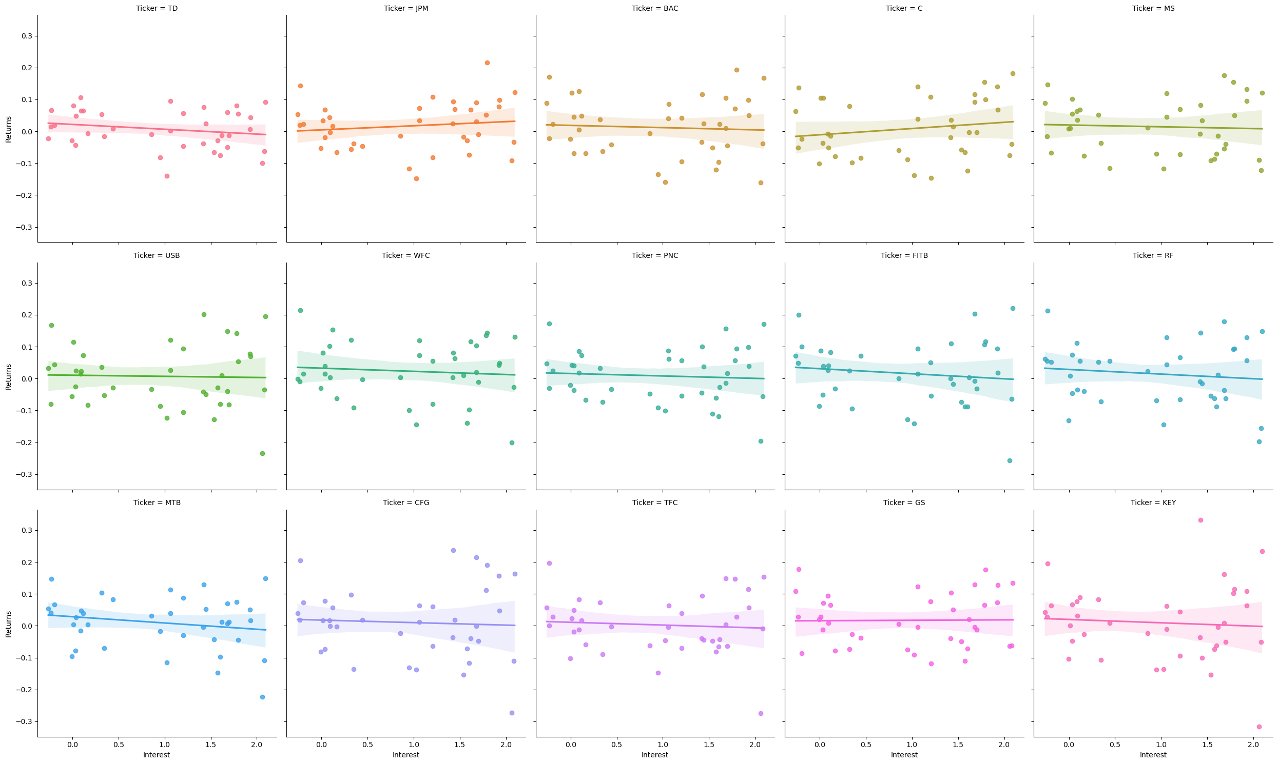
Linear MODEL Plot (Interest Rate & Return)

Slide 6
Evaluating our hypothesis
The hypothesis that banks' financial performance in terms of returns as interest rates rise is directly correlated with their leverage levels is not supported by the correlation data provided.
The data instead suggests a more complex relationship where factors other than just D/E ratios might influence how banks' returns react to changing interest rates.
This might include differences in banks' interest income sensitivity, non-interest income proportions, cost structures, and strategic responses to interest rate changes.
The hypothesis failed to account for these complexities, leading to its rejection based on the observed data.

Slide 7
Thank You!

