Slide 1
A PROJECT REPORT ON “Moive Ticket Management System” SUBMITTED BY: Miss. Autade Aditi Pradeep (2124UCEF1094) SUBJECT: C++ PROGRAMMING Under the guidance of Prof. Ishwari Tirse
Department of Computer Science and Engineering Sanjivani Rural Education Society’s SANJIVANI UNIVERSITY KOPARGAON – 423603 (2024-2025)

Slide 2
INTRODUCTION:
This basic Movie Ticket Management System is a simple console-based application written in C++ that allows users to manage movie ticket bookings with ease. The program provides essential functionalities such as viewing available movies, booking tickets, and displaying booking details. Designed for beginners, this project serves as a great starting point for understanding the fundamentals of programming in C++, including working with structures, arrays, and basic user input handling.
The system maintains a list of movies along with their available seats and allows users to book tickets by entering their details. It keeps track of bookings, updates the number of available seats accordingly, and displays booking records when needed

Slide 4
CODE:
#include <iostream>
#include <string>
using namespace std;
class Movie {
public:
string title;
int availableSeats;
Movie(string t, int seats) {
title = t;
availableSeats = seats;
}
void display() {
cout << "Movie: " << title << ", Available Seats: " << availableSeats << endl;
}
};
class Booking {
public:
string movieTitle;
int numSeats;
Booking(string t, int n) {
movieTitle = t;
numSeats = n;
}
void display() {
cout << "Booking - Movie: " << movieTitle << ", Seats: " << numSeats << endl;
}
};
int main() {
Movie movies[3] = {
Movie("Inception", 50),

Slide 5
Movie("The Matrix", 30),
Movie("Interstellar", 20)
};
Booking* bookings[10];
int bookingCount = 0;
while (true) {
cout << "\n--- Movie Ticket Booking System ---\n";
cout << "1. View Movies\n";
cout << "2. Book Ticket
cout << "3. View Bookings\n";
cout << "4. Exit\n";
cout << "Choose an option: ";
int choice;
cin >> choice;
if (choice == 1) {
cout << "\nAvailable Movies:\n";
for (int i = 0; i < 3; i++) {
movies[i].display();
}
}
else if (choice == 2) {
// Book tickets
cout << "\nEnter movie number (1-3): ";
int movieChoice;
cin >> movieChoice;
if (movieChoice < 1 || movieChoice > 3) {
cout << "Invalid movie choice!\n";
continue;
}
cout << "Enter number of seats to book: ";
int seats;
cin >> seats;
if (seats > movies[movieChoice - 1].availableSeats) {
cout << "Not enough seats available!\n";
continue;
}

Slide 6
movies[movieChoice - 1].availableSeats -= seats;
bookings[bookingCount++] = new Booking(movies[movieChoice - 1].title, seats);
cout << "Booking successful!\n";
}
else if (choice == 3) {
cout << "\nYour Bookings:\n";
if (bookingCount == 0) {
cout << "No bookings found.\n";
} else {
for (int i = 0; i < bookingCount; i++) {
bookings[i]->display();
}
}
}
else if (choice == 4) {
cout << "Exiting...\n";
break;
}
else {
cout << "Invalid choice! Please choose again.\n";
}
}
for (int i = 0; i < bookingCount; i++) {
delete bookings[i];
}
return 0;
}

Slide 7
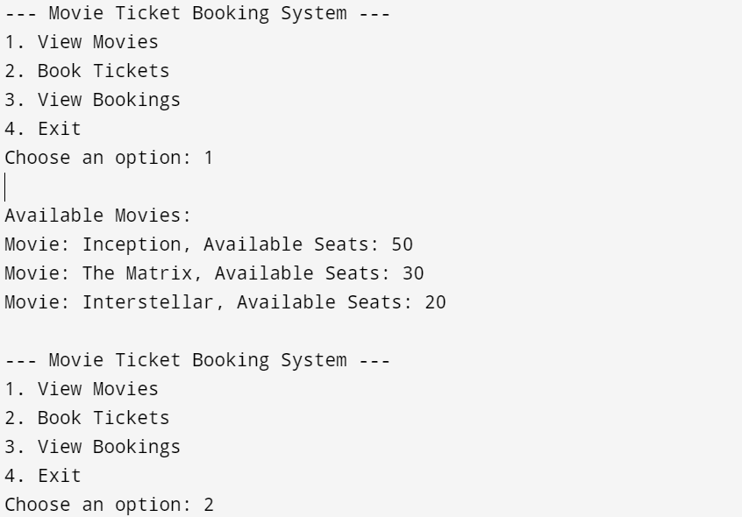
OUTPUT:

Slide 8
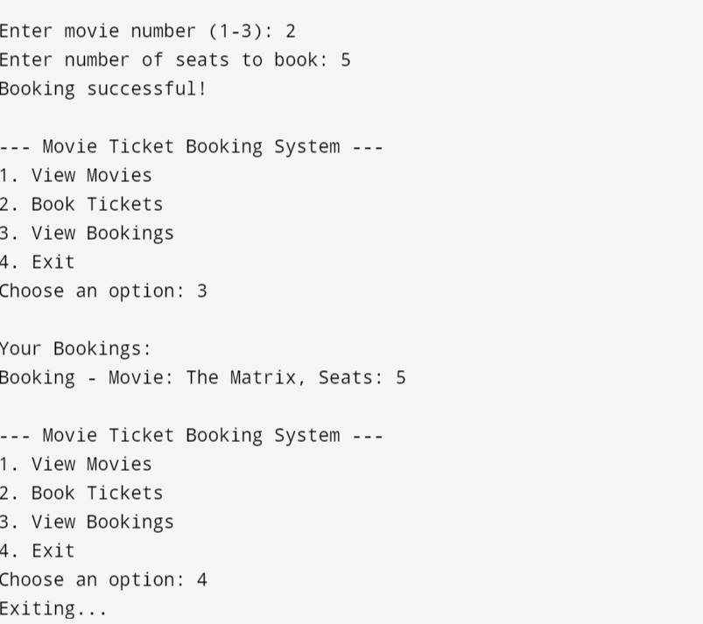

Slide 9
CONCLUSION
The Movie Ticket Management System in C++ provides a straightforward solution for managing basic movie ticket bookings through a console-based interface. It demonstrates fundamental programming concepts such as structures, arrays, and user input handling, making it an excellent project for beginners. By allowing users to view movies, book tickets, and check booking details, it covers the essential functions of a basic ticketing system

