Slide 1


Academic Year : 2025-26
Vishwakarma Institute of Technology, Pune
Course Project:
Climate Change Impact Analyzer on Crop Yield Patterns
Big Data Analytics
Dept : Computer Engineering(Software Engineering)
Name | Roll No.
Aditi Avhad | 76
Pranusha Birhade | 72
Dharati Biradar | 78
Soham Deokar | 75
Subject Teacher : Ms. Madhura Sanap

Slide 2
INTRODUCTION
This project analyzes climate and crop data to understand how and rainfall affect crop yield. Past data is studied to find Calibri and trends using charts and graphs. Simple data analysis tools are used to convert raw data into useful insights. The results help farmers, students, and decision makers understand the impact of climate change on agriculture.
Why This Project Is Needed
Climate change causes irregular weather
Weather changes affect crop yield
Rainfall and are not stable
Farmers lack clear data and analysis
Manual understanding is difficult
Data analysis helps in better decision making

Slide 3
Methodology & Tools
Data Sources
Core Tools
Techniques
Government agriculture datasets
Kaggle Agriculture database and Rainfall data
Python (Pandas, NumPy)
Excel for data validation
Power BI for dashboards
Statistical analysis
Trend analysis
Data visualization

Slide 4
OBJECTIVES / SCOPE
Objectives
To analyze the impact of rainfall on crop production and yield.
To compare production performance across different crop types and states.
To identify top-performing crops based on total production.
To evaluate climate efficiency using the Impact Score metric.
To examine production trends over multiple years.
To support better agricultural decision-making using data insights.
To analyze crop production distribution using histogram and statistical measures.
To compare production performance across different crop types using visual analytics.
Scope of the Project
Study past rainfall data
Analyze crop yield data for different years
Understand how climate affects crop production
Show results using simple charts and graphs
Help in better agricultural planning

Slide 5

Problem Statement
Farmers Face Uncertainty
Analytical Tools Gap
Data-to-Insights Conversion
Climate change makes weather unpredictable, so farmers are unsure about planting time and crop yield. This affects their income and food supply.
Current systems do not properly connect climate data with crop yield data. Because of this, farmers cannot use data to make better farming decisions.
Raw climate and crop data needs to be converted into clear and useful information that farmers and decision makers can understand and use.

Slide 6
Literature Review
Study Stage | Focus Area | Method Used | Limitation | Improvement / Contribution
Early Studies | Crop yield analysis only | Basic statistical methods like mean and average | Climate factors were not considered | Provided base understanding of crop productivity
Later Research | Climate and crop yield relationship | and rainfall comparison analysis | Limited to small datasets and regions | Identified impact of climate variables on crops
Separate Dataset Projects | Climate and agricultural data analyzed separately | Comparative analysis between datasets | Lack of integration reduced accuracy and practical use | Highlighted need for integrated data systems
Recent Studies | Data analytics and visualization techniques | Charts, dashboards, trend analysis | Limited real-time and predictive capability | Improved pattern identification and visual insights
Newer Big Data Projects | Large integrated climate and crop datasets | Big Data tools and advanced analytics | High computational requirements and complexity | Higher accuracy, better insights, and strong decision support

Slide 7
Use of Dataset
Climate dataset is used to study and rainfall
Crop dataset is used to analyze crop yield
Past data helps to find patterns and trends
Data is combined to understand climate impact on crops
Results are shown using charts and graphs
Database Structure
Single integrated Excel dataset
Rows: Large-scale historical records (2.5Lakh+)
Columns include:
Year
Season
Region
Rainfall
Crop Name
Crop Yield
Dataset Used
The dataset contains both climate and crop data
Climate data includes and rainfall
Crop data includes crop type, season, and yield
Data is matched by year, season, and region

Slide 8
Dataset & Preprocessing
Climate Dataset
Crop Dataset
records (daily/seasonal)
Precipitation measurements
Year-wise historical data
Regional geographic coordinates
Crop type classification
Seasonal planting cycles
Yield per acre measurements
Geographic region mapping
Data Integration
Normalization
Unified temporal-spatial framework
Missing Value Handling
Standardization across datasets
Imputation and data quality assessment

Slide 9
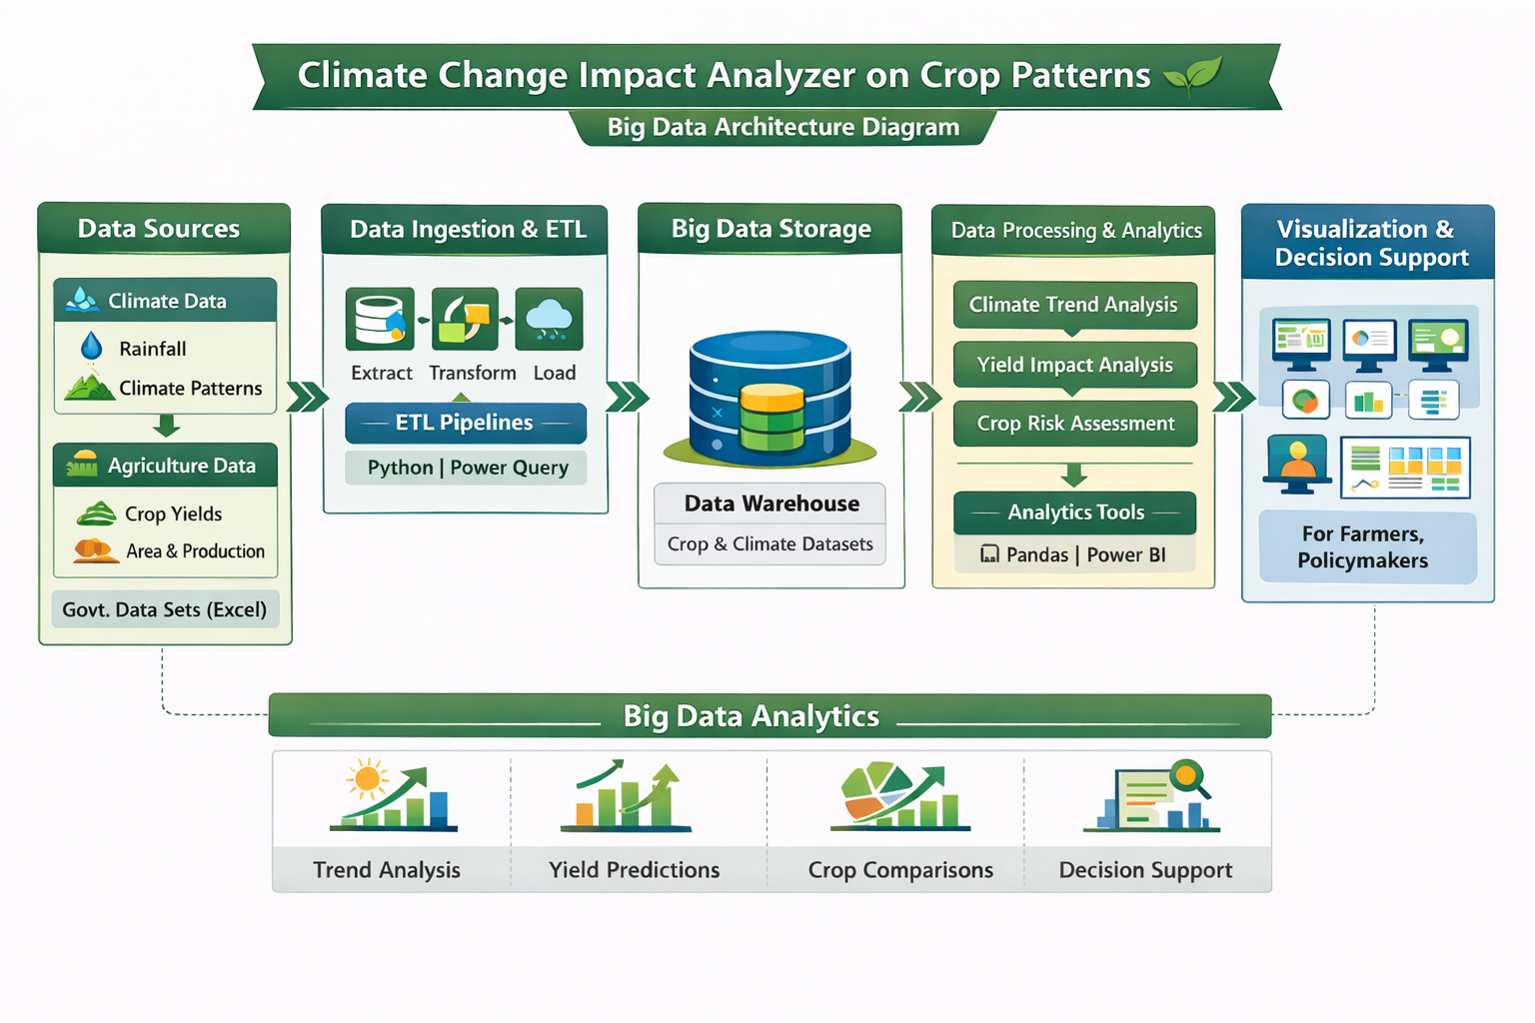
System Architecture / Visuals

Slide 10

Outcomes / Results
Climate patterns like rainfall were clearly observed
Crop yield changes were linked with climate variations
Trends and patterns were identified using charts and graphs
The analysis showed how climate change affects agriculture
Results provide useful insights for better farming decisions

Slide 11
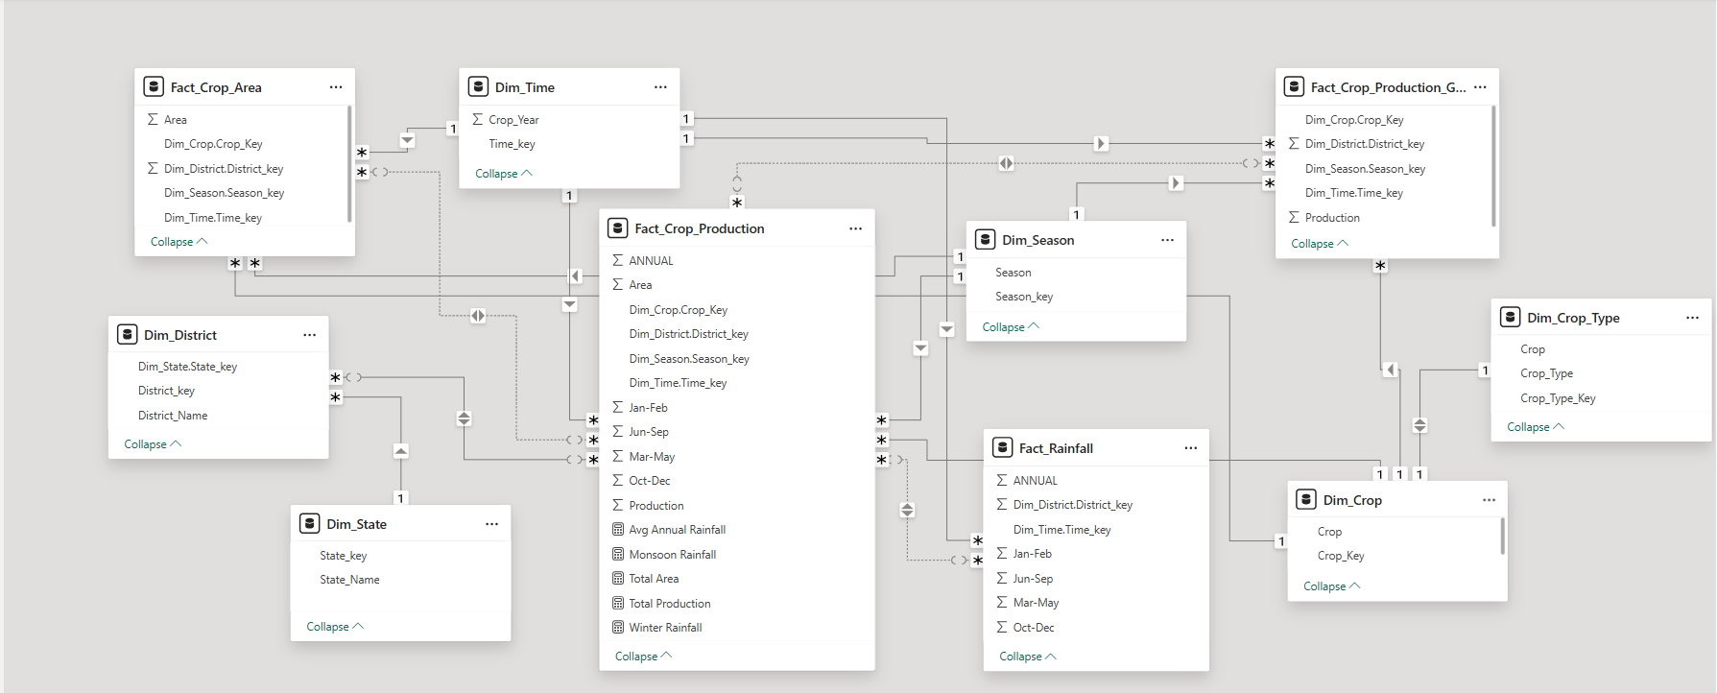
Galaxy / fact Constellation Schema
To support multiple analytical processes within the agricultural data warehouse, a Fact Constellation (Galaxy) Schema was designed. In this schema, multiple fact tables—Fact_Crop_Production, Fact_Crop_Area, and Fact_Rainfall—share common conformed dimension tables such as Crop, Time, Season, and Location (District and State).

Slide 12
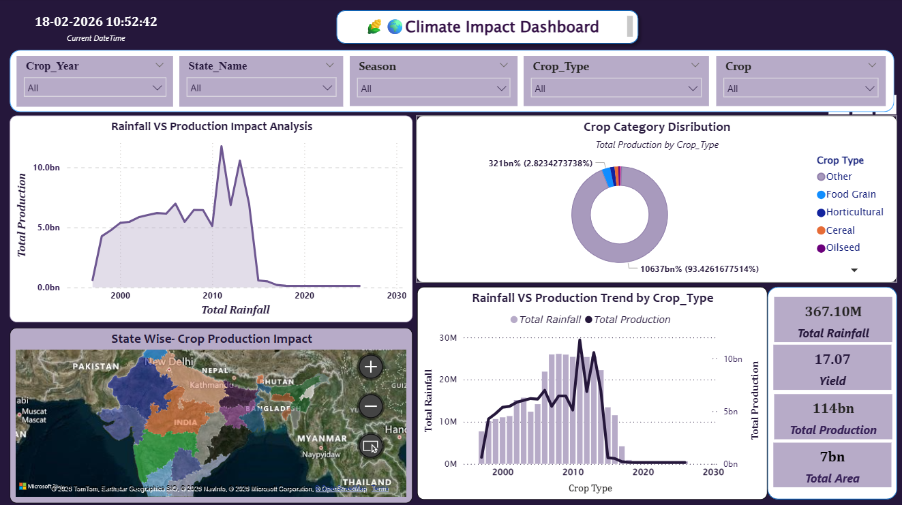
Visualization

Slide 13
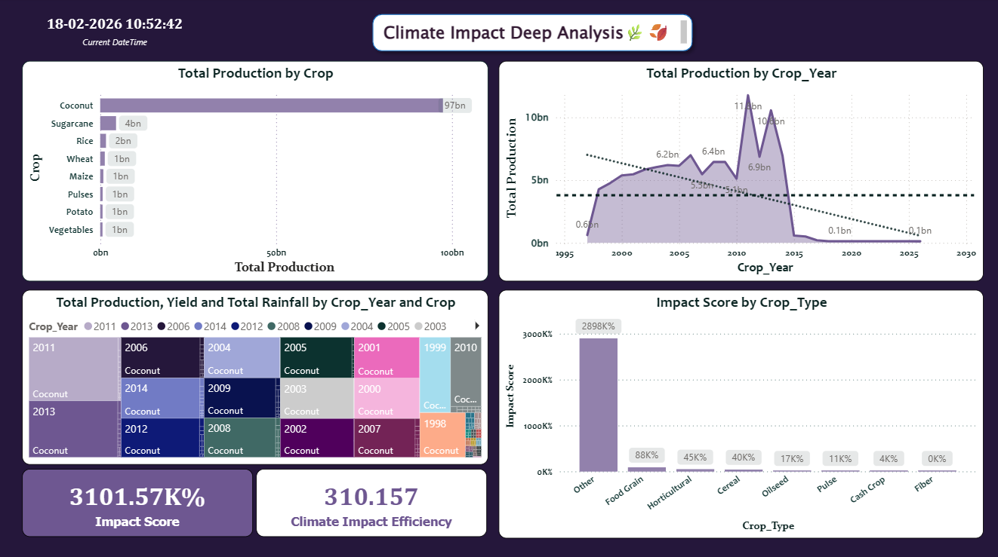

Visualization

Slide 14
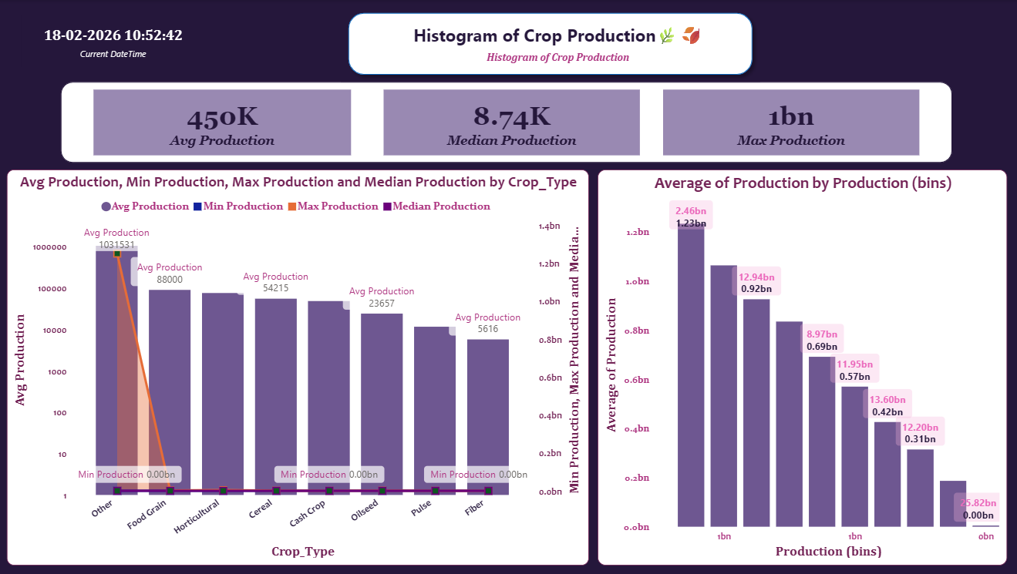
Visualization

Slide 15
Climate Impact Dashboard Explanation
This dashboard analyzes how rainfall affects crop production and yield across different years, states, and crop types.
Page 1 – Overview
Shows Total Production, Rainfall, Yield, and Area
Displays Rainfall vs Production trends
Shows Crop Category distribution
Includes State-wise production map
Page 2 – Deep Analysis
Highlights Top Producing Crops
Shows Production trend over years
Calculates Impact Score (Yield ÷ Rainfall)
Identifies climate efficiency of crops
Page 3 – Production Distribution Analysis
Shows histogram of crop production (production bins)
Displays Average, Median, and Maximum production KPIs
Compares Avg, Min, Max, and Median production by Crop Type

Slide 16
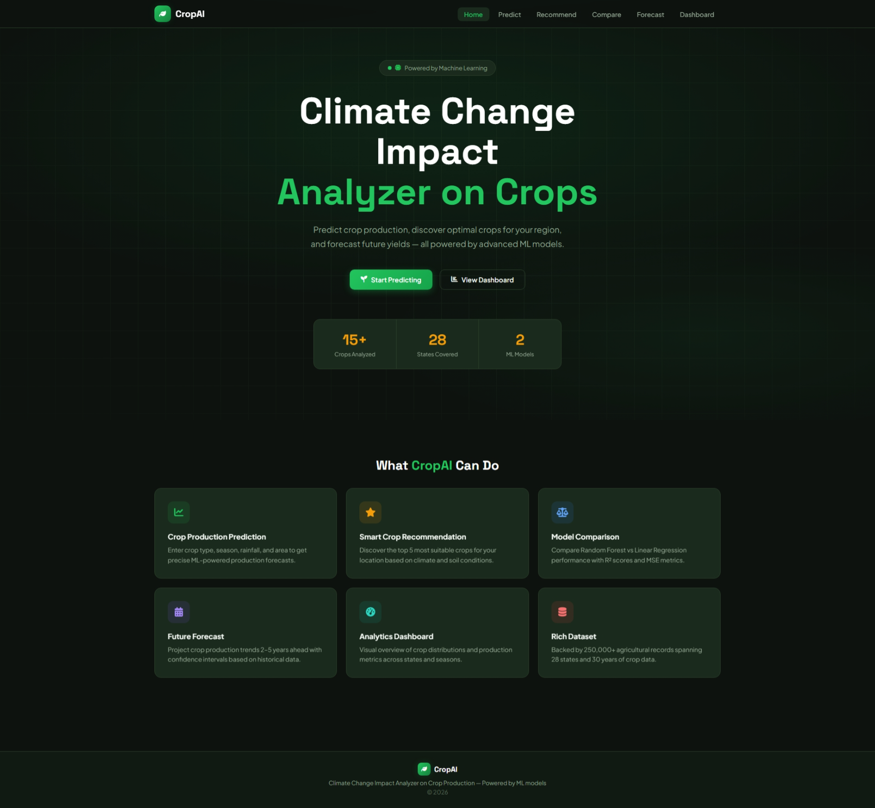
Dashboard
Home Page Explanation :
The home page of the CropAI system provides an overview of the application, highlighting its purpose of analyzing climate change impact on crop production using machine learning. It includes navigation options like Predict, Recommend, Compare, Forecast, and Dashboard for easy access to different features.
It displays key functionalities such as crop prediction, smart crop recommendation, model comparison, future forecasting, analytics dashboard, and dataset information.

Slide 17
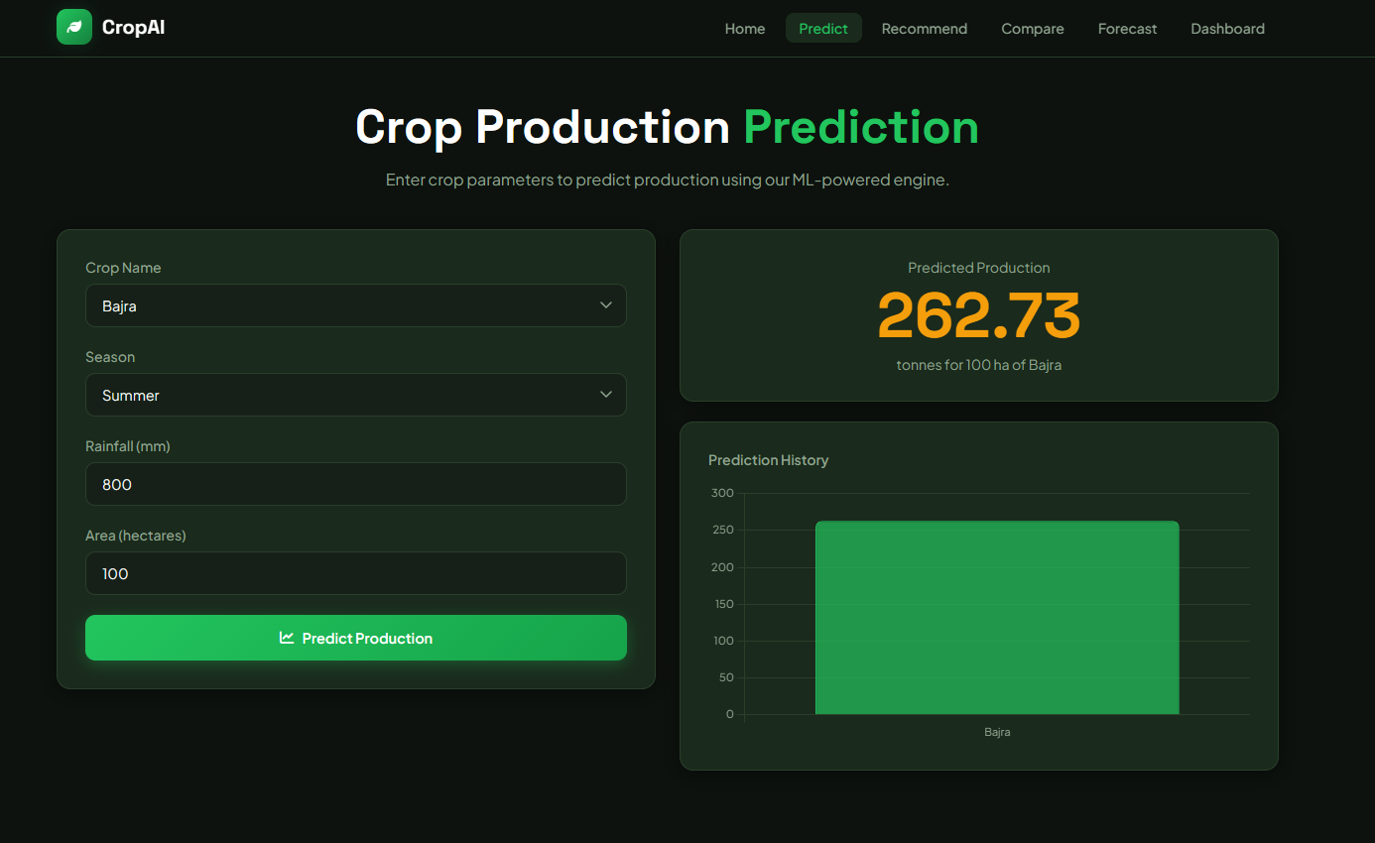
Dashboard
Prediction Page Explanation
The prediction page allows users to input crop details such as crop name, season, rainfall, and area to predict crop production using a machine learning model. After entering the values and clicking “Predict Production,” the system generates the estimated crop yield.
The page also displays the predicted output clearly along with a simple chart showing prediction history. This helps users easily understand the results and analyze crop production based on climate conditions.

Slide 18
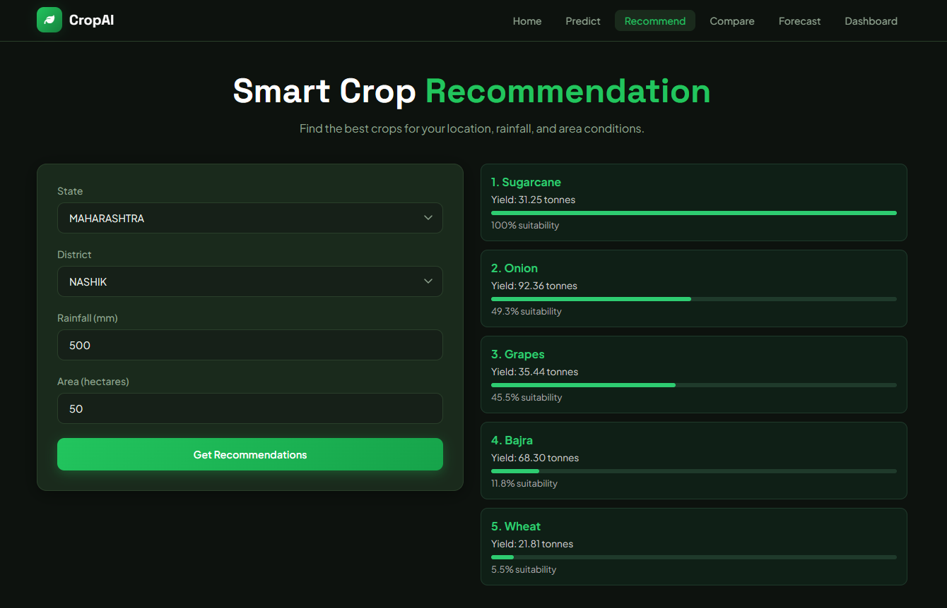
Dashboard
Recommendation Page Explanation
The recommendation page suggests the most suitable crops based on user inputs such as state, district, rainfall, and area. After entering the details, the system analyzes climate conditions and provides a list of recommended crops.
Each crop is displayed with its predicted yield and suitability percentage, helping users identify the best options for cultivation. This feature supports better crop selection and improves agricultural planning.

Slide 19
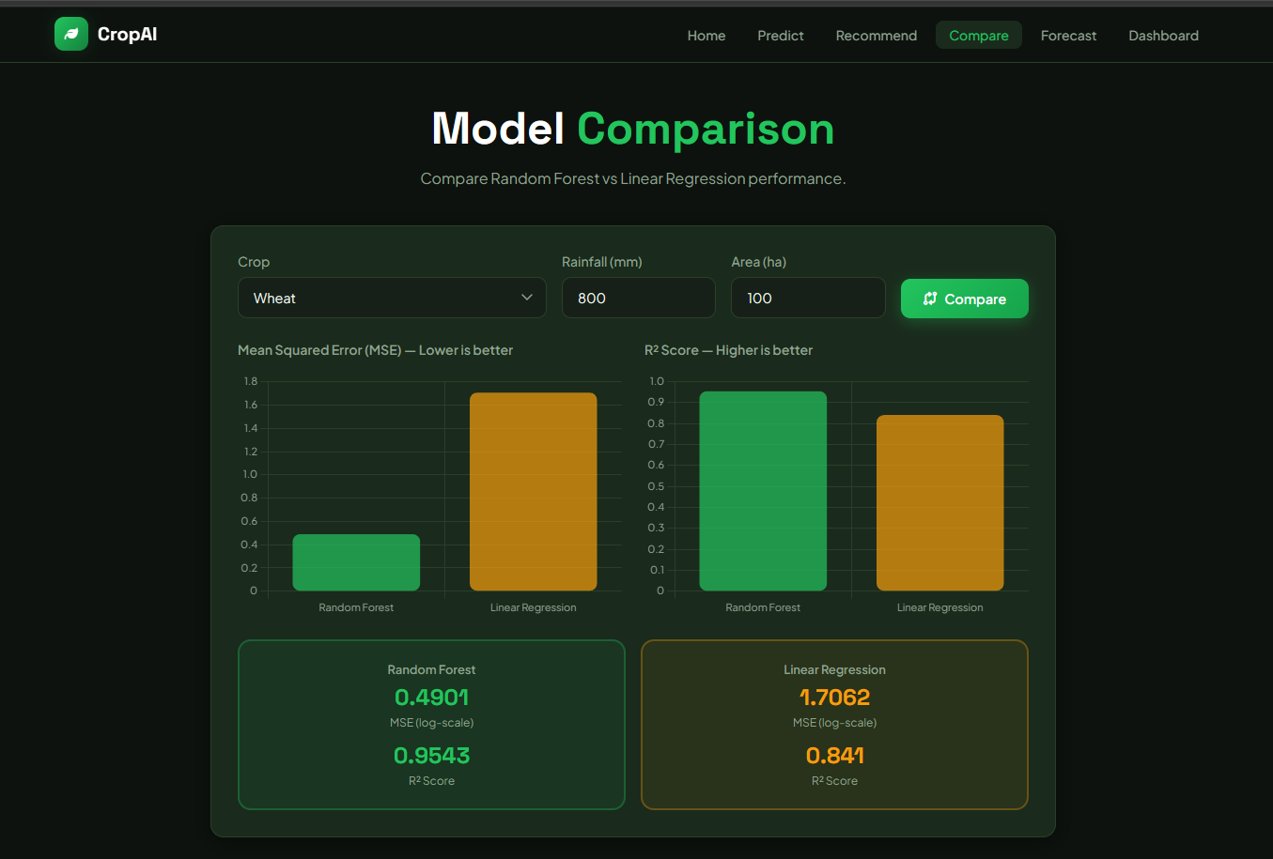
Dashboard
Model Comparison Page Explanation :
The model comparison page compares the performance of two machine learning models: Random Forest and Linear Regression. Users enter inputs like crop, rainfall, and area, and the system evaluates both models.
The comparison is shown using metrics such as Mean Squared Error (MSE) and R² Score, where lower MSE and higher R² indicate better performance. This helps identify which model gives more accurate crop predictions.

Slide 20
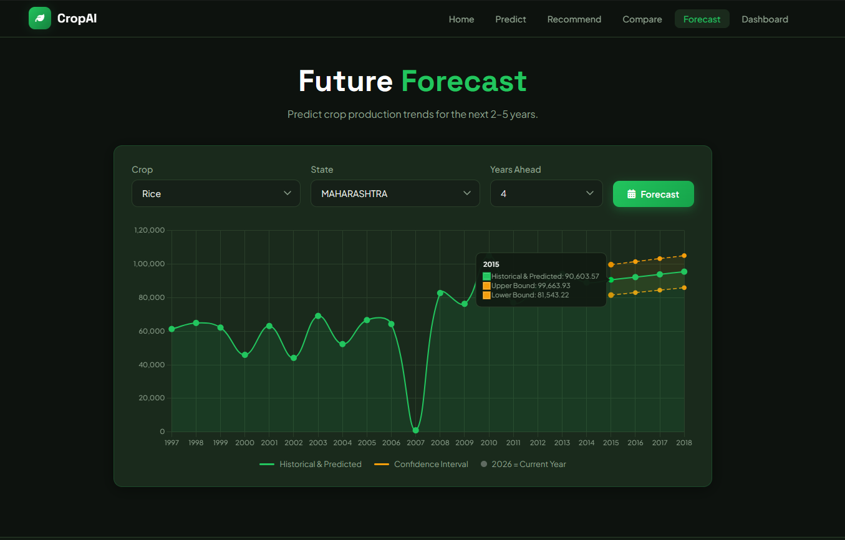
Dashboard
Future Forecast Page Explanation
The future forecast page predicts crop production trends for the next few years based on historical data. Users select crop, state, and number of years, and the system generates future predictions.
The results are displayed using a line graph showing past data and future estimates along with confidence intervals. This helps users understand future trends and plan agricultural activities effectively.

Slide 21
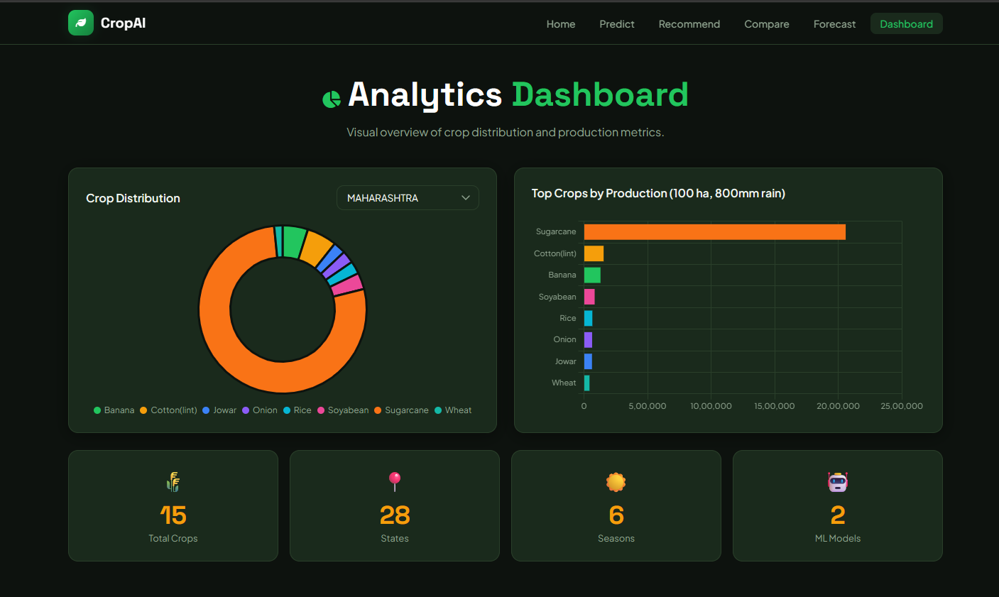
Dashboard
Analytics Dashboard Explanation
The analytics dashboard provides a visual overview of crop production and distribution data. It displays charts such as crop distribution and top crops by production, helping users understand patterns across different crops and regions.
It also shows key statistics like total crops, number of states, seasons, and ML models used. This dashboard helps in quick analysis and supports better decision-making.

Slide 22
PREDICTION MODEL
The system uses a machine learning model (Random Forest) for
prediction
Input features: crop, rainfall, season, area
Model is trained on historical agricultural data
Data is split into training and testing for accuracy
The model learns patterns between climate factors and crop production
Output: predicted crop yield
COMPARATIVE ANALYSIS
Compares actual vs predicted crop production
Evaluates model performance using accuracy/error metrics
Analyzes how different climate factors affect yield
Helps identify which conditions give high or low production
Useful for improving model performance and decision-making

Slide 23
ADVANTAGES AND LIMITATIONS
Advantages
Provides accurate crop prediction using machine learning
Helps understand the impact of climate change on agriculture
Supports better decision-making for farmers and policymakers
Handles both structured (Excel) and semi-structured (JSON) data
Limitations
Prediction accuracy depends on quality and size of dataset
Limited to available features (rainfall, season, etc.)
Does not consider all factors like soil type, pests, fertilizers
Requires internet and technical setup for use

Slide 24

Conclusion & Future Directions
Conclusion
This project shows that climate change has a clear impact on crop yield. and rainfall play an important role in crop production, and data analysis helps in understanding these effects clearly. The results highlight how data analytics can support better planning and decision making in agriculture.
Future Enhancements
Machine learning yield prediction models
Real-time IoT weather sensor integration
Mobile advisory platform for farmers

Slide 25
THANK YOU

