Slide 1

Shri G. S. Institute of Technology and Science
Web Engineering Lab
Presented to: Submitted by:
Mr. Praveen Goyal Aditi Binnani
Ashwini Jain
Divya Bhadauria
Gaurav Kapoor

Slide 2
TravelTrap.com

Slide 3
About the website..
This website has been made for the individuals who love travelling and are planning some trip in or outside India.
It basically helps the travelholics in planning their trip.
It allows users to find the best route to the destination, the places that they must visit at the destinated region, the expected expenditure.
It basically has two ends namely the user end(client) and the server end.

Slide 4
Technical details
The site runs on any computer through any web browser and requires good internet connectivity.
Database design follows the relational model.
The code follows the OOP paradigm.
The code is written using HTML 5, CSS, Javascript for frontend designing and jsp for backend.

Slide 5
Hardware requirements
The machine should have the following configuration for proper running of the website:
16-bit computer.
Minimum 5 GB HDD
Pentium III processor, 500 MHz
Minimum 256 MB RAM

Slide 6
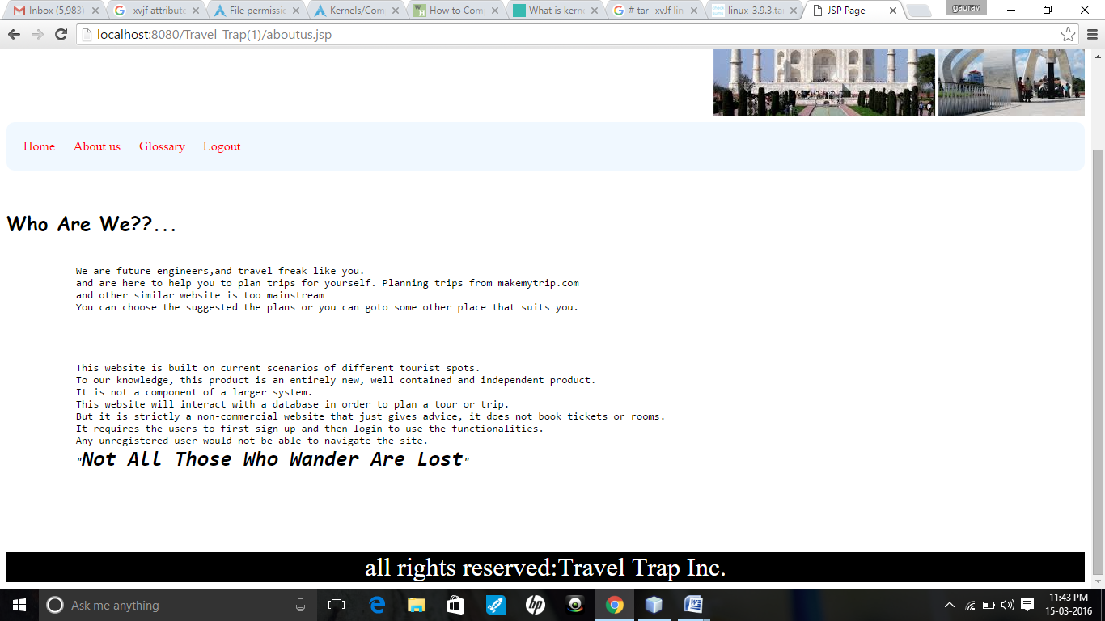
Home page

Slide 7
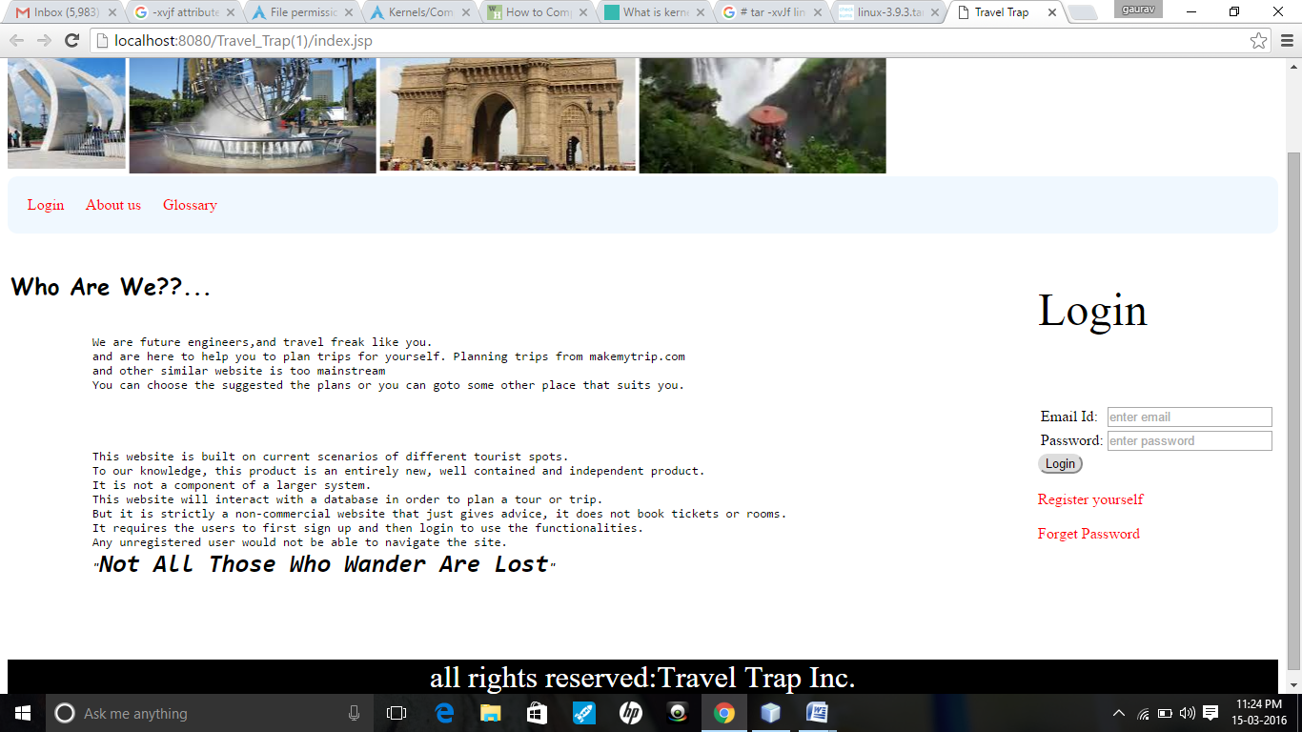
Login page

Slide 8
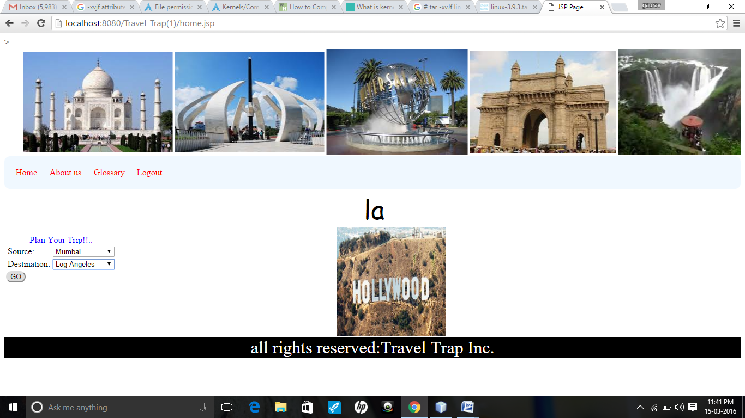
After logging in, the user needs to enter all the details of the trip which he wants to plan . These include the source and the destination.

Slide 9
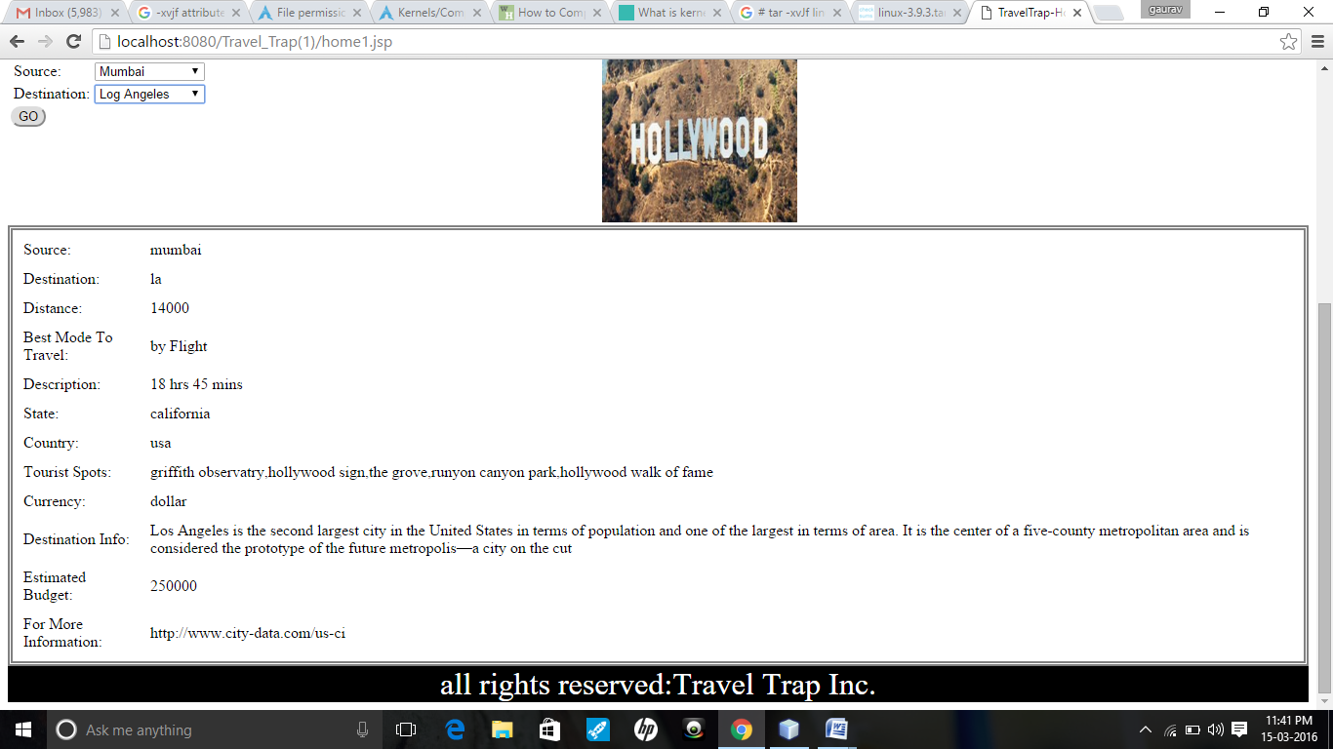
After the source and destination are entered , the user gets the complete information of the place that is to be visited.

Slide 10
