Slide 1

Candy Production: Time Series Analysis
Group 04
Aditi Chauhan
Abhishek Puranik
Sanil Patel
Prachi Mahapatra
Notes:
To change the image on this slide, select the picture and delete it. Then click the Pictures icon in the placeholder to insert your own image.

Slide 2
Introduction
Overview of the dataset:
The dataset used in this project is the monthly production of Candies produced in United States of America (excluding US territories).
The data runs through January 1972 to October 2020.
Our group has selected this specific dataset to understand the overall candy production and how the production is affected in different months in US.
Halloween is one kind of celebration which involves distribution of candies. People do make new resolutions to lose weight and stay fit on event of the New Year. The consumption of candies slightly increases from Christmas holidays to New Year.

Slide 3
Objective
The forecasting of this dataset can provide us with the interesting insights about the industrial production index and the monthly consumption of candies.
Is there any seasonality present in the data?
Months having highest and lowest candy production
Has candy production increased over years?
Prediction of candy production of next 6 months (Nov 2020 – Apr 2021)

Slide 4
Synopsis
We will be following a SARIMA and Neural Network modeling procedure for forecasting. The steps included in the analysis are:
Perform exploratory data analysis
Check for the possible transformation
Test the stationarity of the data
Select the appropriate SARIMA model and forecast the data
Forecast the data using appropriate Neural Network method and forecast the data
Select the efficient model from the above analysis and provide a 6-step ahead forecast.
Conclusion of the forecast

Slide 5
Exploratory Data Analysis:
Check for missing values-This step in R checks whether there are any missing values in the data. The presence of missing values in the data can have an impact on the efficiency of the method used in forecasting the values. Code : sum(is.na(candyHOLD)) Result: 0 (The result suggests that there are no missing values in the data)
Check the frequency of the time series data- The frequency of the data depicts how the data is divided i.e., Monthly, quarterly, yearly, etc.
Code : frequency(candyHOLD) Result : 12 (The result tells us that the data is divided by months)

Slide 6
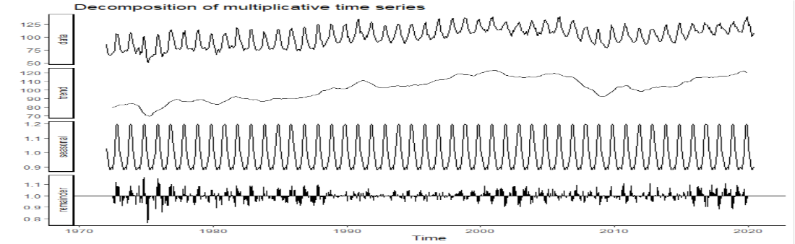
Time Series Decomposition
Code:
decompose_candyts <- decompose(candyHOLD,"multiplicative")
autoplot(decompose_candyts) + theme_classic()

Slide 7
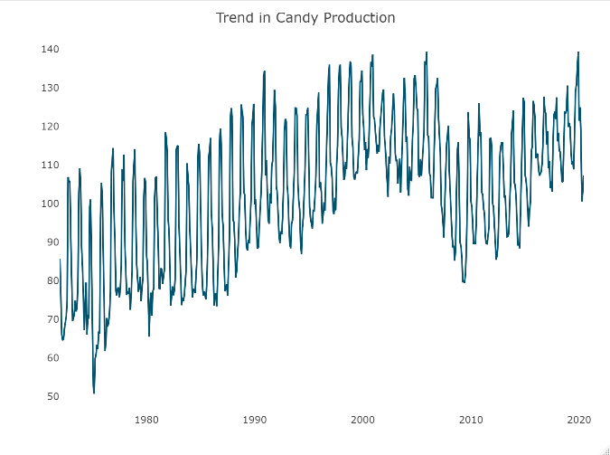
Exploratory Data Analysis:
Trend in Candy Production:
trend=ts_plot(candyHOLD, title="Trend in Candy Production")
trend
From the graph, we can observe that the data does not depict a strong sense of trend over the range of years.
We can observe an increase in earlier years; however, the production of candies appears to be roughly in the same range.
For the purpose of the analysis, we will consider that the data does not showcase a trend.

Slide 8
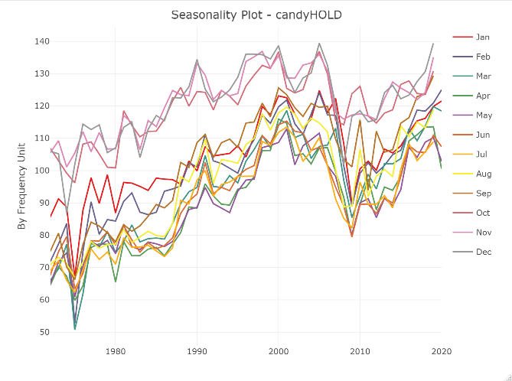
Exploratory Data Analysis:
seasonality=ts_seasonal(candyHOLD, type="cycle")
seasonality
Seasonality in Candy Production:
Seasonality refers to the sudden spikes in the data at typical intervals of time. The seasonality graph reveals that the candy production increases during the months of October, November and December.
The increase in the production could be potentially because of Halloween celebrations, Christmas and New year celebrations.
The specific pattern is followed for many years in the data and hence, it shows a strong sign of seasonality present in the data.

Slide 9
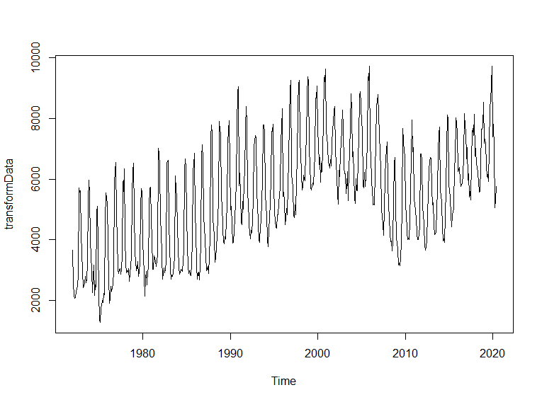
Checking for data transformation
lambda = BoxCox.lambda(candyHOLD)
lambda
transformData = BoxCox(candyHOLD, lambda)
plot(transformData)
Before checking whether the data is stationary, we proceed with the Box-Cox transformation.
From the above R-function, the value of lambda appears to be 1.99 for the dataset.
We can observe that no vital changes are observed when we apply the Box-Cox transformation to the data .
Hence, considering the nature of graph and the value of lambda ( greater than 1) we can proceed without transforming the data.

Slide 10
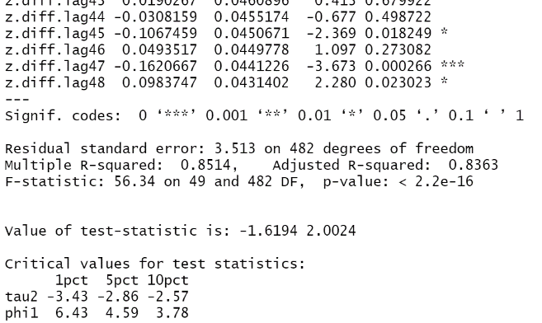
Checking if data is stationary
Ho: The unit root is present in the data (The data is not stationary)
HA: The unit root is not present in the data.(The data is stationary)
Augmented-Dickey-Fuller Unit Root Test
summary(ur.df((candyHOLD),lags=49,type="drift",selectlags="AIC"))
summary(ur.df((candyHOLD),lags=48,type="drift",selectlags="Fixed"))
If type is set to "drift" an intercept is added in the test regression

Slide 11
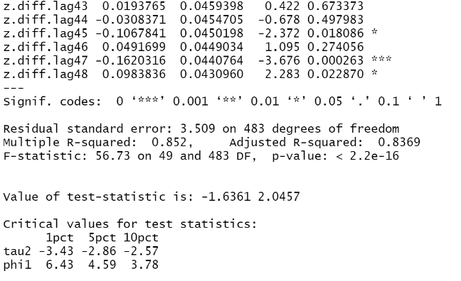
Checking if data is stationary (contd)
Augmented-Dickey-Fuller Unit Root Test
Result:
The Value of the t-statistic: -1.63 is greater than all the test sizes, we Fail to reject the null hypothesis.
We can consider that the unit root is present in the data and non-seasonal differencing is required.

Slide 12
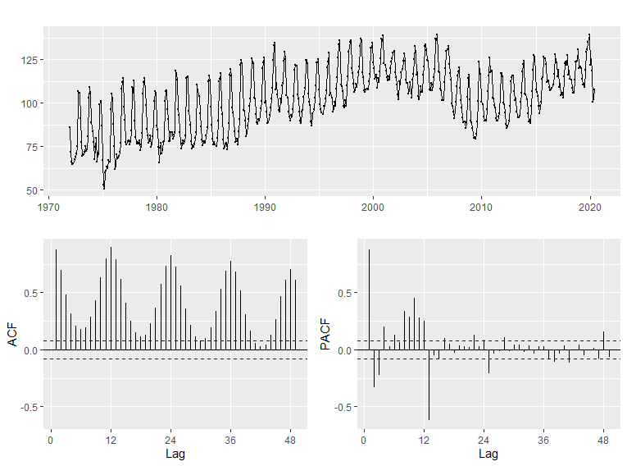
Checking for need of seasonal differencing
nsdiffs(candyHOLD)
[1] 1
For the sake of robustness, we will again check seasonal differencing with
#first difference of the data
nsdiffs(diff(candyHOLD))
[1] 1
ggtsdisplay(candyHOLD,lag.max=49)
Interpretation :
We can verify it from the graph that there is little or no decay at our seasonal lags.
Therefore, Seasonal differencing is necessary.

Slide 13
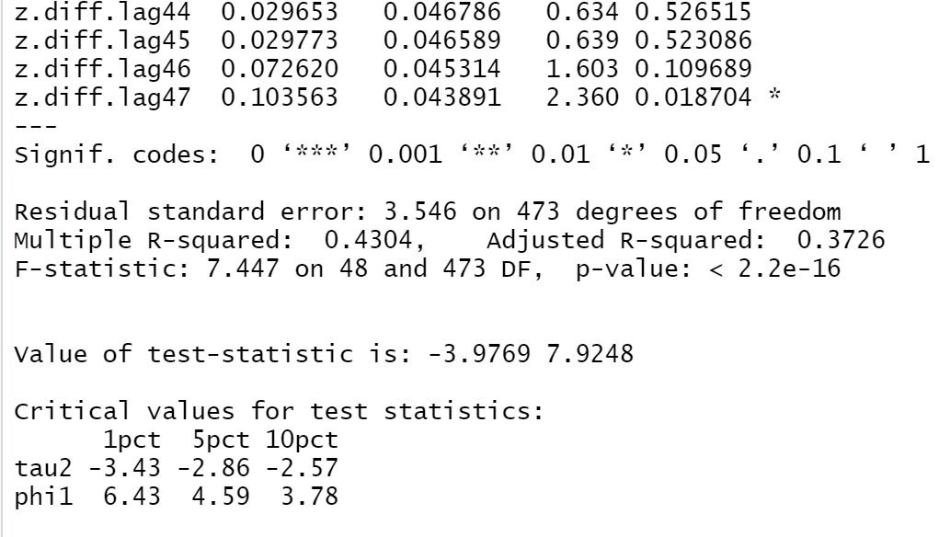
Checking for additional differencing
summary(ur.df(diff(candyHOLD,12),lags=47,type="drift",selectlags="Fixed"))
Interpretation :
According to the above results: t statistic value < 5% test size value. Therefore, we reject the null hypothesis.
We do not need more differencing. so, d=1 and D=1

Slide 14
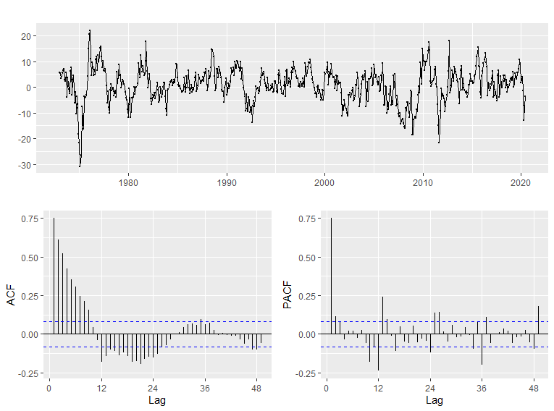
ACF PACF for seasonal differenced data
ggtsdisplay((diff(candyHOLD,12)), lag.max=49)
ACF :
Decay with Oscillation
statistically significant coefficients at 12,24.
PACF :
statistically significant coefficients at multiples of 12.
1st coefficient is also significant.

Slide 15
SARIMA for Time Series Forecasting in R ((p, d, q) X (P, D, Q))
ARIMA
p: Trend autoregression order.
d: Trend difference order.
q: Trend moving average order
Seasonal Elements
There are four seasonal elements that are not part of ARIMA that must be configured; they are:
P: Seasonal autoregressive order.
D: Seasonal difference order.
Q: Seasonal moving average order.
m: The number of time steps for a single seasonal period.
#SARIMA (p, 1, q) X (P, 1, Q)
p: 2,3,4
q: 1,2
P: 0,1
Q: 0,1,2

Slide 16
SARIMA for Time Series Forecasting in R ((p, d, q) X (P, D,1))
Arima(candyHOLD,order=c(2,1,1),seasonal=c(0,1,0)) AIC=3300.19 and BIC=3317.56
Arima(candyHOLD,order=c(2,1,2),seasonal=c(1,1,2)) AIC=3145.38 and BIC=3180.13
Arima(candyHOLD,order=c(2,1,1),seasonal=c(0,1,2)) AIC=3154.95 and BIC=3181.02
Arima(candyHOLD,order=c(3,1,2),seasonal=c(0,1,2)) AIC=3138.31 and BIC=3173.06
Arima(candyHOLD,order=c(4,1,2),seasonal=c(0,1,2)) AIC=3139.92 and BIC=3179.02
Arima(candyHOLD,order=c(4,1,3),seasonal=c(1,1,2)) AIC=3107.13 and BIC=3154.91
Arima(candyHOLD,order=c(4,1,3),seasonal=c(0,1,2)) AIC=3105.05 and BIC=3148.49 (Minimum )

Slide 17
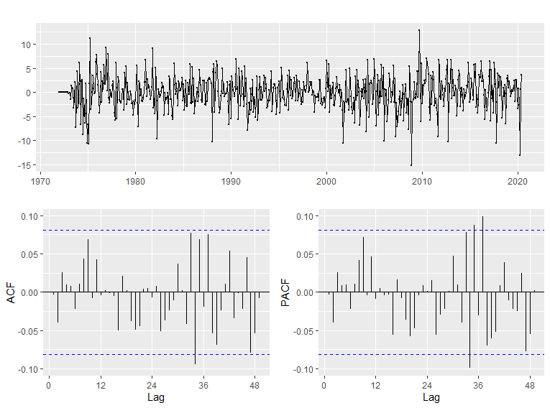
Selecting the final SARIMA model with low AIC and BIC values:
modelSARIMA=Arima(candyHOLD,order=c(4,1,3),seasonal=c(0,1,2))
ggtsdisplay(modelSARIMA$residuals,lag.max=49)

Slide 18
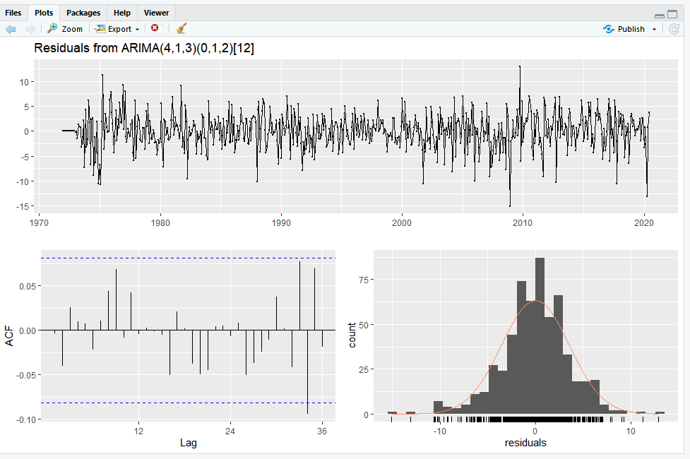
Diagnostic check on residuals:
checkresiduals(Arima(candyHOLD,order=c(4,1,3),seasonal=c(0,1,2)))
Mean of the residuals obtained from SARIMA model is nearly 0.
In the ACF graph, it can be noted that there is no significant correlation between residuals.

Slide 19
Ljung-Box test
H0: The first 49 lags are jointly equal to 0.
HA: complement of H0
Code :
Box.test(modelSARIMA$residuals,lag=49, type="Ljung-Box")
qchisq(.95,49)
Interpretation: I fail to reject: 48.282 < 66.338
Result
Box-Ljung test
data: modelSARIMA$residuals
X-squared = 48.282, df = 49, p-value = 0.5021
[1] 66.33865

Slide 20
4 step forecast using selected SARIMA model: ((4,1,3) X (0,1,2))
foreARIMA=forecast(modelSARIMA,h=4)
Result
 | Point Forecast | Lo 80 | Hi 80 | Lo 95 | Hi 95
Jul 2020 | 105.9706 | 101.3279 | 110.6132 | 98.87027 | 113.0709
Aug 2020 | 117.2459 | 111.4524 | 123.0395 | 108.3855 | 126.1064
Sep 2020 | 124.921 | 118.416 | 131.426 | 114.9725 | 134.8695
Oct 2020 | 129.8739 | 122.8738 | 136.874 | 119.1682 | 140.5796
accuracy(foreARIMA,window(candy, start=c(2020,7)))
Result
 | ME | RMSE | MAE | MPE | MAPE | MASE | ACF1 | Theil's U
Training set | 0.002677 | 3.547657 | 2.676658 | -0.05688 | 2.692122 | 0.529337 | -0.00363 | NA
Test set | 7.539768 | 7.617871 | 7.539768 | 5.914726 | 5.914726 | 1.491067 | 0.020959 | 0.829991

Slide 21
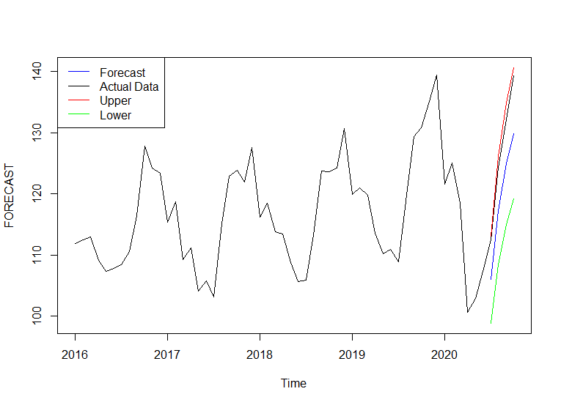
Plot of forecast and test data for SARIMA ((4,1,3) X (0,1,2)) [12]:
Thus, looking at the plot and the values it can be inferred that if the production of candy was carried out in accordance with our forecasted values, which happens to be lower than the actual value the company would have incurred opportunity loss.

Slide 22
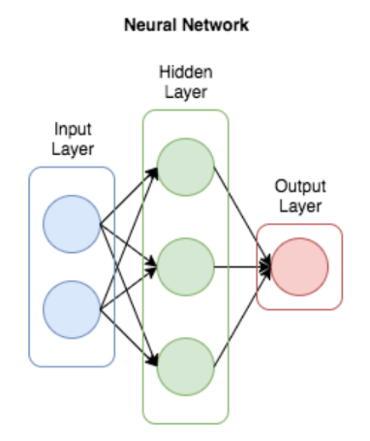
Model 2: Neural Networks
Artificial neural networks are composed of layers of node
Each node is designed to behave similarly to a neuron in the brain
The first layer of a neural net is called the input layer, followed by hidden layers, then finally the output layer
Each node in the neural net performs some sort of calculation, which is passed on to other nodes deeper in the neural net

Slide 23
Model 2.1: Neural Networks :p, P and repeats decided by R
We performed the Neural Net function on our variable in accordance to the values of p, P and repeats decided by R. That is the default values given by R
Code
modelNETAR = nnetar(candyHOLD)
foreNN1=forecast(modelNETAR,h=4)
foreNN1
Year | Jul | Aug | Sep | Oct
2020 | 101.7852 | 114.8086 | 119.7423 | 124.1876
Output:
 | ME | RMSE | MAE | MPE | MAPE | MASE | ACF1 | Theil's U
Training set | -0.00413 | 1.176448 | 0.888924 | -0.03492 | 0.871788 | 0.175794 | 0.079338 | NA
Test set | 11.91168 | 12.09374 | 11.91168 | 9.335816 | 9.335816 | 2.355658 | 0.1898 | 1.295449
Accuracy :

Slide 24
Model 2.2 : Neural Networks :p, P and repeats decided manually
In the second form of forecast, we decided the values for p,P and repeats.
We selected lower values to avoid over fitting of the model.
Code
modelUS = nnetar(candyHOLD,p=2,P=1,size=10,repeats=100)
foreNN2=forecast(modelUS,h=4,PI=TRUE)
foreNN2
 | Point Forecast | Lo 80 | Hi 80 | Lo 95 | Hi 95
Jul 2020 | 109.5897 | 103.7316 | 115.7084 | 101.0783 | 118.5479
Aug 2020 | 117.086 | 109.9535 | 123.203 | 106.1266 | 126.7635
Sep 2020 | 126.5065 | 119.5194 | 131.7869 | 116.4708 | 135.176
Oct 2020 | 130.4574 | 123.1525 | 136.0457 | 119.2003 | 140.1397
Output :
 | ME | RMSE | MAE | MPE | MAPE | MASE | ACF1 | Theil's U
Training set | -0.00127 | 4.457187 | 3.397712 | -0.21723 | 3.416109 | 0.671933 | 0.174908 | NA
Test set | 6.132721 | 6.50753 | 6.132721 | 4.737786 | 4.737786 | 1.212809 | -0.27946 | 0.768951
Accuracy :

Slide 25
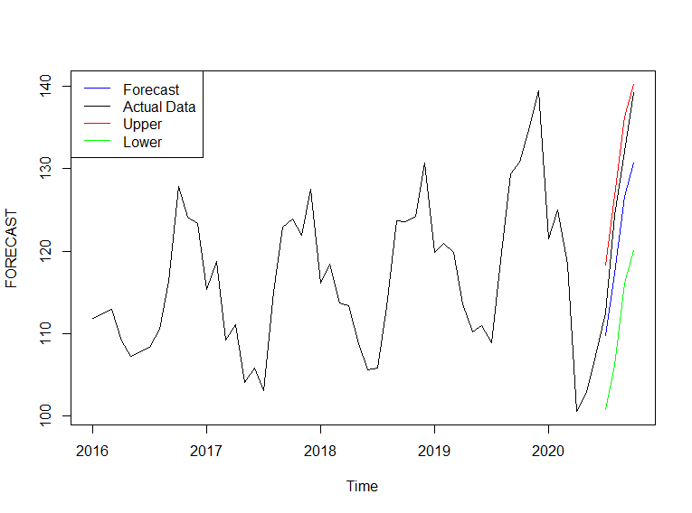
Plotting the forecast and test data for Neural Network 2.2:

Slide 26
Final Model Selection : Accuracy (RMSE)
Model | Testing RMSE | Training RMSE
(4,1,3) X (0,1,2)[12] | 7.617871 | 3.547657
Neural Network - 1 | 12.09374 | 1.176448
Neural Network - 2 | 6.50753 | 4.457187
Among the three models, Neural Net-2 has produced better results. (Least Testing RMSE)
Therefore, we'll produce 6 step forecast on our data using Neural Network:

Slide 27
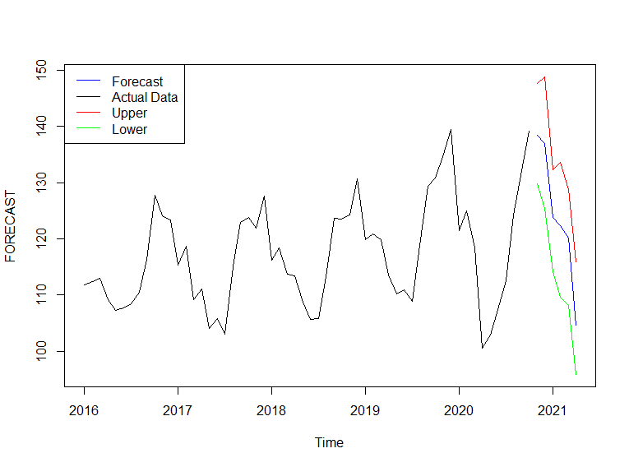
Forecast for next 6 months using Neural Network 2.2
 | Point Forecast | Lo 80 | Hi 80 | Lo 95 | Hi 95
Nov 2020 | 138.5097 | 132.623 | 144.4666 | 129.8656 | 147.6466
Dec 2020 | 137.0197 | 128.882 | 144.6313 | 125.4486 | 148.8738
Jan 2021 | 123.862 | 117.9436 | 129.5369 | 114.1709 | 132.3489
Feb 2021 | 122.4047 | 114.6152 | 130.3154 | 109.6798 | 133.6672
Mar 2021 | 120.111 | 112.5366 | 125.7256 | 108.2021 | 128.7662
Apr 2021 | 104.6941 | 99.04401 | 112.0443 | 95.85716 | 115.8657

Slide 28
Conclusion
We prepared the time series analysis of US monthly Candy Production from 1972 to 2020 .
•EDA of Data : Decomposition of time series shows clear seasonality.
•No Box Cox Transformation of Data
•SARIMA Model Selection : Best Model ((4,1,3) X (0,1,2))[12]
•Residual Plot of SARIMA:
•Neurula Network Model Selection : Selected Model with p= 2 and P = 1 size=10,repeats=100
•6 Step Forecasting and Discussion

Slide 29
How the forecast would affect interested parties
•We have predicted the cady production form Nov 2020 till April 2021.
•We have seen that Forecasted Candy production is high in the month of November (138.5) and December (137.0)and then it suddenly drops in the month of January (123.9) and April (104.6)
•Our interested parties will be Raw Material Suppliers, Candy Producers and Human Resources (Man Hours)
•The candy producers will be needing more supplies during the month of November and December which will affect increase in Raw material and man Hours.
• Similarly, the demand will drop during the time frame of January to April.

Slide 30
Thank You

Slide 31
Data Source and References
Data Source
https://fred.stlouisfed.org/series/IPG3113N
References
Dr Aron Smallwood Notes for Econ Forecasting Class UTA

