Slide 1

Early Detection is Key
ONCOCHECK
HACK DUKE 2025
Aditi Deshpande, Jessica Chen, Siya Patel

Slide 2

Why is early detection important?
Early detection and intervention is one of the most important factors in shaping a cancer prognosis. While many regular screenings such as those for cervical, breast, and prostate cancer have been developed, most people are not aware of their existence or participate in these programs.

Slide 3
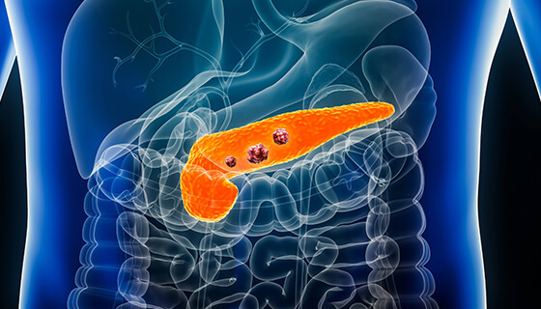
The current lifetime risk of developing cancer is 41% in America!
So what do we do?

Slide 4
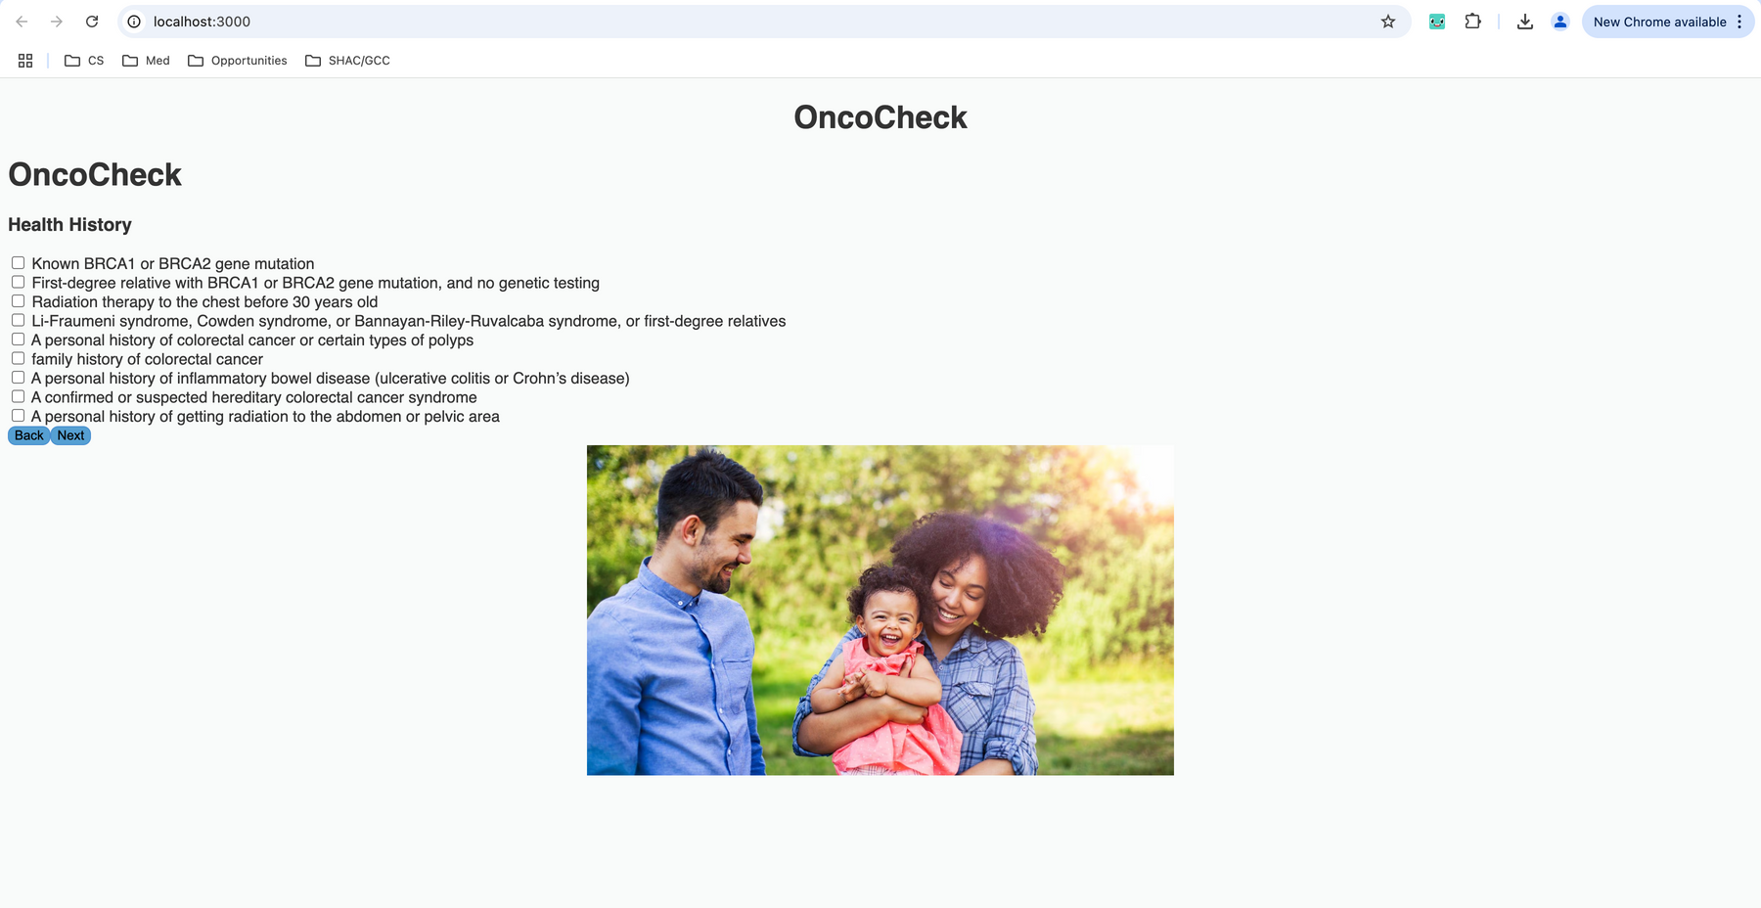

Features: You can enter your health history, lifestyle habits, health insurance plan, demographics (such as age and gender), and zip code information, and it will give you a list of cancer screenings that you should be getting based on your indicated risk factors. A calendar file containing scheduled future reminders at the appropriate time to make an appointment can be exported and imported into your google calendar app.

Slide 5

OncoCheck goes mobile!
Future Directions
Connect with local cancer screening initiative to expand outreach
Apply AI into giving a more personalized recommendation

