Slide 1
Revision

Slide 2
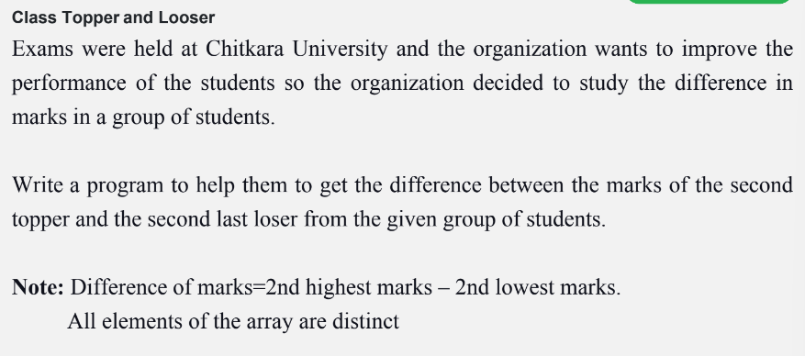

Slide 3
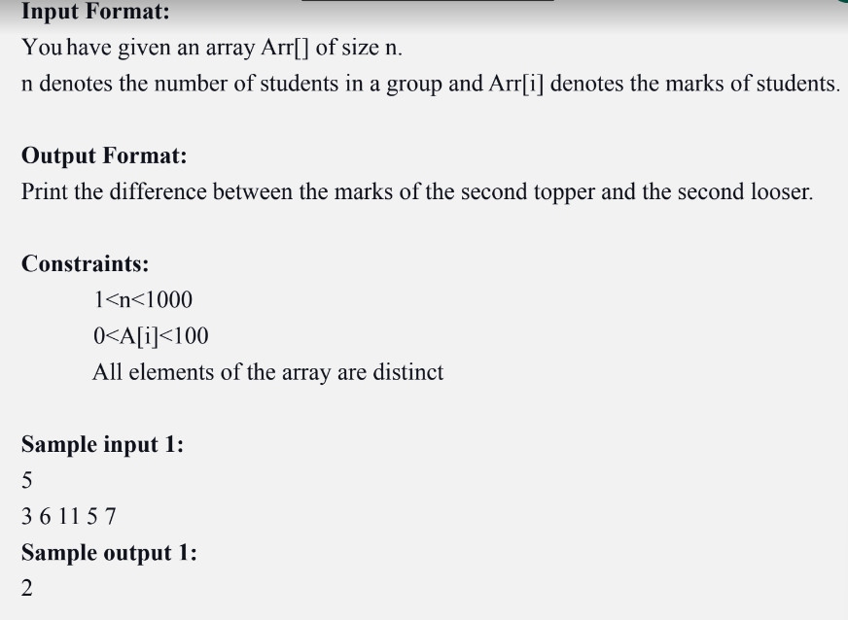

Slide 4
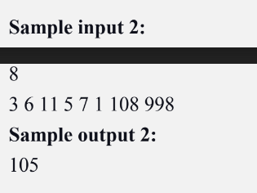

Slide 5
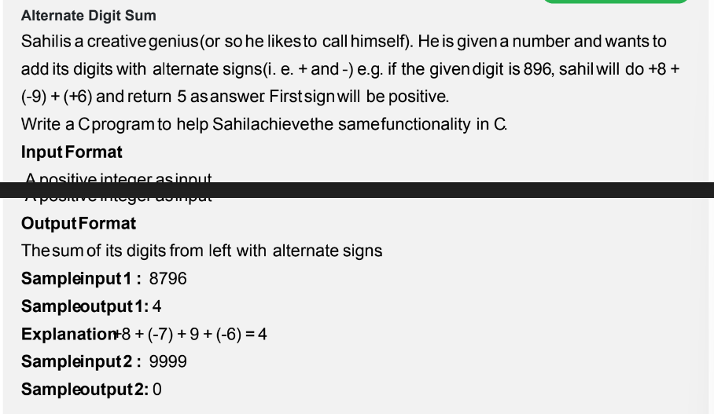

Slide 6
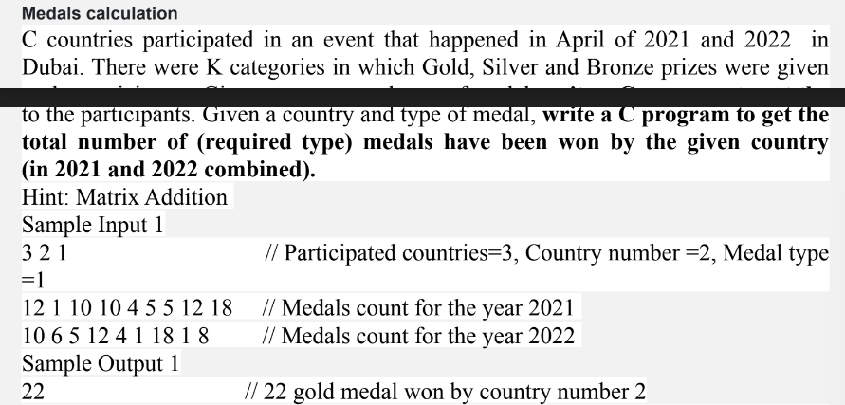

Slide 7
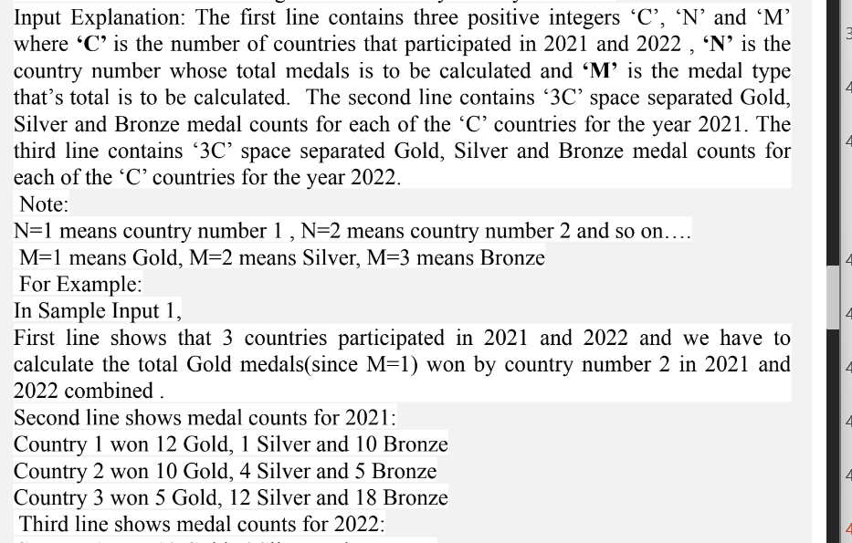

Slide 8
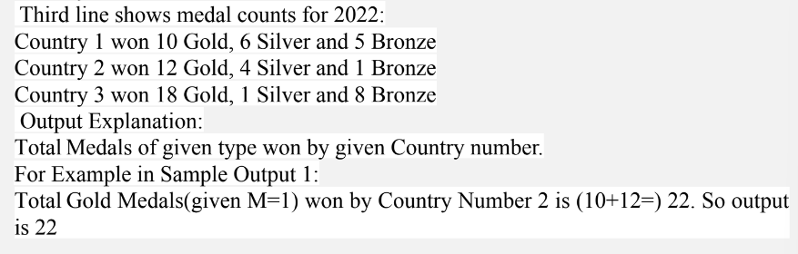

Slide 9
Practice
Write a C program that reads input from a file named "input.txt" and writes the output to a file named "output.txt". The input file contains a integer n(number of integer) in next line contain n integers separated by whitespace, and the program should write to the output file with the sum of integers. Assume that the input file contains at most 1000 integers.
Input File
1,2,3,-2,5
Corresponding Output file
9

Slide 10
Practice
The problem is to count all the possible paths from top left to bottom right of a MxN matrix with the constraints that from each cell you can either move to right or down.
https://practice.geeksforgeeks.org/problems/number-of-paths0926/1

Slide 11
Practice
Write a C program that reads input from a file named "input.txt" and writes the output to a file named "output.txt". The input file contains a integer n(number of integer) in next line contain n integers separated by whitespace, and the program should write to the output file with the maximum sum of contiguous integers. Assume that the input file contains at most 1000 integers.
Input File
1,2,3,-2,5
Corresponding Output file
9

Slide 12
Practice
Suppose you have a file containing Ipv4 addresses and you want to copy only the valid ipv4 addressed to another file. Write a program that prompts the user for the names of the source and destination files, opens the source file in read mode, opens the destination file in write mode, reads the valid data from the source file, writes it to the destination file, and then closes both files.
A valid IPv4 Address is of the form x1.x2.x3.x4 where 0 <= (x1, x2, x3, x4) <= 255.
222.111.111.111 This is valid ipv4 address
5555..555 This is not

Slide 13
Practice
https://practice.geeksforgeeks.org/problems/kadanes-algorithm-1587115620/1?page=1&category[]=Arrays&sortBy=submissions
https://practice.geeksforgeeks.org/problems/validate-an-ip-address-1587115621/1?page=1&category[]=Strings&category[]=Recursion&sortBy=submissions
https://practice.geeksforgeeks.org/problems/2d3fc3651507fc0c6bd1fa43861e0d1c43d4b8a1/1

