Slide 1
Introduction to Recursion

Slide 2
What is Recursion?
Recursion: The technique of calling the recursive functions is known as recursion.
Functions : In c, we can divide a large program into the basic building blocks known as function.
It reduces the duplicity in the code.
It takes arguments and return some value or does not return anything in case of void.

Slide 3
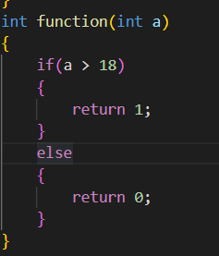
What is Recursion?
Recursion: The technique of calling the recursive functions is known as recursion.
Functions : In c, we can divide a large program into the basic building blocks known as function.
It reduces the duplicity in the code.
It takes arguments and return some value or does not return anything in case of void.

Slide 4
What is Recursion?
Recursion: The technique of calling the recursive functions is known as recursion.
Functions : In c, we can divide a large program into the basic building blocks known as function.
It reduces the duplicity in the code.
It takes arguments and return some value or does not return anything in case of void.
Recursive Functions: A function that calls itself is known as a recursive function.

Slide 5

What is Recursion?
Recursion: The technique of calling the recursive functions is known as recursion.
Functions : In c, we can divide a large program into the basic building blocks known as function.
It reduces the duplicity in the code.
It takes arguments and return some value or does not return anything in case of void.
Recursive Functions: A function that calls itself is known as a recursive function.

Slide 6
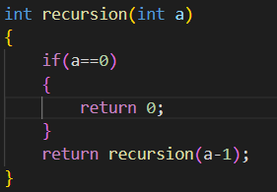
Recursive functions
Recursive Functions: A function that calls itself is known as a recursive function.
Terminating Condition(base case) : To prevent infinite recursion, if else loops can be used where one branch makes the recursive call, and other doesn't.

Slide 7
Recursive functions
Recursive Functions: A function that calls itself is known as a recursive function.
Terminating Condition(base case) : To prevent infinite recursion, if else loops can be used where one branch makes the recursive call, and other doesn't.
Terminating Condition

Slide 8
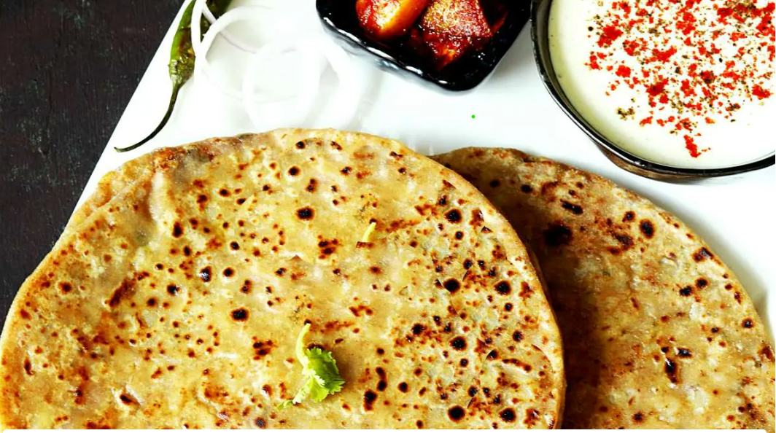
Intuitive understanding
Preparation of Aloo Paratha
Prep(Aloo paratha) = prep(aloo) +
prep(paratha) +
prep(cooking)
= prep(boiling aloo) +
prep(mash the potatoes ) + prep(mixed the ingredients) + prep(Make The Dough) + prep(roll paratha) + prep(put potato inside paratha) + …….
= prep(take aloo) + prep(take necessary utensils) + prep(masala) + prep(take flour) + prep(water)+ …….

Slide 9
Why we need of Recursion?
Recursion is an amazing technique with the help of which we can reduce the length of our code and make it easier to read and write. It has certain advantages over the iteration technique which will be discussed later. A task that can be defined with its similar subtask, recursion is one of the best solutions for it. For example→ The Factorial of a number.

Slide 10
Important Points
Performing the same operations multiple times with different inputs.
In every step, we try smaller inputs to make the problem smaller.
Base condition is needed to stop the recursion otherwise infinite loop will occur.
Stack Overflow in recursion: If the base case is not reached or not defined, then the stack overflow problem may arise

Slide 11
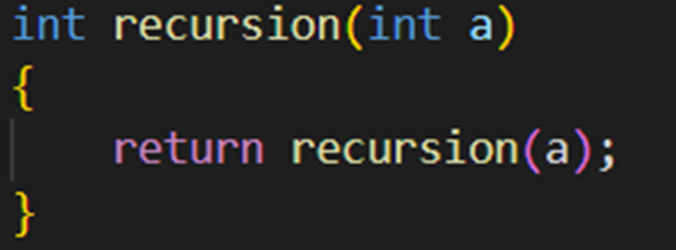
Important Points
Performing the same operations multiple times with different inputs.
In every step, we try smaller inputs to make the problem smaller.
Base condition is needed to stop the recursion otherwise infinite loop will occur.
Stack Overflow in recursion: If the base case is not reached or not defined, then the stack overflow problem may arise

Slide 12
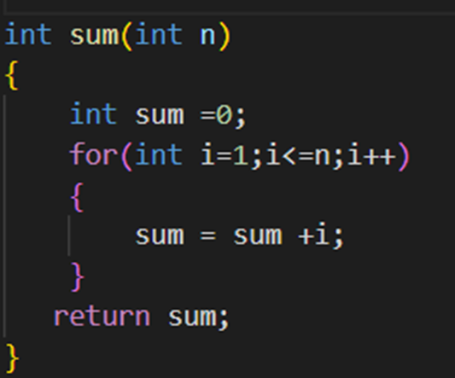
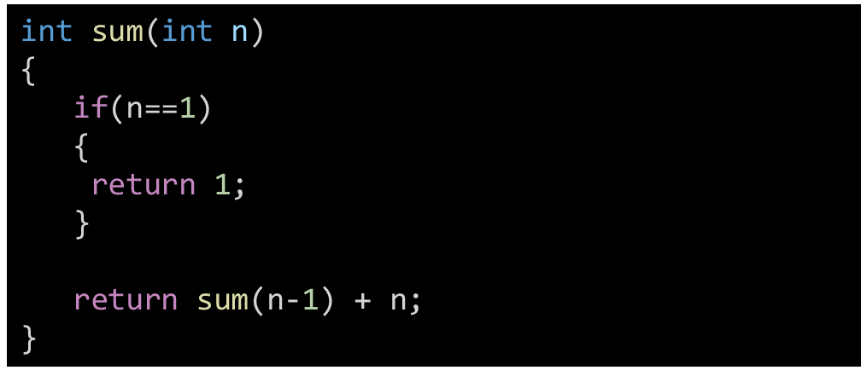
Recursion VS Iteration

Slide 13
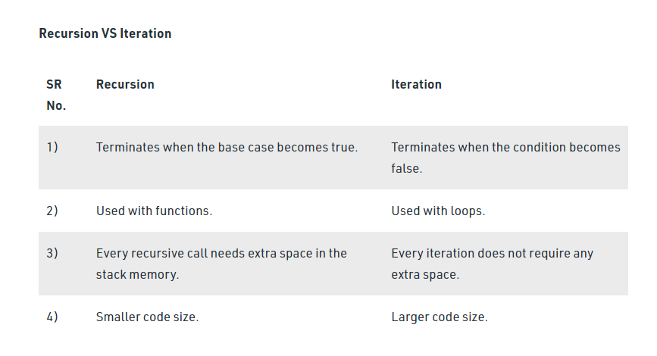
Recursion VS Iteration

Slide 14
How are recursive functions stored in memory?
Recursive function adds to the stack with each recursive call, and keeps the values there until the call is finished.
Hence Recursion uses more memory.
The recursive function uses LIFO (LAST IN FIRST OUT) Structure.

Slide 15
Example1
Print sum of first n natural numbers.

Slide 16

Example1
Print sum of first n natural numbers.
Natural numbers = 1,2,3,….,n
Sum = 1+2+3+4+5+…+n
1st approach:

Slide 17
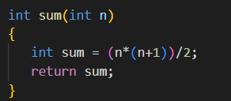
Example1
Print sum of first n natural numbers.
2nd approach: Mathematical Formula
sum of first n natural numbers = n*(n+1)/2

Slide 18
Example1
Print sum of first n natural numbers.
Recursive approach:

Slide 19
Example1
int sum(int n)
{
if(n==1)
{
return 1;
}
return sum(n-1) + n;
}
Print sum of first n natural numbers.
Recursive approach:
Sum(n) = sum(n-1) + n
= sum(n-2) + n-1 + n
= sum(n-3) + n-2 + n-1 + n;
= sum(n-4) +n-3 + n-2 + n-1 + n;
:
:
:
= 1 + 2 + 3 + ………………….+ n-1 + n-2 + n-3

Slide 20
Example 2:
Print Factorial of a number.

Slide 21
Example 2:
Print Factorial of a number.
factorial of n = n*(n-1)*(n-2)*….*1
1st approach:
int fact(int n)
{
int ans = 1;
for(int i=n;i>=1;i--)
{
ans = ans*i;
}
return ans;
}

Slide 22
Example 2:
Print Factorial of a number.
factorial of n = n*(n-1)*(n-2)*….*1
2nd approach: Mathematical formula
product of n numbers = pow(a,n)*pow(r,(n(n-1))/2)

Slide 23
Example 2:
Print Factorial of a number.
factorial of n = n*(n-1)*(n-2)*….*1
3rd approach: Recursive

Slide 24
Example 2:
Print Factorial of a number.
factorial of n = n*(n-1)*(n-2)*….*1
3rd approach: Recursive
fact(n) = fact(n-1)*n
= fact(n-2)*(n-1) *n
= fact(n-3)*(n-2)*(n-1)*n;
= fact(n-4)*(n-3)*(n-2)*(n-1)*n;
:
:
:
= 1*2*3*………………….*(n-2)*(n-1)(n)

Slide 25
Example 2:
int fact(int n )
{
if(n==0)
{
return 1;
}
return fact(n-1)*n;
}
Print Factorial of a number.
factorial of n = n*(n-1)*(n-2)*….*1
3rd approach: Recursive
fact(n) = fact(n-1)*n
= fact(n-2)*(n-1) *n
= fact(n-3)*(n-2)*(n-1)*n;
= fact(n-4)*(n-3)*(n-2)*(n-1)*n;
:
:
:
= 1*2*3*………………….*(n-2)*(n-1)(n)

Slide 26
Practice
Write a recursive function to print first n natural numbers.
Test Case
Enter a number: 5
Output
1 2 3 4 5

Slide 27
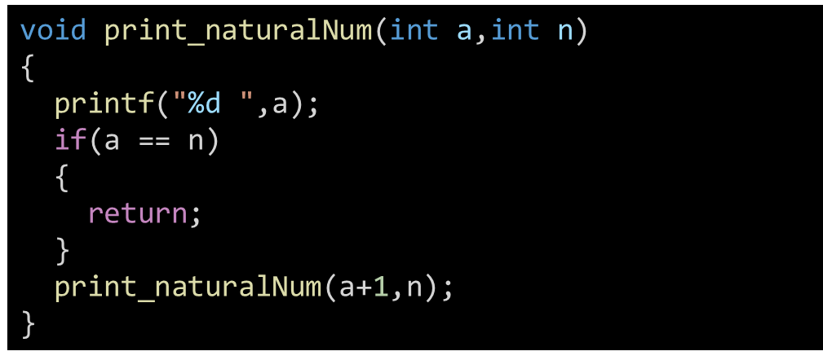
Practise
Write a recursive function to print first n natural numbers.
Test Case
Enter a number: 5
Output
1 2 3 4 5
int main()
{
int n;
printf("Enter a number:");
scanf("%d",&n);
int a =1;
print_naturalNum(a,n);
return 0;
}

Slide 28
Practice
Write a Recursive functions to print Factorial of a number.
Test Case
Enter a number: 5
Output
120

Slide 29
Practice
long long fact(long long n)
{
if(n==1)
{
return 1;
}
return fact(n-1)*n;
}
Write a Recursive functions to print Factorial of a number.
Test Case
Enter a number: 5
Output
120
int main()
{
int n;
printf("Enter a number:");
scanf("%d",&n);
int a =1;
int ans = fact(n);
printf("%d\n",ans);
return 0;
}

Slide 30
Practice
Write a program to print the Fibonacci nth terms where n>2 .
Hint:
Fibonacci series is the series where every term is sum of previous two terms except the first two terms. First two terms of Fibonacci series is 0 and 1. As
N = 6
Fibonacci series = 0 1 1 2 3 5 8 13 21..……….
6th term = 8

Slide 31
Practice
int print_fibonacci_Series(int n)
{
if(n==0)
{
return 0;
}
if(n==1)
{
return 1;
}
int a = print_fibonacci_Series(n-1);
int b = print_fibonacci_Series(n-2);
return a+b;
}
Write a program to print the Fibonacci nth terms where n>2 .
Hint:
Fibonacci series is the series where every term is sum of previous two terms except the first two terms. First two terms of Fibonacci series is 0 and 1. As
N = 6
Fibonacci series = 0 1 1 2 3 5 8 13 21..……….
6th term = 8

